Slide 1
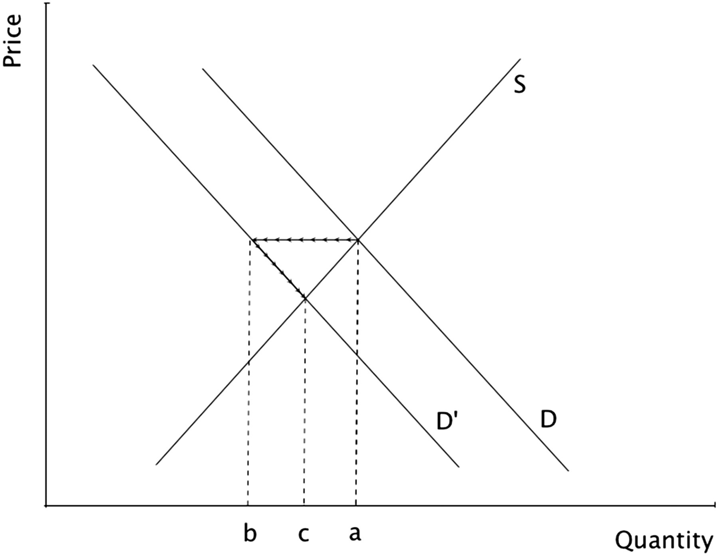
Figure 1 Macroeconomic price effect Notes: This graph depicts the macroeconomic price effect associated with an energy ...
Notes:
Figure 1 Macroeconomic price effect Notes: This graph depicts the macroeconomic price effect associated with an energy efficiency policy that shifts demand inwards from D to D′. The shift in demand reduces the quantity of energy demanded from a to b; however, the equilibrium outcome yields a smaller energy reduction due to the price effect, which moves quantity from b to c.
Unless provided in the caption above, the following copyright applies to the content of this slide: © The Author 2015. Published by Oxford University Press on behalf of the Association of Environmental and Resource Economists. All rights reserved. For Permissions, please email: journals.permissions@oup.com

