Slide 1
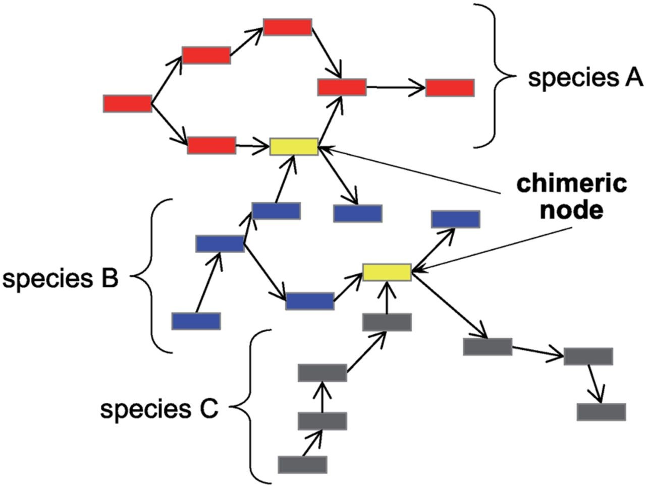
Figure 1. Chimeric nodes need to be split to obtain independent sub-graphs in a metagenomic assembly.
Notes:
Figure 1. Chimeric nodes need to be split to obtain independent sub-graphs in a metagenomic assembly.
Unless provided in the caption above, the following copyright applies to the content of this slide: © The Author 2014. Published by Oxford University Press on behalf of Kazusa DNA Research Institute.This is an Open Access article distributed under the terms of the Creative Commons Attribution License (http://creativecommons.org/licenses/by/4.0/), which permits unrestricted reuse, distribution, and reproduction in any medium, provided the original work is properly cited.

Slide 2
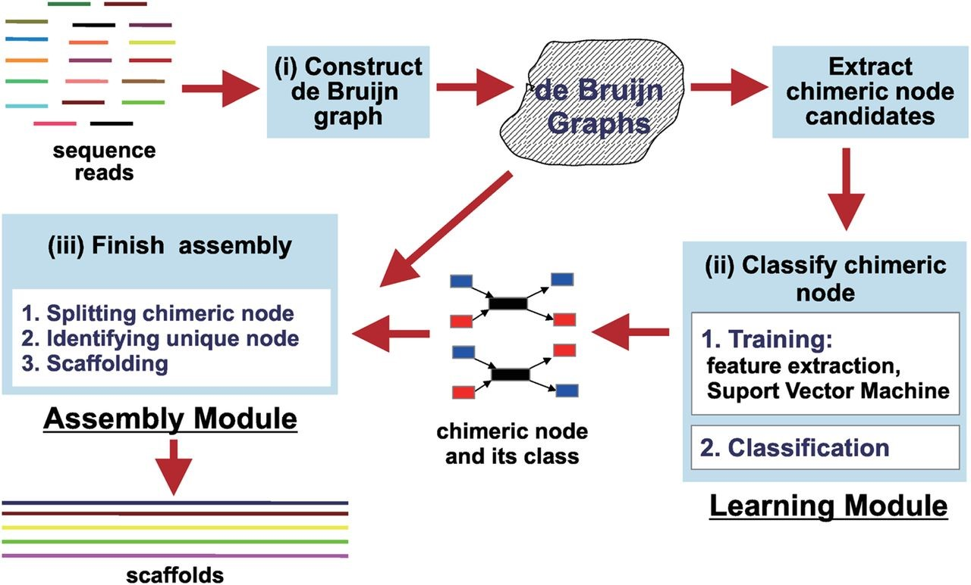
Figure 2. MetaVelvet-SL system consists of three major procedures: (i) construction of a de Bruijn graph; (ii) ...
Notes:
Figure 2. MetaVelvet-SL system consists of three major procedures: (i) construction of a de Bruijn graph; (ii) classification of chimeric nodes and (iii) final assembly tasks.
Unless provided in the caption above, the following copyright applies to the content of this slide: © The Author 2014. Published by Oxford University Press on behalf of Kazusa DNA Research Institute.This is an Open Access article distributed under the terms of the Creative Commons Attribution License (http://creativecommons.org/licenses/by/4.0/), which permits unrestricted reuse, distribution, and reproduction in any medium, provided the original work is properly cited.

Slide 3
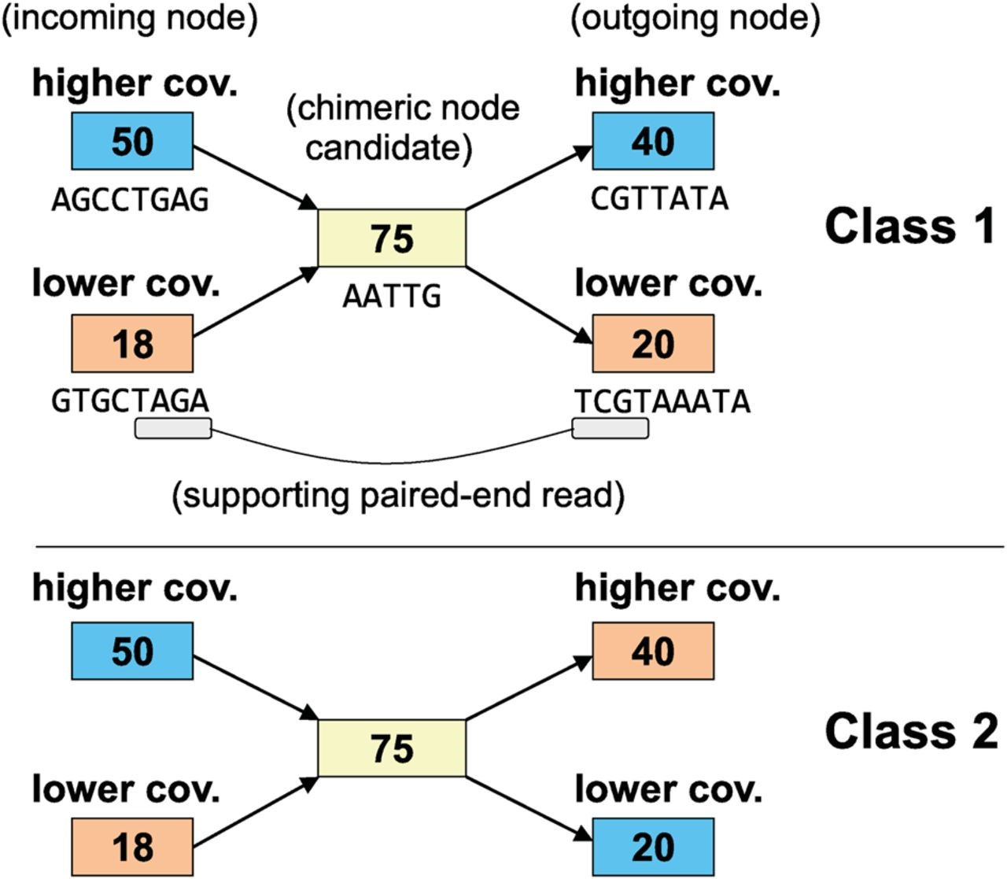
Figure 3. Chimeric nodes fall into two classes. Nodes of the same colour represent the same species. The number in each ...
Notes:
Figure 3. Chimeric nodes fall into two classes. Nodes of the same colour represent the same species. The number in each node represents the coverage value of the node. A contig sequence is also attached to each node.
Unless provided in the caption above, the following copyright applies to the content of this slide: © The Author 2014. Published by Oxford University Press on behalf of Kazusa DNA Research Institute.This is an Open Access article distributed under the terms of the Creative Commons Attribution License (http://creativecommons.org/licenses/by/4.0/), which permits unrestricted reuse, distribution, and reproduction in any medium, provided the original work is properly cited.

Slide 4
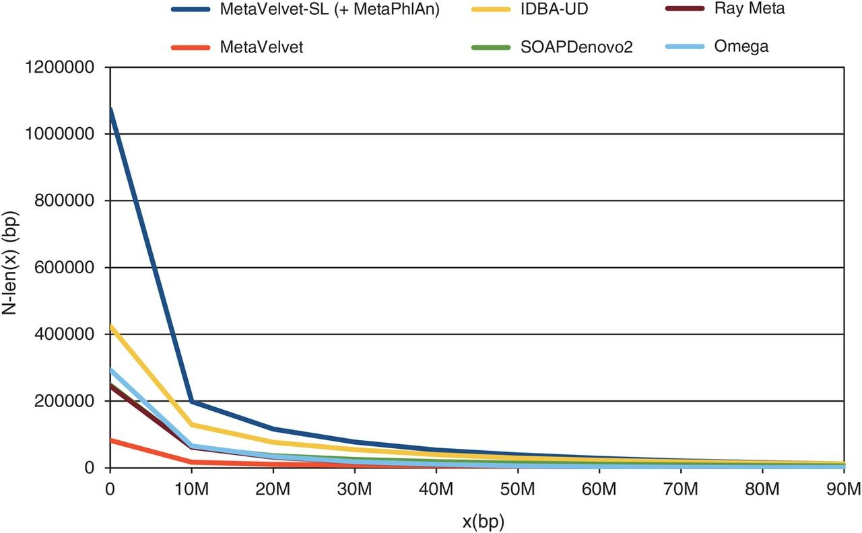
Figure 4. The N-len(x) plots for the MH0006 data set of human gut microbial data.
Notes:
Figure 4. The N-len(x) plots for the MH0006 data set of human gut microbial data.
Unless provided in the caption above, the following copyright applies to the content of this slide: © The Author 2014. Published by Oxford University Press on behalf of Kazusa DNA Research Institute.This is an Open Access article distributed under the terms of the Creative Commons Attribution License (http://creativecommons.org/licenses/by/4.0/), which permits unrestricted reuse, distribution, and reproduction in any medium, provided the original work is properly cited.

