Slide 1
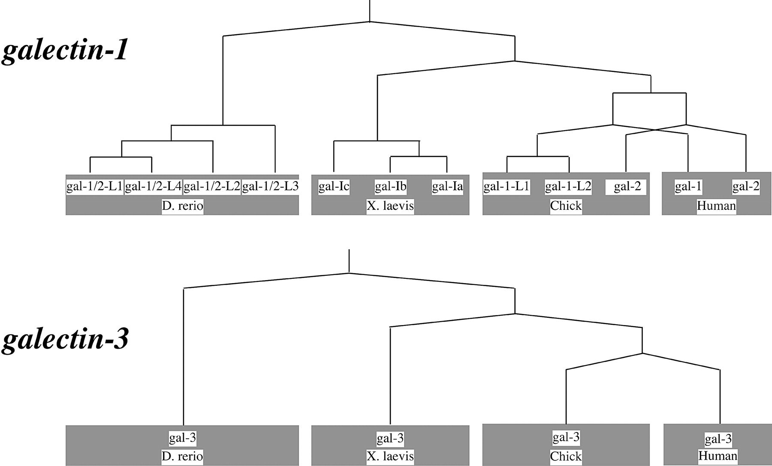
Fig. 5. Duplication and divergence events in the galectin-1/2 (top) and the galectin-3 (bottom) subgroups. Horizontal ...
Notes:
Fig. 5. Duplication and divergence events in the galectin-1/2 (top) and the galectin-3 (bottom) subgroups. Horizontal lines indicate gene duplications; oblique lines indicate speciation events
Unless provided in the caption above, the following copyright applies to the content of this slide: Molecular Biology and Evolution vol. 21 no. 7 © Society for Molecular Biology and Evolution 2004; all rights reserved.

Slide 2
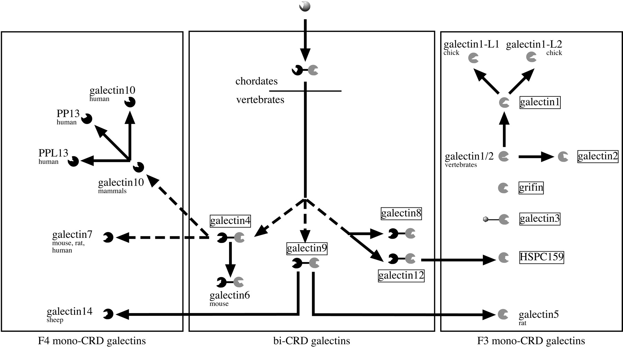
Fig. 4. Proposed phylogenetic relationships between chordate galectins based on gene location, exon-intron structure ...
Notes:
Fig. 4. Proposed phylogenetic relationships between chordate galectins based on gene location, exon-intron structure and sequence based phylogenetic tree. Dotted arrows indicate uncertainty in the sequence of divergence. The two types of CRDs are shown in black (F4-CRDs) or grey (F3-CRDs). Boxed galectins have been identified in a large variety of species. Unboxed galectins have only been identified in a subset of species (indicated under the name of the galectin)
Unless provided in the caption above, the following copyright applies to the content of this slide: Molecular Biology and Evolution vol. 21 no. 7 © Society for Molecular Biology and Evolution 2004; all rights reserved.

Slide 3
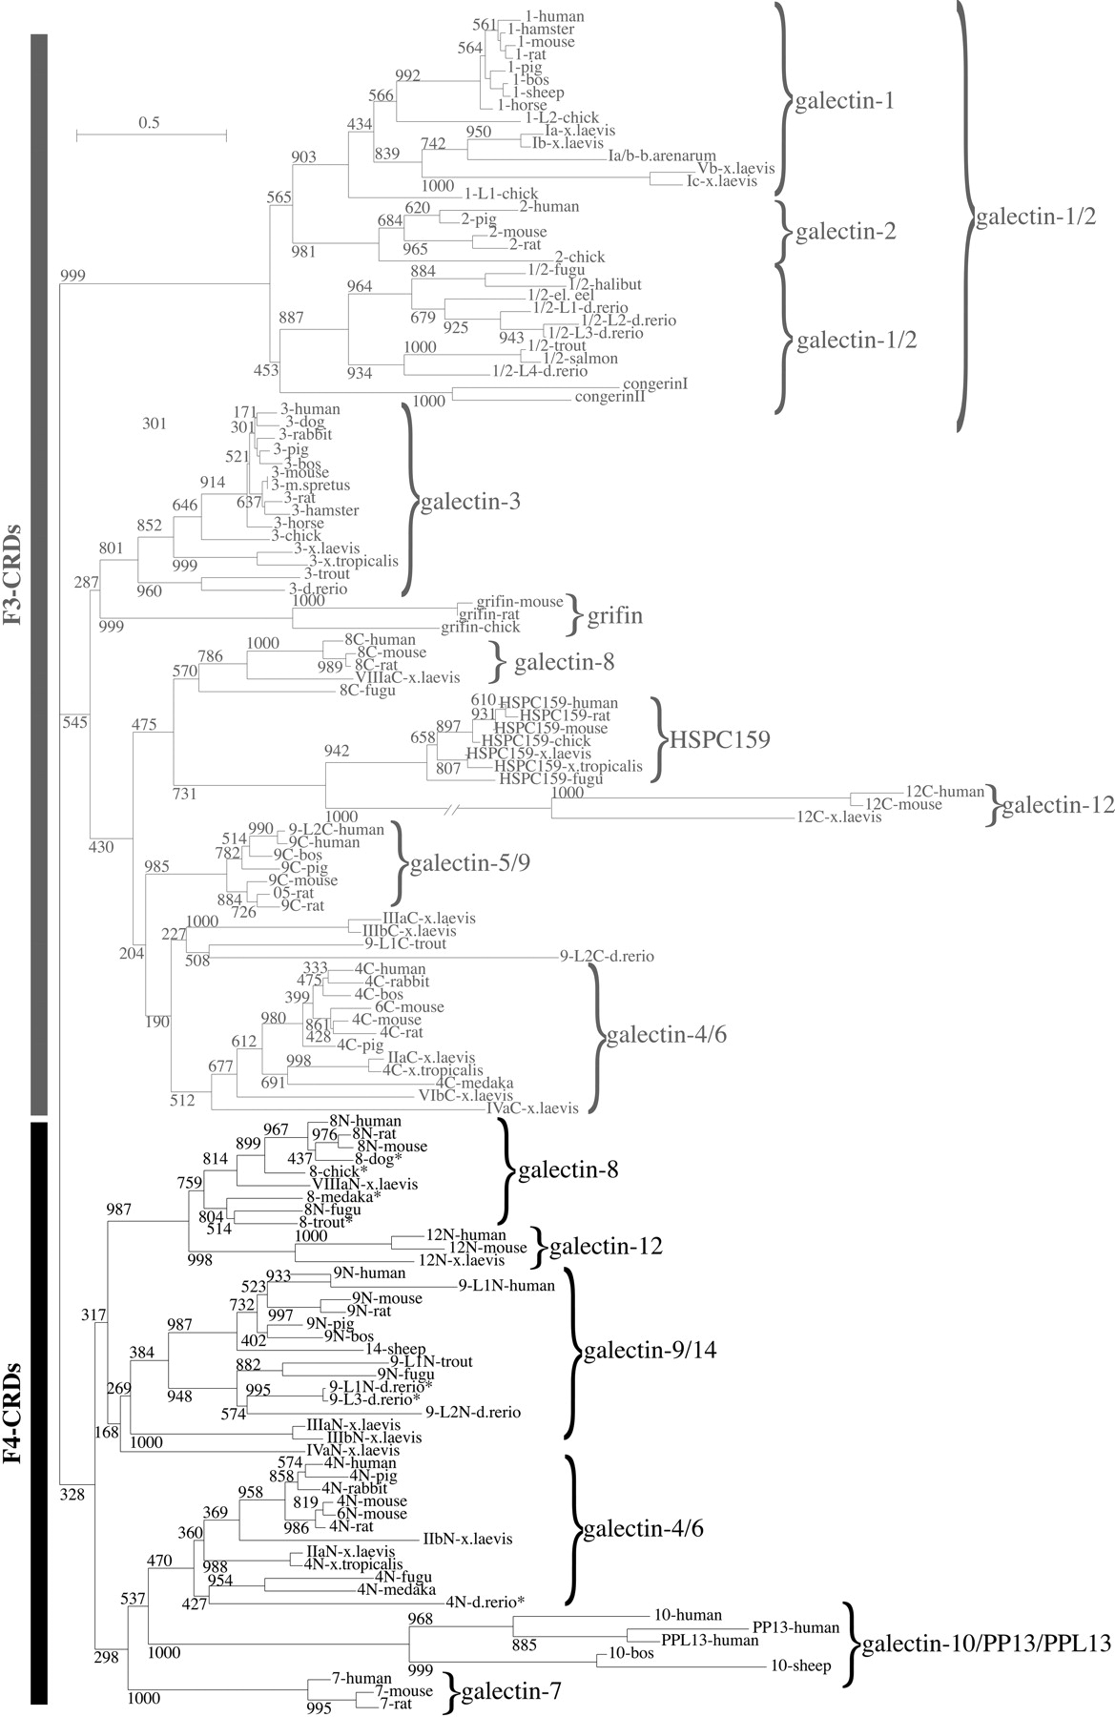
Fig. 3. Phylogenetic tree connecting the amino acid sequences of the known chordate galectins. The tree was ...
Notes:
Fig. 3. Phylogenetic tree connecting the amino acid sequences of the known chordate galectins. The tree was constructed with the distance method using the BIONJ program. The substitution rate for variable sites was determined by a gamma distribution. Pairwise maximum likelihood distances were computed with the Müller and Vingron model of substitution using Tree-Puzzle. Bootstrap values calculated using 1,000 replicates are indicated above each branch. Asterisks correspond to partial sequences. Ambystoma: Ambystoma mexicanum; b.arenarum: Bufo.arenarum; bos: Bos taurus; chick: Gallus gallus; ciona: Ciona intestinalis; conger: Conger myriaster; d.rerio: Danio rerio; dog: Canis familiaris; el.eel: Electrophorus electricus; fugu: Takifugu rubripes; halibut: Paralichthys olivaceus; hamster: Cricetulus griseus; horse: Equus caballus; human: Homo sapiens; medaka: Oryzias latipes; mouse: Mus musculus; m.spretus: Mus spretus; pig: Sus scrofa; podarcis: Podarcis hispanica; rabbit: Oryctolagus cuniculus; rat: Rattus norvegicus; salmon: Salmo sala; sheep: Ovis aries; trout: Oncorhynchus mykiss; x.laevis: Xenopus laevis; x.tropicalis: Xenopus tropicalis
Unless provided in the caption above, the following copyright applies to the content of this slide: Molecular Biology and Evolution vol. 21 no. 7 © Society for Molecular Biology and Evolution 2004; all rights reserved.

Slide 4
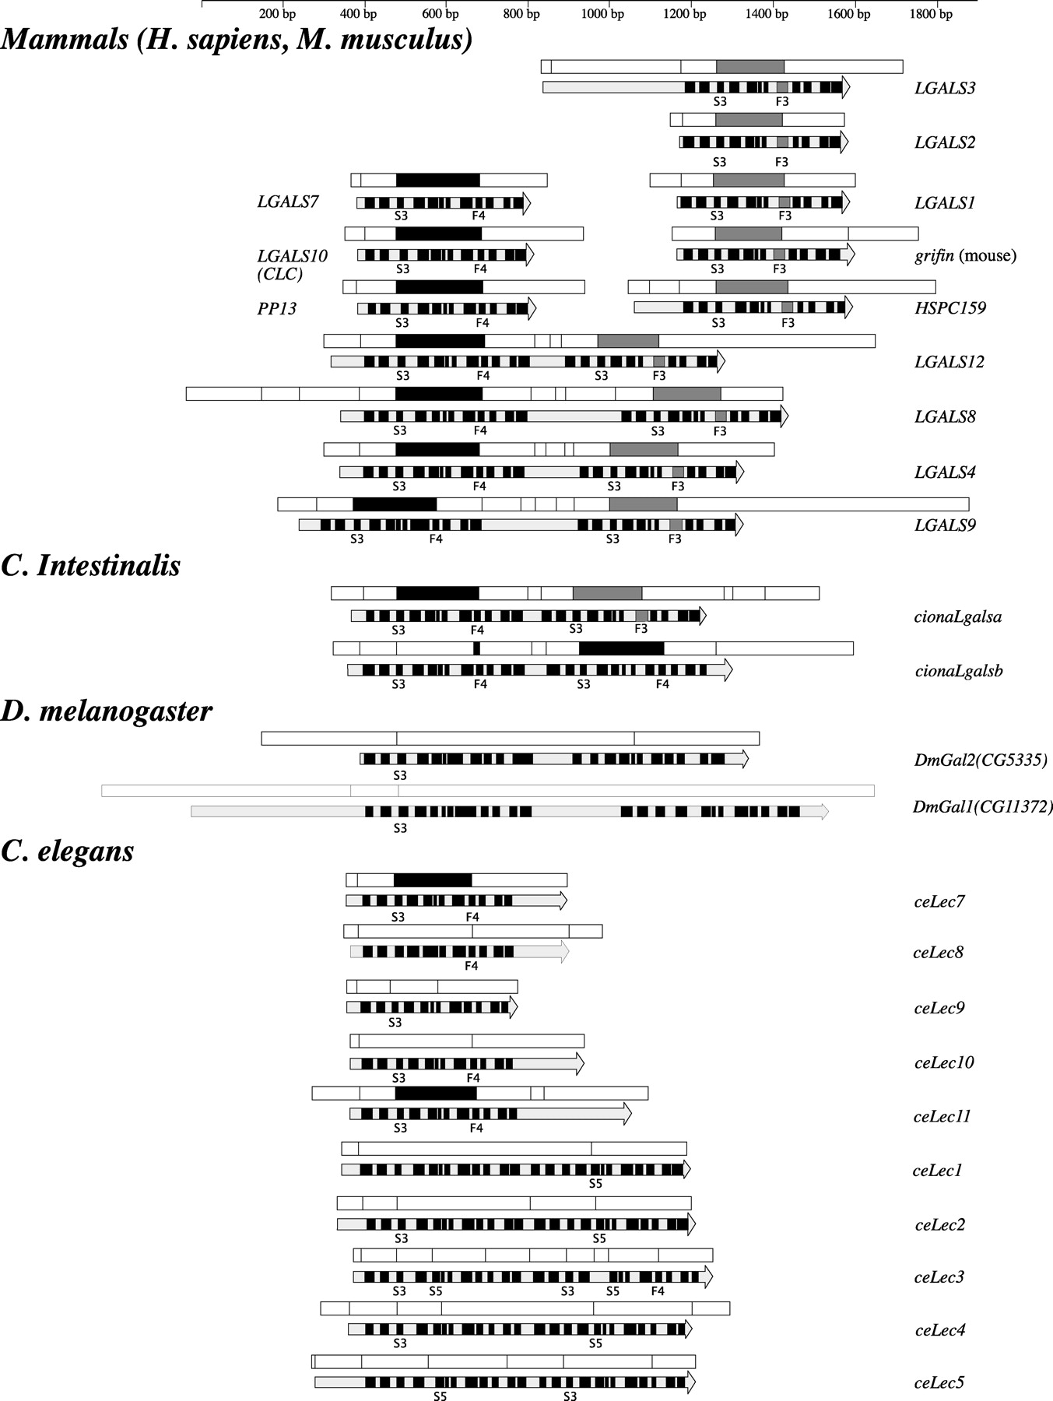
Fig. 2. Comparison of the Lgals gene organization from different species. Each galectin open reading frame is ...
Notes:
Fig. 2. Comparison of the Lgals gene organization from different species. Each galectin open reading frame is indicated as a long grey arrow with boxes corresponding to the different β-strands that form the S and F β-sheets. The names of the relevant β-strands are indicated below each arrow. Exons are represented as boxes placed above each arrow. The W exons, which contain the highly conserved tryptophan residue of galectins, are either filled in black when they encode S3 to F4 sequences (F4 subtype), or they are filled in grey when they encode S3 to F3 sequences (F3 subtype). Note that all mammalian bi-CRD galectins are of the F4-F3 subtype
Unless provided in the caption above, the following copyright applies to the content of this slide: Molecular Biology and Evolution vol. 21 no. 7 © Society for Molecular Biology and Evolution 2004; all rights reserved.

Slide 5
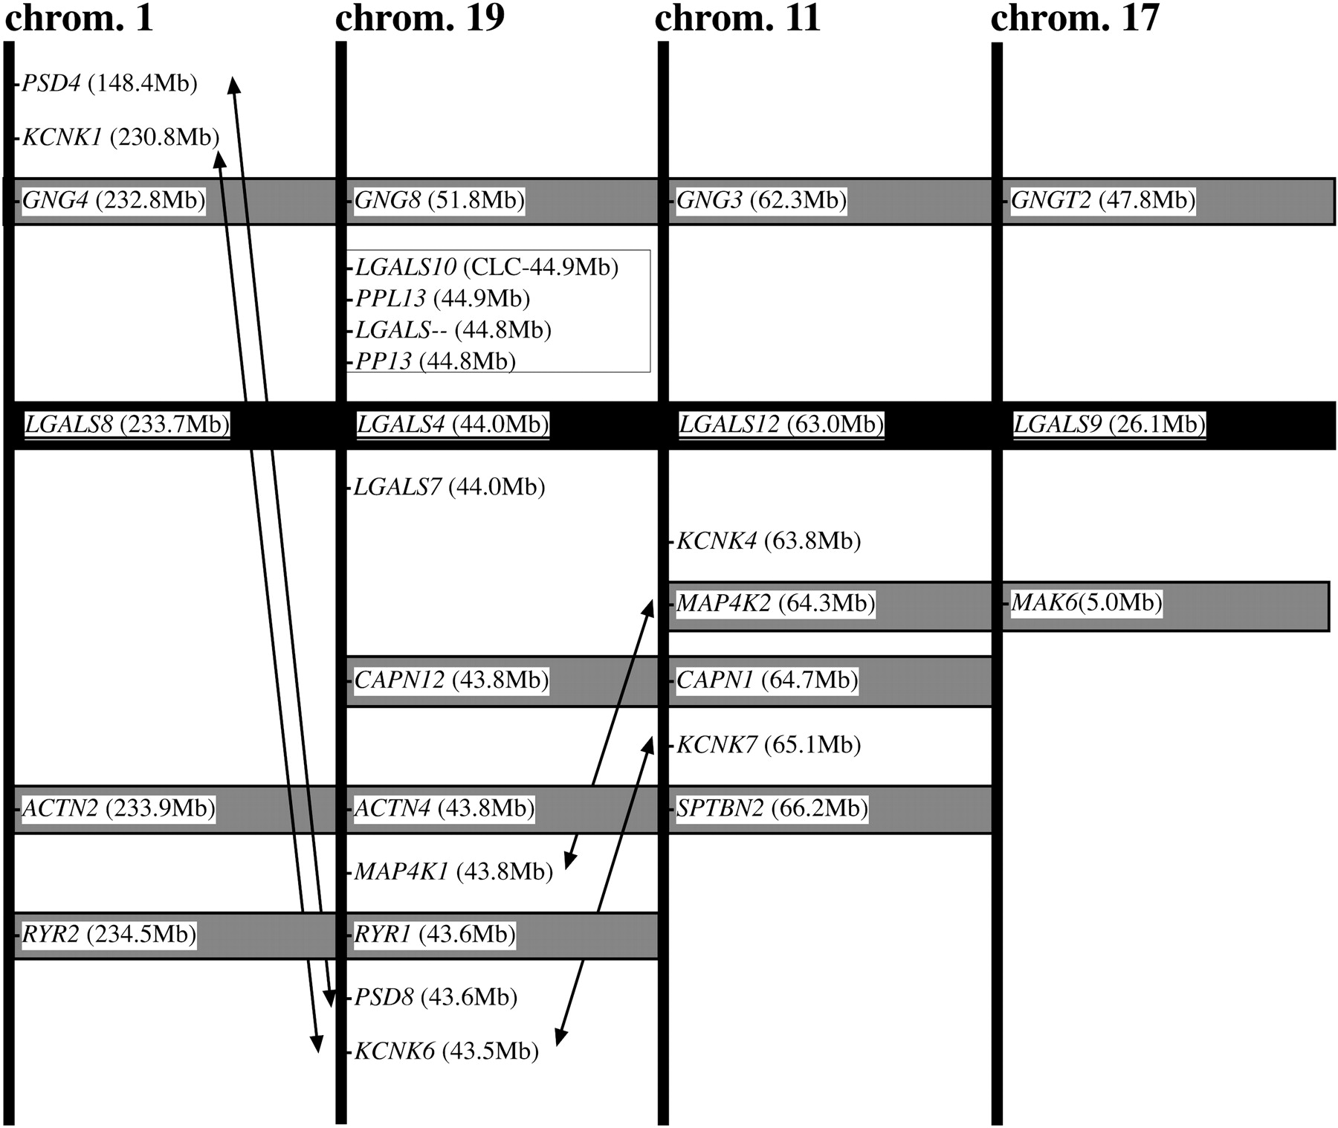
Fig. 1. Physical map of the chromosomal regions surrounding the genes encoding the bi-CRD galectins in Homo sapiens. ...
Notes:
Fig. 1. Physical map of the chromosomal regions surrounding the genes encoding the bi-CRD galectins in Homo sapiens. LGLS-4, -8, -9, and -12 genes are located on paralogous chromosomal segments. Chromosome numbers are indicated at the top (chromosomes 1, 19, 11, 17). Gene positions along the chromosome are given in brackets as reported in www.ensembl.org/Homo_sapiens/. Galectin genes are shown in a black box. Genes shown in grey boxes have conserved positions relative to each other. Double-headed arrows point to genes of the same family, the positions of which have been shuffled relative to the others
Unless provided in the caption above, the following copyright applies to the content of this slide: Molecular Biology and Evolution vol. 21 no. 7 © Society for Molecular Biology and Evolution 2004; all rights reserved.

