Slide 1
Table 1 Incidence of sepsis, as determined in 5 studies.
Notes:
Table 1 Incidence of sepsis, as determined in 5 studies.
Unless provided in the caption above, the following copyright applies to the content of this slide: © 2005 by the Infectious Diseases Society of America

Slide 2
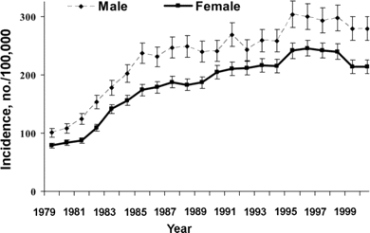
Figure 1 Incidence of sepsis in the United States from 1979 to 2000, stratified by sex.
Notes:
Figure 1 Incidence of sepsis in the United States from 1979 to 2000, stratified by sex.
Unless provided in the caption above, the following copyright applies to the content of this slide: © 2005 by the Infectious Diseases Society of America

Slide 3
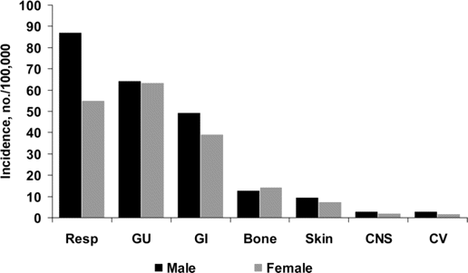
Figure 2 Incidence of sepsis according to the source of infection, stratified by sex. CV, cardiovascular; GI, ...
Notes:
Figure 2 Incidence of sepsis according to the source of infection, stratified by sex. CV, cardiovascular; GI, gastrointestinal; GU, genitourinary; Resp, respiratory.
Unless provided in the caption above, the following copyright applies to the content of this slide: © 2005 by the Infectious Diseases Society of America

Slide 4
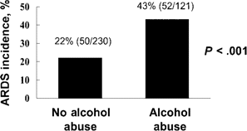
Figure 3 Incidence of acute respiratory distress syndrome (ARDS) in 351 critically ill patients, stratified by a prior ...
Notes:
Figure 3 Incidence of acute respiratory distress syndrome (ARDS) in 351 critically ill patients, stratified by a prior history of alcohol abuse.
Unless provided in the caption above, the following copyright applies to the content of this slide: © 2005 by the Infectious Diseases Society of America

