Slide 1
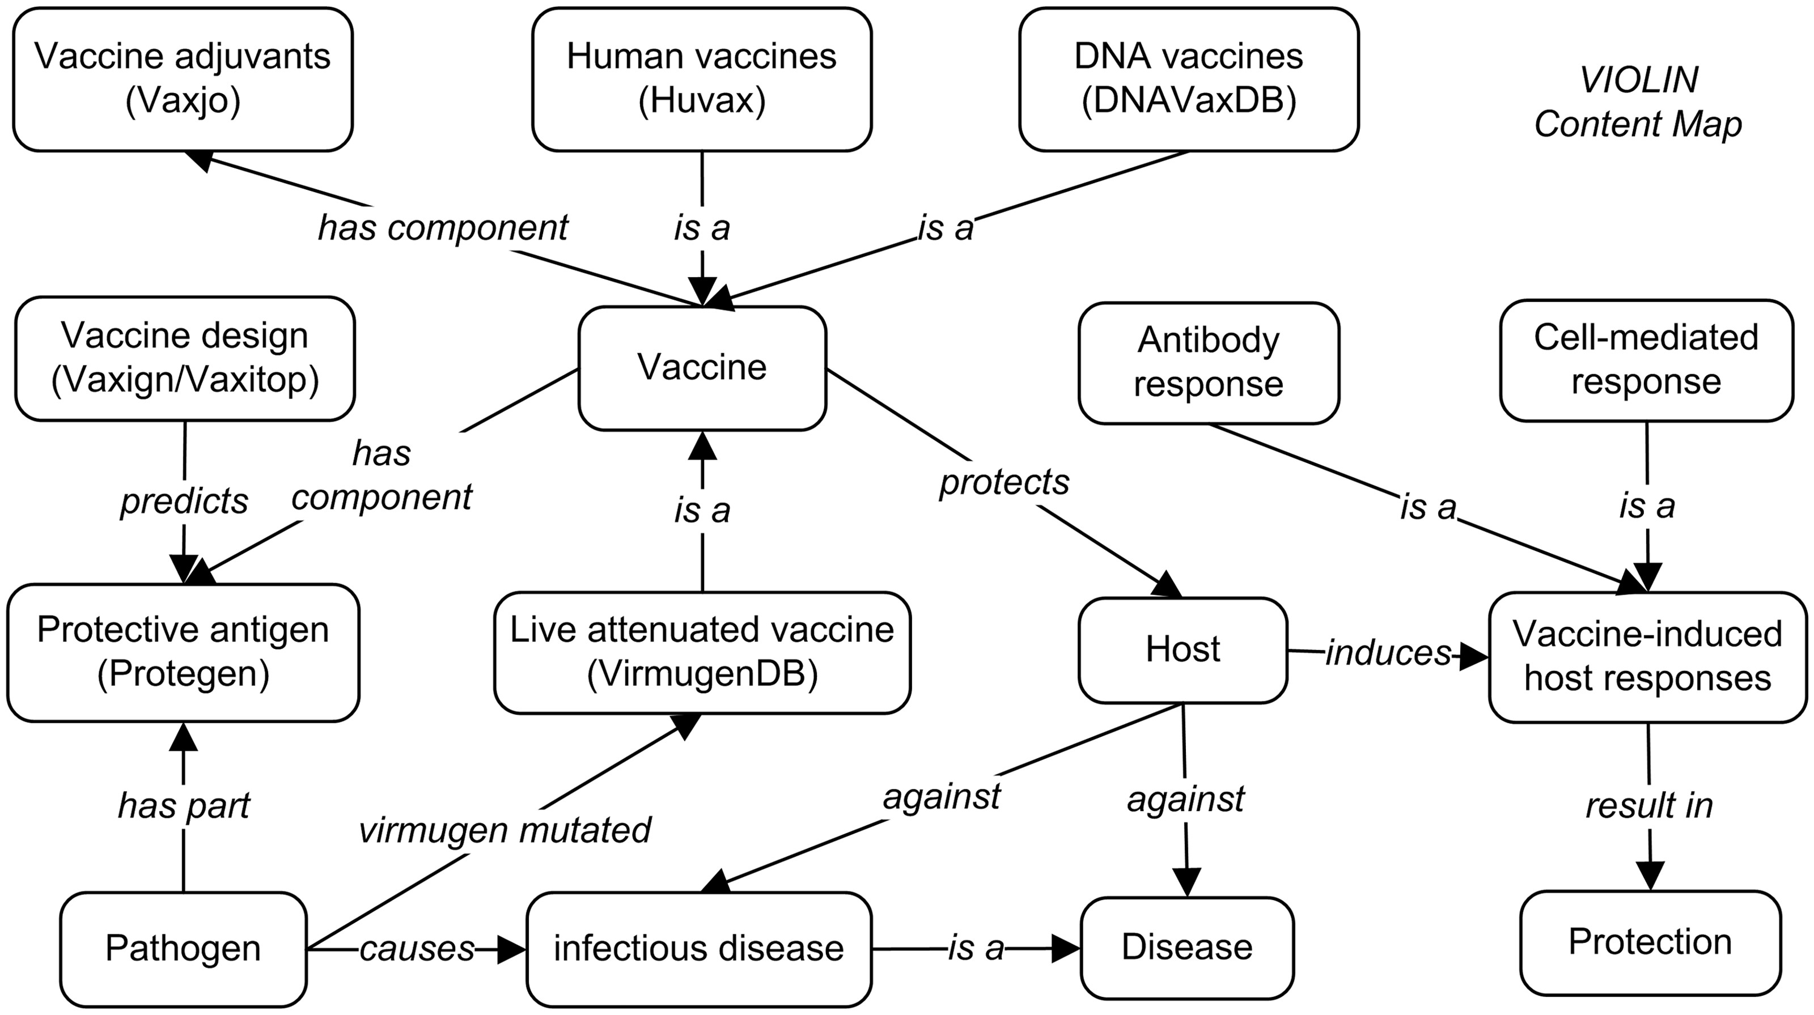
Figure 1. Overview of major VIOLIN components and their relations. The program names inside parentheses are databases ...
Notes:
Figure 1. Overview of major VIOLIN components and their relations. The program names inside parentheses are databases or tools. For components with no quoted program names, the information is listed in the general VIOLIN database.
Unless provided in the caption above, the following copyright applies to the content of this slide: © The Author(s) 2013. Published by Oxford University Press.This is an Open Access article distributed under the terms of the Creative Commons Attribution Non-Commercial License (http://creativecommons.org/licenses/by-nc/3.0/), which permits non-commercial re-use, distribution, and reproduction in any medium, provided the original work is properly cited. For commercial re-use, please contact journals.permissions@oup.com

