Slide 1
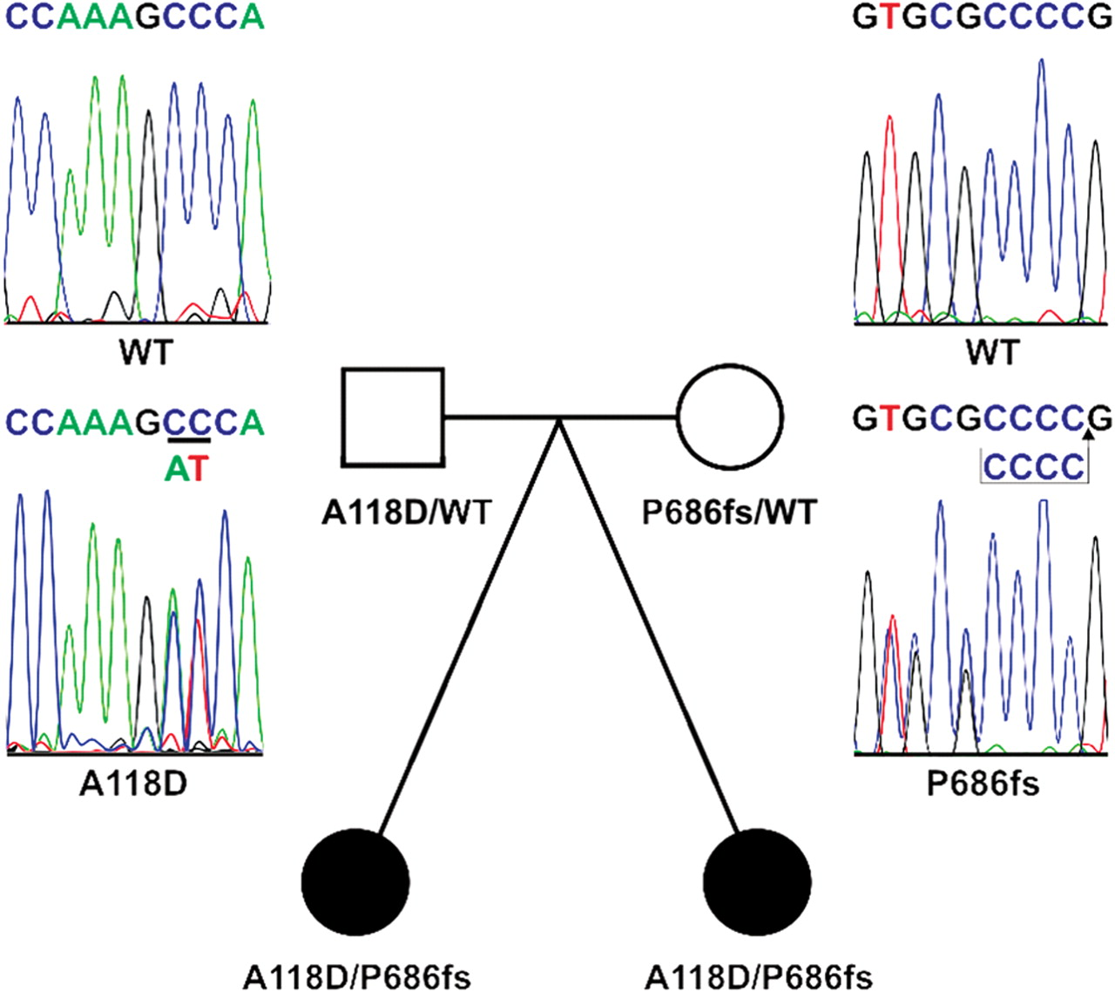
Figure 1. Family pedigree of the female twin sisters affected by iron-refractory iron deficiency anemia. The TMPRSS6 ...
Notes:
Figure 1. Family pedigree of the female twin sisters affected by iron-refractory iron deficiency anemia. The TMPRSS6 mutations identified by automated sequencing are displayed with the wild-type (WT) allele sequence beside the appropriate heterozygous affected parent as chromatographs. The missense mutation of Alanine 118 to Aspartate (A118D) results from the heterozygous substitutions c.467C>A and c.468C>T in exon 3. The frameshift mutation immediately following Proline 686 (P686fs) arises from an insertion of the four nucleotides CCCC between bases 2172 and 2173 in exon 16.
Unless provided in the caption above, the following copyright applies to the content of this slide: © The Author 2009. Published by Oxford University Press. All rights reserved. For Permissions, please email: journals.permissions@oxfordjournals.org

Slide 2
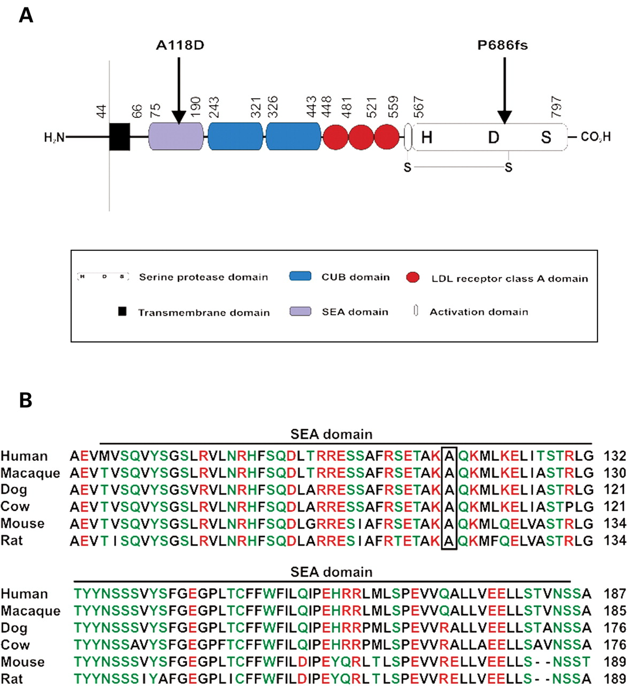
Figure 2. Mutation domain locations in matriptase-2. ( A ) Schematic representation of the predicted domain structure ...
Notes:
Figure 2. Mutation domain locations in matriptase-2. ( A ) Schematic representation of the predicted domain structure of the matriptase-2 protein with the corresponding location of the A118D and P686fs mutations. The matriptase-2 sequence was analyzed for modular protein domains using the SMART algorithm (ExPASy Proteomics Tools website) and the provided numbers refer to the amino acid position in the preproenzyme. ( B ) Matriptase-2 SEA domain sequences from the indicated species were aligned using ClustalX 2.0.10 software ( 46 ). Residues corresponding to human alanine 118 are boxed. Amino acids have been classified as hydrophobic (black), charged (red) or polar (green). Sequences were obtained from the following GenBank entries: Human NP_705837; Macaque XP_001085319; Dog XP_531743; Cow XP_871580; Mouse NP_082178; Rat XP_235768.
Unless provided in the caption above, the following copyright applies to the content of this slide: © The Author 2009. Published by Oxford University Press. All rights reserved. For Permissions, please email: journals.permissions@oxfordjournals.org

Slide 3
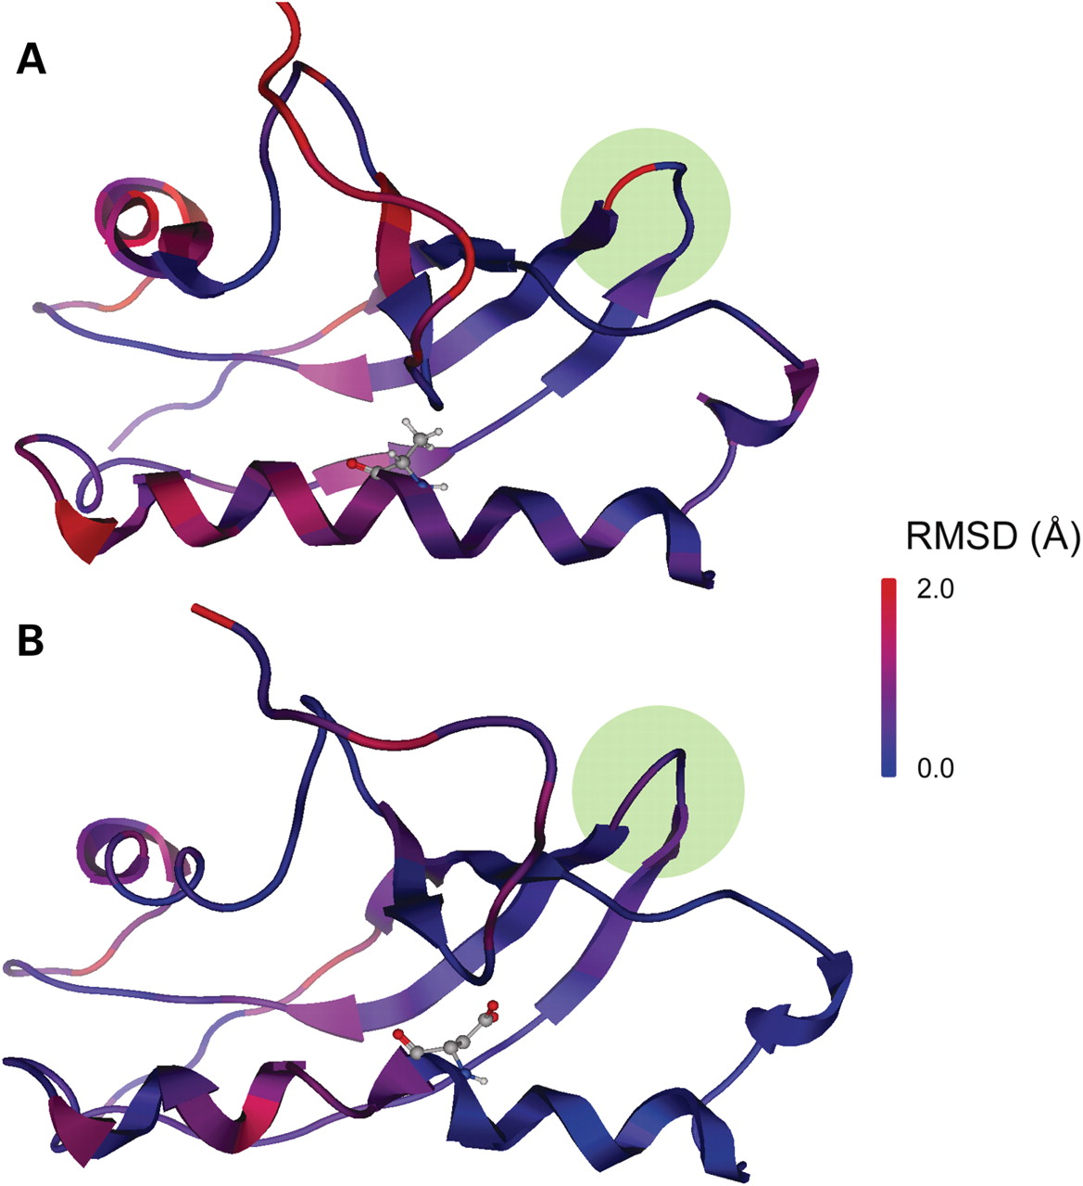
Figure 3. Predicted structural consequences of the SEA domain mutation. Energy-minimized homology models of ( A ) ...
Notes:
Figure 3. Predicted structural consequences of the SEA domain mutation. Energy-minimized homology models of ( A ) wild-type and ( B ) mutant matriptase-2 SEA domains. Structures are shown as ribbons, and residue 118 is displayed as a ball and stick. Molecular shifts after energy minimization are displayed with the color code, where regions in red have been shifted farther away than regions in blue.
Unless provided in the caption above, the following copyright applies to the content of this slide: © The Author 2009. Published by Oxford University Press. All rights reserved. For Permissions, please email: journals.permissions@oxfordjournals.org

Slide 4
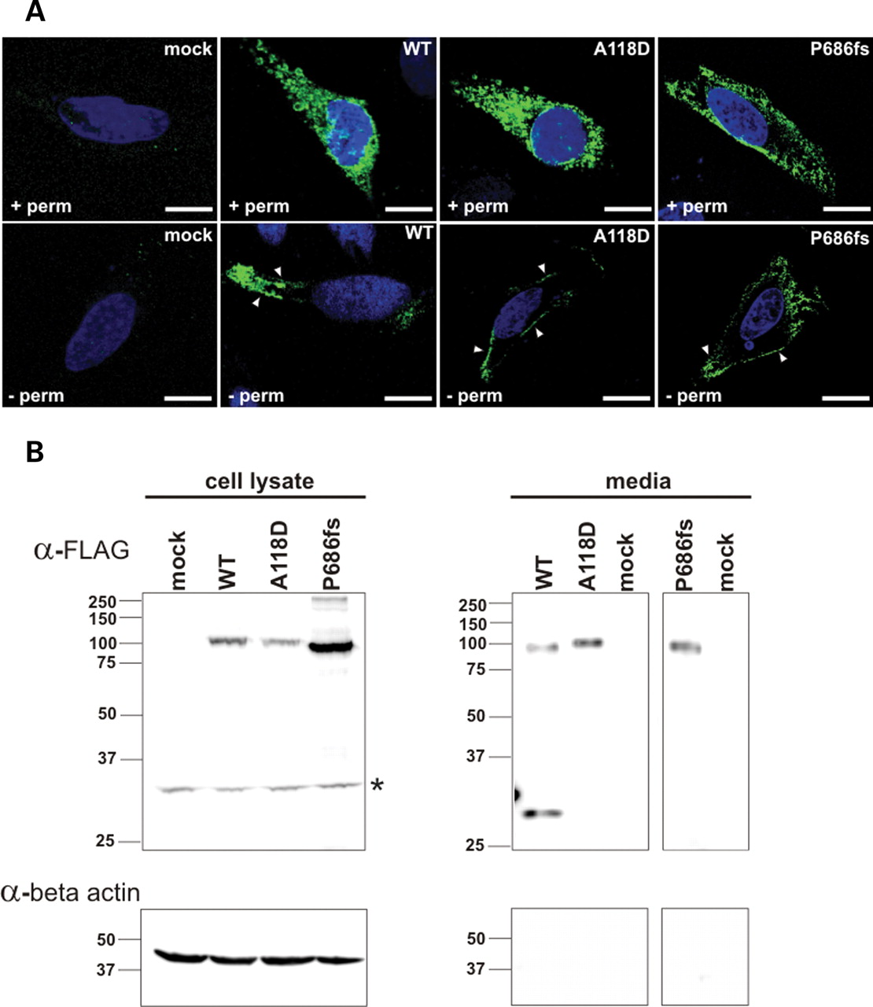
Figure 4. Cellular expression and localization of wild-type and mutant matriptase-2 proteins. ( A ) Confocal ...
Notes:
Figure 4. Cellular expression and localization of wild-type and mutant matriptase-2 proteins. ( A ) Confocal microscopy analysis of permeabilized (upper panel;+perm) and non-permeabilized (lower panel; - perm) HepG2 cells transiently transfected with pcDNA3 only (mock), pcDNA3 matriptase-2 wild-type-FLAG (WT), pcDNA3 matriptase-2 A118D-FLAG (A118D) or pcDNA3 matriptase-2 P686fs-FLAG (P686fs) expression constructs. Cells were incubated with an anti-FLAG antibody (green) and stained with DAPI (blue) to identify nuclei. Cell surface localized matriptase-2 proteins in non-permeabilized cells are indicated by arrowheads. The white scale bar represents 10 µm. ( B ) Western blot analysis probing with an anti-FLAG antibody of whole cell lysates (upper left panel) and conditioned media (upper right panels) from HepG2 cells transiently transfected with pcDNA3 only (mock), pcDNA3-matriptase-2 wild-type-FLAG (WT), pcDNA3 matriptase-2 A118D-FLAG (A118D) or pcDNA3 matriptase-2 P686fs-FLAG (P686fs). Lysates (50 µg) and conditioned media, which are displayed in separated panels due to differences in protein amounts (left panel represents 100 µg of media and the right panel 50 µg of media), were electrophoresed under reducing conditions. Membranes were also probed with an anti-beta actin antibody to demonstrate equal loading in cell lysates (lower left panel) and an absence of intracellular protein contamination (lower right panels). Asterisk denotes non-specific band.
Unless provided in the caption above, the following copyright applies to the content of this slide: © The Author 2009. Published by Oxford University Press. All rights reserved. For Permissions, please email: journals.permissions@oxfordjournals.org

Slide 5
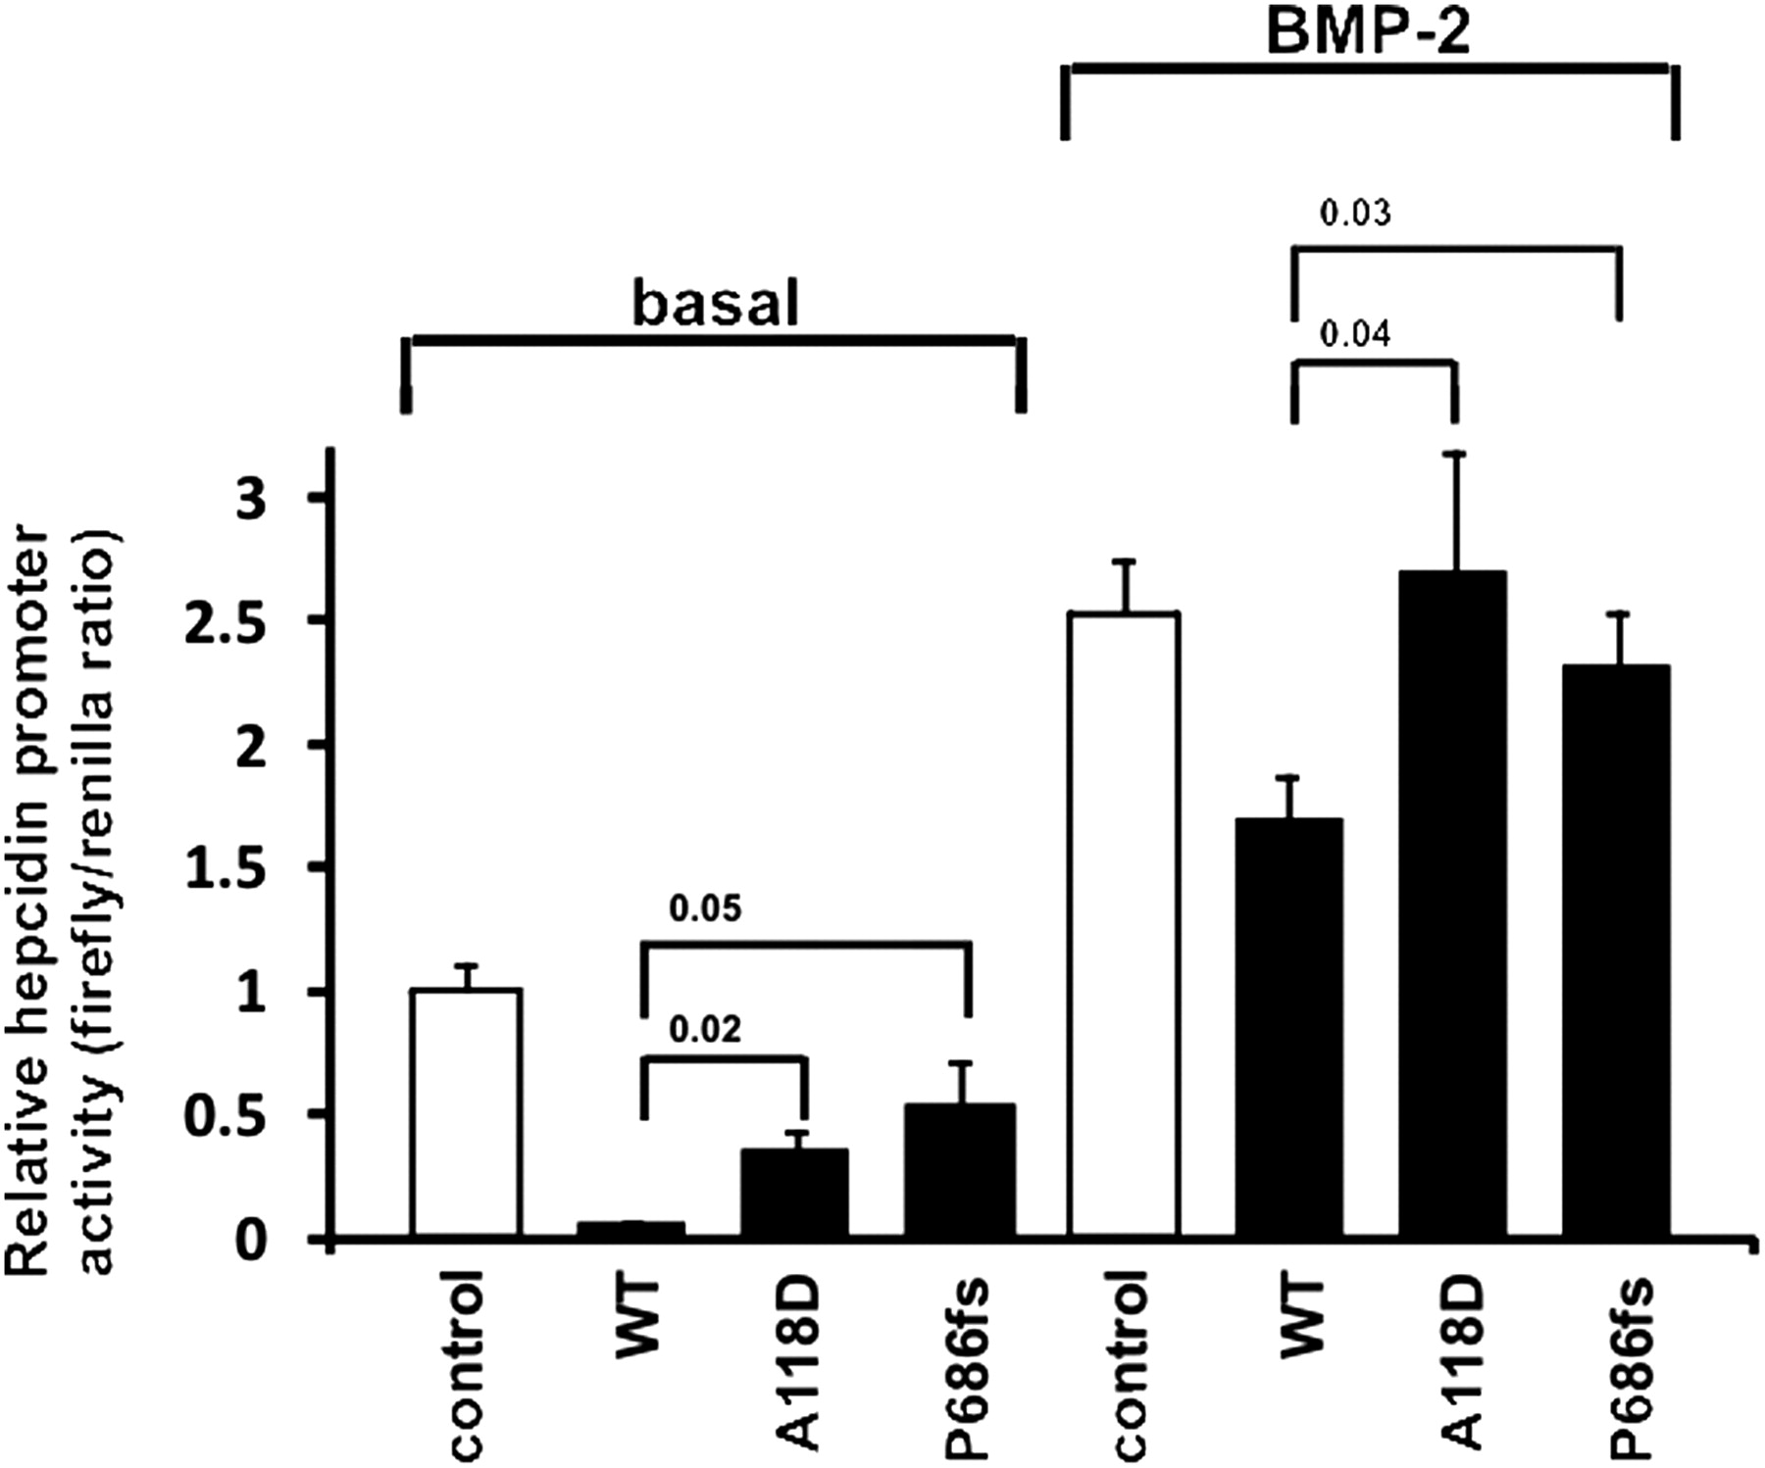
Figure 5. Reduced hepcidin suppression by the A118D and P686fs mutant matriptase-2 enzymes. The hepcidin promoter ...
Notes:
Figure 5. Reduced hepcidin suppression by the A118D and P686fs mutant matriptase-2 enzymes. The hepcidin promoter luciferase reporter construct and pRL-TK construct (transfection efficiency control) were transiently transfected into the Hep3B cell line simultaneously with expression vectors encoding hemojuvelin, in addition to either wild-type matriptase-2 (WT), A118D mutant matriptase-2 (A118D), P686fs mutant matriptase-2 (P686fs) or no insert (vector control). The transcriptional activity of the hepcidin promoter under basal and BMP-2 stimulated conditions was quantified by determining the Firefly (hepcidin)/Renilla (transfection control) luciferase activities. Results are reported as the mean ± SEM of the relative luciferase activity for cells transfected with WT, A118D or P686fs matriptase-2, compared with cells transfected with vector only. The experiment was performed in triplicate. Student's t- test was used for estimation of statistical significance with the calculated P -values displayed.
Unless provided in the caption above, the following copyright applies to the content of this slide: © The Author 2009. Published by Oxford University Press. All rights reserved. For Permissions, please email: journals.permissions@oxfordjournals.org

