Slide 1
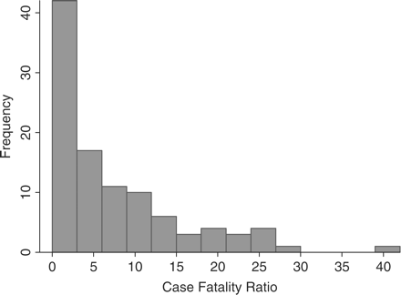
Figure 1 Histogram of overall CFRs reported by all studies
Notes:
Figure 1 Histogram of overall CFRs reported by all studies
Unless provided in the caption above, the following copyright applies to the content of this slide: Published by Oxford University Press © World Health Organization 2009. All rights reserved. The World Health Organization has granted the Publisher permission for the reproduction of this article.

Slide 2
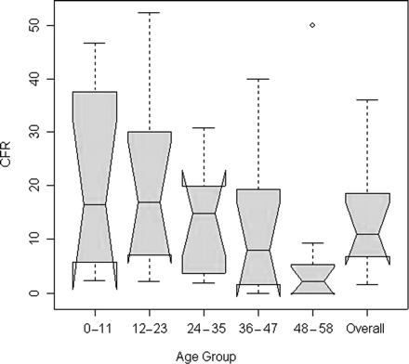
Figure 2 Notched box plot of CFR for studies with defined age groups. In a notched box plot, the notches represent a ...
Notes:
Figure 2 Notched box plot of CFR for studies with defined age groups. In a notched box plot, the notches represent a robust estimate of the uncertainty about the medians for box-to-box comparison. Boxes whose notches do not overlap indicate that the medians of the two groups differ at the 5% significance level. The median is represented by the horizontal line through each box
Unless provided in the caption above, the following copyright applies to the content of this slide: Published by Oxford University Press © World Health Organization 2009. All rights reserved. The World Health Organization has granted the Publisher permission for the reproduction of this article.

Slide 3
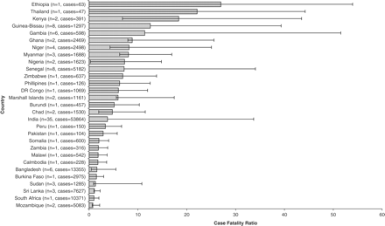
Figure 3 CFRs by country. The bar represents the median of all studies (n = number of studies in the country), with ...
Notes:
Figure 3 CFRs by country. The bar represents the median of all studies (n = number of studies in the country), with the lines representing the minimum and maximum of the studies from the country
Unless provided in the caption above, the following copyright applies to the content of this slide: Published by Oxford University Press © World Health Organization 2009. All rights reserved. The World Health Organization has granted the Publisher permission for the reproduction of this article.

