Slide 1
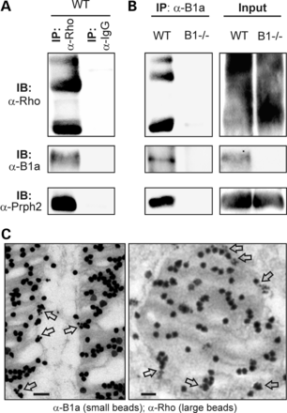
Figure 1. CNGB1a, peripherin-2 and rhodopsin are assembled in a protein complex in rod OS. (A) Retinal lysates of ...
Notes:
Figure 1. CNGB1a, peripherin-2 and rhodopsin are assembled in a protein complex in rod OS. (A) Retinal lysates of wild-type (WT) mice were immunoprecipitated with an anti-rhodopsin antibody (α-Rho) or a nonspecific control IgG (α-IgG). Precipitated samples were analyzed in immunoblots (IB) using α-Rho and antibodies directed against the CNGB1a subunit (α-B1a) and peripherin-2 (α-Prph2) as indicated. (B) Left, retinal lysates of WT and CNGB1-knockout mice (B1−/−) were immunoprecipitated with α-B1a and probed with α-Rho, α-B1a and α-Prph2. Right, loading control containing 10% of the protein lysate used for the co-IP in the left panel. (C) Immunoelectron microscopy images of longitudinal (left) and transversal (right) sections of rod OS co-stained with small-diameter immunogold particles coupled to α-B1a and large-diameter particles coupled to α-Rho, respectively. Co-localization of large and small particles is marked by arrows. Scale bar, 100 nm.
Unless provided in the caption above, the following copyright applies to the content of this slide: © The Author 2014. Published by Oxford University Press. All rights reserved. For Permissions, please email: journals.permissions@oup.com

Slide 2
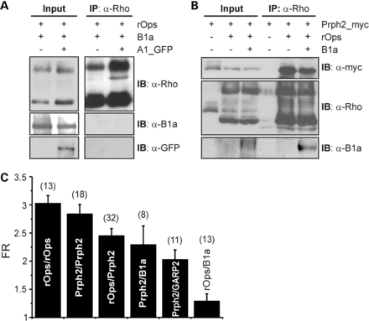
Figure 2. Peripherin-2 binds to both rod apo-opsin and CNGB1a. (A) Lysates from HEK293 cells co-transfected with rod ...
Notes:
Figure 2. Peripherin-2 binds to both rod apo-opsin and CNGB1a. (A) Lysates from HEK293 cells co-transfected with rod apo-opsin (rOps), CNGB1a (B1a) and GFP-tagged CNGA1 (A1_GFP) were immunoprecipitated with α-Rho and probed with antibodies as indicated. (B) Co-IP from HEK293 cells co-expressing myc-tagged Prph2, rOps and B1a as indicated. Immunoprecipitates were analyzed with α-myc, α-Rho and α-B1a antibodies. Single transfection of peripherin-2 served as negative control for nonspecific binding to the beads (third lane from right). (C) FRET measurements from HEK293 cells co-transfected with different OS-specific proteins to monitor homomeric and heteromeric protein–protein interactions. Fret ratios for the single FRET pairs are as follows: rOps/rOps, FR = 3.03 ± 0.14; Prph2/Prph2, FR = 2.84 ± 0.17; rOps/Prph2, FR = 2.45 ± 0.13; Prph2/B1a, FR = 2.30 ± 0.33; Prph2/GARP2, FR = 2.03 ± 0.17; rOps/B1a, FR = 1.29 ± 0.13. Numbers of independent measurements (n) are given in brackets.
Unless provided in the caption above, the following copyright applies to the content of this slide: © The Author 2014. Published by Oxford University Press. All rights reserved. For Permissions, please email: journals.permissions@oup.com

Slide 3
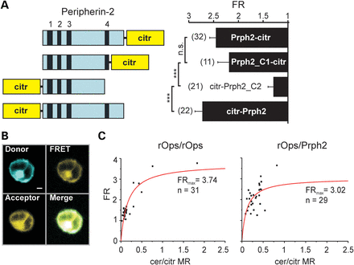
Figure 3. FRET-based determination of the binding characteristics of the rod opsin/peripherin-2 interaction. (A) Left, ...
Notes:
Figure 3. FRET-based determination of the binding characteristics of the rod opsin/peripherin-2 interaction. (A) Left, schematic representation of peripherin-2 constructs used to determine the FRs shown in the right panel. Citrine was fused to either the N- or C-terminus of peripherin-2. Numbered black boxes (1–4) represent the transmembrane domains of peripherin-2. Right, FR of the peripherin-2 constructs co-expressed with rOps-cerulean. Numbers of independent measurements (n) are given in brackets. Fret ratios for the single FRET pairs are as follows: rOps/Prph2-citr, FR = 2.45 ± 0.13; rOps/Prph2_C1-citr, FR = 2.19 ± 0.23; rOps/citr-Prph2_C2, FR = 1.29 ± 0.11; rOps/citr-Prph2, FR = 2.73 ± 0.15. (B) Representative confocal images of FRET channels (Donor, FRET, Acceptor and Merge) of single HEK293 cells used for the calculation of the FRs are shown in C. Scale bar = 3 µm. (C) Results of the confocal FRET imaging obtained from measurements of plasma membrane-restricted regions of single cells (black squares). FR was plotted against the cerulean/citrine molar ratio (cer/citr MR) to obtain FRmax and the binding curves.
Unless provided in the caption above, the following copyright applies to the content of this slide: © The Author 2014. Published by Oxford University Press. All rights reserved. For Permissions, please email: journals.permissions@oup.com

Slide 4
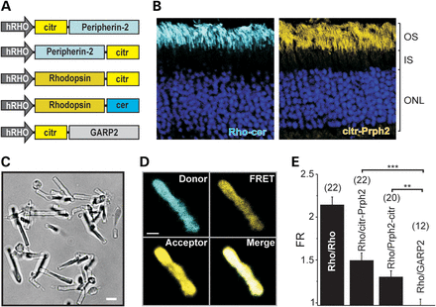
Figure 4. FRET in isolated rod OS from WT mice injected with different rAAV constructs. (A) Schematic view of the ...
Notes:
Figure 4. FRET in isolated rod OS from WT mice injected with different rAAV constructs. (A) Schematic view of the constructs used for the rAAV-mediated transduction of retinas from P14 C57/Bl6N WT mice. hRHO, human rhodopsin promoter. (B) Representative confocal images of retinal sections from mice expressing rhodopsin-cerulean (left) and citrin-peripherin-2 (right). OS, outer segment; IS, inner segment; ONL, outer nuclear layer. (C) Bright-field images of an isolated OS isolated from mouse retina. (D) Representative confocal image of a single OS used for FRET measurements and co-expressing rhodopsin-cerulean (donor) and peripherin-2-citrin (acceptor), respectively. Scale bar = 2 µm. (E) Results of the FRET measurements for different FRET pair combinations. Numbers of independent measurements (n) are given in brackets. FRET ratios for the single FRET pairs are as follows: Rho/Rho, FR = 2.14 ± 0.09; Rho/citr-Prph2, FR = 1.49 ± 0.09; Rho/Prph2-citr, FR = 1.30 ± 0.07; Rho/GARP2, FR = 0.97 ± 0.07.
Unless provided in the caption above, the following copyright applies to the content of this slide: © The Author 2014. Published by Oxford University Press. All rights reserved. For Permissions, please email: journals.permissions@oup.com

Slide 5
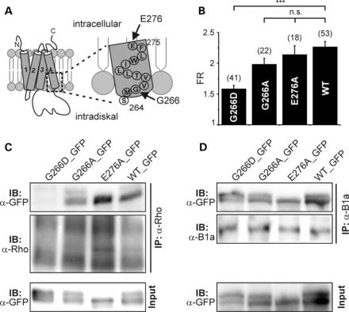
Figure 5. adRP-associated mutation in TM4 of peripherin-2 abolishes binding to rhodopsin. (A) Schematic view of the ...
Notes:
Figure 5. adRP-associated mutation in TM4 of peripherin-2 abolishes binding to rhodopsin. (A) Schematic view of the positions of the mutations in the TM4 of peripherin-2 analyzed in B–C (black arrows). (B) FRET experiment from HEK293 cells co-transfected with rod opsin and peripherin-2 wild-type (WT) or mutant constructs, respectively. FRET ratios for the single FRET pairs are as follows: Rho/G266D, FR = 1.58 ± 0.05; Rho/G266A, FR = 1.98 ± 0.09; Rho/E276A, FR = 2.14 ± 0.14; Rho/WT, FR = 2.26 ± 0.08. (C) Co-IP from HEK293 cells co-expressing rhodopsin and GFP-tagged wild-type or mutant peripherin-2 constructs. (D) Co-IP from HEK293 cells co-expressing CNGB1a and GFP-tagged wild-type or mutant peripherin-2 constructs. All peripherin-2 constructs in C and D were detected with the GFP-specific antibody (α-GFP).
Unless provided in the caption above, the following copyright applies to the content of this slide: © The Author 2014. Published by Oxford University Press. All rights reserved. For Permissions, please email: journals.permissions@oup.com

Slide 6
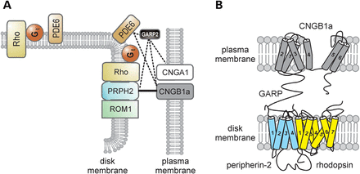
Figure 6. Peripherin-2 couples the CNG channel to the phototransduction cascade in rod OS. (A) Simplified paradigm of ...
Notes:
Figure 6. Peripherin-2 couples the CNG channel to the phototransduction cascade in rod OS. (A) Simplified paradigm of protein–protein interactions in the disk rim region of OS. Peripherin-2 simultaneously binds to its homolog ROM1, to CNGB1a and to rhodopsin. The soluble GARP2 undergoes multiple protein–protein interactions with CNGB1a, CNGA1, phosphodiesterase (PDE6) and peripherin-2 as indicated by the dashed line. Gt, transducin. (B) Tentative model of the CNGB1a/peripherin-2/rhodopsin complex. Note that the exact portion of rhodopsin that binds to TM4 of peripherin-2 is not known and is only tentatively assigned in this cartoon.
Unless provided in the caption above, the following copyright applies to the content of this slide: © The Author 2014. Published by Oxford University Press. All rights reserved. For Permissions, please email: journals.permissions@oup.com

