Slide 1
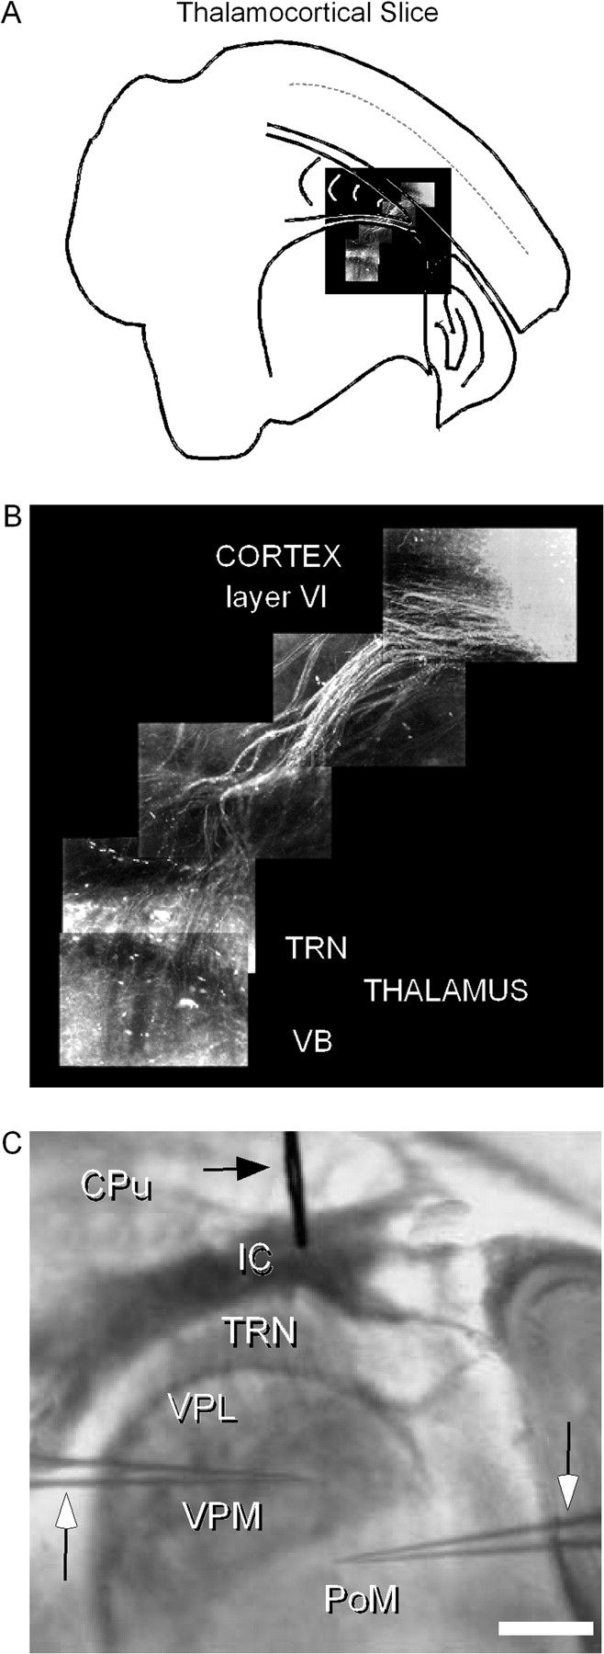
Figure 1. Anatomical layout of cortical feedback pathway in the thalamocortical slice. (A) Layer VI feedback fibers ...
Notes:
Figure 1. Anatomical layout of cortical feedback pathway in the thalamocortical slice. (A) Layer VI feedback fibers labeled with fluorescent dextrans mapped onto a cartoon of the thalamocortical slice to indicate the location of tracer injection and extent of labeling. (B) Magnified view of labeled fibers from (A) showing continuous labeling from layer VI of S1 cortex to the TRN and the VB of the thalamus. (C) Bright field transilluminated living slice photographed with stimulating and recording electrodes (stimulating: black horizontal arrow, top; recording: vertical arrows, sides). Dark and light regions delineate borders between the different nuclei of the thalamus. Scale bar = 1.5 mm. Abbreviations: CPu, caudate putamine; IC, internal capsule; VPL, ventral posterolateral nucleus; VPM, ventral posteromedial nucleus; PoM, posteromedial complex. Arrows indicate recording electrodes.
Unless provided in the caption above, the following copyright applies to the content of this slide: © The Author 2007. Published by Oxford University Press. All rights reserved. For permissions, please e-mail: journals.permissions@oxfordjournals.org

Slide 2
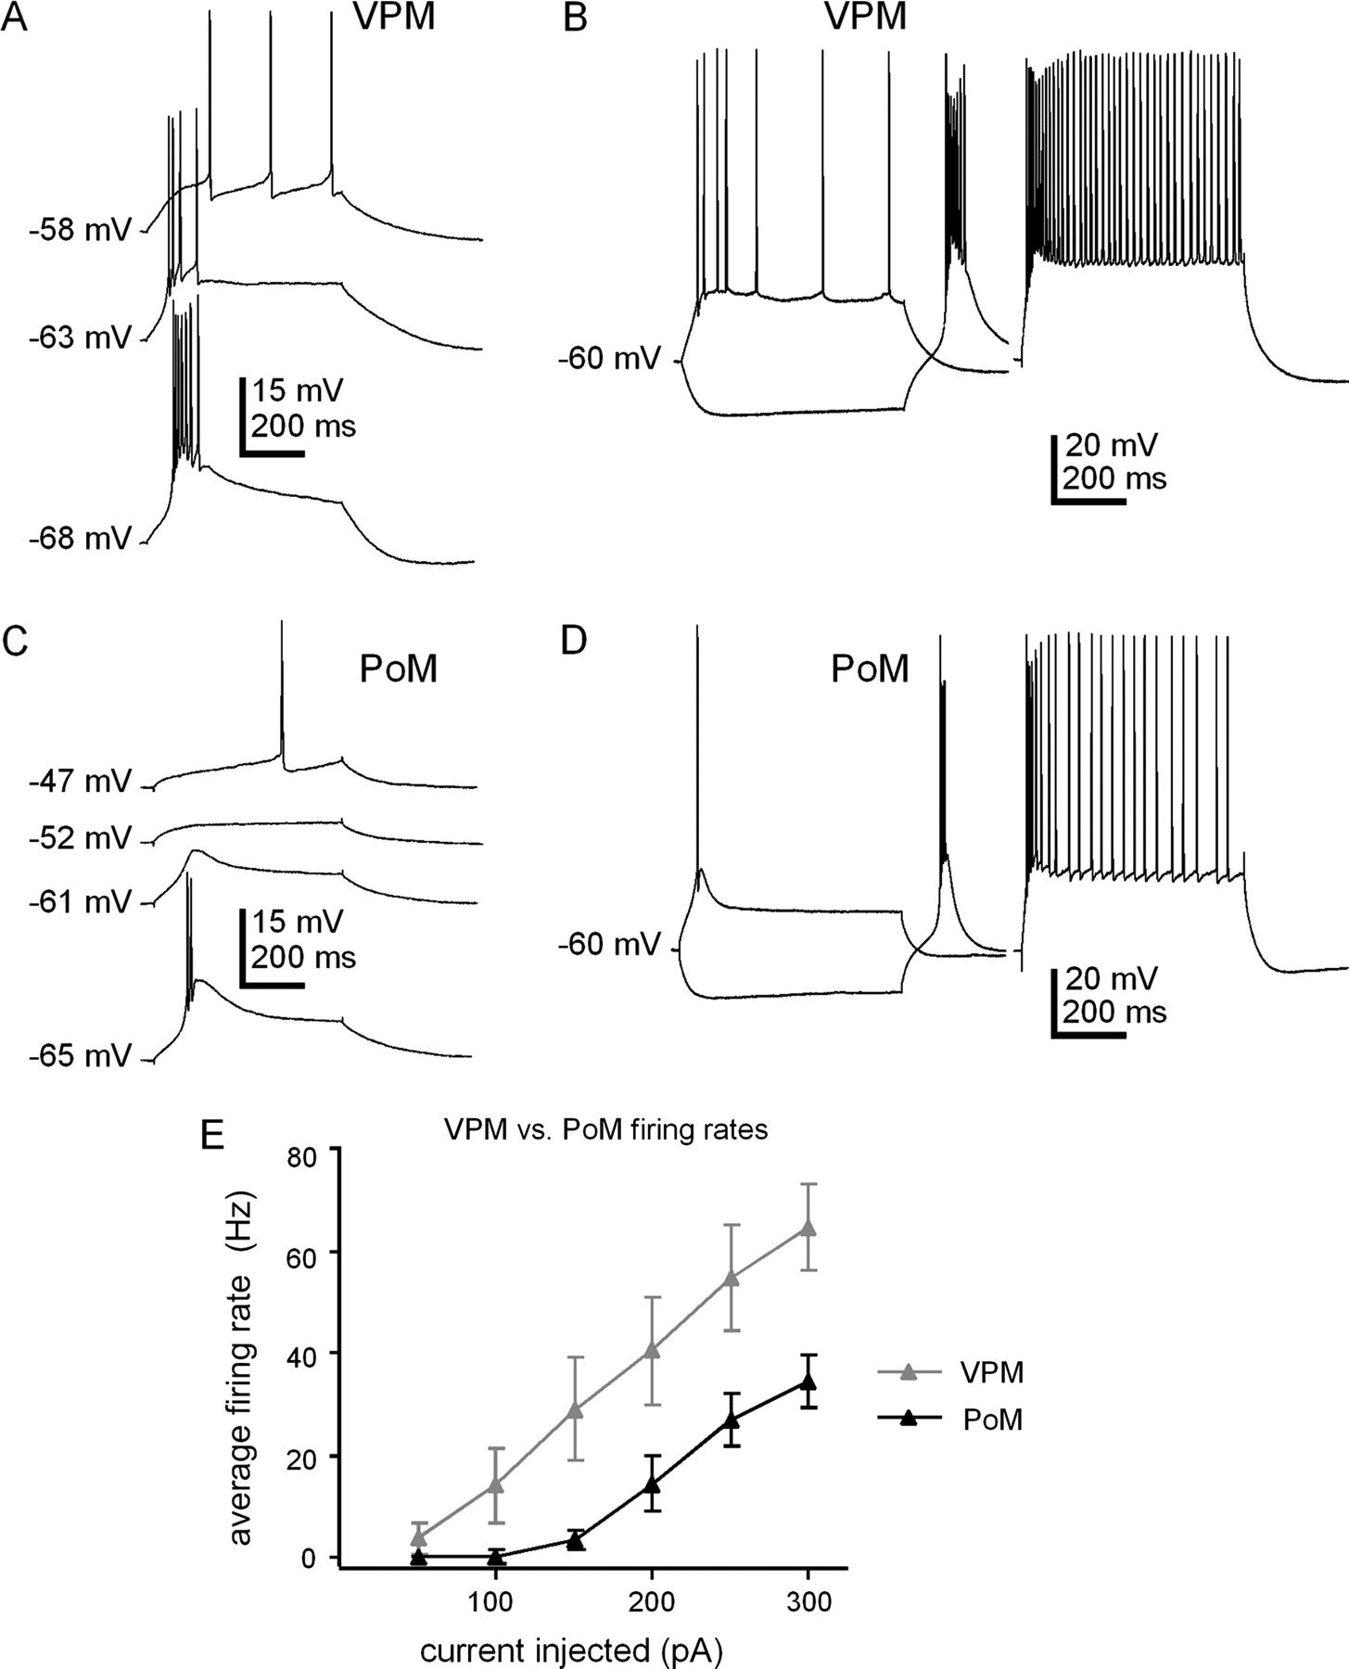
Figure 2. Firing properties of VPM and PoM cells. (A) Transition from tonic firing to burst firing in a VPM neuron at ...
Notes:
Figure 2. Firing properties of VPM and PoM cells. (A) Transition from tonic firing to burst firing in a VPM neuron at different holding potentials (+50 pA stimulation). (B) Example of a typical VPM neuron response to intracellular depolarizing and hyperpolarizing pulses (−100, +100, and +300 pA stimuli). (C) Transition from tonic firing to burst firing in a PoM neuron at different holding potentials (+50 pA stimulation). (D) Example of a typical PoM neuron response to intracellular depolarizing and hyperpolarizing pulses (−100, +100, and +300 pA stimuli). (E) Plot of firing rates (mean ± standard error) for VPM and PoM neurons to different positive current injections from Vrest. Values are the final steady-state frequencies from tonic firing during 600 ms depolarizing current pulses. N = 8 VPM cells, and 15 PoM cells. See Table 1 for Vrest values.
Unless provided in the caption above, the following copyright applies to the content of this slide: © The Author 2007. Published by Oxford University Press. All rights reserved. For permissions, please e-mail: journals.permissions@oxfordjournals.org

Slide 3
Figure 3. Response heterogeneity of VPM and PoM cells to intensity-dependent stimulation of internal capsule fibers. ...
Notes:
Figure 3. Response heterogeneity of VPM and PoM cells to intensity-dependent stimulation of internal capsule fibers. The multiple sweeps in each panel represent responses to increasing stimulus intensity starting from the lowest detectable response (threshold). (A) Example of a VPM cell with EPSPs. (B) Example of a VPM cell with IPSPs. Stimulus intensities = 25, 50, 100, 200, and 400 μA, for panels (A) and (B). (C) Responses of a PoM cell that receives both excitation and inhibition. (Stimulus intensities = 10, 20, 40, 80, 160, and 320 μA). Arrows highlight the EPSPs. All traces Vhold = −60 mV. (D) Plot of the response signatures over a population of VPM and PoM cells. The categories on the x axis represent cells that exhibit EPSPs, IPSPs, or responses showing a combination of excitation and inhibition (“both”). The y axis counts the percent of each type cell with the given response signature. Cases with IPSPs potentially activated by antidromic spikes from VPM were not included in the graph (see Fig. 4B for threshold example).
Unless provided in the caption above, the following copyright applies to the content of this slide: © The Author 2007. Published by Oxford University Press. All rights reserved. For permissions, please e-mail: journals.permissions@oxfordjournals.org

Slide 4
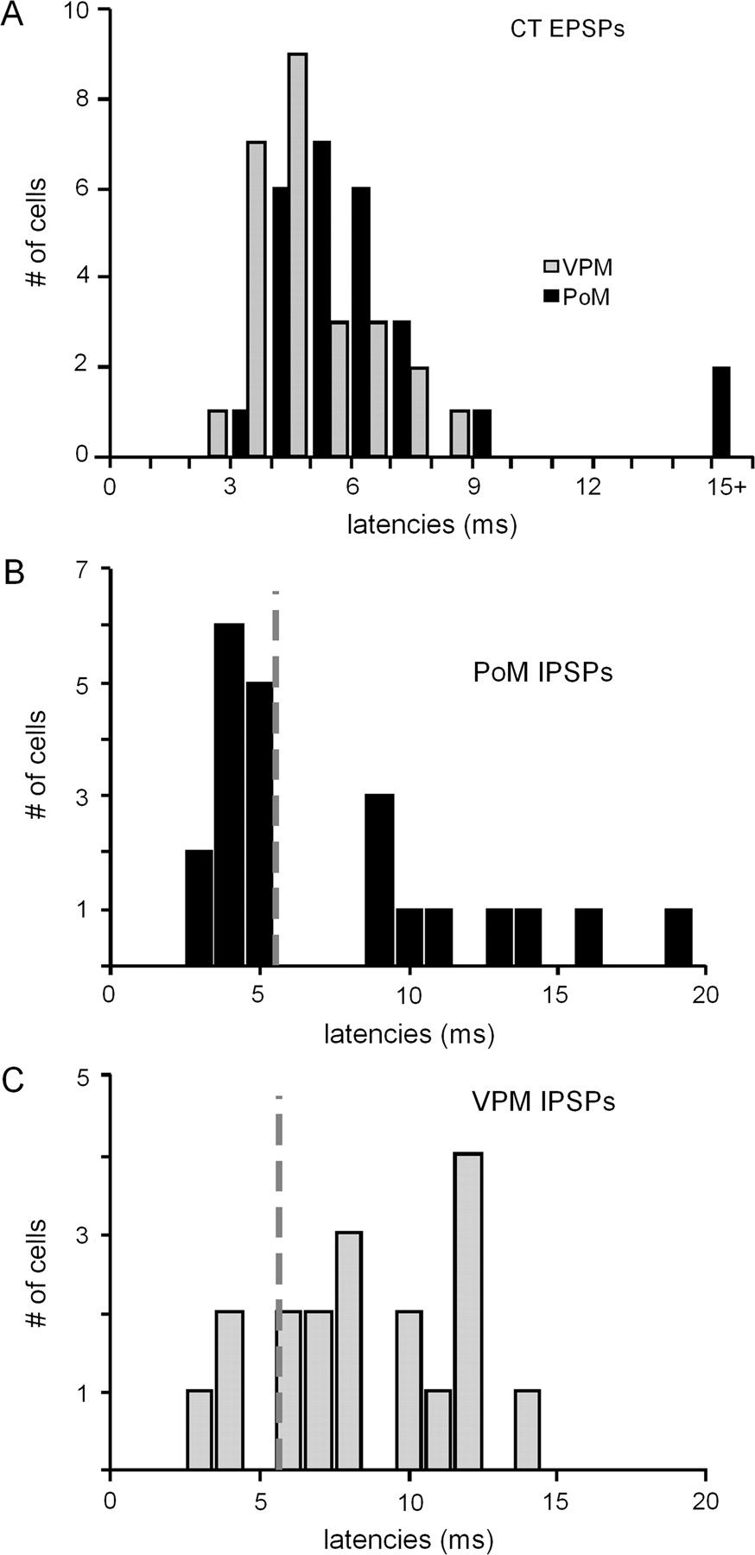
Figure 4. EPSP and IPSP response latencies. (A) Distribution of EPSP response latencies in VPM versus PoM. (B) Response ...
Notes:
Figure 4. EPSP and IPSP response latencies. (A) Distribution of EPSP response latencies in VPM versus PoM. (B) Response latencies for IPSPs seen in PoM cells. Gray line (also seen in panel C) marks the threshold for the beginning of latencies of corticothalamic origin in PoM (see Results for further discussion). (C) Response latencies for IPSPs in VPM cells. Bin size = 1 ms for all panels.
Unless provided in the caption above, the following copyright applies to the content of this slide: © The Author 2007. Published by Oxford University Press. All rights reserved. For permissions, please e-mail: journals.permissions@oxfordjournals.org

Slide 5
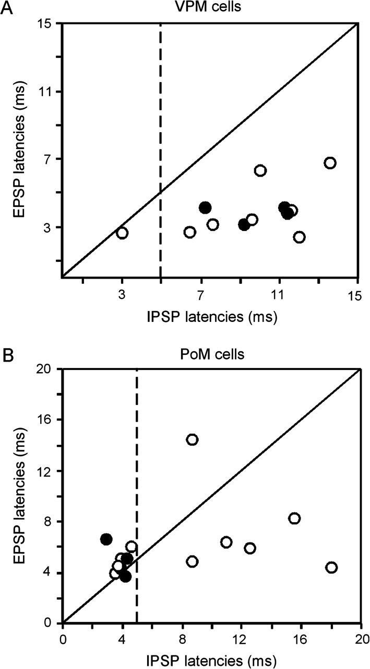
Figure 5. Comparison of EPSP and IPSP latencies for individual VPM (A) and PoM (B) cells showing mixed responses (both ...
Notes:
Figure 5. Comparison of EPSP and IPSP latencies for individual VPM (A) and PoM (B) cells showing mixed responses (both excitation and inhibition). Each circle represents the EPSP and IPSP latency from the response of a single cell. Black dots indicate cell responses where the EPSP failed on the first shock during train stimulation but showed EPSPs to the second shock, which was used to calculate the EPSP latency. Diagonal lines indicate the location for EPSPs and IPSPs with equal latencies. Thus, circles above the lines indicate IPSP latencies faster than EPSP latencies, and circles below the line indicate IPSPs with longer latencies than EPSPs. Dotted vertical lines indicate the separation of thalamocortical-evoked IPSPs (latencies 5.5 ms). N = 12 VPM cells, and N = 14 PoM cells.
Unless provided in the caption above, the following copyright applies to the content of this slide: © The Author 2007. Published by Oxford University Press. All rights reserved. For permissions, please e-mail: journals.permissions@oxfordjournals.org

Slide 6
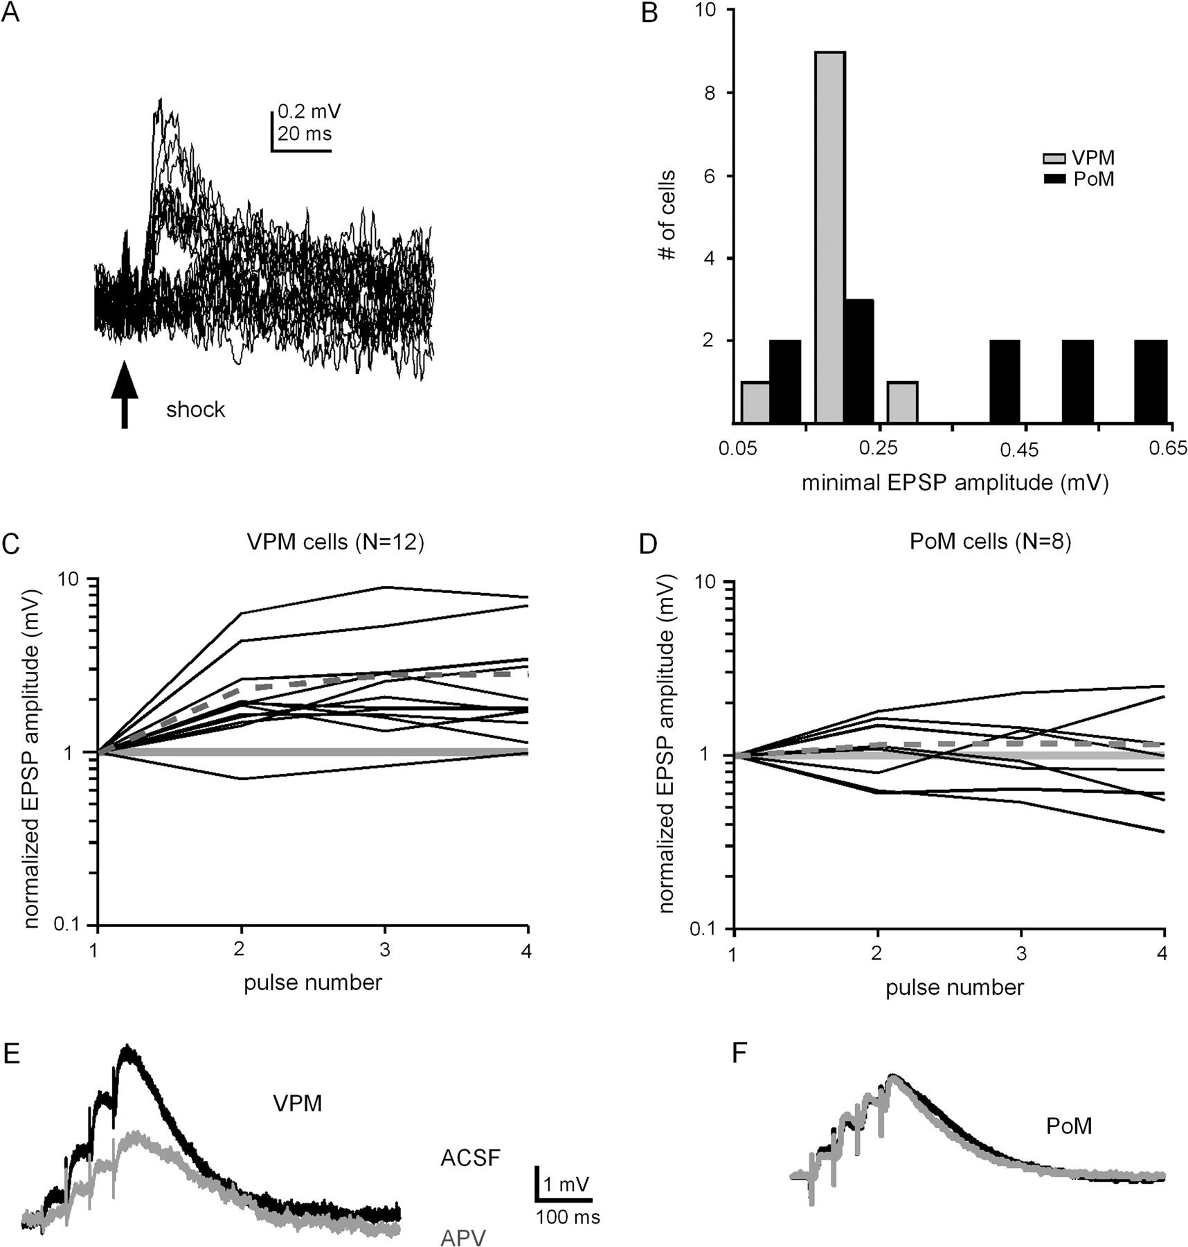
Figure 6. Characterization of EPSPs. (A) Response of a VPM cell to single minimal shocks to the internal capsule (10 ...
Notes:
Figure 6. Characterization of EPSPs. (A) Response of a VPM cell to single minimal shocks to the internal capsule (10 μA; 20 sweeps). (B) Plot of the distribution of minimal EPSPs for the population of VPM and PoM neurons tested. Bin size = 0.1 mV, range = 0.1–0.7 mV. N = 11 VPM cells and 11 PoM cells. Comparison of VPM (C) and PoM (D) cell EPSP response amplitudes to train stimulation (40 Hz). The x axes plot the stimulus number, and y axes plot the EPSP response amplitude normalized to the first EPSP, plotted on a log scale. Each line represents the response of one cell. For pulse numbers 2–4, values >1 indicate facilitation and values <1 indicate depression. Solid gray lines at y value 1 indicates the location of unchanging EPSP amplitudes. Dotted lines in each graph show the population average for the given cell type. (E) and (F): Examples of a VPM cell (E) and a PoM cell (F) EPSP responses before and after application of the NMDA blocker APV. Black responses are before APV application, and gray superimposed responses are during APV application. All EPSPs for this were recorded in ACSF with full inhibitory blockade using BMI and CGP-62349 (see Materials and Methods).
Unless provided in the caption above, the following copyright applies to the content of this slide: © The Author 2007. Published by Oxford University Press. All rights reserved. For permissions, please e-mail: journals.permissions@oxfordjournals.org

Slide 7
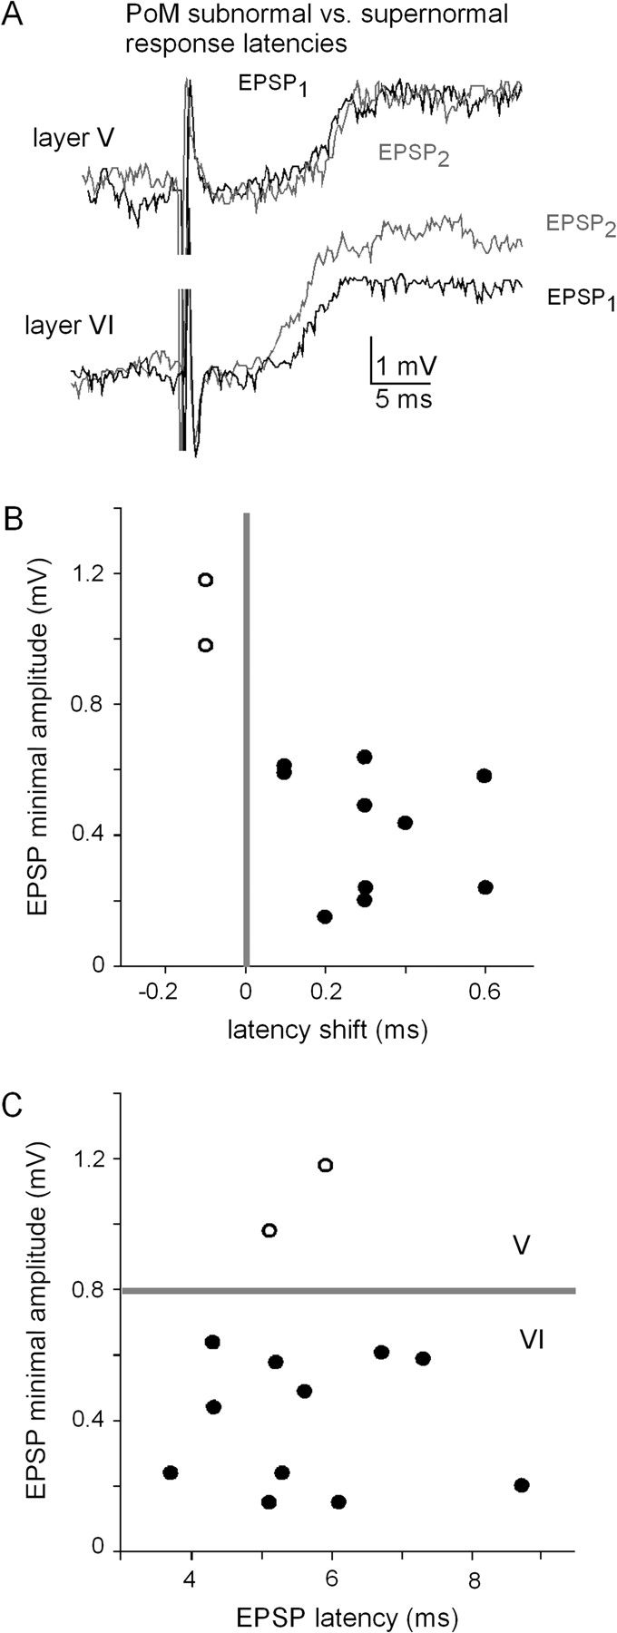
Figure 7. Distinction between layer V and layer VI inputs to PoM. (A) Responses to paired-pulse stimuli (50 Hz). Thin ...
Notes:
Figure 7. Distinction between layer V and layer VI inputs to PoM. (A) Responses to paired-pulse stimuli (50 Hz). Thin axons from layer VI can be identified by their tendency to evoke shorter latencies from the second pulse compared with the first (supernormality). Larger diameter fibers exhibit either no change in latency or slightly longer latencies to the second of 2 pulses (normality or subnormality). In the top example (“layer V”), the second EPSP arrived 0.1 ms later than the first. In the bottom example (“layer VI”), the second EPSP arrived 0.6 ms earlier than the first. (B) Corticothalamic responses of PoM cells sorted by change in latency and minimal amplitude (N = 13 cells). (C) PoM responses of the same cells shown in panel B but plotted by absolute latency versus minimum EPSP amplitude. Filled circles represent responses from layer VI activation; open circles are from possible layer V activation.
Unless provided in the caption above, the following copyright applies to the content of this slide: © The Author 2007. Published by Oxford University Press. All rights reserved. For permissions, please e-mail: journals.permissions@oxfordjournals.org

Slide 8
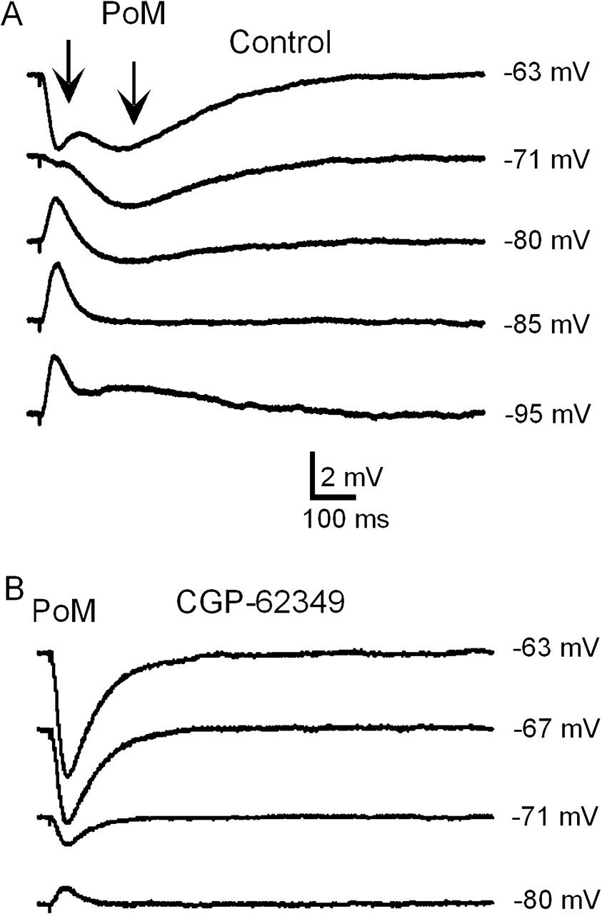
Figure 8. Inhibitory responses show both early and late components. (A) Responses of a PoM cell at different holding ...
Notes:
Figure 8. Inhibitory responses show both early and late components. (A) Responses of a PoM cell at different holding potentials to a single internal capsule shock in ACSF. First arrow indicates the onset of the early, fast inhibitory component. Second arrow indicates the onset of the slower, late inhibitory component. Reversal of the fast and slow inhibitory components can be seen near −71 mV and −85 mV, respectively. (B) The same cell in (A) after application of CGP-62349, which blocked the slow inhibitory component. Responses to single shocks while the cell was held at different potentials reveal a reversal of the fast inhibitory component near −75 mV. Stimulus = 150 μA (A and B).
Unless provided in the caption above, the following copyright applies to the content of this slide: © The Author 2007. Published by Oxford University Press. All rights reserved. For permissions, please e-mail: journals.permissions@oxfordjournals.org

Slide 9
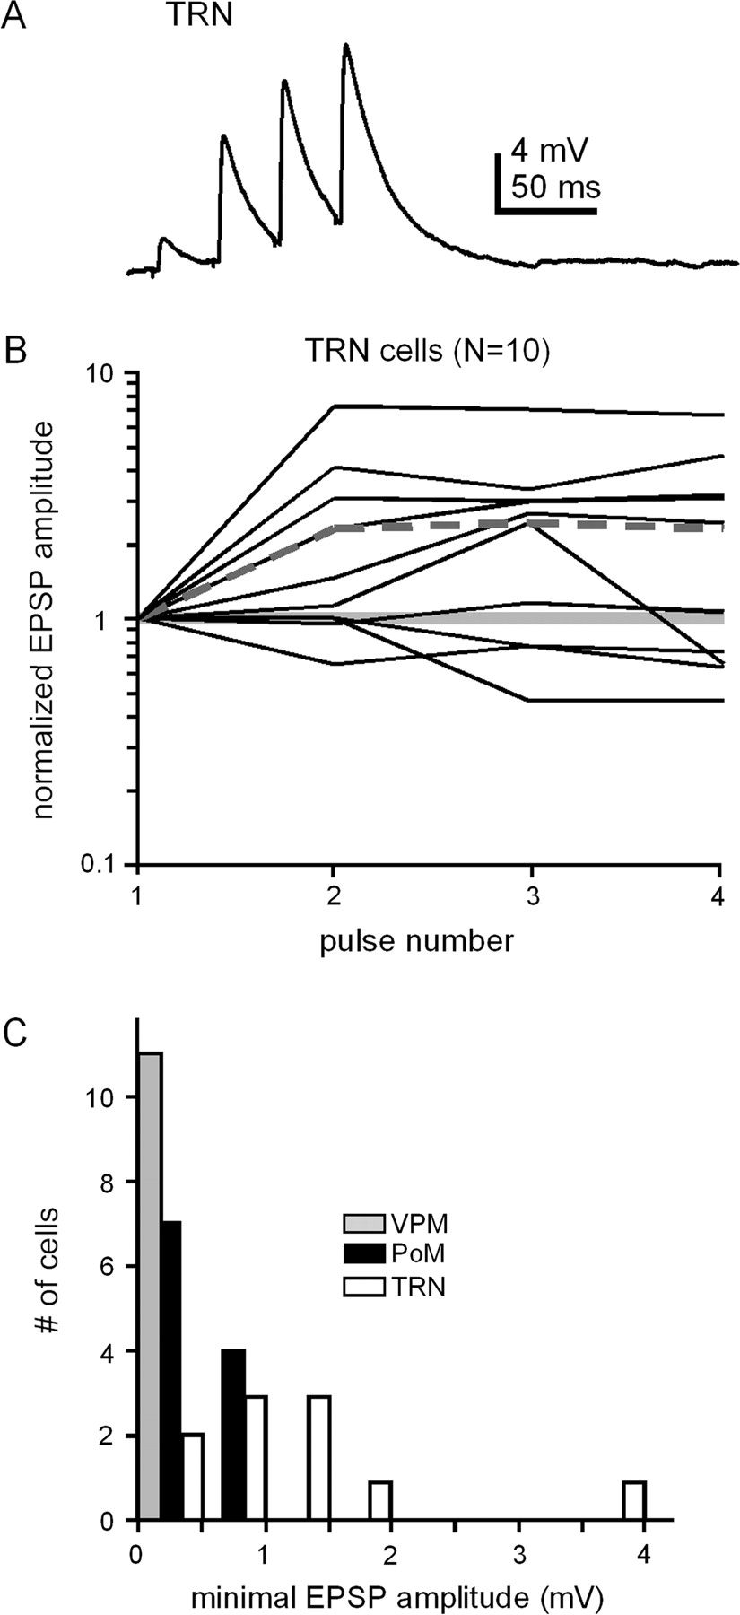
Figure 9. Cortical feedback responses of TRN neurons to internal capsule stimulation. (A) Example response of a single ...
Notes:
Figure 9. Cortical feedback responses of TRN neurons to internal capsule stimulation. (A) Example response of a single TRN neuron to1.5× threshold stimulus train (40 Hz), showing strong facilitation. (B) Summary of the population of TRN responses to 40-Hz train stimulation. All EPSP amplitudes are normalized to the response to the first pulse. The y axis is plotted on a log scale. Each line represents the responses of a single neuron. Solid gray line indicates unchanging EPSP amplitude. Lines below solid gray show response depression, and lines above solid gray show response facilitation. Dotted gray line indicates population average (N = 10 cells). (C) Distribution of minimal EPSP amplitudes for the 3 thalamic cells types: VPM, PoM, and TRN. Bin size = 0.5 mV, range = 0.5–4 mV. All EPSPs smaller than 0.5 mV are pooled in the first bin. (N = 11 VPM, 11 PoM, and 10 TRN cells).
Unless provided in the caption above, the following copyright applies to the content of this slide: © The Author 2007. Published by Oxford University Press. All rights reserved. For permissions, please e-mail: journals.permissions@oxfordjournals.org

Slide 10
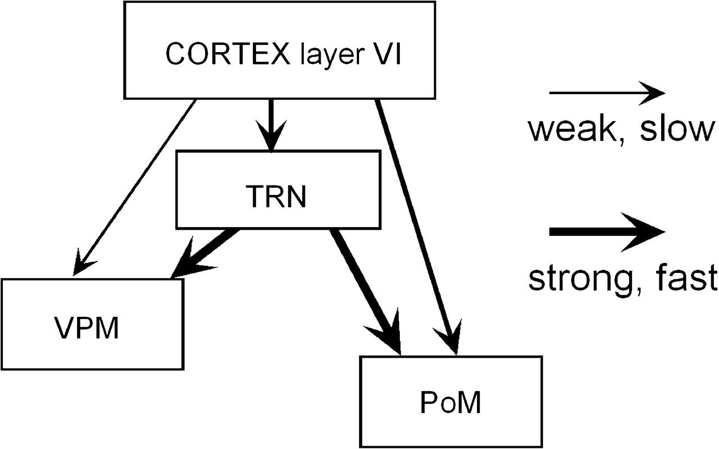
Figure 10. A model of the mono- and disynaptic feedback pathways from cortex layer VI to VPM, PoM, and TRN neurons in ...
Notes:
Figure 10. A model of the mono- and disynaptic feedback pathways from cortex layer VI to VPM, PoM, and TRN neurons in the thalamus. Line thickness is ranked by PSP amplitude and reliability, which is also consistent with the ranking of the anatomical axon arbor thickness: Thin lines indicate the slow-conducting fine fibers from layer VI, and thick lines indicate the fast-conducting larger fibers from the TRN to VPM and PoM.
Unless provided in the caption above, the following copyright applies to the content of this slide: © The Author 2007. Published by Oxford University Press. All rights reserved. For permissions, please e-mail: journals.permissions@oxfordjournals.org

