Slide 1
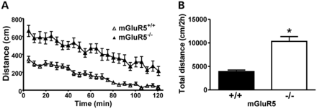
Figure 1. mGluR5^{−/−} mice exhibit increased locomotor activity. Graph shows total distance traveled by ...
Notes:
Figure 1. mGluR5−/− mice exhibit increased locomotor activity. Graph shows total distance traveled by wild-type (mGluR5+/+) (n = 11) and mGluR5 knockout (mGluR5−/−) (n = 12) mice measured at 5-min intervals (A) or cumulatively >120 min (B). Each animal was monitored for 120 min in open-field apparatus. Data represent the means ± SEM. * indicates significant difference as compared with mGluR5+/+ mice (P < 0.05).
Unless provided in the caption above, the following copyright applies to the content of this slide: © The Author 2013. Published by Oxford University Press. All rights reserved. For Permissions, please email: journals.permissions@oup.com

Slide 2
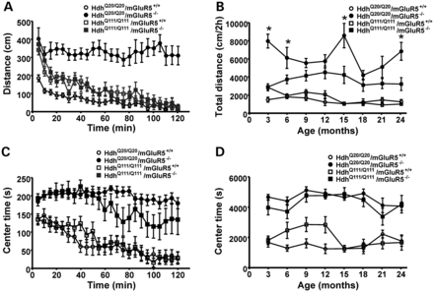
Figure 2. Mutant huntingtin abrogates mGluR5^{−/−}-induced increased locomotor activity. Graphs show total ...
Notes:
Figure 2. Mutant huntingtin abrogates mGluR5−/−-induced increased locomotor activity. Graphs show total distance traveled (A) and time spent in the center of the apparatus (C) by control (HdhQ20/Q20/mGluR5+/+) (n = 11), mGluR5 null control (HdhQ20/Q20/mGluR5−/−) (n = 11), mutant HD (HdhQ111/Q111/mGluR5+/+) (n = 12) and mGluR5 null mutant HD (HdhQ111/Q111/mGluR5−/−) mice (n = 11) at 3 months of age measured at 5-min intervals. Each animal was monitored for 120 min. Data represent the means ± SEM. Graphs show total distance traveled (B) and time spent in the center (D) by HdhQ20/Q20/mGluR5+/+ (n = 9–11), HdhQ20/Q20/mGluR5−/− (n = 6–11), HdhQ111/Q111/mGluR5+/+ (n = 9–12) and HdhQ111/Q111/mGluR5−/− mice (n = 6–11) tested at 3, 6, 9, 12, 15, 18, 21 and 24 months of age. Each animal was monitored for 120 min in the open-field apparatus. Data represent means ± SEM. * indicates significant differences as compared with HdhQ111/Q111/mGluR5−/− mice (P < 0.05).
Unless provided in the caption above, the following copyright applies to the content of this slide: © The Author 2013. Published by Oxford University Press. All rights reserved. For Permissions, please email: journals.permissions@oup.com

Slide 3
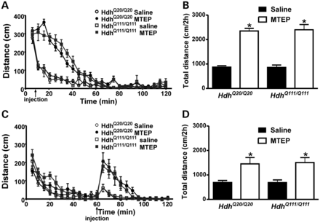
Figure 3. Acute MTEP injection induces increased locomotor activity in both Hdh^{Q20/Q20} and ...
Notes:
Figure 3. Acute MTEP injection induces increased locomotor activity in both HdhQ20/Q20 and HdhQ111/Q111 mice. (A and B) Graphs show total distance traveled by control (HdhQ20/Q20) (MTEP n = 8 and saline n = 7) and mutant HD (HdhQ111/Q111) (MTEP n = 8 and saline n = 7) mice. Animals were placed in the open-field box and injected at an injection point of 5 min with either saline or MTEP (i.p. 5 mg/Kg). Each animal was monitored for 120 min, and total distance was measured at 5-min intervals (A) or cumulatively >120 min (B). (C and D) Graphs show total distance traveled by HdhQ20/Q20 (MTEP n = 8 and saline n = 7) and HdhQ111/Q111 (MTEP n = 8 and saline n = 7) mice. Animals were placed in the open-field box and injected at an injection point of 60 min with either saline or MTEP (i.p. 5 mg/Kg). Each animal was monitored for 120 min, and total distance was measured at 5-min intervals (C) or cumulatively >120 min (D). Data represent the means ± SEM. * indicates significant differences as compared with matched genotype injected with saline (P < 0.05).
Unless provided in the caption above, the following copyright applies to the content of this slide: © The Author 2013. Published by Oxford University Press. All rights reserved. For Permissions, please email: journals.permissions@oup.com

Slide 4
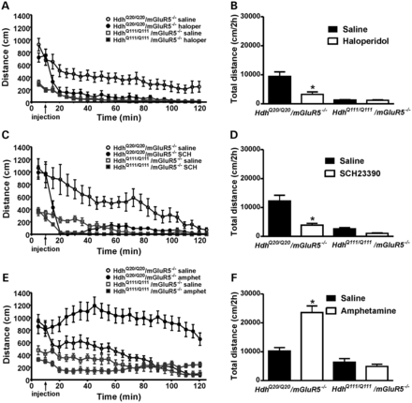
Figure 4. Role of mutated huntingtin protein in locomotor activity involves both mGluR5 and dopamine neurotransmission. ...
Notes:
Figure 4. Role of mutated huntingtin protein in locomotor activity involves both mGluR5 and dopamine neurotransmission. (A and B) Graphs show total distance traveled by mGluR5 null control (HdhQ20/Q20/mGluR5−/−)(haloperidol (haloper) n = 11 and saline n = 10) and mGluR5 null mutant HD (HdhQ111/Q111/mGluR5−/−) (haloperidol n = 7 and saline n = 7) mice. Animals were placed in the open-field box and injected at an injection point of 10 min with either saline or haloperidol (i.p. 0.5 mg/kg). Each animal was monitored for 120 min, and total distance was measured at 5-min intervals (A) or cumulatively >120 min (B). (C and D) Graphs show total distance traveled by HdhQ20/Q20/mGluR5−/− (SCH23390 (SCH) n = 9 and saline n = 10) and HdhQ111/Q111/mGluR5−/− (SCH23390 n = 11 and saline n = 10) mice. Animals were placed in the open-field box and injected at an injection point of 10 min with either saline or SCH23390 (i.p. 0.5 mg/kg). Each animal was monitored for 120 min, and total distance was measured at 5-min intervals (C) or cumulatively >120 min (D). (E and F) Graphs show total distance traveled by HdhQ20/Q20/mGluR5−/− (amphetamine (amphet) n = 21 saline n = 15) and HdhQ111/Q111/mGluR5−/− (amphetamine n = 21 and saline n = 15) mice. Animals were placed in the open-field box and injected at an injection point of 10 min with either saline or amphetamine (i.p. 2 mg/kg). Each animal was monitored for 120 min, and total distance was measured at 5-min intervals (E) or cumulatively >120 min (F). Data represent means ± SEM. * indicates significant differences as compared with matched genotype injected with saline (P < 0.05).
Unless provided in the caption above, the following copyright applies to the content of this slide: © The Author 2013. Published by Oxford University Press. All rights reserved. For Permissions, please email: journals.permissions@oup.com

Slide 5
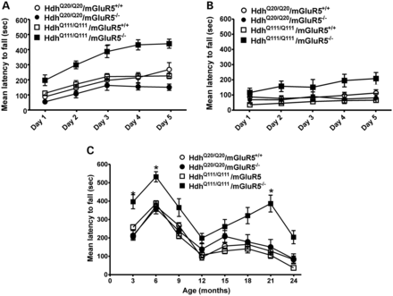
Figure 5. mGluR5 knockout improves Hdh^{Q111/Q111} rotarod performance. (A and B) Graphs show rotarod learning ...
Notes:
Figure 5. mGluR5 knockout improves HdhQ111/Q111 rotarod performance. (A and B) Graphs show rotarod learning curve represented as latency to fall from accelerating rotarod by control (HdhQ20/Q20/mGluR5+/+)(n = 9–11), mGluR5 null control (HdhQ20/Q20/mGluR5−/−) (n = 6–11), mutant HD (HdhQ111/Q111/mGluR5+/+) (n = 9–12) and mGluR5 null mutant HD (HdhQ111/Q111/mGluR5−/−) (n = 6–11) mice that were 3 (A) and 24 (B) months old. Each animal was trained for 10 min in six trials performed every day for five consecutive days. (C) Graph shows latency to fall from accelerating rotarod by HdhQ20/Q20/mGluR5+/+ (n = 9–11), HdhQ20/Q20/mGluR5−/− (n = 6–11), HdhQ111/Q111/mGluR5+/+ (n = 9–12) and HdhQ111/Q111/mGluR5−/− (n = 6–11) mice tested at 3, 6, 9, 12, 15, 18, 21 and 24 months of age. Each animal was tested in three trials, and the average latency to fall was determined. Data represent means ± SEM. * indicates significant differences as compared with HdhQ20/Q20/mGluR5+/+ mice (P < 0.05).
Unless provided in the caption above, the following copyright applies to the content of this slide: © The Author 2013. Published by Oxford University Press. All rights reserved. For Permissions, please email: journals.permissions@oup.com

Slide 6
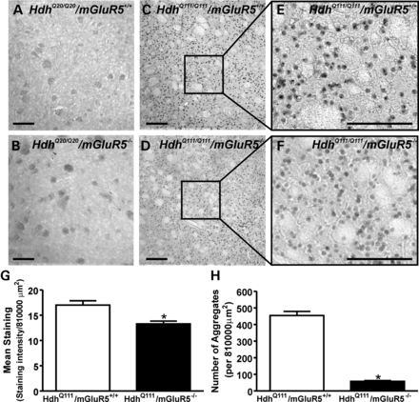
Figure 6. The number of huntingtin (EM48) intranuclear inclusions is reduced by the knockout of mGluR5 in ...
Notes:
Figure 6. The number of huntingtin (EM48) intranuclear inclusions is reduced by the knockout of mGluR5 in HdhQ111/Q111/mGluR5−/− mice. Shown are representative images for EM48 immunostaining from (A) control (HdhQ20/Q20/mGluR5+/+), (B) mGluR5 null control (HdhQ20/Q20/mGluR5−/−), (C) mutant HD (HdhQ111/Q111/mGluR5+/+) and (D) mGluR5 null mutant HD (HdhQ111/Q111/mGluR5−/−) striatal slices. Previous panels were enlarged to show intranuclear inclusions present in HdhQ111/Q111/mGluR5+/+ (E) and HdhQ111/Q111/mGluR5−/− (F) striatal slices. Graphs show quantification of diffuse EM48 staining (G) and number of Huntingtin aggregates (intranuclear inclusions) (G) found per 900 × 900 μm2. Data represent the means ± SEM for three independent experiments. Asterisks indicate significant differences (unpaired t-test) as compared with HdhQ111/Q111/mGluR5+/+ mice (P < 0.05). Scale bar = 150 µm.
Unless provided in the caption above, the following copyright applies to the content of this slide: © The Author 2013. Published by Oxford University Press. All rights reserved. For Permissions, please email: journals.permissions@oup.com

Slide 7
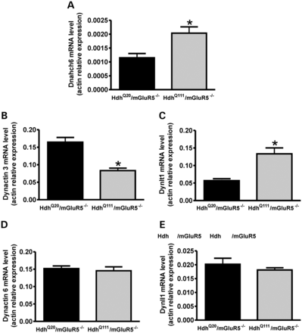
Figure 7. Gene expression changes between Hdh^{Q20/Q20}/mGluR5^{−/−} versus ...
Notes:
Figure 7. Gene expression changes between HdhQ20/Q20/mGluR5−/− versus HdhQ111/Q111/mGluR5−/− mice. Graph shows mRNA levels of dynein heavy chain axonemal 6 (Dnahc6), NM_001164669.1 (A), dynactin 3, NM_016890 (B), dynein light Tctex chain-type 1B (Dynlt1b), NM_009342 (C), dynactin 6, NM_011722 (D), and dynein light chain LC8-type 1 (Dynll1), NM_019682 (D) determined by quantitative RT-PCR. mRNA was extracted from the striatum of age-matched mGluR5 null mutant HD (HdhQ111/Q111/mGluR5−/−) and mGluR5 null control (HdhQ20/Q20/mGluR5−/−) mice. qPCR reaction was performed in triplicate and normalized to actin mRNA levels. Data represent the means ± SEM of four independent experiments. * indicates significant differences as compared with HdhQ20/Q20/mGluR5−/− mice (P < 0.05).
Unless provided in the caption above, the following copyright applies to the content of this slide: © The Author 2013. Published by Oxford University Press. All rights reserved. For Permissions, please email: journals.permissions@oup.com

