Slide 1
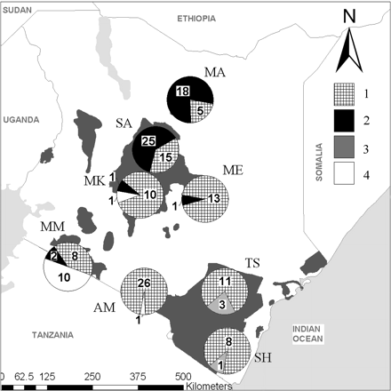
Figure 1 Map of Kenya showing the current distribution of elephants (gray-shaded areas). The pie charts show ...
Notes:
Figure 1 Map of Kenya showing the current distribution of elephants (gray-shaded areas). The pie charts show proportionately the percentage of individuals in each population sampled belonging to the 4 respective clades observed based on mtDNA. The sampling locality (Marsabit = MA; Samburu = SA; Mt Kenya = MK; Meru = ME; Amboseli = AM; Tsavo = TS; Shimba Hills = SH; and Maasai Mara = MM) is approximately in the center of each pie chart, and the number of individuals sharing the haplotype group for each population is indicated either inside or next to the slices of each pie chart.
Unless provided in the caption above, the following copyright applies to the content of this slide: © The American Genetic Association. 2008. All rights reserved. For permissions, please email: journals.permissions@oxfordjournals.org.

Slide 2
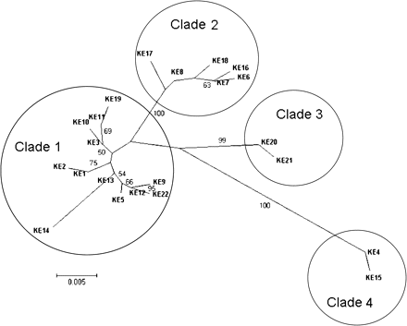
Figure 2 A radial neighbor-joining phylogenetic tree showing relationship among 22 mtDNA control region haplotypes ...
Notes:
Figure 2 A radial neighbor-joining phylogenetic tree showing relationship among 22 mtDNA control region haplotypes obtained from 159 individual elephants analyzed from their populations in Kenya. Statistical support for the nodes in the tree was obtained based on 1000 bootstrap replications in the computer program MEGA 4.0 (only nodes with ≥50% replicates are indicated).
Unless provided in the caption above, the following copyright applies to the content of this slide: © The American Genetic Association. 2008. All rights reserved. For permissions, please email: journals.permissions@oxfordjournals.org.

