Slide 1
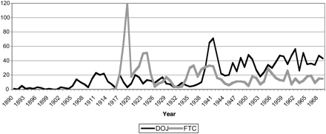
Figure 1. U.S. government activities
Notes:
Figure 1. U.S. government activities
Unless provided in the caption above, the following copyright applies to the content of this slide: © The Author (2012). Published by Oxford University Press. All rights reserved. For Permissions, please email: journals.permissions@oup.com

Slide 2
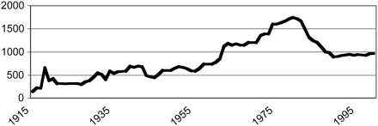
Figure 2. FTC staff
Notes:
Figure 2. FTC staff
Unless provided in the caption above, the following copyright applies to the content of this slide: © The Author (2012). Published by Oxford University Press. All rights reserved. For Permissions, please email: journals.permissions@oup.com

Slide 3
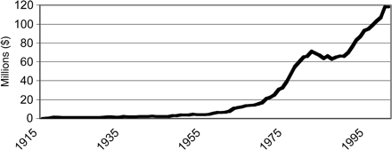
Figure 3. FTC appropriations
Notes:
Figure 3. FTC appropriations
Unless provided in the caption above, the following copyright applies to the content of this slide: © The Author (2012). Published by Oxford University Press. All rights reserved. For Permissions, please email: journals.permissions@oup.com

Slide 4
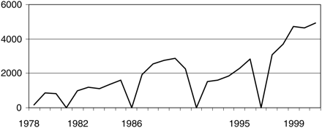
Figure 4. Pre-merger notifications
Notes:
Figure 4. Pre-merger notifications
Unless provided in the caption above, the following copyright applies to the content of this slide: © The Author (2012). Published by Oxford University Press. All rights reserved. For Permissions, please email: journals.permissions@oup.com

Slide 5
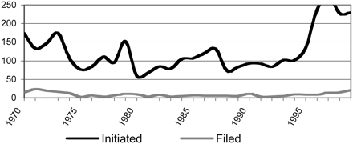
Figure 5. Merger investigations and adverse decisions
Notes:
Figure 5. Merger investigations and adverse decisions
Unless provided in the caption above, the following copyright applies to the content of this slide: © The Author (2012). Published by Oxford University Press. All rights reserved. For Permissions, please email: journals.permissions@oup.com

Slide 6
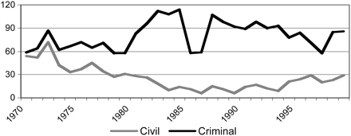
Figure 6. Antitrust division filings
Notes:
Figure 6. Antitrust division filings
Unless provided in the caption above, the following copyright applies to the content of this slide: © The Author (2012). Published by Oxford University Press. All rights reserved. For Permissions, please email: journals.permissions@oup.com

Slide 7
Figure 7. Private case filings
Notes:
Figure 7. Private case filings
Unless provided in the caption above, the following copyright applies to the content of this slide: © The Author (2012). Published by Oxford University Press. All rights reserved. For Permissions, please email: journals.permissions@oup.com

Slide 8
Figure 8. Ratio of public to private filings
Notes:
Figure 8. Ratio of public to private filings
Unless provided in the caption above, the following copyright applies to the content of this slide: © The Author (2012). Published by Oxford University Press. All rights reserved. For Permissions, please email: journals.permissions@oup.com

Slide 9
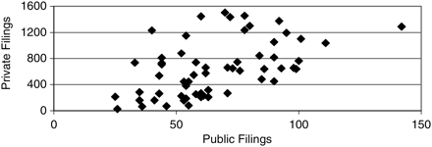
Figure 9. Private and public filings, 1945-2004
Notes:
Figure 9. Private and public filings, 1945-2004
Unless provided in the caption above, the following copyright applies to the content of this slide: © The Author (2012). Published by Oxford University Press. All rights reserved. For Permissions, please email: journals.permissions@oup.com

Slide 10
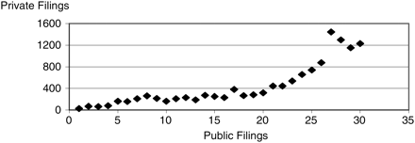
Figure 10. Private and public filings, 1945-1974
Notes:
Figure 10. Private and public filings, 1945-1974
Unless provided in the caption above, the following copyright applies to the content of this slide: © The Author (2012). Published by Oxford University Press. All rights reserved. For Permissions, please email: journals.permissions@oup.com

Slide 11
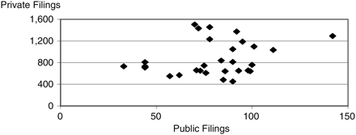
Figure 11. Private and public filings, 1975-2004
Notes:
Figure 11. Private and public filings, 1975-2004
Unless provided in the caption above, the following copyright applies to the content of this slide: © The Author (2012). Published by Oxford University Press. All rights reserved. For Permissions, please email: journals.permissions@oup.com

Slide 12
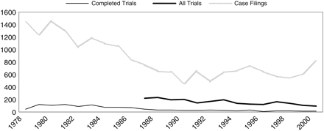
Figure 12. Evolution of private enforcement
Notes:
Figure 12. Evolution of private enforcement
Unless provided in the caption above, the following copyright applies to the content of this slide: © The Author (2012). Published by Oxford University Press. All rights reserved. For Permissions, please email: journals.permissions@oup.com

Slide 13
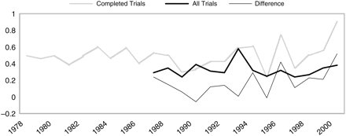
Figure 13. Judicial outcomes: probability of plaintiffs winning
Notes:
Figure 13. Judicial outcomes: probability of plaintiffs winning
Unless provided in the caption above, the following copyright applies to the content of this slide: © The Author (2012). Published by Oxford University Press. All rights reserved. For Permissions, please email: journals.permissions@oup.com

