Slide 1
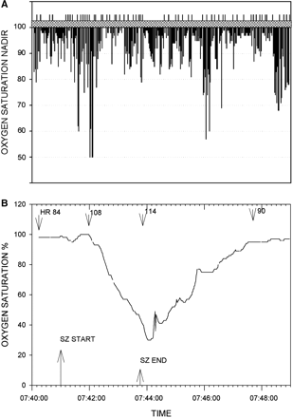
Fig. 1 (A) Oxygen saturation nadir (percent saturation) for each seizure. Recorded saturation values below 50% were ...
Notes:
Fig. 1 (A) Oxygen saturation nadir (percent saturation) for each seizure. Recorded saturation values below 50% were truncated at 50%. The vertical lines above the hatched bar separate data from the 56 individual patients. (B) Pronounced oxygen desaturation with a complex partial left temporal onset seizure without secondary generalization. Patient was a 19-year-old male with a BMI of 19.9. Seizure onset occurred with the patient awake and sitting in bed. He became unresponsive with lip smacking, a slight head turn to the left followed by forceful head turning to the right. He remained sitting for the duration of the seizure. The heart rate (b.p.m.) at various times is shown. Two other complex partial seizures in this patient (one left and one right temporal onset) were accompanied by oxygen desaturations below 50%. Oxygen saturation percent is shown on the ordinate.
Unless provided in the caption above, the following copyright applies to the content of this slide: © The Author (2008). Published by Oxford University Press on behalf of the Guarantors of Brain. All rights reserved. For Permissions, please email: journals.permissions@oxfordjournals.org

Slide 2
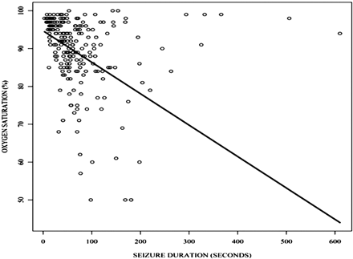
Fig. 2 Plot of seizure duration versus level of desaturation. Oxygen saturation = 94.704 – 0.083 × seizure ...
Notes:
Fig. 2 Plot of seizure duration versus level of desaturation. Oxygen saturation = 94.704 – 0.083 × seizure duration.
Unless provided in the caption above, the following copyright applies to the content of this slide: © The Author (2008). Published by Oxford University Press on behalf of the Guarantors of Brain. All rights reserved. For Permissions, please email: journals.permissions@oxfordjournals.org

Slide 3
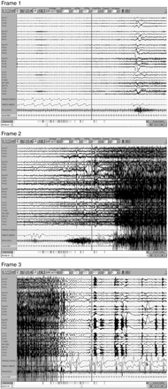
Fig. 3 Complex partial seizure with secondary generalization recorded in a 31-year-old woman; 60 s per frame. Frame ...
Notes:
Fig. 3 Complex partial seizure with secondary generalization recorded in a 31-year-old woman; 60 s per frame. Frame 1 shows right temporal onset seizure with central apnoea. Secondary generalization occurs in Frame 2 and oxygen desaturation is seen. Seizure ends in Frame 3 with resumption of breathing and continued but improving oxygen desaturation.
Unless provided in the caption above, the following copyright applies to the content of this slide: © The Author (2008). Published by Oxford University Press on behalf of the Guarantors of Brain. All rights reserved. For Permissions, please email: journals.permissions@oxfordjournals.org

Slide 4
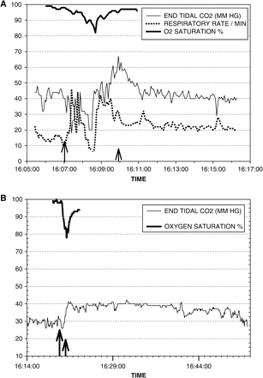
Fig. 4 (A) Partial onset seizure with secondary generalization. There is an increase in ETCO2 above 65 mm Hg ...
Notes:
Fig. 4 (A) Partial onset seizure with secondary generalization. There is an increase in ETCO2 above 65 mm Hg accompanying a drop in oxygen saturation. Respiratory rate increases during the period of hypercarbia. The longer arrow indicates seizure onset; the shorter arrow indicates seizure end. (B) Left temporal onset complex partial seizure. There is an abrupt increase in ETCO2 with concomitant drop in oxygen saturation. ETCO2 elevation persists above preictal levels for >30 min after the end of the seizure.
Unless provided in the caption above, the following copyright applies to the content of this slide: © The Author (2008). Published by Oxford University Press on behalf of the Guarantors of Brain. All rights reserved. For Permissions, please email: journals.permissions@oxfordjournals.org

