Slide 1
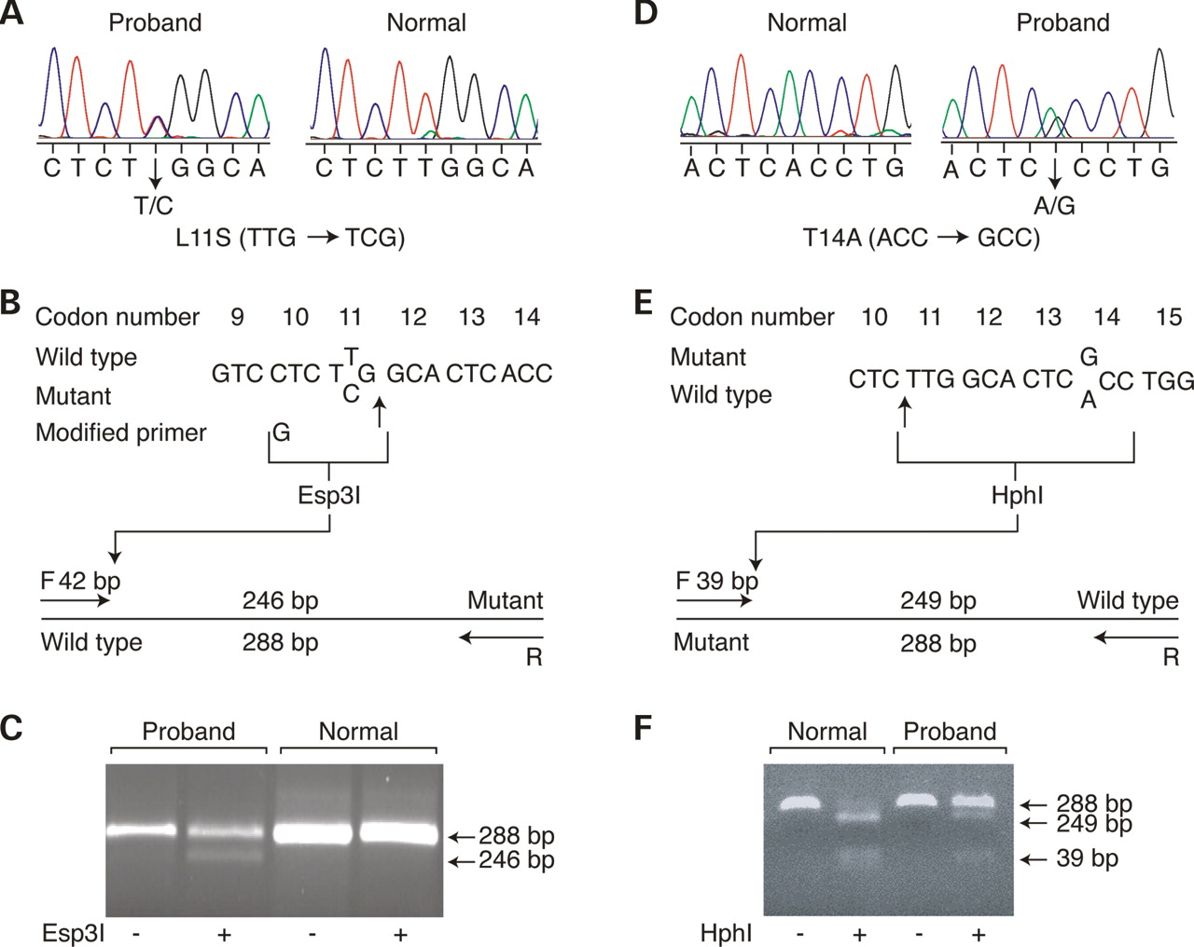
Figure 1. Detection of mutations in the CASR gene. Case 1: (A) Direct sequence analysis of the exon 2 genomic ...
Notes:
Figure 1. Detection of mutations in the CASR gene. Case 1: (A) Direct sequence analysis of the exon 2 genomic DNA amplicon of the proband (left) revealed a heterozygous missense mutation (L11S, TTG→TCG) compared with an unrelated normal individual (right). The sense strand is shown. (B) Wild-type and mutant sequences of part of exon 2. The restriction enzyme Esp31 recognition site that is created by the mutation in combination with a modified forward primer (F) is bracketed (and the cleavage site arrowed). The position of the Esp31 site in the mutant allele is shown in the restriction map of the exon 2 amplicon. (C) Gel electrophoretic separation of undigested or Esp31 restriction digests of exon 2 PCR product from the proband and a normal individual. Undigested and Esp31-digested exon 2 amplicon sizes are shown to the right. Case 2: (D) Direct sequence analysis of the exon 2 genomic DNA amplicon of the proband (right) revealed a heterozygous missense mutation (T14A, ACC→GCC) compared with an unrelated normal individual (left). The sense strand is shown. (E) Mutant and wild-type sequences of part of exon 2. The restriction enzyme Hph1 recognition site present in wild-type, but destroyed by the mutation, is bracketed (and the cleavage site arrowed). The position of the Hph1 site in the wild-type is shown in the restriction map of the exon 2 amplicon. (F) Gel electrophoretic separation of undigested or Hph1 restriction digests of exon 2 PCR product from a normal individual or the proband. Undigested and Hph1-digested exon 2 amplicon sizes are shown to the right.
Unless provided in the caption above, the following copyright applies to the content of this slide: © The Author 2005. Published by Oxford University Press. All rights reserved. For Permissions, please email: journals.permissions@oupjournals.org

Slide 2
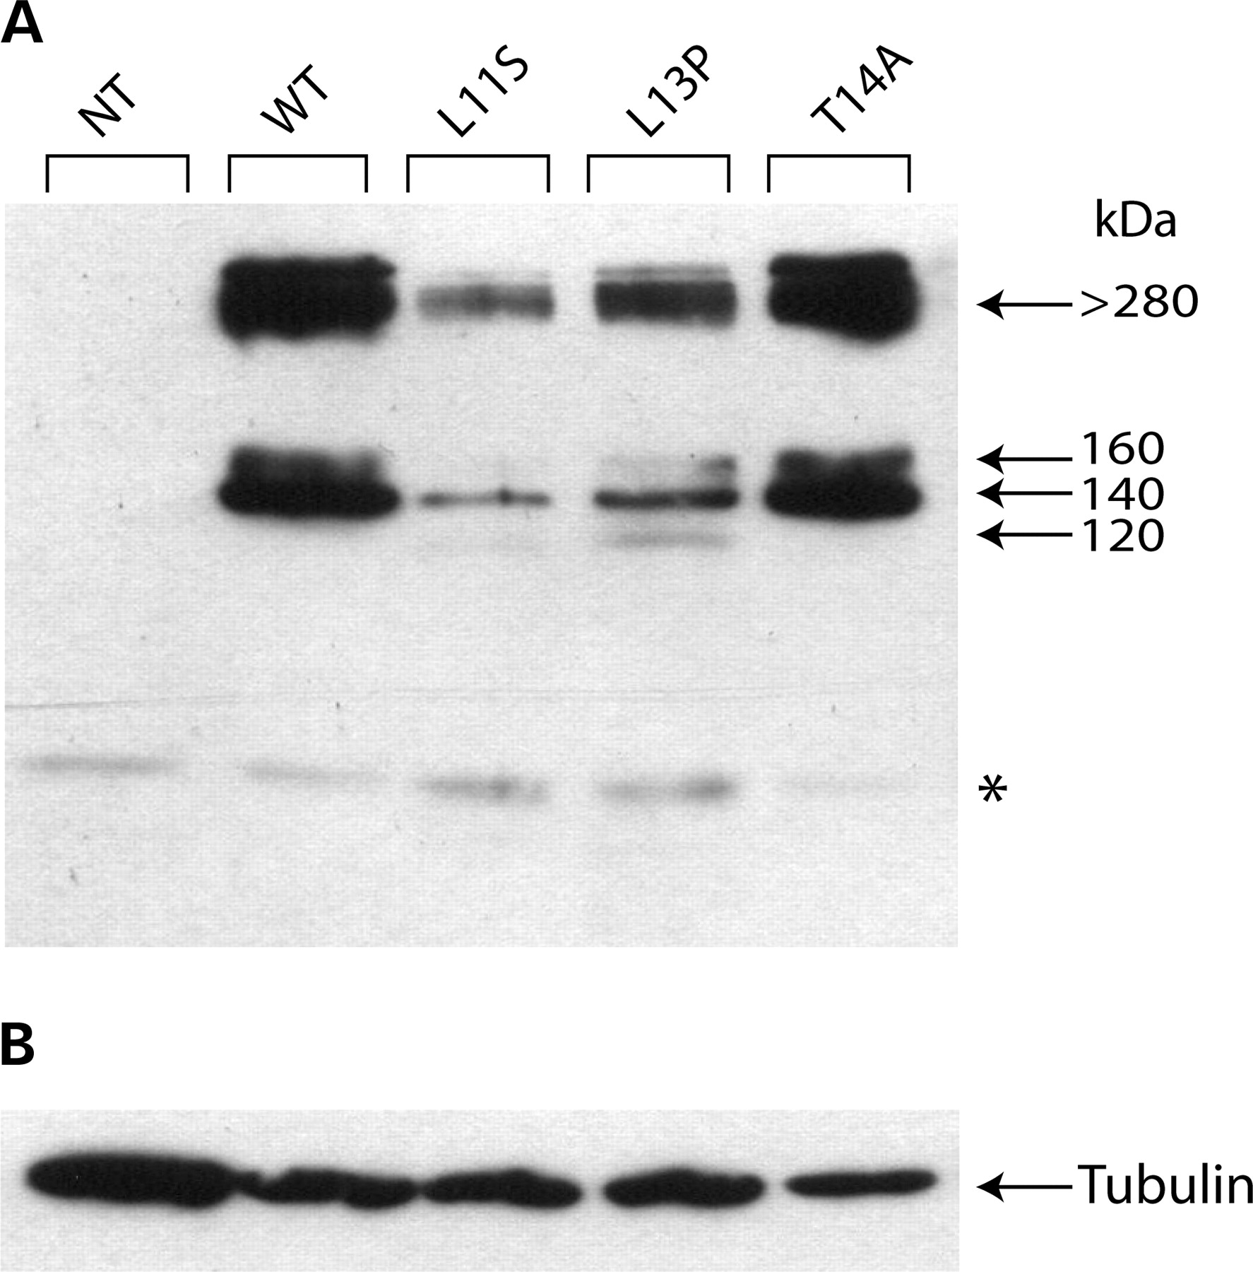
Figure 2. Expression levels of wild-type and mutant CASRs in transfected human kidney cells. Western blot ...
Notes:
Figure 2. Expression levels of wild-type and mutant CASRs in transfected human kidney cells. Western blot analysis was performed as described in Materials and Methods on extracts of HEK293 cells either mock-transfected (NT) or transiently transfected with wild-type (WT) or mutant (L11S, L13P, T14A) c-Myc-tagged CASR cDNAs. (A) Proteins stained with a c-Myc tag monoclonal antibody, 9E10 (asterisk indicates endogenous c-Myc); (B) Endogenous proteins stained with a β-tubulin antibody.
Unless provided in the caption above, the following copyright applies to the content of this slide: © The Author 2005. Published by Oxford University Press. All rights reserved. For Permissions, please email: journals.permissions@oupjournals.org

Slide 3
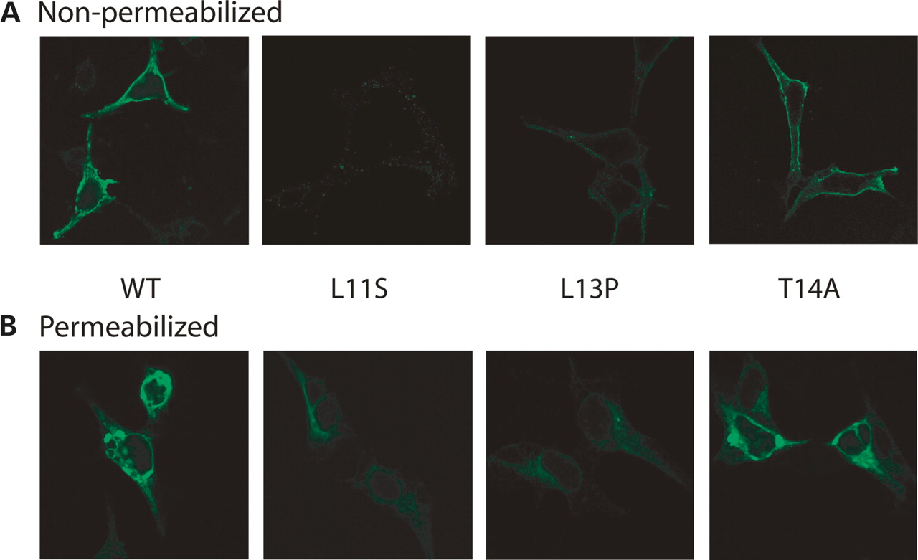
Figure 3. Plasma membrane and intracellular expression of wild-type and mutant CASRs in transfected human ...
Notes:
Figure 3. Plasma membrane and intracellular expression of wild-type and mutant CASRs in transfected human kidney cells. Fluorescence immunocytochemistry and confocal microscopy was performed as described in Materials and Methods on extracts of HEK293 cells transiently transfected with wild-type (WT) or mutant (L11S, L13P, T14A) c-Myc-tagged CASR cDNAs. Immunostaining was performed with c-Myc monoclonal antibody 9E10, and detection was made with goat anti-mouse FITC-conjugated secondary antibody. Examples of fields of (A) non-permeabilized cells and (B) permeabilized cells. Magnification: 600×.
Unless provided in the caption above, the following copyright applies to the content of this slide: © The Author 2005. Published by Oxford University Press. All rights reserved. For Permissions, please email: journals.permissions@oupjournals.org

Slide 4
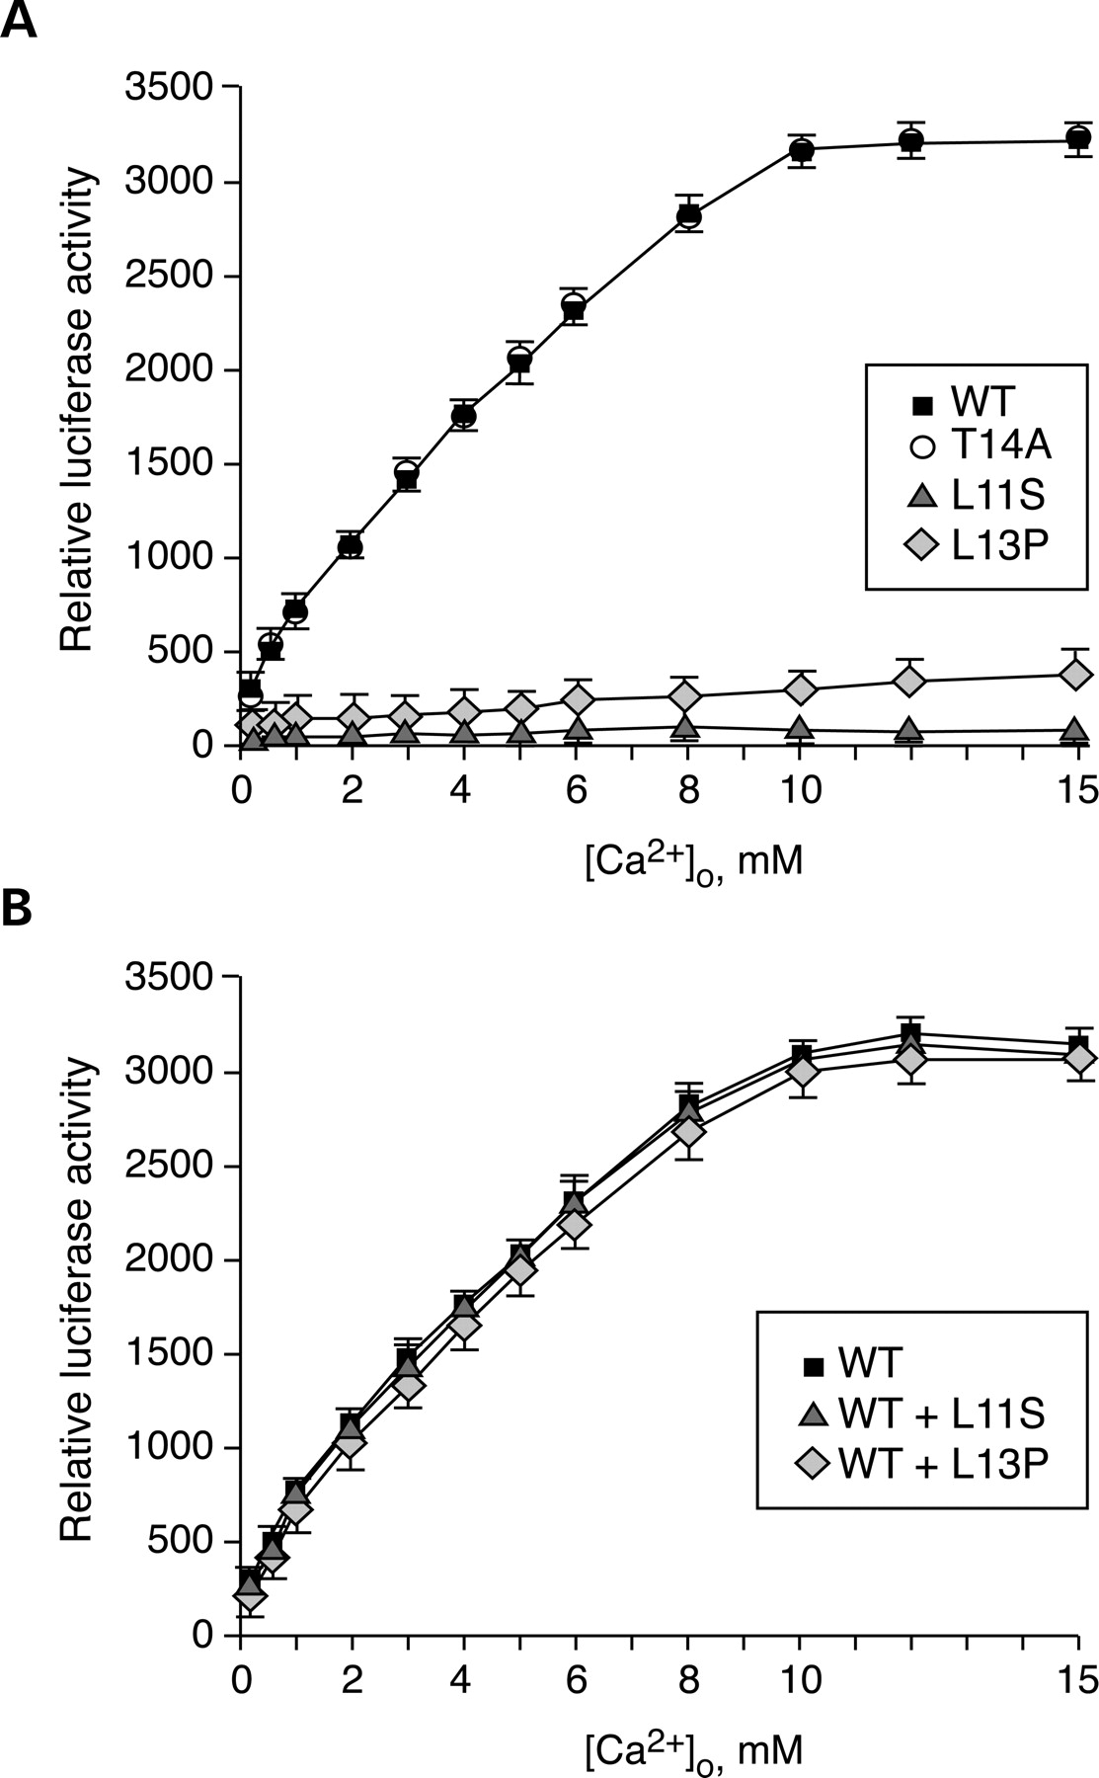
Figure 4. Cell signaling of wild-type and mutant CASRs in transfected human kidney cells. (A) Extracellular ...
Notes:
Figure 4. Cell signaling of wild-type and mutant CASRs in transfected human kidney cells. (A) Extracellular calcium-evoked increases in MAPK activity in HEK293 cells transiently transfected with either wild-type (WT) or mutant (L11S, L13P, T14A) CASR cDNAs and a MAPK trans-reporting system were assessed as described in Materials and Methods. Values shown are mean (n=4); the SE values are shown for WT and L13P, above, and for T14A and L11S, below, the values, respectively. (B) Extracellular calcium-evoked increase in MAPK activity in cells transiently transfected with either WT alone, or WT and L11S, or WT and L13P CASR cDNAs. Values shown are mean (n=4); the SE's are shown for WT and WT+L11S, above, and for WT+L13P, below, the values, respectively.
Unless provided in the caption above, the following copyright applies to the content of this slide: © The Author 2005. Published by Oxford University Press. All rights reserved. For Permissions, please email: journals.permissions@oupjournals.org

Slide 5
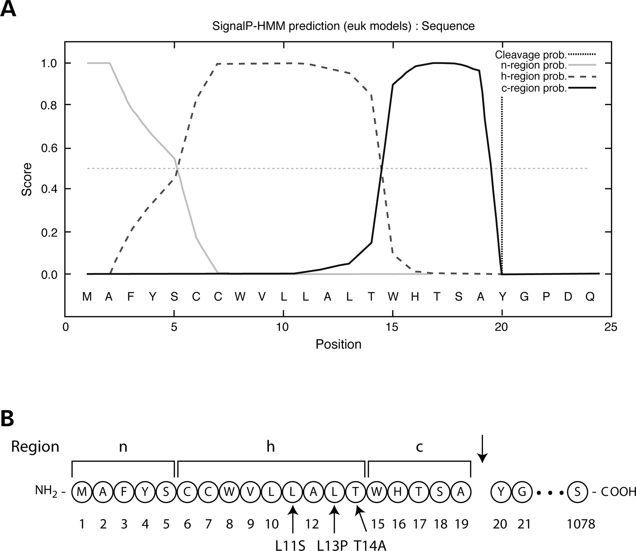
Figure 5. Signal peptide of the CASR. The probability that the N-terminal region of the CASR constitutes a ...
Notes:
Figure 5. Signal peptide of the CASR. The probability that the N-terminal region of the CASR constitutes a signal peptide was examined with the SignalP-HMM program (version 3.0) as described in Materials and Methods. (A) A highly significant probability score was obtained and the positions of the n-, h- and c-regions were predicted in addition to a signal peptide cleavage site between amino acids 19 and 20. (B) A summary of the SignalP predictions. The CASR mutations in the hydrophobic core are arrowed.
Unless provided in the caption above, the following copyright applies to the content of this slide: © The Author 2005. Published by Oxford University Press. All rights reserved. For Permissions, please email: journals.permissions@oupjournals.org

Slide 6
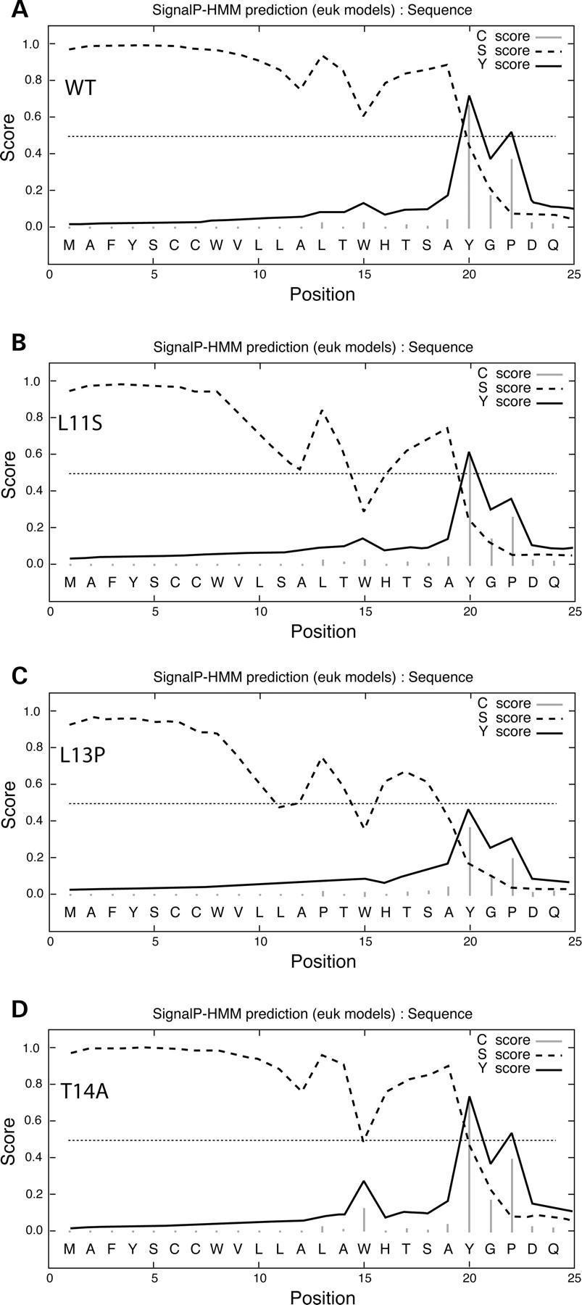
Figure 6. Comparison of the signal peptides of CASR wild-type and mutants. The N-terminal regions of the CASR ...
Notes:
Figure 6. Comparison of the signal peptides of CASR wild-type and mutants. The N-terminal regions of the CASR wild-type (WT) and mutants (L11S, L13P, T14A) were analyzed with the SignalP-NN program (version 3.0) as described in Materials and Methods. Attainment of signal peptide prediction (s-), cleavage site prediction (c-) and derived cleavage site prediction (y-) scores >50% cutoff values indicate proper signal peptide function and cleavage, whereas values below the cutoff indicate compromised function.
Unless provided in the caption above, the following copyright applies to the content of this slide: © The Author 2005. Published by Oxford University Press. All rights reserved. For Permissions, please email: journals.permissions@oupjournals.org

Slide 7
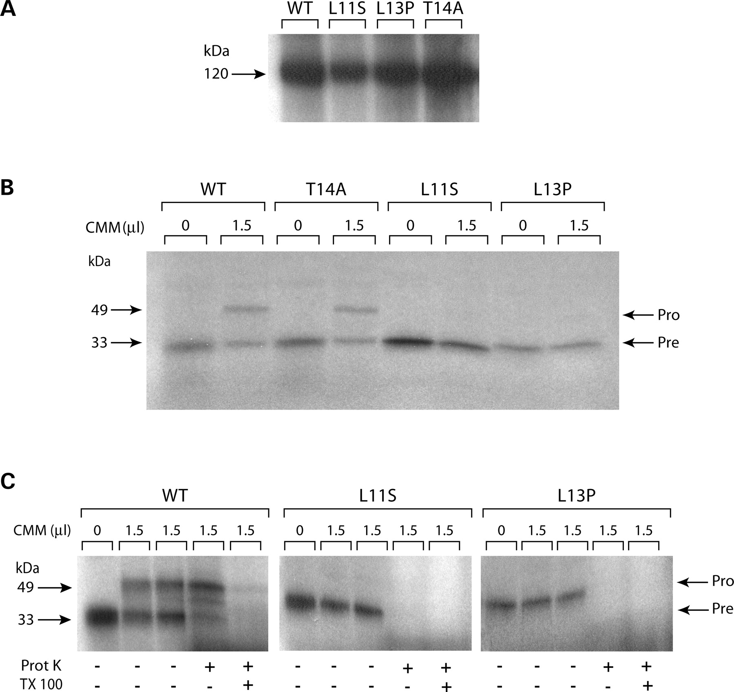
Figure 7. CASR and the early secretory pathway. The ability of CASR wild-type (WT) and mutant (L11S, L13P, ...
Notes:
Figure 7. CASR and the early secretory pathway. The ability of CASR wild-type (WT) and mutant (L11S, L13P, T14A) RNAs to be (A) translated, the nascent polypeptide chains to undergo (B) core glycosylation or (C) translocation into microscomal vesicles were assessed as described in Materials and Methods. CMM, canine microsomal membranes; Prot K, proteinase K; TX-100, Triton X-100; Pre, preprotein, Pro, processed protein.
Unless provided in the caption above, the following copyright applies to the content of this slide: © The Author 2005. Published by Oxford University Press. All rights reserved. For Permissions, please email: journals.permissions@oupjournals.org

Slide 8
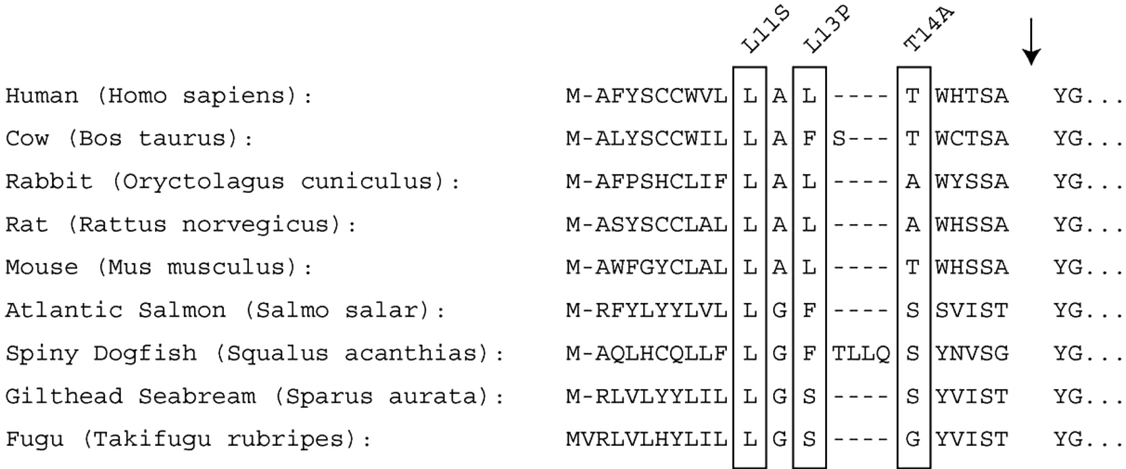
Figure 8. Alignment of CASR signal peptide sequences. The CASR signal peptide sequences from diverse species ...
Notes:
Figure 8. Alignment of CASR signal peptide sequences. The CASR signal peptide sequences from diverse species were aligned with Clustal W as described in Materials and Methods. The residues corresponding to the mutations identified in the human CASR (L11S, L13P, T14A) are boxed.
Unless provided in the caption above, the following copyright applies to the content of this slide: © The Author 2005. Published by Oxford University Press. All rights reserved. For Permissions, please email: journals.permissions@oupjournals.org

