Slide 1
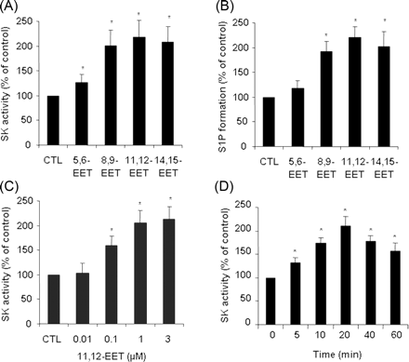
Figure 1 Activation of sphingosine kinase (SK) by epoxyeicosatrienoic acids (EETs) in human umbilical vein endothelial ...
Notes:
Figure 1 Activation of sphingosine kinase (SK) by epoxyeicosatrienoic acids (EETs) in human umbilical vein endothelial cells (HUVECs). (A) Quiescent HUVECs were treated with vehicle or 1 µmol/L EETs for 20 min, SK activity was then measured. n = 3. *P < 0.05 vs. vehicle control (CTL). (B) Measurements of S1P levels after treatment of quiescent HUVECs with either vehicle or 1 µmol/L EETs for 20 min. The data are representative of three independent experiments. *P < 0.05 vs. CTL. (C) Dose-dependent effect of 11,12-EET on SK activation. Quiescent HUVECs were treated with vehicle or 11,12-EET at the indicated concentrations for 20 min, SK activity was then measured. n = 3. *P < 0.05 vs. CTL. (D) Activity assay showing the time-dependent effects of 11,12-EET on SK activation. The data are representative of three independent experiments. *P < 0.05 vs. 0 h.
Unless provided in the caption above, the following copyright applies to the content of this slide: Published on behalf of the European Society of Cardiology. All rights reserved. © The Author 2008. For permissions please email: journals.permissions@oxfordjournals.org

Slide 2
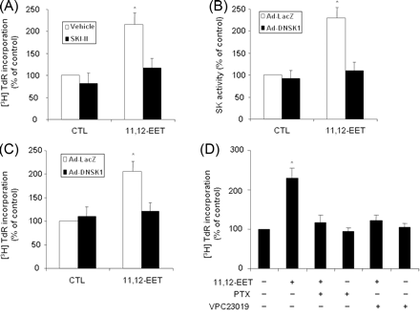
Figure 2 Role of sphingosine kinase (SK) activation in 11,12-epoxyeicosatrienoic acid (EET)-induced endothelial cell ...
Notes:
Figure 2 Role of sphingosine kinase (SK) activation in 11,12-epoxyeicosatrienoic acid (EET)-induced endothelial cell (EC) proliferation. (A) Quiescent human umbilical vein endothelial cells (HUVECs) were pretreated with vehicle or 3 µmol/L SKI-II for 1 h, and 11,12-EET (1 µmol/L) stimulated cell proliferation was then measured by [3H]-thymidine (3H-TdR) incorporation. (B) HUVECs were transduced with Ad-LacZ or Ad-DNSK1 at MOI = 100 for 48 h, and SK activity was measured after exposure to 1 µmol/L 11,12-EET for 20 min. (C) HUVECs were transduced with Ad-LacZ or Ad-DNSK1 at MOI = 100 for 48 h. 11,12-EET (1 µmol/L) stimulated cell proliferation was then measured by 3H-TdR incorporation. The data are representatives of three independent experiments. *P < 0.05 vs. vehicle control (CTL). (D) 11,12-EET (1 µmol/L) induced cell proliferation was measured in HUVECs treated with either PTX (100 ng/mL) or VPC23019 (10 µmol/L). The data are representative of four independent experiments. *P < 0.05 vs. 11,12-EET + PTX or 11,12-EET + VPC23019.
Unless provided in the caption above, the following copyright applies to the content of this slide: Published on behalf of the European Society of Cardiology. All rights reserved. © The Author 2008. For permissions please email: journals.permissions@oxfordjournals.org

Slide 3
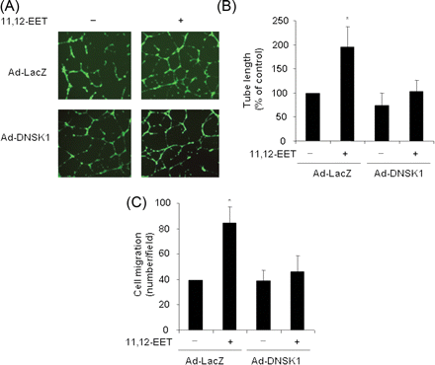
Figure 3 Role of sphingosine kinase (SK) in 11,12-epoxyeicosatrienoic acid (EET)-induced angiogenesis. (A) Human ...
Notes:
Figure 3 Role of sphingosine kinase (SK) in 11,12-epoxyeicosatrienoic acid (EET)-induced angiogenesis. (A) Human umbilical vein endothelial cells (HUVECs) were transduced with Ad-LacZ or Ad-DNSK1 at MOI = 100 for 24 h, and the cells were then starved in M-199 containing 1% FBS for 24 h. HUVECs (n = 8 per group) were treated with or without 11,12-EET, and capillary-like tube-formation was assessed (see Methods for details). Representative fields for Matrigel-based capillary-like tube formation at ×40 magnification are shown. (B) Quantitative analysis of overexpression of DNSK1 on 11,12-EET (1 µmol/L) stimulated tube formation. The data are representative of three independent experiments. *P < 0.05 vs. AdDNSK1 + 11,12-EET. (C) Effect of overexpression of DNSK1 on 11,12-EET (1 µmol/L)-stimulated endothelial cell migration. Cell migration was measured in 11,12-EET-stimulated HUVECs transduced with either Ad-LacZ or AdDNSK1 (MOI = 100) for 48 h. The data are representative of three independent experiments. *P < 0.05 vs. Ad-DNSK1 + 11,12-EET.
Unless provided in the caption above, the following copyright applies to the content of this slide: Published on behalf of the European Society of Cardiology. All rights reserved. © The Author 2008. For permissions please email: journals.permissions@oxfordjournals.org

Slide 4
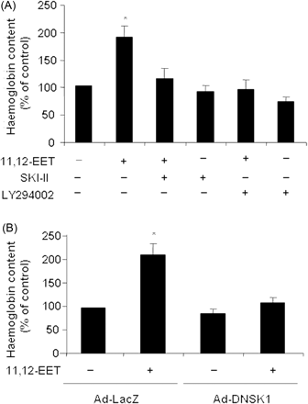
Figure 4 Inhibition of sphingosine kinase-1 (SK1) suppresses 11,12-epoxyeicosatrienoic acid (EET)-induced Matrigel ...
Notes:
Figure 4 Inhibition of sphingosine kinase-1 (SK1) suppresses 11,12-epoxyeicosatrienoic acid (EET)-induced Matrigel plug angiogenesis in vivo. (A) C57BL/6 mice were injected subcutaneously with 0.5 mL Matrigel premixed with vehicle or 100 µmol/L 11,12-EET with and without SKI-II (3 µmol/L) or LY294002 (250 µmol/L). one week later, the Matrigel plugs were harvested for haemoglobin with Drabkin’s reagent. The data are representative of three independent experiments. *P < 0.05 vs. 11,12-EET + SKI-II or 11,12-EET + LY294002. (B) C57BL/6 mice were injected subcutaneously with 0.5 mL of Matrigel premixed with vehicle or 100 µmol/L 11,12-EET with and without Ad-LacZ or Ad-DNSK1. Two weeks later, the Matrigel plugs were harvested for haemoglobin with Drabkin’s reagent. The data are representative of three independent experiments. *P < 0.05 vs. 11,12-EET + Ad-DNSK1.
Unless provided in the caption above, the following copyright applies to the content of this slide: Published on behalf of the European Society of Cardiology. All rights reserved. © The Author 2008. For permissions please email: journals.permissions@oxfordjournals.org

Slide 5
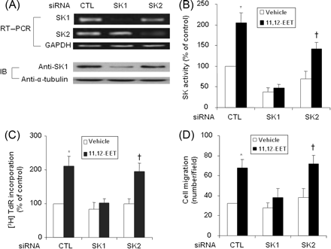
Figure 5 Effects of siRNA mediated knockdown of sphingosine kinase (SK) on 11,12-epoxyeicosatrienoic acid ...
Notes:
Figure 5 Effects of siRNA mediated knockdown of sphingosine kinase (SK) on 11,12-epoxyeicosatrienoic acid (EET)-induced cell proliferation and migration. (A) The expression of SK1 and SK2 was determined by RT–PCR and immunoblotting analysis (IB) in human umbilical vein endothelial cells (HUVECs) transfected with control (CTL) siRNA and SK specific siRNAs for 48 h. (B) HUVECs were transfected with CTL siRNA and SK1 and SK2 specific siRNAs for 48 h. SK activity was then measured after exposure to 1 µmol/L 11,12-EET for 20 min. The data are representative of three independent experiments. *P < 0.05 vs. vehicle + CTL siRNA. †P < 0.05 vs. vehicle + SK2 siRNA. (C) HUVECs were transfected with SK1 and SK2 specific siRNAs for 48 h, and 11,12-EET (1 µmol/L) stimulated cell proliferation was then determined. The data are representative of four independent experiments. *P < 0.05 vs. 11,12-EET + SK1 siRNA. †P < 0.05 vs. vehicle + SK2 siRNA. (D) HUVECs were transfected with SK1 and SK2 specific siRNAs for 48 h. 11,12-EET (1 µmol/L) stimulated endothelial cell migration was then determined. The data are representative of three independent experiments. *P < 0.05 vs. 11,12-EET+SK1 siRNA. †P < 0.05 vs. vehicle + SK2 siRNA.
Unless provided in the caption above, the following copyright applies to the content of this slide: Published on behalf of the European Society of Cardiology. All rights reserved. © The Author 2008. For permissions please email: journals.permissions@oxfordjournals.org

Slide 6
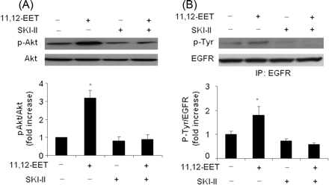
Figure 6 A, Effects of sphingosine kinase (SK) inhibitor SKI-II on 11,12-EET-induced Akt phosphorylation. Quiescent ...
Notes:
Figure 6 A, Effects of sphingosine kinase (SK) inhibitor SKI-II on 11,12-EET-induced Akt phosphorylation. Quiescent human umbilical vein endothelial cells (HUVECs) were pretreated with 3 µmol/L SKI-II for 1 h and then stimulated with 1 µmol/L 11,12-epoxyeicosatrienoic acid (EET) for 30 min. Cell lyastes (30 µg of protein per lane) were subjected to western blot with anti-Akt and anti-phospho-Akt antibodies. Phosphorylation levels for Akt was were quantitated by densitometry. The data are representative of three independent experiments. *P < 0.05 vs. vehicle alone or 11,12-EET + SKI-II. (B) Effects of SK inhibitor SKI-II on the transactivation of epidermal growth factor receptor (EGFR). Quiescent HUVECs were pretreated with 3 µmol/L SKI-II for 1 h and then stimulated with 1 µmol/L 11,12-EET for 30 min. Cell lyastes (500 µg) were subjected to immunoprecipitation with anti-EGFR antibody and then western blot with anti-phospho-tyrosine and anti-EGFR antibodies. Phosphorylation levels for EGFR were quantitated by densitometry. The data are representative of three independent experiments. *P < 0.05 vs. vehicle alone or 11,12-EET + SKI-II.
Unless provided in the caption above, the following copyright applies to the content of this slide: Published on behalf of the European Society of Cardiology. All rights reserved. © The Author 2008. For permissions please email: journals.permissions@oxfordjournals.org

