Slide 1
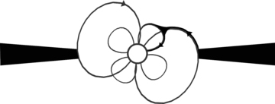
Figure 1 Schematic depiction of the accretion flow from the disc on to the neutron star magnetosphere with misaligned ...
Notes:
Figure 1 Schematic depiction of the accretion flow from the disc on to the neutron star magnetosphere with misaligned dipole and quadrupole fields. The figure shows the plane of the rotation axis and the dipole symmetry axis. Only one path of accretion is shown. The symmetry is broken further when the quadrupole axis lies outside this plane. The dark lines indicate the locations of high-density pockets and matter flow towards the star.
Unless provided in the caption above, the following copyright applies to the content of this slide: © 2012 The Author Monthly Notices of the Royal Astronomical Society © 2012 RAS

