Slide 1
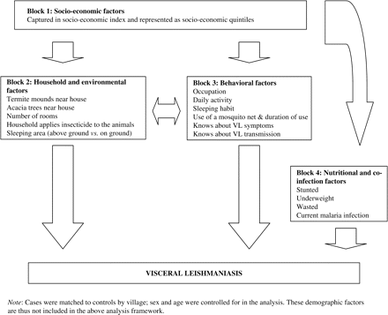
Figure 1 Framework for socio-economic, household/environmental, behavioural and nutritional/co-infection variables and ...
Notes:
Figure 1 Framework for socio-economic, household/environmental, behavioural and nutritional/co-infection variables and being infected with visceral leishmaniasis in the Pokot county, East Africa. This approach distinguishes between distal and proximate factors: distal factors rarely have a direct effect on disease outcomes but operate through a number of inter-related proximate determinants, which in turn affects directly risk of disease. For example, SES does not affect directly the risk of VL but may affect VL indirectly through, for example, (i) the likelihood of sleeping outdoors or ownership of bed net, both of which influence in turn the risk of exposure to biting by sandflies or (ii) individual nutritional status which influences susceptibility to disease
Unless provided in the caption above, the following copyright applies to the content of this slide: Published by Oxford University Press on behalf of the International Epidemiological Association © The Author 2008; all rights reserved.

