Slide 1
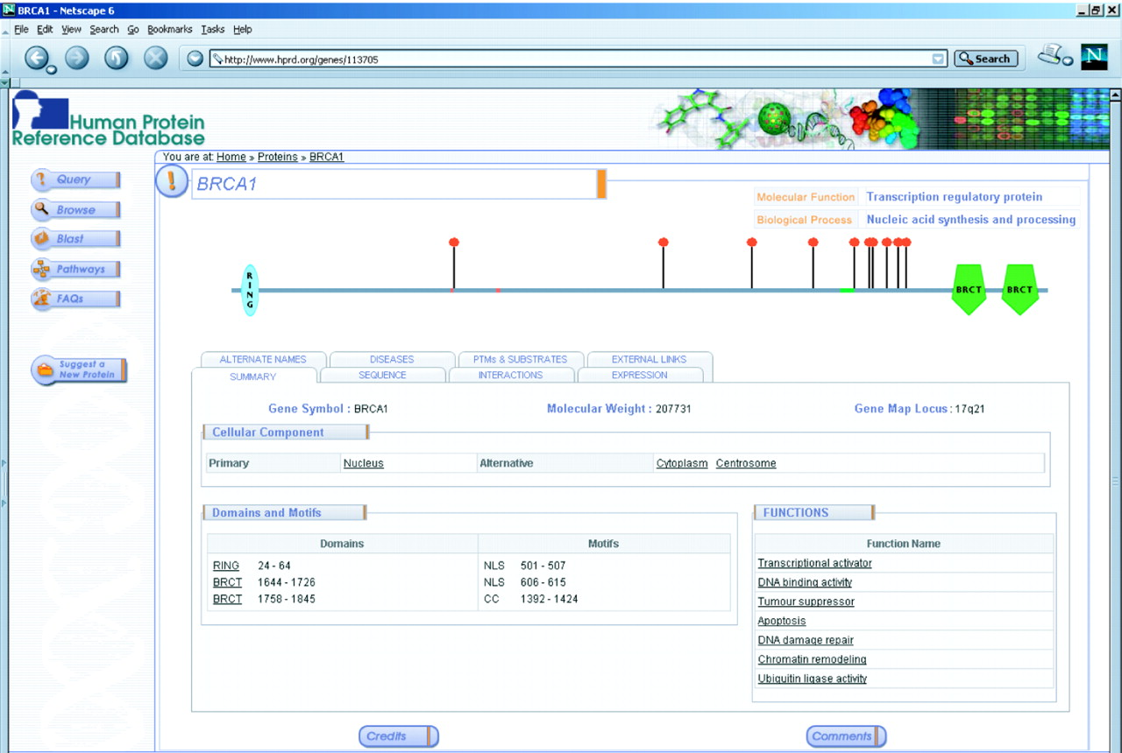
Figure 1. A screenshot of the molecule page for BRCA1. The molecule page serves as the entry point for ...
Notes:
Figure 1. A screenshot of the molecule page for BRCA1. The molecule page serves as the entry point for accessing detailed annotation of proteins in HPRD. Molecular function and biological process for each molecule are indicated at the top right with a graphic representation of the protein domains and motifs and PTMs displayed in the middle. Under the summary tab, the HUGO gene symbol, the calculated molecular weight and the gene locus are indicated along with the cellular component, which refers to subcellular localization. The extent of domains and motifs is shown under the summary tab but can also be accessed by mousing over an individual region or motif in the graph. All underlined text is linked to PubMed entries that provide further details or to a database source.
Unless provided in the caption above, the following copyright applies to the content of this slide: Oxford University Press

Slide 2
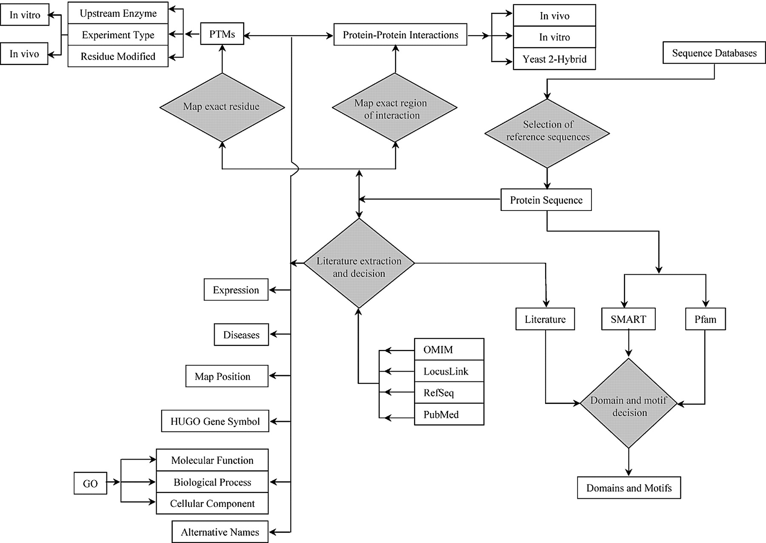
Figure 2. A schematic outlining the basic steps in the annotation procedure. The annotations are carried out ...
Notes:
Figure 2. A schematic outlining the basic steps in the annotation procedure. The annotations are carried out by trained biologists who critically read the published literature. The entries to be annotated are carefully selected from all the existing database entries by BLAST analysis ( 6 ) as well as manual inspection to provide the reference sequence. Interpretive annotation steps are represented by orange diamonds in the schematic. For instance, the annotator performs domain and motif analysis using the SMART ( 7 ) and Pfam ( 8 ) programs as well as by reading the literature. The OMIM database is used for disease annotations ( 9 ), and RefSeq and LocusLink ( 10 ) for sequences and links to other databases.
Unless provided in the caption above, the following copyright applies to the content of this slide: Oxford University Press

Slide 3
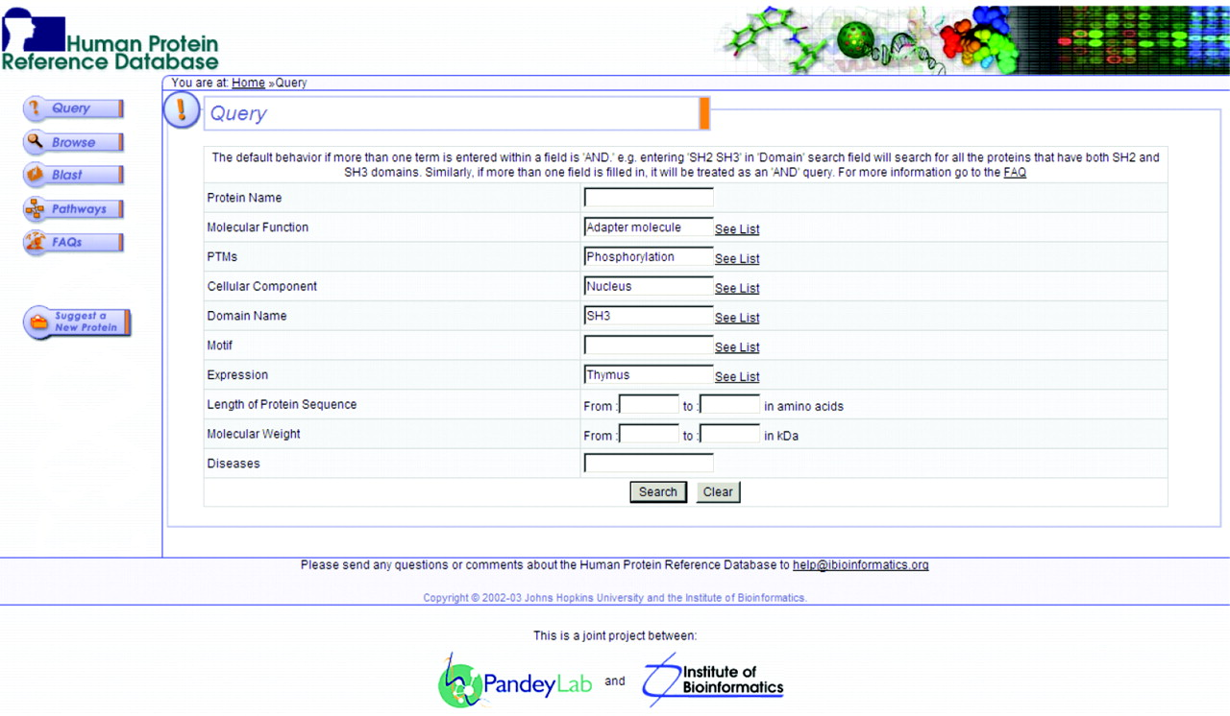
Figure 3. A screenshot of the query page in HPRD. A user can search multiple annotation fields to retrieve ...
Notes:
Figure 3. A screenshot of the query page in HPRD. A user can search multiple annotation fields to retrieve protein entries based on protein name, molecular function, PTMs, cellular component, domains, motifs, tissue expression, length, molecular weight and diseases. The query system allows Boolean searches and the query terms are provided as pop‐up lists for query fields other than protein name and diseases. Wild card searches using * are permitted by the query engine. Querying multiple search fields is processed as an ‘AND’ type of query by default. For example, a search for an adapter molecule, phosphorylation, nucleus, SH3 domain and thymus, as shown in the figure will retrieve a single entry for the Fyn binding protein, FYB, which satisfies all these parameters.
Unless provided in the caption above, the following copyright applies to the content of this slide: Oxford University Press

Slide 4
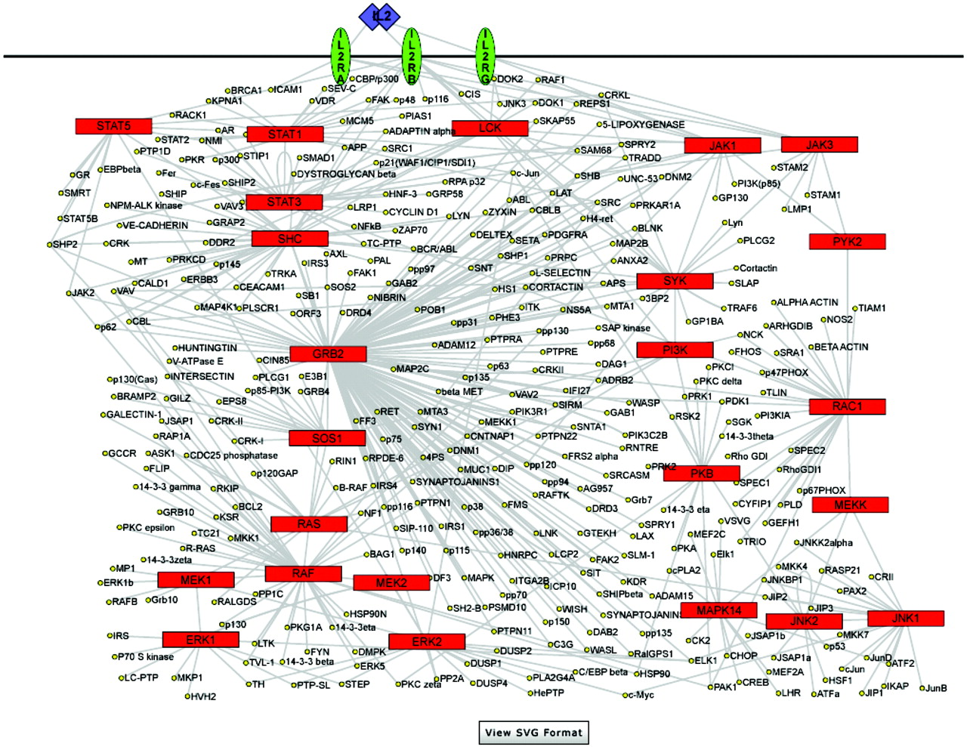
Figure 4. Visualizing protein interaction networks in HPRD. The interleukin‐2 receptor pathway is shown with ...
Notes:
Figure 4. Visualizing protein interaction networks in HPRD. The interleukin‐2 receptor pathway is shown with red boxes indicating the major signaling molecules in the pathway and yellow circles representing the interaction partners. The pathways are displayed as jpeg images by default with the option of viewing them as SVG images by clicking on the ‘view SVG format’ button at the bottom. With an appropriate SVG viewer plug‐in, a user is able to visualize the network with additional functionalities such as zoom operations, a search function within the pathway, a hand tool for maneuvering the figure and links to individual molecule pages by clicking on the name of any protein.
Unless provided in the caption above, the following copyright applies to the content of this slide: Oxford University Press

