Slide 1
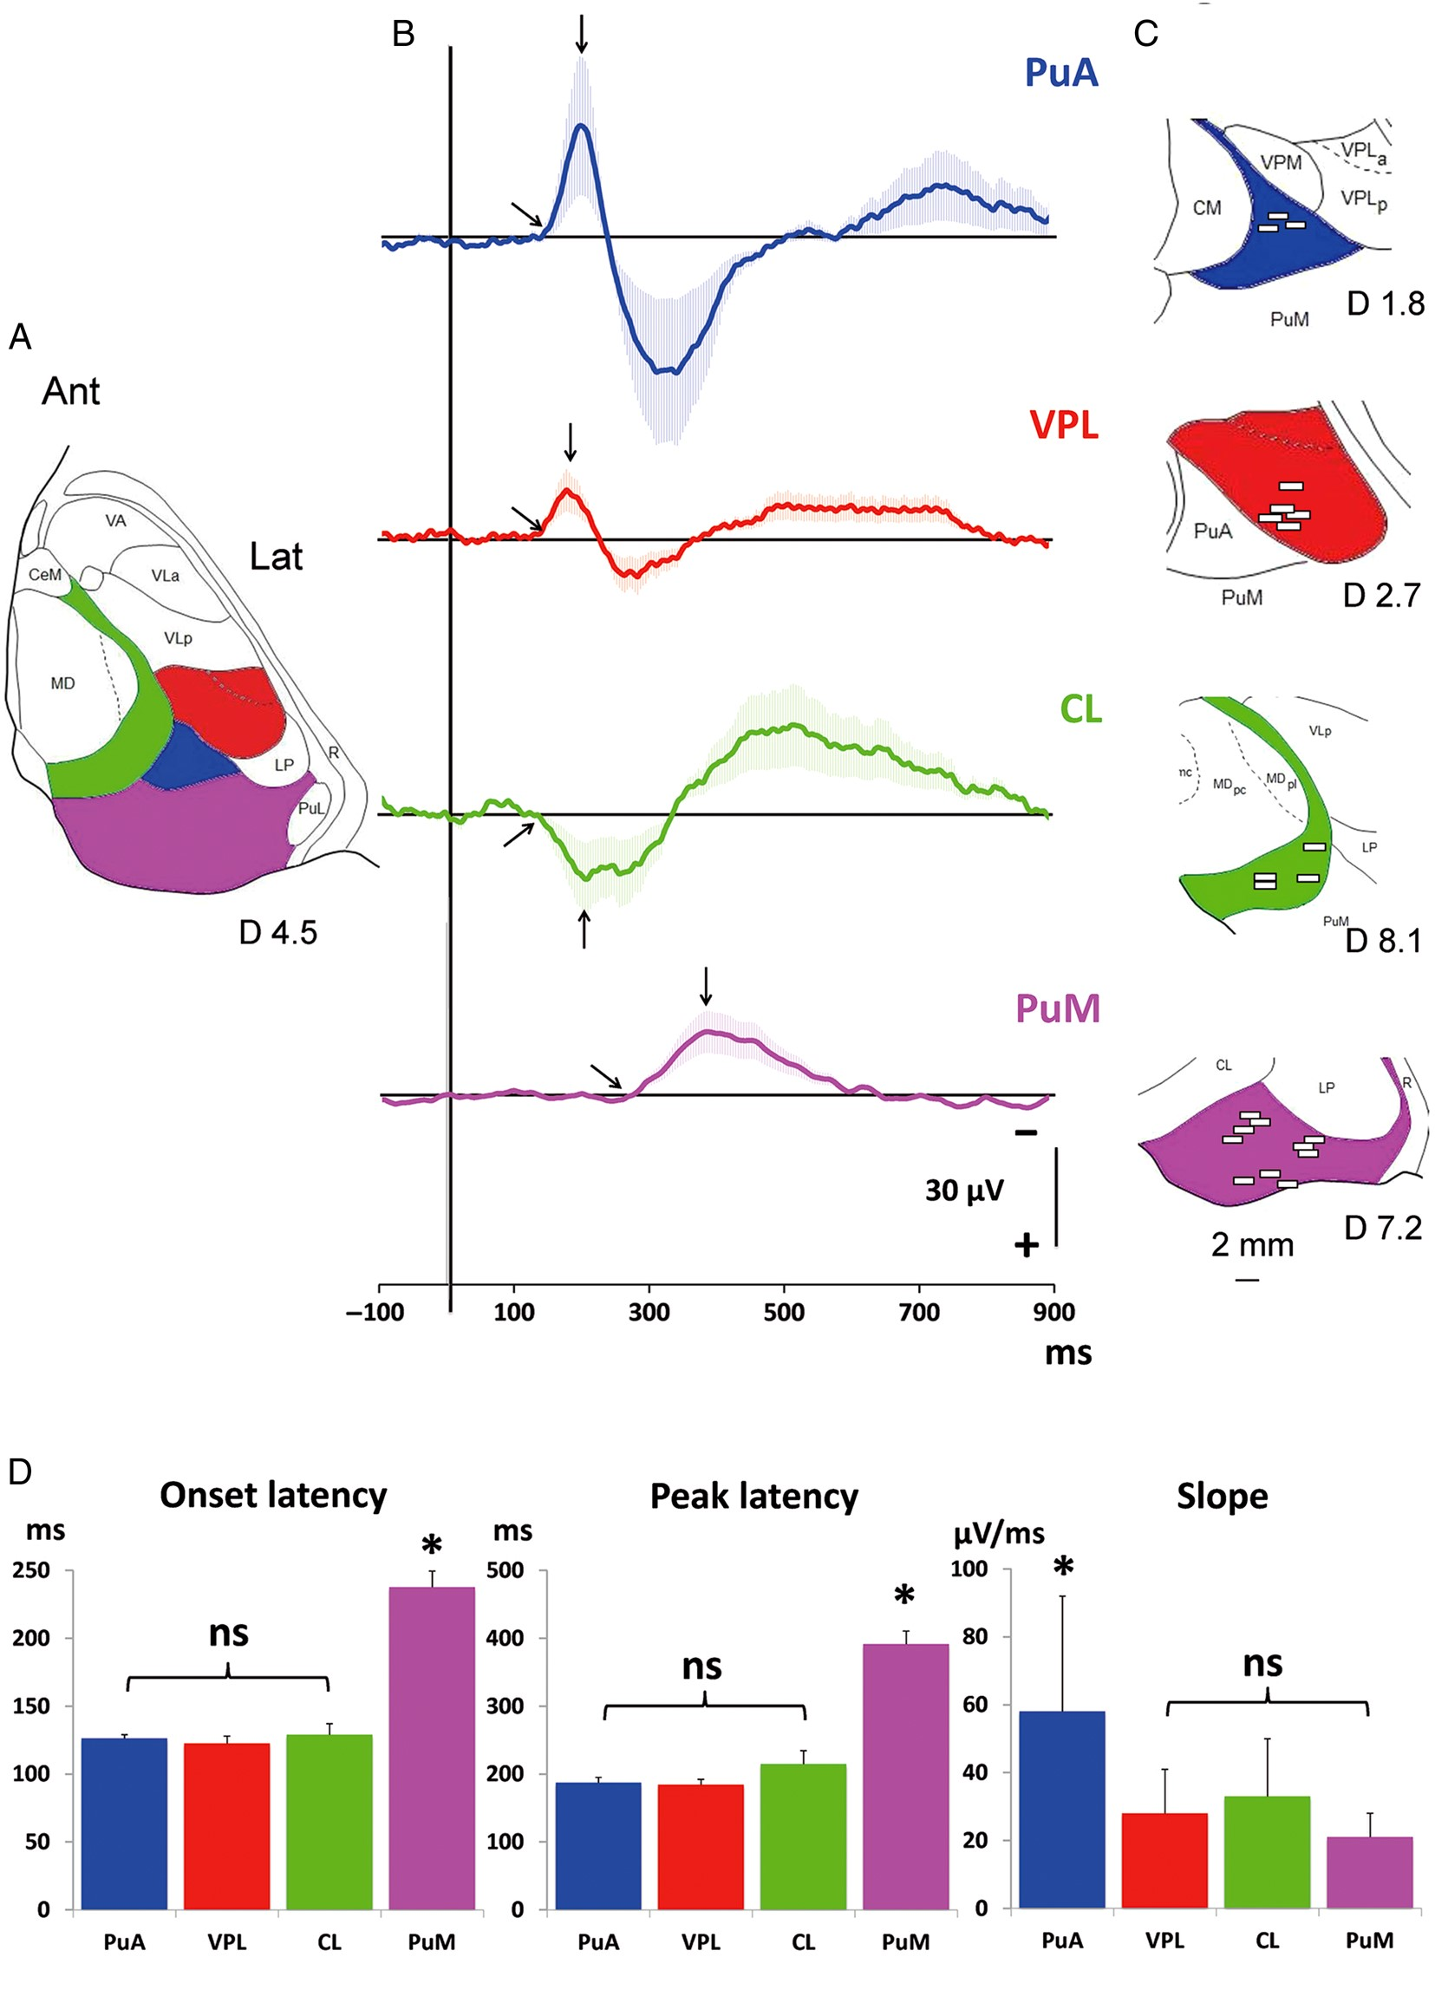
Figure 1. Characteristics of the nociceptive responses in the 4 thalamic nuclei recorded. (A) Horizontal section of the ...
Notes:
Figure 1. Characteristics of the nociceptive responses in the 4 thalamic nuclei recorded. (A) Horizontal section of the stereotactic Morel's atlas (1997) 4.5 mm above AC/PC showing the 4 thalamic nuclei. (B) Grand averages (±SEM) of responses obtained in each nucleus. The arrows indicate the onset and peak of the responses. (C) Enlargements of horizontal sections of the stereotactic Morel's atlas (1997) focused on each nucleus show the contact localizations at which responses were recorded in each patient. Contacts in the left thalamus were X-flipped to the right one. (D) Graphs showing for each nucleus the mean latencies (±SEM) of onset and peak of the first response component and its slope (amplitude/duration from onset to peak). Note that response onset in PuM is significantly delayed when compared with those recorded in the 3 other nuclei and that the slope of the PuA response is steeper when compared with the others.
Unless provided in the caption above, the following copyright applies to the content of this slide: © The Author 2015. Published by Oxford University Press. All rights reserved. For Permissions, please e-mail: journals.permissions@oup.com

Slide 2
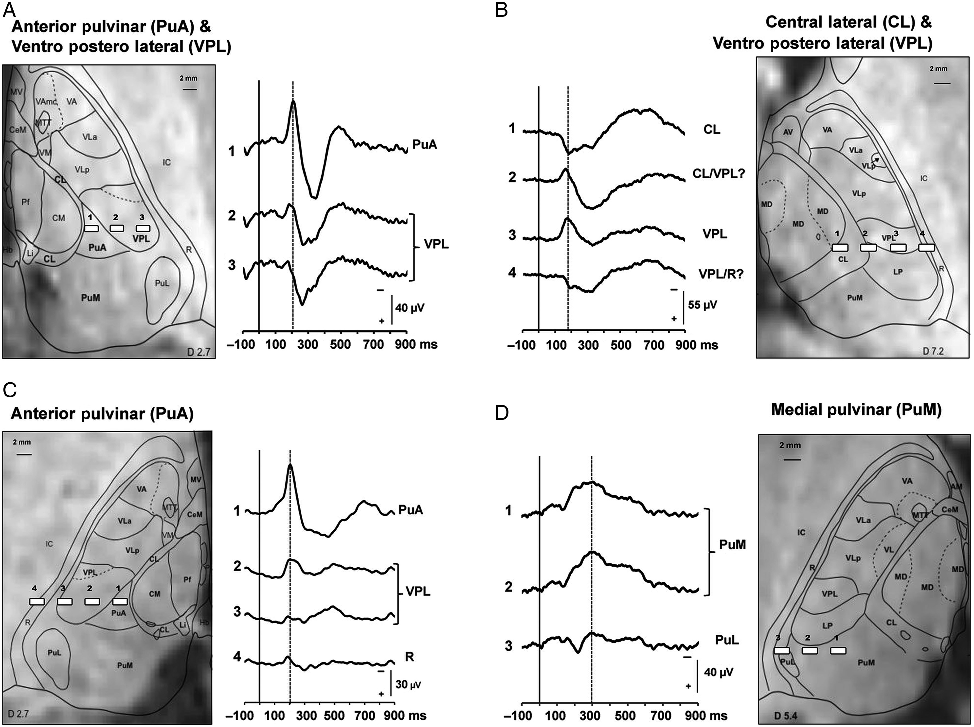
Figure 2. Thalamic evoked responses to nociceptive laser stimuli obtained in 4 patients. Horizontal preimplantation MR ...
Notes:
Figure 2. Thalamic evoked responses to nociceptive laser stimuli obtained in 4 patients. Horizontal preimplantation MR images are centered on the stereotactic dorsoventral coordinate corresponding to electrode positions. The localization of the different contacts, determined on postimplantation MR images, is numbered from medial to lateral. The corresponding planes of Morel's atlas (1997) are superimposed on MR images in each patient. LEP recorded from the different contacts are shown in referential mode. (A) LEP recorded in PuA and VPL (20 stimuli). Note the significantly larger amplitude of the averaged PuA response. (B) LEP recorded in CL and VPL (30 stimuli). A polarity reversal is observed between contacts 3–4 supporting local origin within VPL. A second aspect of polarity reversal is also observed between contacts 1–2, but its meaning is difficult to ascertain since contact 2 appears to overlap CL, VPL, and LP nuclei, its response being probably dominated by the VPL response. Note the difference in LEP morphology between responses recorded in these 2 thalamic nuclei. (C) LEP recorded in PuA and VPL (25 stimuli). Note the difference in amplitudes between the 2 nuclei. (D) LEP recorded in PuM (15 stimuli). Note the delayed response in PuM compared with LEPs recorded in the 3 other thalamic nuclei.
Unless provided in the caption above, the following copyright applies to the content of this slide: © The Author 2015. Published by Oxford University Press. All rights reserved. For Permissions, please e-mail: journals.permissions@oup.com

Slide 3
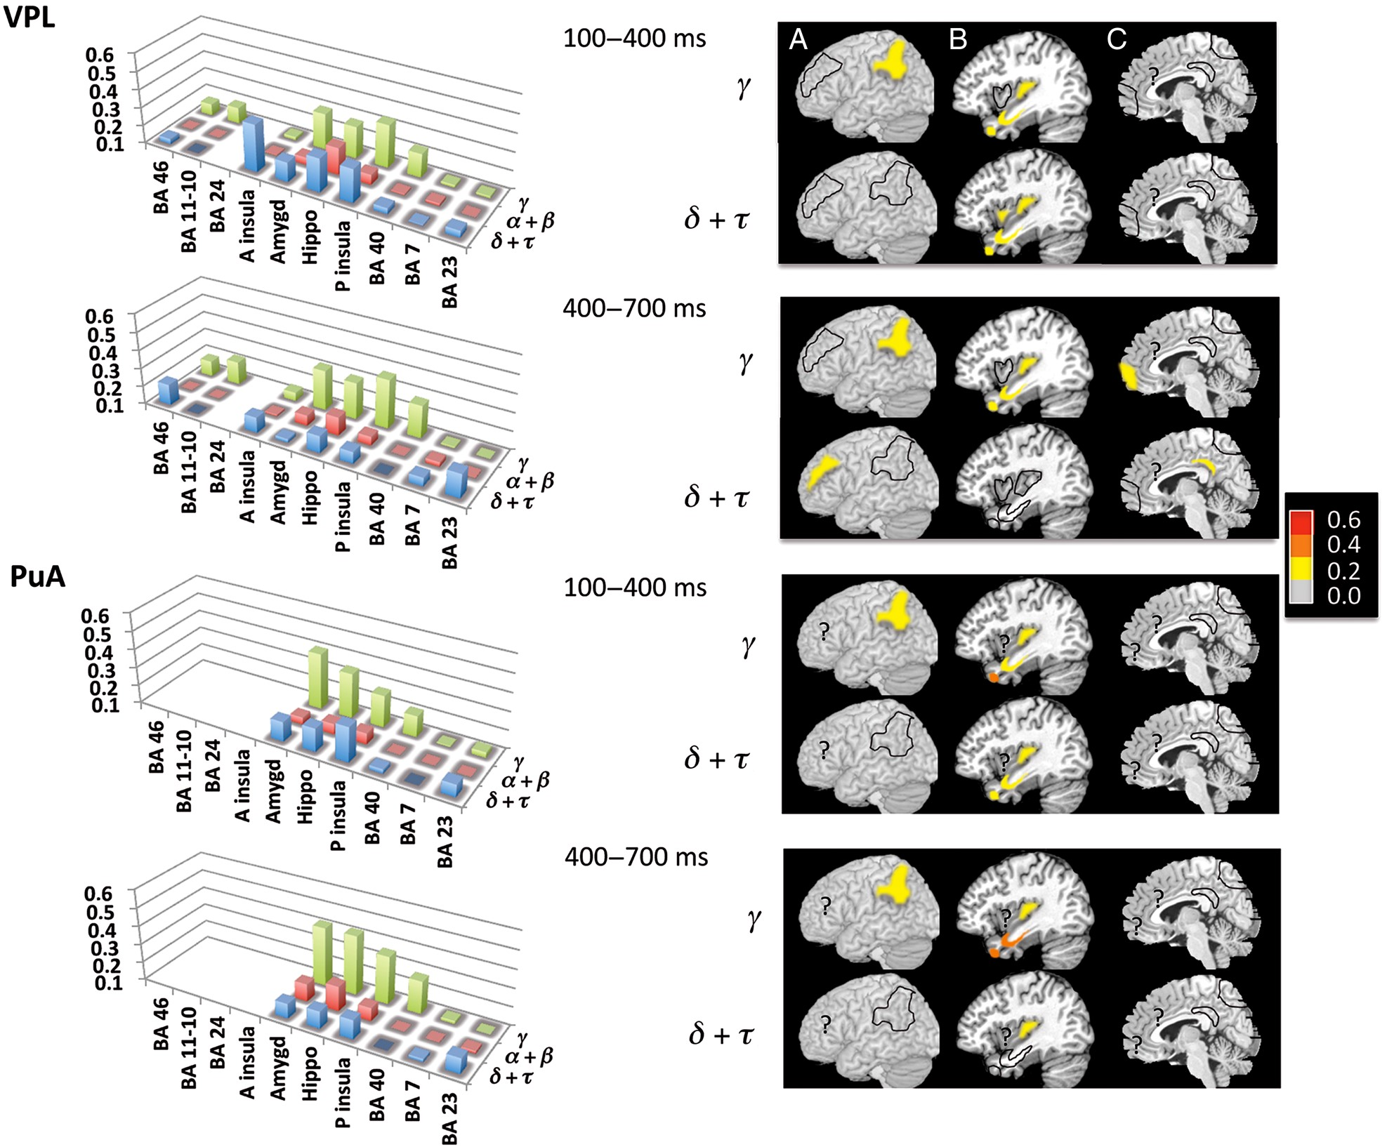
Figure 3. Cortical functional coherence with respect to VPL and PuA. Left: Coherence level of EEG frequency bands ...
Notes:
Figure 3. Cortical functional coherence with respect to VPL and PuA. Left: Coherence level of EEG frequency bands calculated in the 100–400 and 400–700 ms time windows following nociceptive stimuli between each of the 2 thalamic nuclei and 10 different cortical structures. VPL: ventral posterior lateral nucleus; PuA: anterior pulvinar. Ordinate: level of coherence from 0.1 to 0.6; abscissa: cortical structures (BA 46: dorsolateral prefrontal; BA 40: lateral parietal; A. insula: anterior insula; P. insula: posterior insula; Amygd: amygdala; Hippo: hippocampus; BA 11-10: orbito-frontal and prefrontal; BA 24: anterior cingulate; BA 23: posterior cingulate; BA 7: precuneus; third coordinate: frequency bands (δ + τ, α + β, γ). White parts on the histogram floor correspond to cortical structures where coherence values were not available. Right: Brain areas with significant level of coherence on normalized anatomical model of the brain proposed by the McConnell Brain Imaging Center of the Montréal Neurological Institute: (A) brain convexity showing lateral areas, (B) sagittal slices showing insula, projection of amygdale and hippocampus, and (C) mid-sagittal showing medial structures. Significant levels of coherence (>0.2) are represented for each structure with a color scale from yellow to red. Gray areas defined by dotted lines indicate that the level of coherence was <0.2, while the symbol “?” indicates that data in the area were not available.
Unless provided in the caption above, the following copyright applies to the content of this slide: © The Author 2015. Published by Oxford University Press. All rights reserved. For Permissions, please e-mail: journals.permissions@oup.com

Slide 4
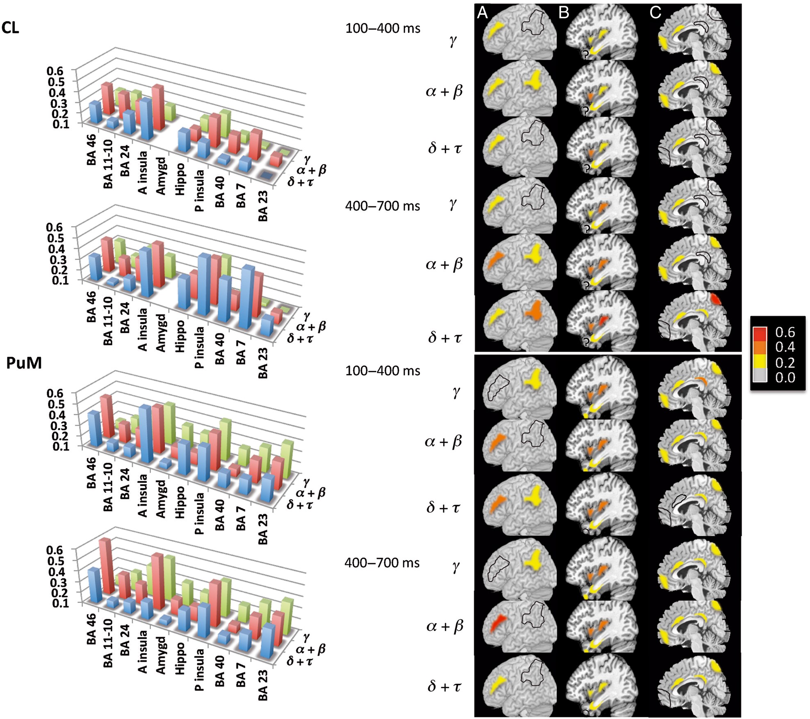
Figure 4. Cortical functional coherence with respect to CL and PuM. Left: Coherence level of EEG frequency bands ...
Notes:
Figure 4. Cortical functional coherence with respect to CL and PuM. Left: Coherence level of EEG frequency bands calculated in the 100–400 and 400–700 ms time windows following nociceptive stimuli between each of the 4 thalamic nuclei and 10 different cortical structures. PuM: medial pulvinar; CL: central lateral nucleus. Ordinate: level of coherence from 0.1 to 0.6; abscissa: cortical structures (see Fig. 3); third coordinate: frequency bands (δ + τ, α + β, γ). White parts on the histogram floor correspond to cortical structures where coherence values were not available. Right: Brain areas with significant level of coherence on normalized anatomical model of the brain proposed by the McConnell Brain Imaging Center of the Montréal Neurological Institute: (A) Brain convexity showing lateral areas, (B) sagittal slices showing insula, projection of amygdale and hippocampus, and (C) mid-sagittal showing medial structures. Significant levels of coherence (>0.2) are represented for each structure with a color scale from yellow to red. Gray areas defined by dotted lines indicate that the level of coherence was <0.2, while the symbol “?” indicates that data in the area were not available.
Unless provided in the caption above, the following copyright applies to the content of this slide: © The Author 2015. Published by Oxford University Press. All rights reserved. For Permissions, please e-mail: journals.permissions@oup.com

Slide 5
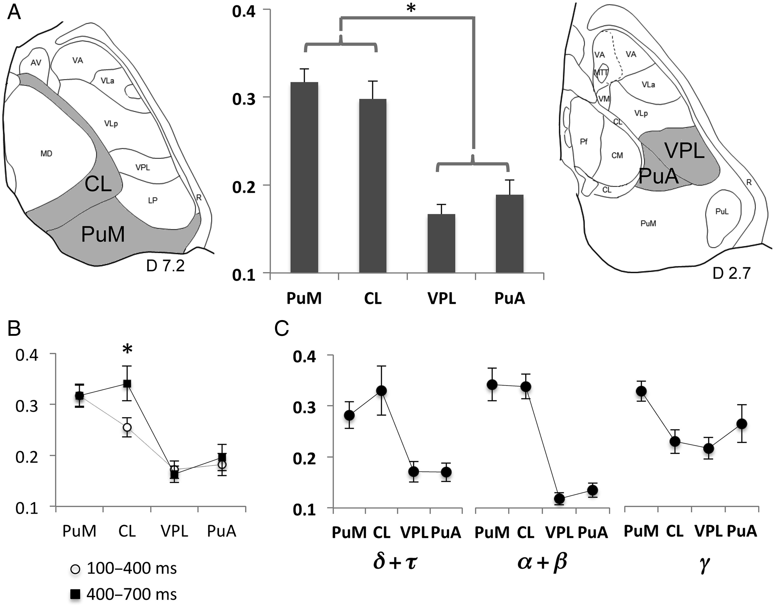
Figure 5. Thalamo-cortical functional coherence. (A) Left: Horizontal sections of the stereotactic Morel's atlas (1997) ...
Notes:
Figure 5. Thalamo-cortical functional coherence. (A) Left: Horizontal sections of the stereotactic Morel's atlas (1997) 7.2 above AC/PC showing CL and PuM. Right: Horizontal sections of the stereotactic Morel's atlas (1997) 2.7 mm above AC/PC showing VPL and PuA. Middle: Mean levels of coherence between the 4 thalamic nuclei and related cortical areas. Note the much higher thalamo-cortical coherence values for CL and PuM, relative to VPL and PuA (see text for statistics). (B). Mean levels of coherence between the 4 thalamic nuclei and related cortical areas according to time window. Note that the coherence value of CL was higher during the second time window when compared with the first one. (C) Interaction between frequency bands and thalamic nuclei. The mean coherence values were higher for CL and PuM than for VPL and PuA in the δ + τ and α + β, while in the γ band the PuM values were higher for PuM than CL and VPL and not than PuA.
Unless provided in the caption above, the following copyright applies to the content of this slide: © The Author 2015. Published by Oxford University Press. All rights reserved. For Permissions, please e-mail: journals.permissions@oup.com

