Slide 1
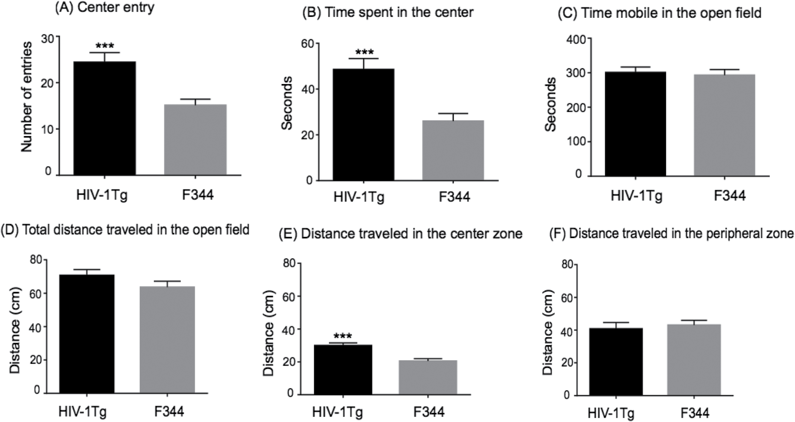
Figure 1. Difference in baseline measures of novelty-seeking behavior in HIV-1Tg and F344 rats in the open-field arena ...
Notes:
Figure 1. Difference in baseline measures of novelty-seeking behavior in HIV-1Tg and F344 rats in the open-field arena test (N = 9–12 per group). The HIV-1Tg rats spent more time in, exhibited higher numbers of entries into, and traveled greater distance in the center zone of the arena compared with F344 rats. Difference from F344 rats ***p ≤ .001.
Unless provided in the caption above, the following copyright applies to the content of this slide: © The Author 2017. Published by Oxford University Press on behalf of the Society for Research on Nicotine and Tobacco. All rights reserved. For permissions, please e-mail: journals.permissions@oup.com.

