Slide 1
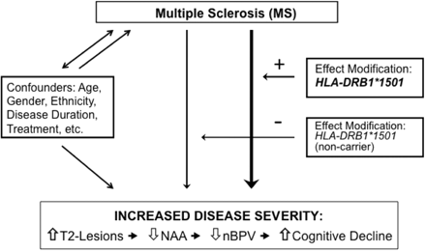
Fig. 1 Schematic representation of the relationship between MS and disease severity with the influence of ...
Notes:
Fig. 1 Schematic representation of the relationship between MS and disease severity with the influence of confounders, in addition to the effect modifier, HLA-DRB1*1501, that is proposed to facilitate increased brain injury. A unidirectional arrow indicates a causal association. A non-causal relationship is indicated by the bidirectional arrow.
Unless provided in the caption above, the following copyright applies to the content of this slide: © The Author (2008). Published by Oxford University Press on behalf of the Guarantors of Brain. All rights reserved. For Permissions, please email: journals.permissions@oxfordjournals.org

