Slide 1
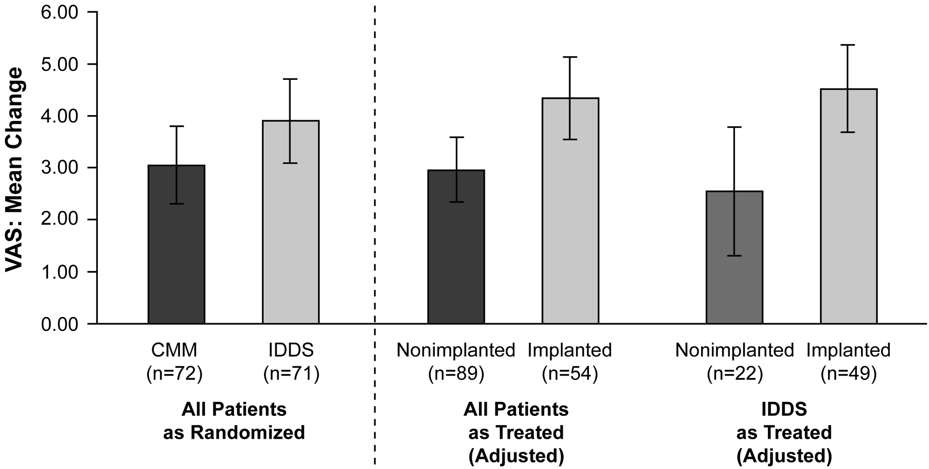
Figure 1 Mean reduction in VAS score with CMM alone versus CMM and IDDS [44]. Patients with cancer-related pain that ...
Notes:
Figure 1 Mean reduction in VAS score with CMM alone versus CMM and IDDS [44]. Patients with cancer-related pain that was refractory to systemic morphine (200 mg/d) received CMM alone or IDDS plus CMM. CMM was based on previously published guidelines; IDDS was initiated with morphine but could be switched to other agents if necessary for pain reduction. Reduction in VAS pain score from baseline to Week 4 (as randomized and as treated) is presented. In the analysis of all patients as treated, the difference between nonimplanted and implanted patients is significant (P = 0.007). In the analysis of patients randomized to IDDS as treated, the difference between nonimplanted and implanted patients is also significant (P = 0.01). Error bars are ±2 standard errors. CMM = conventional medical management; IDDS = intrathecal drug delivery system; VAS = visual analog scale. Reprinted with permission from Smith TJ, et al. J Clin Oncol 2002;20(19):4040-9.[44]
Unless provided in the caption above, the following copyright applies to the content of this slide: © 2016 American Academy of Pain Medicine.This is an Open Access article distributed under the terms of the Creative Commons Attribution-NonCommercial-NoDerivs licence (http://creativecommons.org/licenses/by-nc-nd/4.0/), which permits non-commercial reproduction and distribution of the work, in any medium, provided the original work is not altered or transformed in any way, and that the work properly cited. For commercial re-use, please contact journals.permissions@oup.com

Slide 2
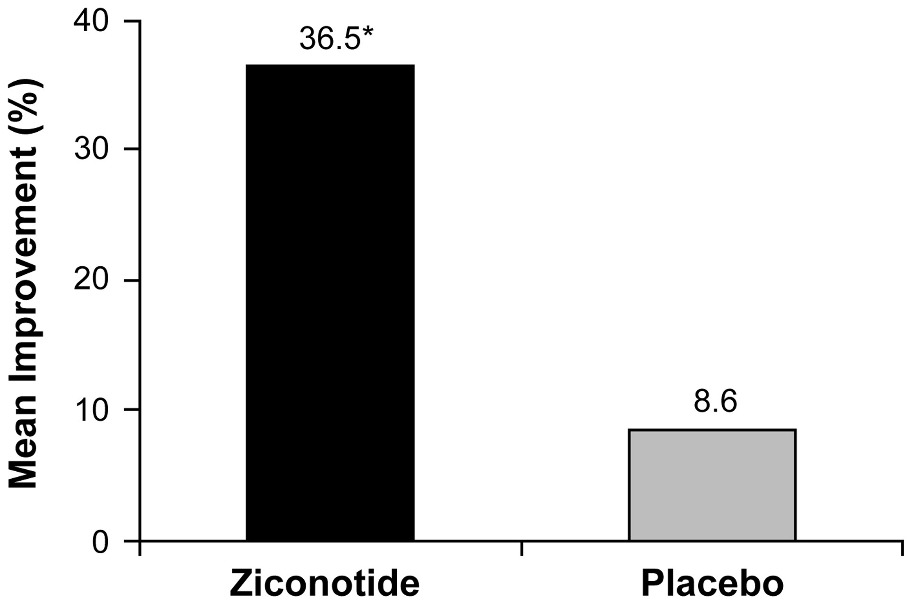
Figure 2 Mean percentage change in VASPI score: pooled analysis of patients with cancer-related pain in two ...
Notes:
Figure 2 Mean percentage change in VASPI score: pooled analysis of patients with cancer-related pain in two placebo-controlled clinical trials of ziconotide [76]. Patients with pain related to cancer or AIDS received either a “fast” or “slow” titration schedule of ziconotide. The fast titration regimen consisted of a ziconotide 0.4 mcg/h starting dose with upward titration every 12 hours to the maximum tolerated dose over 5 to 6 days [31,76]. The slow titration schedule used a starting ziconotide dose of 0.1 mcg/h with upward titration by 0.05 to 0.1 mcg/h no more than once every 24 hours to a maximum allowable dose of 0.9 mcg/h over 21 days [33,76]. VASPI score was assessed at baseline and at the end of the titration period. *P = 0.023 vs placebo. VASPI = visual analog scale of pain intensity.
Unless provided in the caption above, the following copyright applies to the content of this slide: © 2016 American Academy of Pain Medicine.This is an Open Access article distributed under the terms of the Creative Commons Attribution-NonCommercial-NoDerivs licence (http://creativecommons.org/licenses/by-nc-nd/4.0/), which permits non-commercial reproduction and distribution of the work, in any medium, provided the original work is not altered or transformed in any way, and that the work properly cited. For commercial re-use, please contact journals.permissions@oup.com

