Slide 1
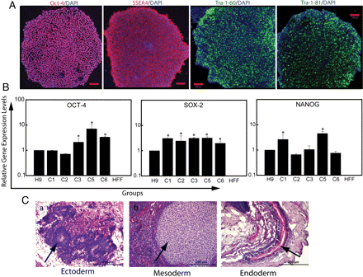
Figure 1 Characterization of virus-free iPSCs. (A) Immunostaining of the undifferentiated hiPSC colonies with Oct-4, ...
Notes:
Figure 1 Characterization of virus-free iPSCs. (A) Immunostaining of the undifferentiated hiPSC colonies with Oct-4, SSEA4, Tra-1-60, and Tra-1-81 antibodies followed by counterstaining with 4',6-diamidino-2-phenylindole. Scale bar represents 100 µm. (B) Relative gene expression levels of Oct-4, Sox-2, and Nanog in five iPSC clones (C1–C5) in comparison with the hESC line, H9 (positive control) and human foreskin fibroblasts (HFF; negative control). The mean Ct values of duplicate measurements were calculated and subsequently normalized against housekeeping gene (GAPDH) for the same sample. After normalization, the means of triplicate samples from three independent experiments were plotted relative to H9 for all the markers. Data represented are mean ± SEM (n = 3). *P < 0.05 vs. H9. (C) Haematoxylin and eosin staining of teratoma sections of clone MSnviPSNF3 showing the presence of ectoderm (neural rosettes), mesoderm (cartilage), and endoderm (secretory tubule). Scale bars represent 200 μm.
Unless provided in the caption above, the following copyright applies to the content of this slide: Published on behalf of the European Society of Cardiology. All rights reserved. © The Author 2011. For permissions please email: journals.permissions@oup.com.

Slide 2
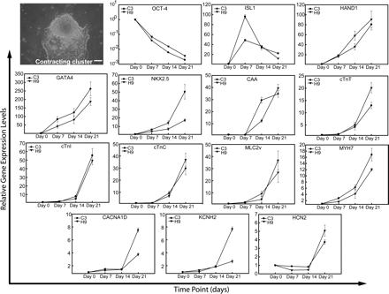
Figure 2 Temporal gene expression pattern during cardiomyogenesis. A spontaneous contracting cluster developed ...
Notes:
Figure 2 Temporal gene expression pattern during cardiomyogenesis. A spontaneous contracting cluster developed following differentiation. Scale bar represents 50 µm. Graphs show real-time RT-PCR data showing various hallmark markers for cardiomyocyte differentiation (days0, 7, 14, and 21). The data shown here are a comparison of MSnviPSNF3 (C3) with respect to the hESC line (H9). The mean Ct values of duplicate measurements were calculated and subsequently normalized against housekeeping gene (GAPDH) for the same sample. After normalization, the means of triplicate samples from three independent experiments were plotted relative to the baseline values of each individual marker for both cell lines. Data represented are means ± SEM (n = 3). Details of gene abbreviations are provided in the Supplementary material online, Table S1.
Unless provided in the caption above, the following copyright applies to the content of this slide: Published on behalf of the European Society of Cardiology. All rights reserved. © The Author 2011. For permissions please email: journals.permissions@oup.com.

Slide 3
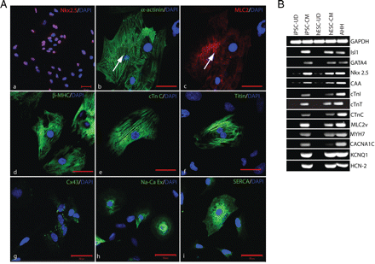
Figure 3 Structural and molecular characterization of iPSC-CMs. (A) Immunostaining of transcriptional factor, Nkx2.5, ...
Notes:
Figure 3 Structural and molecular characterization of iPSC-CMs. (A) Immunostaining of transcriptional factor, Nkx2.5, structural proteins, sarcomeric α-actinin, myosin light chain 2 (MLC2), β-myosin heavy chain (β-MHC), cardiac troponin C (cTn C), titin, gap junction connexin 43 (Cx43), and ion channels, namely, Na+–Ca2+ exchanger (Na-Ca Ex) and sarco(endo)plasmic reticulum Ca2+-ATPase (SERCA). Nuclei were counterstained with 4',6-diamidino-2-phenylindole in all images. All images were obtained at ×63 magnification except Nkx2.5 (×20). Bar = 50 µm for all images. (B) Semi-quantitative RT-PCR analysis of undifferentiated and day 21 differentiated cardiomyocytes of clone MSnviPSNF3 and H9 with adult human heart. Abbreviations: iPSC-UD, undifferentiated MSnviPSNF3 cells; iPSC-CM, MSnviPSNF3-derived cardiomyocytes; hESC-UD, undifferentiated H9 cells; hESC-CM, H9-derived cardiomyocytes; and AHH, adult human heart.
Unless provided in the caption above, the following copyright applies to the content of this slide: Published on behalf of the European Society of Cardiology. All rights reserved. © The Author 2011. For permissions please email: journals.permissions@oup.com.

Slide 4
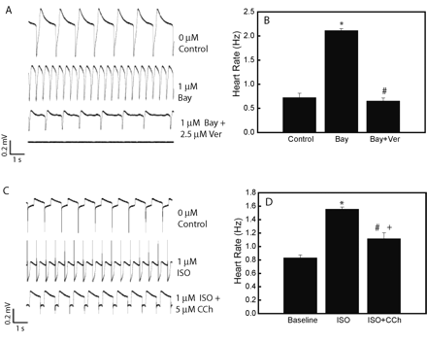
Figure 5 Inhibition studies of iPSC-CMs. (A and B) Changes in beating frequency induced by verapamil in the presence ...
Notes:
Figure 5 Inhibition studies of iPSC-CMs. (A and B) Changes in beating frequency induced by verapamil in the presence of Bay K 8644. *P < 0.05 vs. control, and #P < 0.05 vs. Bay group. (C and D) Muscarinic inhibition of beating frequency during adrenergic stimulation. *P < 0.05 vs. control, #P < 0.05 vs. Iso group, and +P < 0.05 vs. control. Data are represented as the means ± SEM of three independent experiments. Abbreviations: Bay, Bay K 8644; Ver, Verapamil; ISO, isoprenaline; and CCh, carbamycholine.
Unless provided in the caption above, the following copyright applies to the content of this slide: Published on behalf of the European Society of Cardiology. All rights reserved. © The Author 2011. For permissions please email: journals.permissions@oup.com.

Slide 5
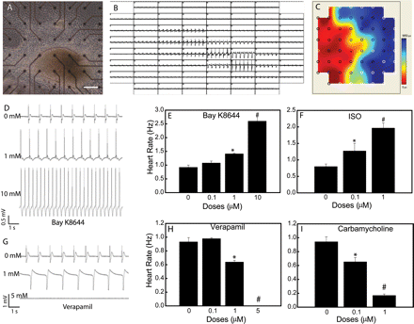
Figure 4 Microelectrode array mapping and chronotropic effects of pharmacological interventions. (A–C) Contracting ...
Notes:
Figure 4 Microelectrode array mapping and chronotropic effects of pharmacological interventions. (A–C) Contracting clusters on the MEA chips with extracellular electrograms from all electrodes used to generate colour-coded activation maps. Scale bar represents 200 µm. (D–I) Dose-dependent chronotropic changes induced by Bay K 8644 (D and E), isoprenaline (F), verapamil (G and H), and carbamycholine (I). *P < 0.05 vs. control (no treatment) and #P < 0.01 vs. control (no treatment).
Unless provided in the caption above, the following copyright applies to the content of this slide: Published on behalf of the European Society of Cardiology. All rights reserved. © The Author 2011. For permissions please email: journals.permissions@oup.com.

Slide 6
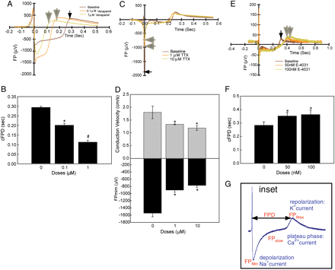
Figure 6 Human iPSC-CMs respond to pharmacologically active compounds. (A and B) Extracellular field potential (FP) ...
Notes:
Figure 6 Human iPSC-CMs respond to pharmacologically active compounds. (A and B) Extracellular field potential (FP) recordings following verapamil treatment demonstrate shortening of the field potential duration (FPD). (C and D) Tetradotoxin (TTX), a sodium channel blocker, reduces minimal field potential (FPmin) and conduction velocity. (E and F) Field potential recording demonstrates an increase in field repolarization following treatment with E-4031. Note that the small black arrows show the normal baseline recordings, whereas large grey arrows show changes after treatment. (G) Inset, schematic diagram of a multi-electrode array trace, showing how results were analysed to calculate FPD and field repolarization (QT interval). All graphs represent values as means ± SEM of three independent experiments. *P < 0.05 vs. control, and #P < 0.01 vs. control. Abbreviation: cFPD, corrected FPD.
Unless provided in the caption above, the following copyright applies to the content of this slide: Published on behalf of the European Society of Cardiology. All rights reserved. © The Author 2011. For permissions please email: journals.permissions@oup.com.

