Slide 1
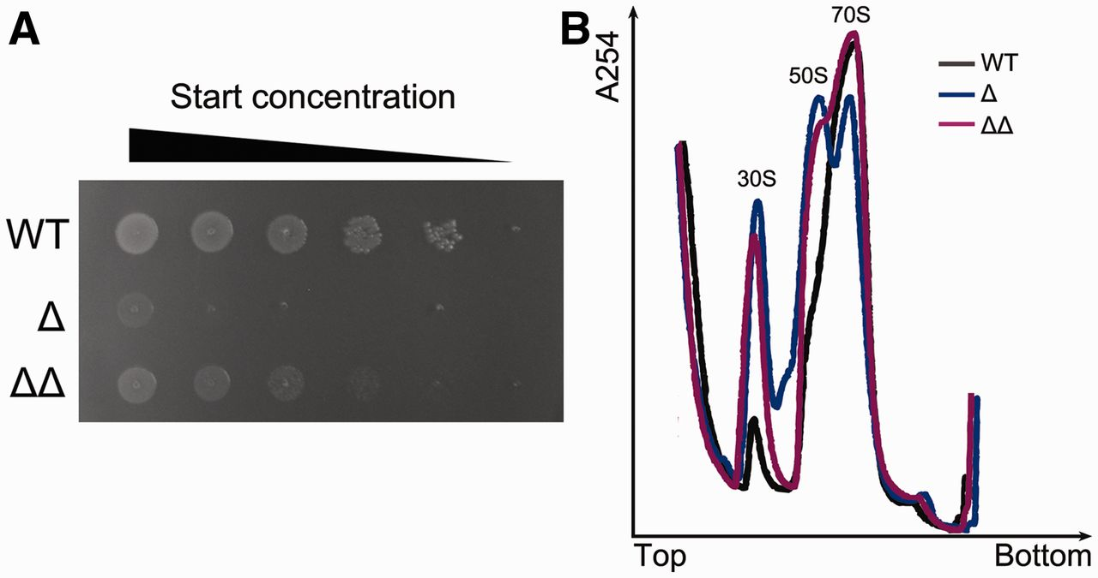
Figure 1. Phenotypes of the Δ rimM and Δ rbfA Δ rsgA strains. ( A ) Spot assay showing that both the Δ rimM (Δ) and Δ ...
Notes:
Figure 1. Phenotypes of the Δ rimM and Δ rbfA Δ rsgA strains. ( A ) Spot assay showing that both the Δ rimM (Δ) and Δ rbfA Δ rsgA (ΔΔ) strains grow slowly, compared with the wild-type strain (WT). ( B ) Ribosome profile analysis of the A19, Δ rimM and Δ rbfA Δ rsgA strains. The profile curves of the WT, Δ and ΔΔ strains are colored in black, green and red, respectively. Deletion of RimM or a combination of RbfA and RsgA causes an accumulation of immature 30S subunits. Both experiments indicate that deletion of RimM is more deleterious.
Unless provided in the caption above, the following copyright applies to the content of this slide: © The Author(s) 2013. Published by Oxford University Press.This is an Open Access article distributed under the terms of the Creative Commons Attribution License (http://creativecommons.org/licenses/by-nc/3.0/), which permits non-commercial reuse, distribution, and reproduction in any medium, provided the original work is properly cited. For commercial re-use, please contact journals.permissions@oup.com.

Slide 2
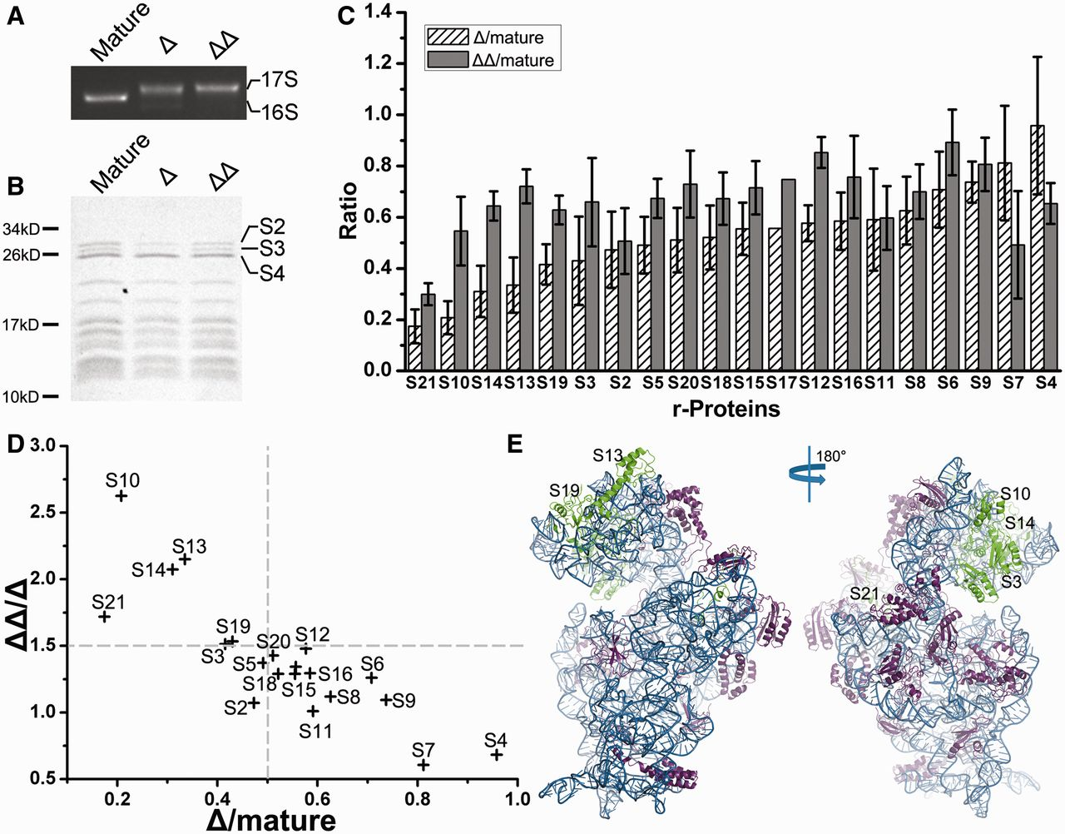
Figure 2. Compositional characterization of the immature 30S subunits. Composition of mature and immature 30S subunits ...
Notes:
Figure 2. Compositional characterization of the immature 30S subunits. Composition of mature and immature 30S subunits from the A19 Δ rimM (Δ) and Δ rbfA Δ rsgA (ΔΔ) strains was analyzed in both the RNA and protein levels. ( A ) RNA gel analysis of the rRNAs in the Δ and ΔΔ samples. ( B ) Tricine-SDS–PAGE analysis of the protein composition of the immature 30S subunits. ( C ) QMS analysis of the protein composition in the Δ and the ΔΔ samples. Error bars show standard deviations. The difference in protein ratio between the Δ and ΔΔ samples was subjected to a one-tailed t -test, which reports a significant difference for S10, S14, S13, S3, S12, S5, S4, S7 ( P < 0.01), S19 and S6 ( P < 0.05). ( D ) The relative protein ratios of the ΔΔ sample to the Δ sample (ΔΔ/Δ) are plotted against the ratios of the Δ sample to the mature one (Δ/mature). ( E ) Atomic structure of the mature 30S subunit ( 38 ) viewed from the inter-subunit and solvent sides, with proteins in the top-left part of (D) colored in green.
Unless provided in the caption above, the following copyright applies to the content of this slide: © The Author(s) 2013. Published by Oxford University Press.This is an Open Access article distributed under the terms of the Creative Commons Attribution License (http://creativecommons.org/licenses/by-nc/3.0/), which permits non-commercial reuse, distribution, and reproduction in any medium, provided the original work is properly cited. For commercial re-use, please contact journals.permissions@oup.com.

Slide 3
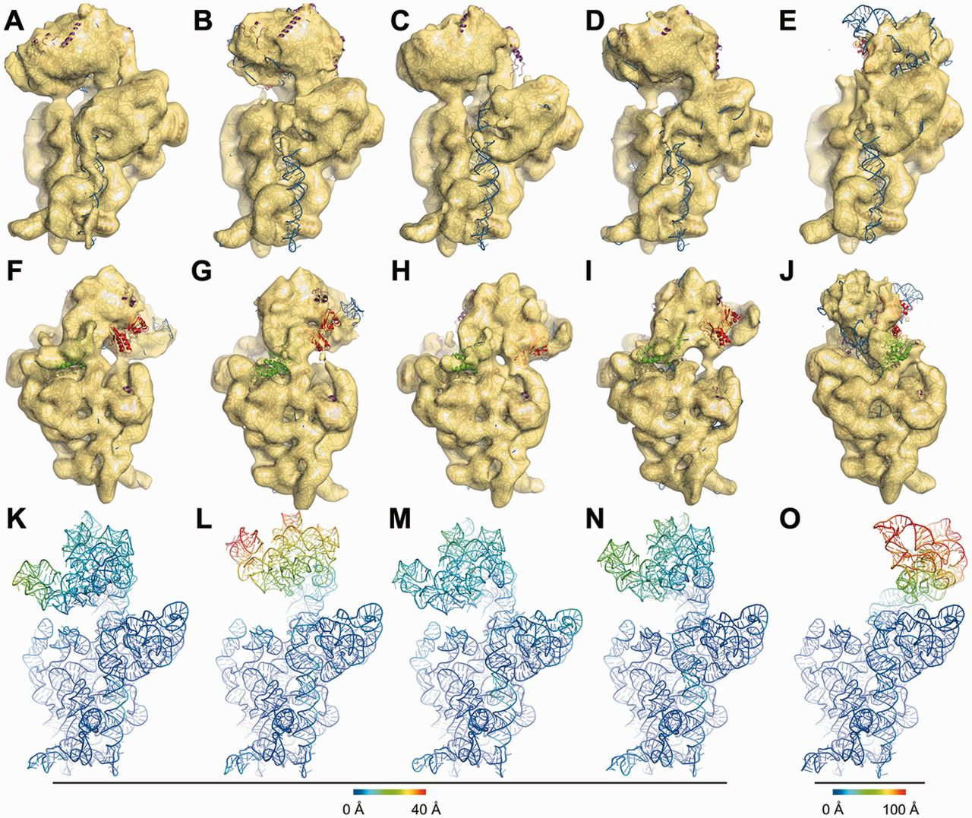
Figure 3. Overview of the five cryo-EM structures of the immature 30S subunits from the Δ rimM strain. The five ...
Notes:
Figure 3. Overview of the five cryo-EM structures of the immature 30S subunits from the Δ rimM strain. The five density maps ( A–E or F–J , respectively) are displayed in transparent surface representation, superimposed with flexibly fitted crystal structures in cartoon representation. For each map, both the inter-subunit view (A–E) and the solvent view (F–J) are displayed. The 16S rRNA, S2, S3 and the rest 30S subunit proteins are painted in blue, green, red and purple, respectively. Deviations of the 16S rRNA backbones in the fitted model from that of the mature 30S subunit are colored as indicated by the scale to form the temperature maps ( K–O ).
Unless provided in the caption above, the following copyright applies to the content of this slide: © The Author(s) 2013. Published by Oxford University Press.This is an Open Access article distributed under the terms of the Creative Commons Attribution License (http://creativecommons.org/licenses/by-nc/3.0/), which permits non-commercial reuse, distribution, and reproduction in any medium, provided the original work is properly cited. For commercial re-use, please contact journals.permissions@oup.com.

Slide 4
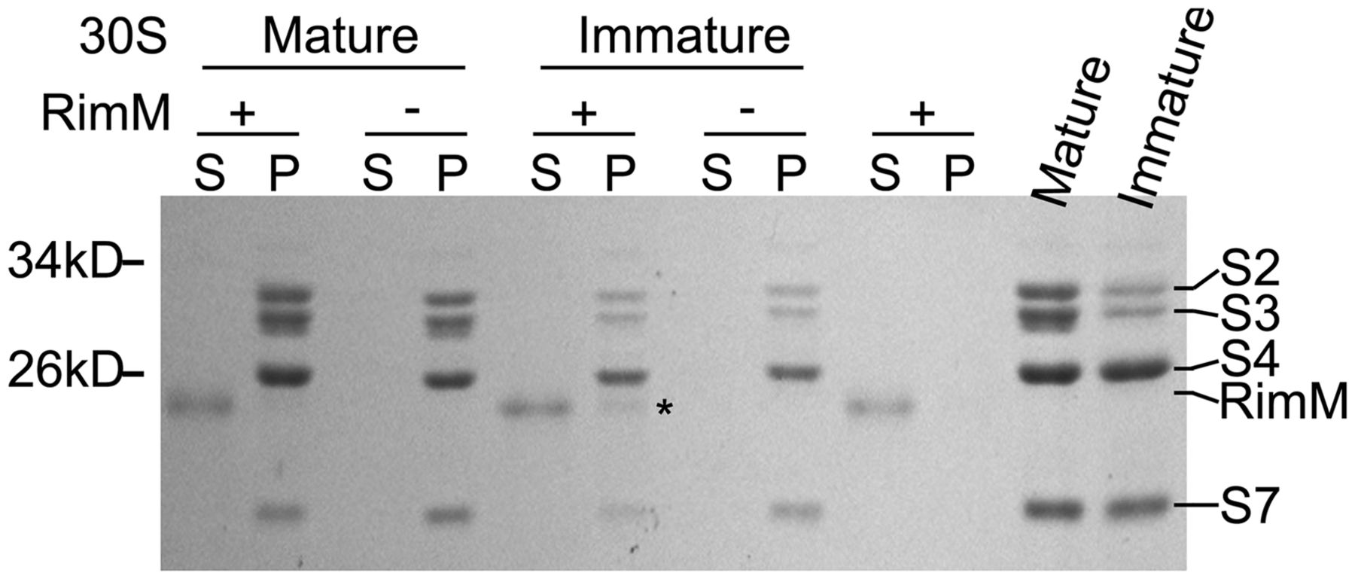
Figure 4. RimM preferentially binds to the immature 30S subunits from the Δ rimM strain. Immature 30S subunits from ...
Notes:
Figure 4. RimM preferentially binds to the immature 30S subunits from the Δ rimM strain. Immature 30S subunits from the Δ rimM strain and mature 30S subunits from the 70S ribosomes were incubated with or without a 30-fold excess of RimM. The mixtures were pelleted by centrifugation. The pellets (P) and the supernatants (S) were separated and resolved by SDS–PAGE. RimM alone was centrifuged as a control. The asterisk denotes the weak binding of RimM to the immature 30S subunits.
Unless provided in the caption above, the following copyright applies to the content of this slide: © The Author(s) 2013. Published by Oxford University Press.This is an Open Access article distributed under the terms of the Creative Commons Attribution License (http://creativecommons.org/licenses/by-nc/3.0/), which permits non-commercial reuse, distribution, and reproduction in any medium, provided the original work is properly cited. For commercial re-use, please contact journals.permissions@oup.com.

Slide 5
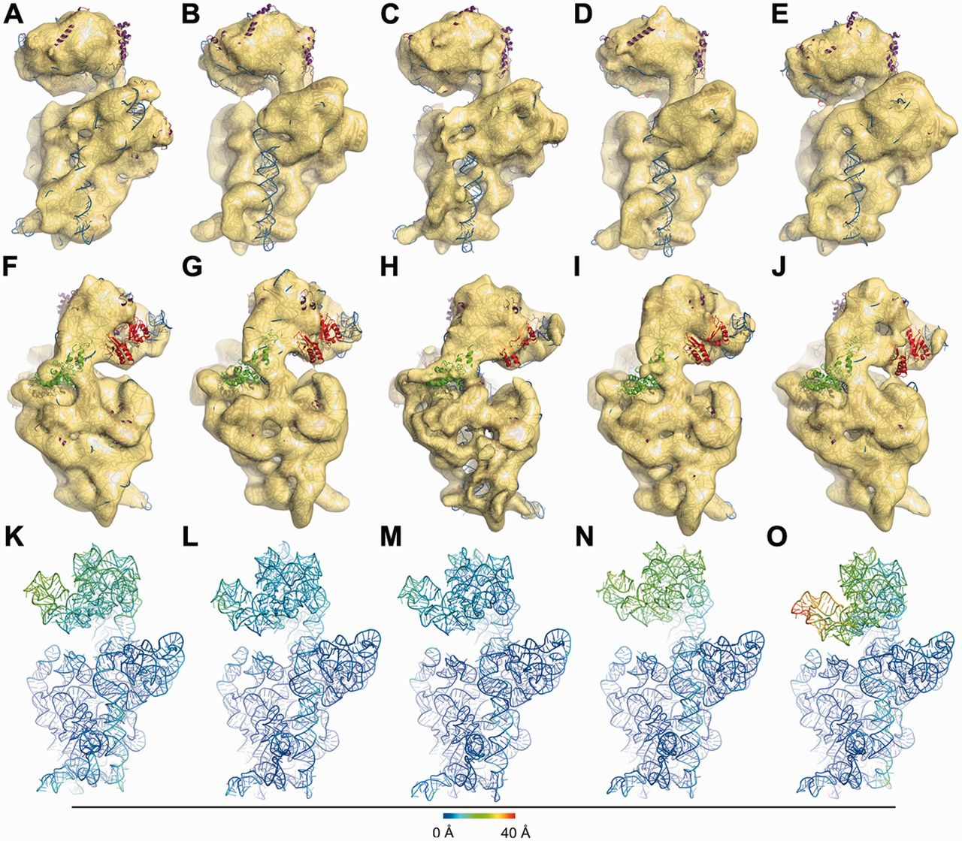
Figure 5. Overview of the five cryo-EM structures of the immature 30S subunits treated with RimM. The five density ...
Notes:
Figure 5. Overview of the five cryo-EM structures of the immature 30S subunits treated with RimM. The five density maps ( A–E or F–J , respectively) are displayed in transparent surface representation, superimposed with flexibly fitted crystal structures in cartoon representation. For each map, both the inter-subunit view (A–E) and the solvent view (F–J) are displayed. The 16S rRNA, S2, S3 and the rest 30S subunit proteins are painted in blue, green, red and purple, respectively. Deviations of the 16S rRNA backbones in the fitted model from that of the mature 30S subunit are colored as indicated by the scale to form the temperature maps ( K–O ).
Unless provided in the caption above, the following copyright applies to the content of this slide: © The Author(s) 2013. Published by Oxford University Press.This is an Open Access article distributed under the terms of the Creative Commons Attribution License (http://creativecommons.org/licenses/by-nc/3.0/), which permits non-commercial reuse, distribution, and reproduction in any medium, provided the original work is properly cited. For commercial re-use, please contact journals.permissions@oup.com.

Slide 6
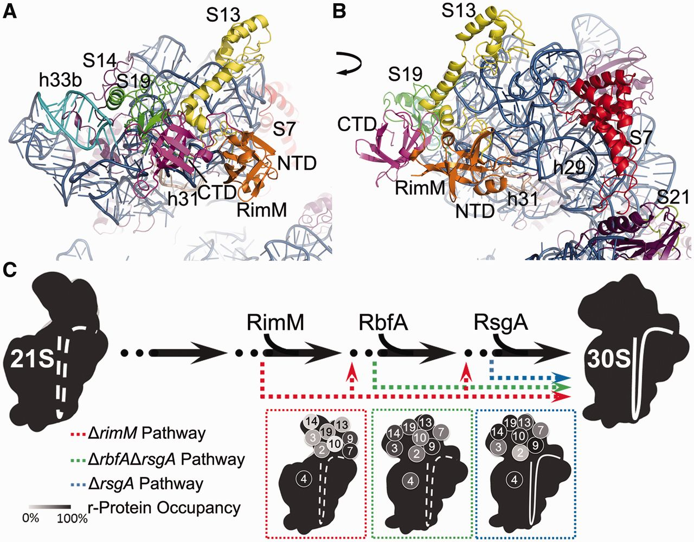
Figure 6. Mechanistic model of the RimM function in the in vivo assembly of the 3′-domain. ( A ) The head domain of ...
Notes:
Figure 6. Mechanistic model of the RimM function in the in vivo assembly of the 3′-domain. ( A ) The head domain of the 30S subunit viewed from the inter-subunit side. ( B ) Same as (A), with a 70° rotation around Y -axis. The h33b, h31 and the rest of the 16S rRNA are painted in cyan, wheat and blue, respectively. The C-terminal domain of RimM (CTD), N-terminal domain of RimM (NTD), S7, S13, S19 and S14 are painted in magenta, orange, red, yellow, green and purple, respectively. ( C ) RimM, RbfA and RsgA act at different checkpoints during the in vivo assembly. The deficiency of assembly factors diverts the assembly into less efficient branches (colored dash lines) and causes accumulation of a set of closely related intermediates (colored boxes). The ribosomal protein levels in the three sets of in vivo intermediates are displayed in the gray scale. The data of the intermediates from a Δ rsgA strain is from a previous study ( 50 ). The large conformational differences among the three sets of in vivo intermediate were also shown in cartoon: the Δ rimM one (red) with a dramatically rotated head domain and a disordered helix 44; the Δ rbfA Δ rsgA one (green) with a disordered helix 44 only; the Δ rsgA one (blue) with a well-resolved helix 44.
Unless provided in the caption above, the following copyright applies to the content of this slide: © The Author(s) 2013. Published by Oxford University Press.This is an Open Access article distributed under the terms of the Creative Commons Attribution License (http://creativecommons.org/licenses/by-nc/3.0/), which permits non-commercial reuse, distribution, and reproduction in any medium, provided the original work is properly cited. For commercial re-use, please contact journals.permissions@oup.com.

