Slide 1
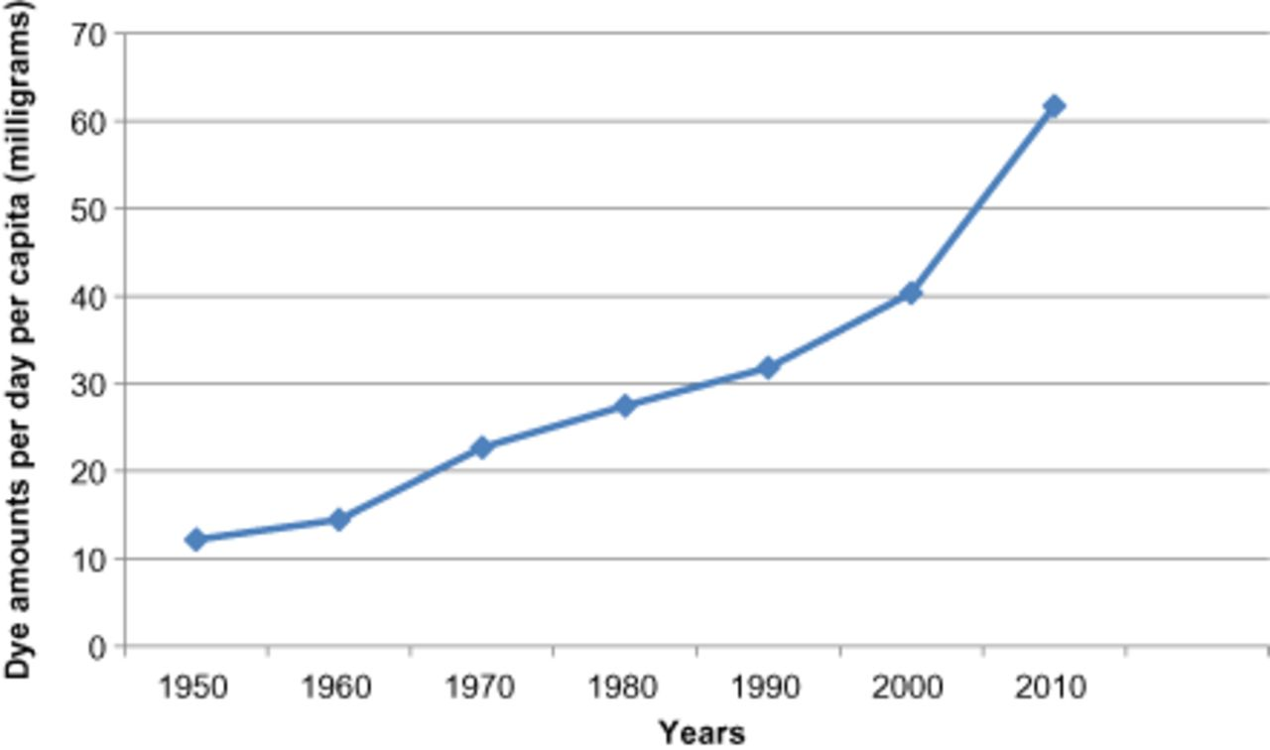
Figure 1 Per capita per day certification of food dyes (in mg) between 1950 and 2010, as certified by the US Food and ...
Notes:
Figure 1 Per capita per day certification of food dyes (in mg) between 1950 and 2010, as certified by the US Food and Drug Administration.
Unless provided in the caption above, the following copyright applies to the content of this slide: © 2013 International Life Sciences Institute

