Slide 1
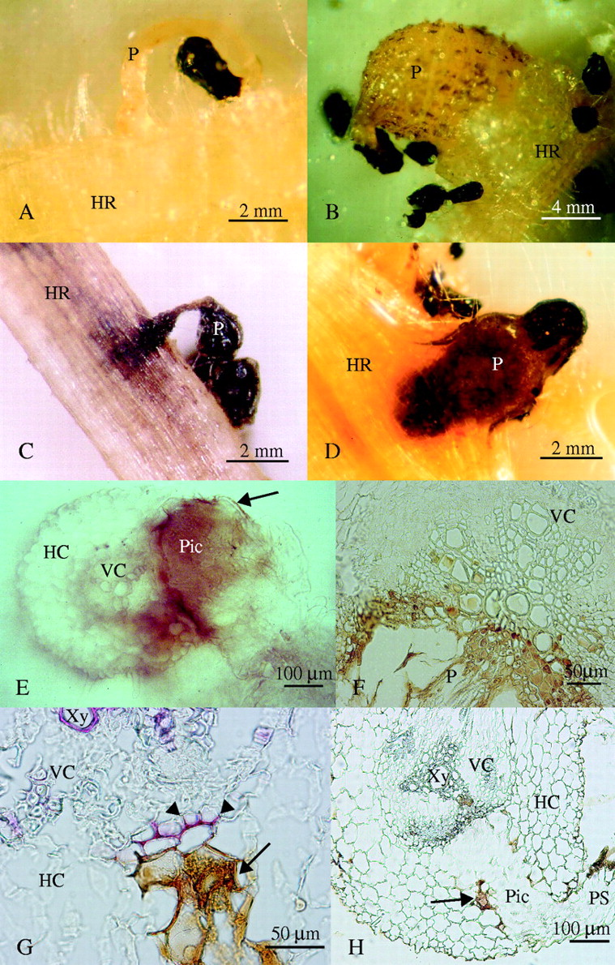
Fig. 1. Resistant reaction found in response to O. crenata attack. (A) Compatible Orobanche crenata development on ...
Notes:
Fig. 1. Resistant reaction found in response to O. crenata attack. (A) Compatible Orobanche crenata development on susceptible pea: early attachment showing hyaline radicle (10 d after inoculation), and (B) healthy tubercle (20 d after inoculation). (C) Surface view of incompatible seedling penetration on resistant faba bean (20 d after inoculation). (D) Necrotic O. crenata tubercle on resistant pea (30 d after inoculation). (E) Non-stained hand-cut section of an unsuccessful seedling penetration on resistant vetch (20 d after inoculation) showing accumulation of a dark brown material. Arrow indicates brown material in contact only with parasite tissues. (F) Detail of a non-stained microtome cross-section of a necrotic tubercle on resistant vetch (30 d after inoculation) showing accumulation of a brown material inside host vessels. (G) Detail of an unsuccessful penetration on resistant vetch (20 d after inoculation) showing the lignified host cells (arrowheads) in contact with the parasite intrusive cells, after phloroglucinol–HCl staining. The arrow indicates accumulation of a brown secreted material. (H) Non-stained section of an unsuccessful penetration attempt on resistant vetch (20 d after inoculation). The arrow indicates accumulation of brown material. HR, Host root; P, parasite; PS, parasite seedling; Pic, parasite intrusive cells; HC, host cortex; VC, host vascular cylinder; Xy, xylem vessel.
Unless provided in the caption above, the following copyright applies to the content of this slide: © The Author 2005. Published by Oxford University Press on behalf of the Annals of Botany Company. All rights reserved. For Permissions, please email: journals.permissions@oupjournals.org

Slide 2
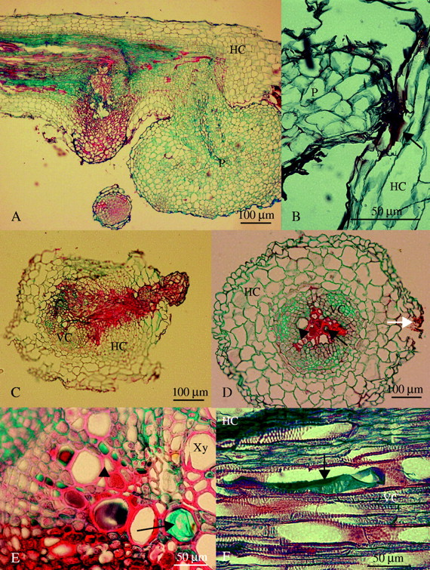
Fig. 2. (A) Longitudinal section of a resistant vetch root showing both a necrotic (stained red) and a healthy ...
Notes:
Fig. 2. (A) Longitudinal section of a resistant vetch root showing both a necrotic (stained red) and a healthy (stained blue) tubercle (30 d after inoculation). (B) Light micrograph of a broomrape seedling attached and trying to penetrate into a resistant faba bean root (10 d after inoculation). Arrow indicates accumulation of a red staining substance that did not show any fluorescence. (C) Cross-section of an unsuccessful seedling penetration on resistant lentil (20 d after inoculation). (D) Cross-section of a resistant pea root away from the haustorium of a necrotic tubercle (30 d after inoculation). The white arrow indicates the side where the tubercle and the haustorium were located in other consecutive sections, the black arrow indicates accumulation of safranin-staining substance with fluorescence and the arrowhead indicates accumulation of alcian-staining carbohydrates inside vessel elements. (E) Detailed cross-section of a resistant vetch root near the haustorium of a necrotic tubercle (30 d after inoculation). The arrow indicates accumulation of alcian-staining carbohydrates and arrowhead indicates accumulation of red staining substance with fluorescence inside vessel elements. (F) Longitudinal section of a resistant vetch root (30 d after inoculation) showing a xylem vessel filled with the alcian-staining carbohydrates (arrow). P, Parasite; HC, host cortex; VC, host vascular cylinder; Xy, xylem vessel.
Unless provided in the caption above, the following copyright applies to the content of this slide: © The Author 2005. Published by Oxford University Press on behalf of the Annals of Botany Company. All rights reserved. For Permissions, please email: journals.permissions@oupjournals.org

Slide 3
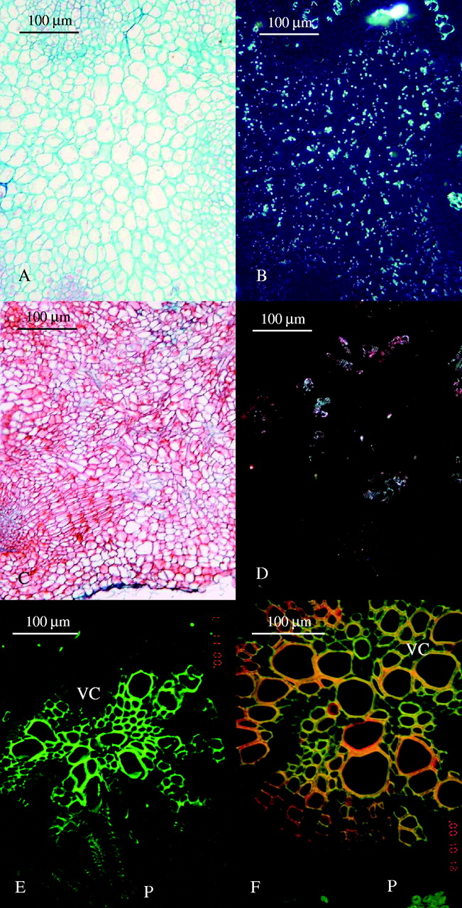
Fig. 3. (A) Light micrograph of a cross-section in a healthy broomrape tubercle on susceptible pea (30 d after ...
Notes:
Fig. 3. (A) Light micrograph of a cross-section in a healthy broomrape tubercle on susceptible pea (30 d after inoculation). (B) The same as (A) under polarized light showing accumulation of starch grains. (C) Light micrograph of a cross-section in a necrotic broomrape tubercle on resistant pea (30 d after inoculation). (D) The same as (C) under polarized light showing the lack of starch grains. (E) Cross-section of a susceptible pea root with the haustorium of a healthy tubercle under fluorescence microscopy (30 d after inoculation). (F) Cross-section of a resistant pea root and the haustorium of a necrotic tubercle under fluorescence microscopy (30 d after inoculation). Red colour corresponds to the red staining substance which is seen in Fig. 2C, the cell wall itself fluoresces in yellow and green fluorescence is seen only in a few unaffected xylem cells. P, Parasite; HC, host cortex; VC, host vascular cylinder.
Unless provided in the caption above, the following copyright applies to the content of this slide: © The Author 2005. Published by Oxford University Press on behalf of the Annals of Botany Company. All rights reserved. For Permissions, please email: journals.permissions@oupjournals.org

