Slide 1
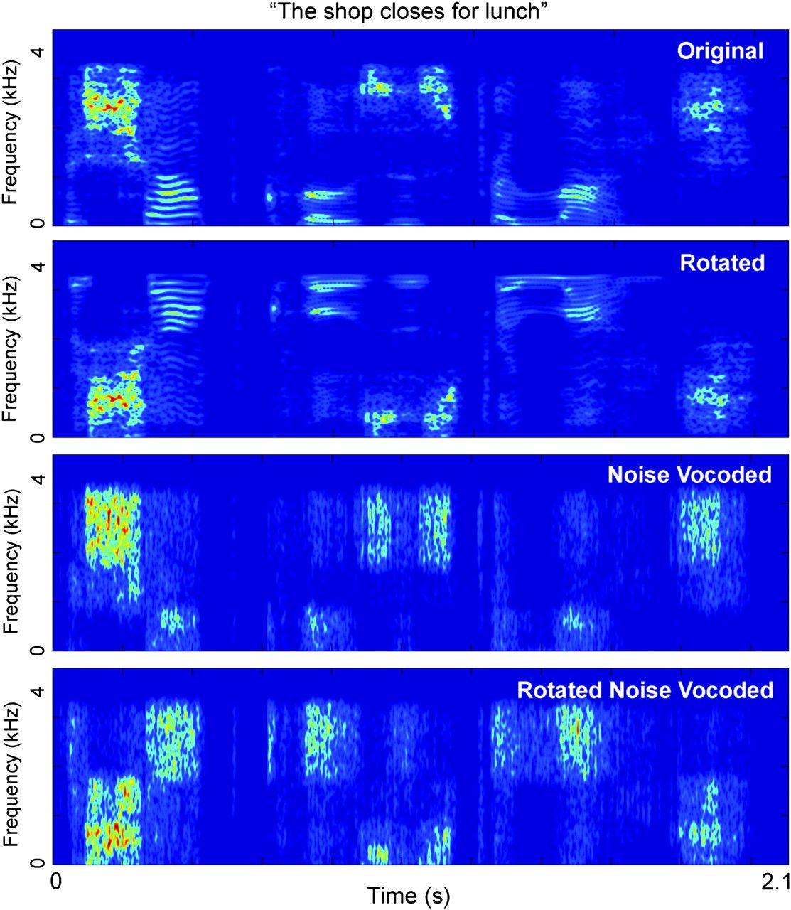
Figure 1. Spectrograms for a sample set of stimuli based on the sentence, the shop closes for lunch.
Notes:
Figure 1. Spectrograms for a sample set of stimuli based on the sentence, the shop closes for lunch.
Unless provided in the caption above, the following copyright applies to the content of this slide: © The Author 2010. Published by Oxford University Press. All rights reserved. For permissions, please e-mail: journals.permissions@oxfordjournals.org

Slide 2
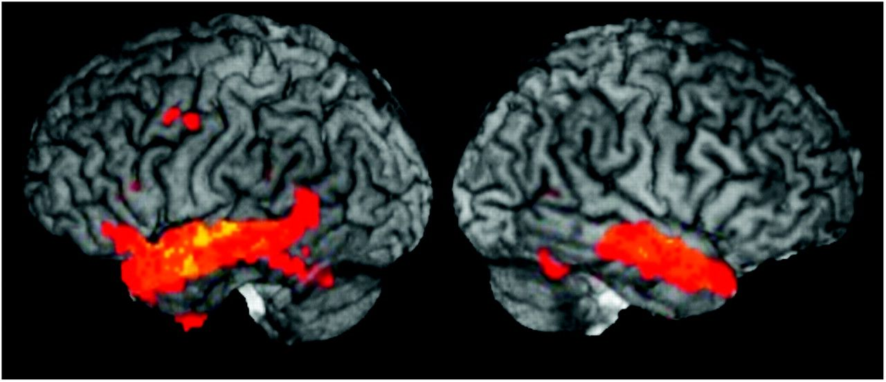
Figure 2. Group results from a standard BOLD amplitude subtraction analysis (P = 0.05, false discovery rate corrected) ...
Notes:
Figure 2. Group results from a standard BOLD amplitude subtraction analysis (P = 0.05, false discovery rate corrected) projected onto a surface-rendered template brain showing regions that respond more to intelligible speech (clear + NV) than unintelligible speech (rot + rotNV).
Unless provided in the caption above, the following copyright applies to the content of this slide: © The Author 2010. Published by Oxford University Press. All rights reserved. For permissions, please e-mail: journals.permissions@oxfordjournals.org

Slide 3
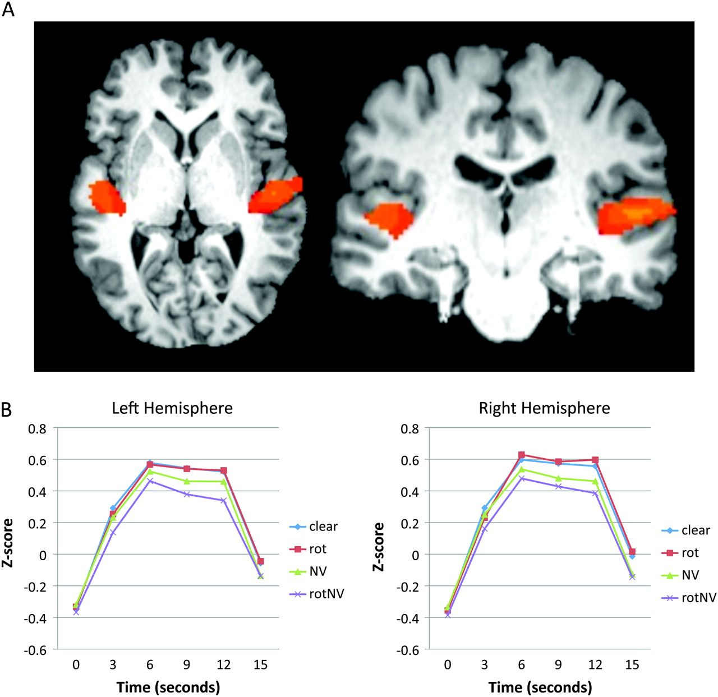
Figure 3. Activation of auditory core regions (HG) to 8-Hz amplitude-modulated wideband noise versus rest (scanner ...
Notes:
Figure 3. Activation of auditory core regions (HG) to 8-Hz amplitude-modulated wideband noise versus rest (scanner noise), P < 0.001, uncorrected. (A) Axial and coronal slices showing activation in HG and immediately surrounding tissue. Images are in radiological convention (left = right). (B) Average signal time course for each speech condition for the HG ROI in each hemisphere. Note the virtually identical average response to clear and rot speech.
Unless provided in the caption above, the following copyright applies to the content of this slide: © The Author 2010. Published by Oxford University Press. All rights reserved. For permissions, please e-mail: journals.permissions@oxfordjournals.org

Slide 4
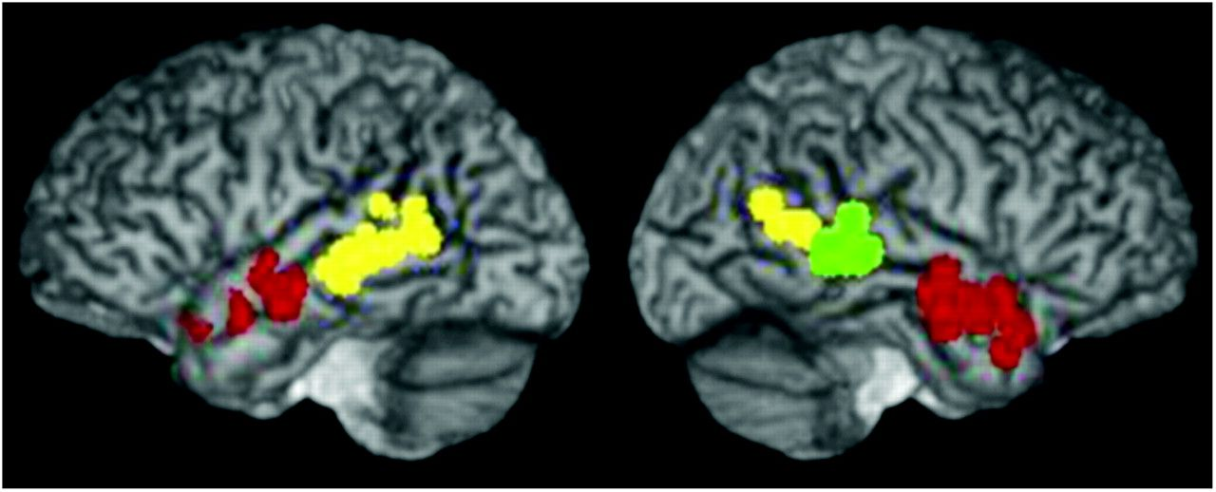
Figure 4. Location of the peak voxel in STS ROIs for each subject projected onto a surface-rendered template brain. ...
Notes:
Figure 4. Location of the peak voxel in STS ROIs for each subject projected onto a surface-rendered template brain. ROIs were identified using the contrast, clear minus rot with a threshold of P < 0.0001, uncorrected. Red, aSTS; green, mSTS; yellow, pSTS. Note the nonoverlapping distributions of these ROIs across subjects.
Unless provided in the caption above, the following copyright applies to the content of this slide: © The Author 2010. Published by Oxford University Press. All rights reserved. For permissions, please e-mail: journals.permissions@oxfordjournals.org

Slide 5
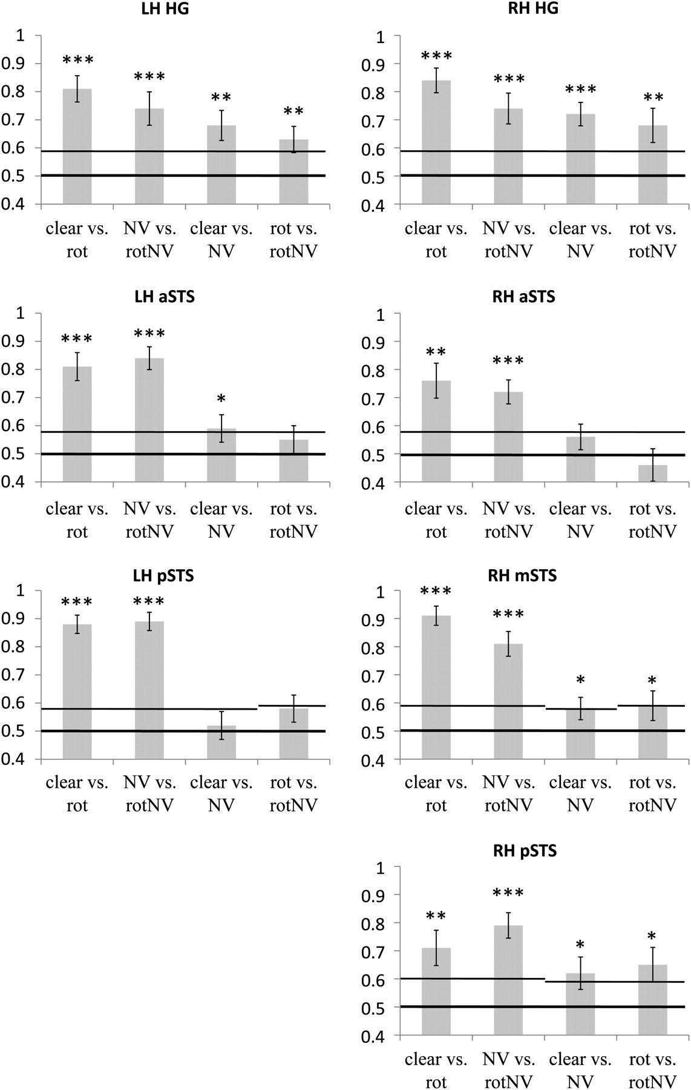
Figure 5. Classification accuracy (proportion correct) for the 4 classification contrasts in the 3 left hemisphere ROIs ...
Notes:
Figure 5. Classification accuracy (proportion correct) for the 4 classification contrasts in the 3 left hemisphere ROIs and 4 right hemisphere ROIs. The left 2 bars in each graph are “intelligibility” contrasts (intelligible vs. unintelligible) and the right 2 bars in each graph are acoustic contrasts (acoustically different intelligible vs. intelligible and acoustically different unintelligible vs. unintelligible). Thick black horizontal line indicates chance (0.5) and thin black line marks the upper bound of the 95% confidence interval determined via a bootstrapping procedure. As the bootstrapping procedure was calculated separately for each classification contrast, the 95% confidence interval boundary can vary from one condition to the next. LH, left hemisphere; RH, right hemisphere; clear, clear speech; rot, rotated speech; NV, noise-vocoded speech; rotNV, rotated noise-vocoded speech. *P < 0.05, **P < 0.01, ***P < 0.001.
Unless provided in the caption above, the following copyright applies to the content of this slide: © The Author 2010. Published by Oxford University Press. All rights reserved. For permissions, please e-mail: journals.permissions@oxfordjournals.org

Slide 6
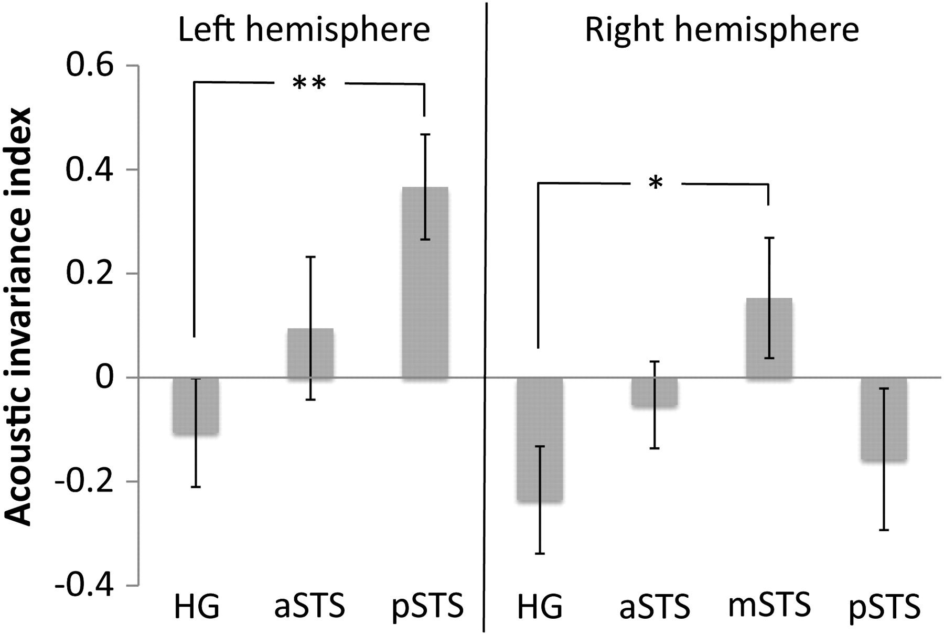
Figure 6. Acoustic invariance across the 7 ROIs as measured using an acoustic invariance index (see text). This index ...
Notes:
Figure 6. Acoustic invariance across the 7 ROIs as measured using an acoustic invariance index (see text). This index effectively ranges from −1 to 1 where positive values indicate higher degrees of acoustic invariance and negative values indicate lower degrees of acoustic invariance (i.e., more acoustic sensitivity). *P < 0.05, **P < 0.01, 2 tailed.
Unless provided in the caption above, the following copyright applies to the content of this slide: © The Author 2010. Published by Oxford University Press. All rights reserved. For permissions, please e-mail: journals.permissions@oxfordjournals.org

