Slide 1
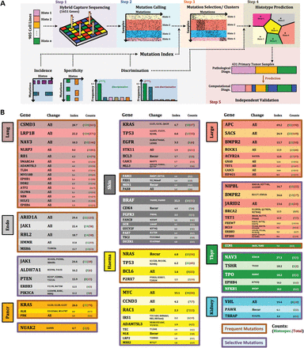
Figure 1. (A) Schematic outline of the five main steps in this study. (B) Selective (purple frame) and frequent (brown ...
Notes:
Figure 1. (A) Schematic outline of the five main steps in this study. (B) Selective (purple frame) and frequent (brown frame) biologically relevant meta-mutations of eight cancer types (histology-specific colors) are listed in mutation index descending order. Gene name, selected amino acid changes, mutation index as well as histology-specific (green) and total (red) counts are recorded.
Unless provided in the caption above, the following copyright applies to the content of this slide: © The Author 2013. Published by Oxford University Press. All rights reserved. For Permissions, please email: journals.permissions@oup.com

Slide 2
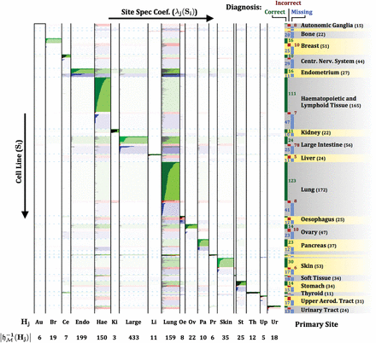
Figure 2. Bar plots of mutation coefficients for cell lines (ordinate) against cancer types (abscissa), segregated by ...
Notes:
Figure 2. Bar plots of mutation coefficients for cell lines (ordinate) against cancer types (abscissa), segregated by correct (green), incorrect (red) and missing (blue) ICOMS diagnoses. Color intensities mirror accumulation of mutation coefficients in each field.
Unless provided in the caption above, the following copyright applies to the content of this slide: © The Author 2013. Published by Oxford University Press. All rights reserved. For Permissions, please email: journals.permissions@oup.com

Slide 3
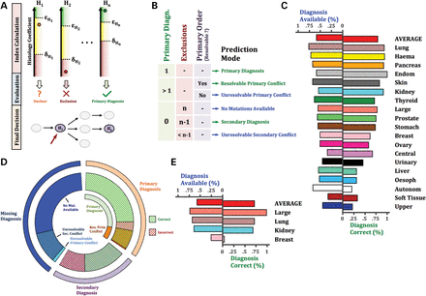
Figure 3. (A) Schematic outline of ICOMS prediction steps. (B) Primary associations (green) and exclusions (red) of ...
Notes:
Figure 3. (A) Schematic outline of ICOMS prediction steps. (B) Primary associations (green) and exclusions (red) of cancer types as well as their comparability (primary partial order, purple) are combined to derive a final ICOMS prediction (six decision modes). Criteria, marked by ‘-’ are irrelevant for diagnosis. (C) ICOMS accuracy on cell lines. Rates of available (left) and correct (right) diagnoses are illustrated as bar plots for 19 cancer types (histology-specific colors). All cell lines are incorporated equally into the calculation of the average fractions. (D) Fractions of primary, secondary and missing diagnoses (outer ring) are segregated by ICOMS prediction modes (inner ring). Correct and incorrect diagnoses are marked by green and red stripes, respectively. (E) ICOMS accuracy on primary tumor samples (4 cancer types).
Unless provided in the caption above, the following copyright applies to the content of this slide: © The Author 2013. Published by Oxford University Press. All rights reserved. For Permissions, please email: journals.permissions@oup.com

Slide 4
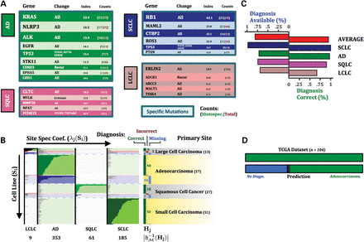
Figure 4. (A) Biologically relevant meta-mutations of lung cancer subtypes are listed in mutation index descending ...
Notes:
Figure 4. (A) Biologically relevant meta-mutations of lung cancer subtypes are listed in mutation index descending order. (B) Bar plots of mutation-derived coefficients of lung cancer subtypes. Color intensities mirror accumulation of mutation coefficients in each field. (C) ICOMS accuracy on lung cancer subtypes. All cell lines are incorporated equally into the calculation of the average fractions. (D) Mapping of annotated (top, TCGA) to predicted (bottom, ICOMS) lung cancer subtypes of 104 primary lung adenocarcinoma samples. Samples, for which no computational diagnosis is available, are stained in navy blue.
Unless provided in the caption above, the following copyright applies to the content of this slide: © The Author 2013. Published by Oxford University Press. All rights reserved. For Permissions, please email: journals.permissions@oup.com

