Slide 1
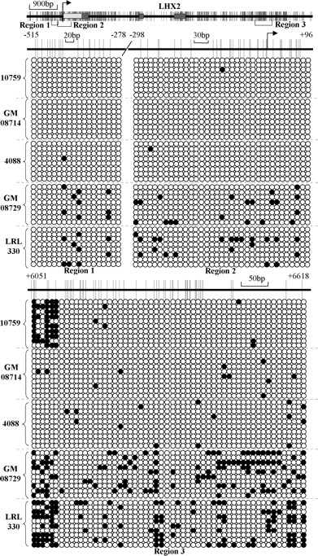
Figure 6. Bisulfite genomic sequencing analysis of the LHX2 homeobox gene whose expression is increased in ICF relative ...
Notes:
Figure 6. Bisulfite genomic sequencing analysis of the LHX2 homeobox gene whose expression is increased in ICF relative to normal LCLs. Three CpG-rich regions of LHX2 were analyzed (denoted regions 1–3 below the CpG plot at the top) in the same five cell lines used in Figs. 4 and 5; two within the promoter/5′ region and one within a very CpG-rich domain in intron 3. Symbols and labels are the same as in Fig. 4. Boxes represent exons; dark gray, translated; light gray, 5′-UTR. A summary of the total percent methylation for all regions is provided in Table 1.
Unless provided in the caption above, the following copyright applies to the content of this slide: © The Author 2007. Published by Oxford University Press. All rights reserved. For Permissions, please email: journals.permissions@oxfordjournals.org

Slide 2
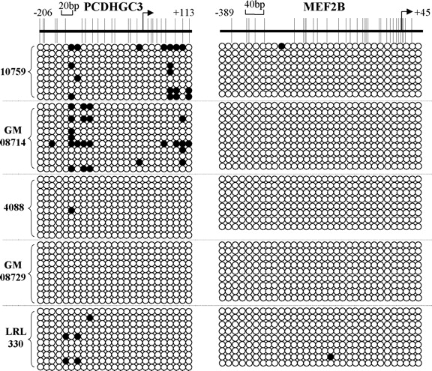
Figure 5. Bisulfite genomic sequencing analysis of genes demonstrating decreased expression in ICF syndrome cells. The ...
Notes:
Figure 5. Bisulfite genomic sequencing analysis of genes demonstrating decreased expression in ICF syndrome cells. The CpG-rich regions of two genes, PCDHGC3 and MEF2B, were analyzed for differences in DNA methylation patterns in three ICF cell lines and two normal cell lines. Symbols and labels are the same as in Fig. 4. A summary of the total percent methylation for all genes is provided in Table 1.
Unless provided in the caption above, the following copyright applies to the content of this slide: © The Author 2007. Published by Oxford University Press. All rights reserved. For Permissions, please email: journals.permissions@oxfordjournals.org

Slide 3
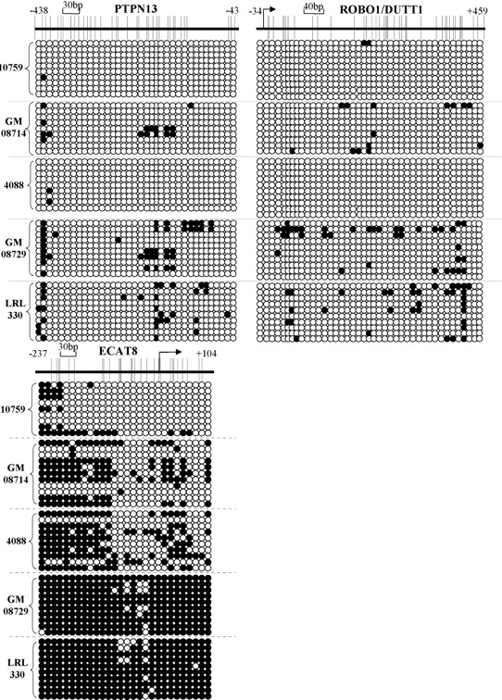
Figure 4. Bisulfite genomic sequencing (BGS) analysis of genes demonstrating increased expression in ICF syndrome ...
Notes:
Figure 4. Bisulfite genomic sequencing (BGS) analysis of genes demonstrating increased expression in ICF syndrome cells. The CpG-rich regions of three genes, PTPN13, ROBO1/DUTT1 and ECAT8 were analyzed for differences in DNA methylation patterns in three ICF cell lines and two normal cell lines. A CpG plot of the region analyzed is at the top of each panel and circles below this indicate methylation status; filled circles, methylated CpGs, open circles, unmethylated CpGs. Numbering is relative to the transcription start site as defined using NCBI MapViewer. The bent arrow, when shown, is the transcription start site. Each row of circles corresponds to one bacterial clone. Following bisulfite treatment and PCR, resulting products were TA-cloned and at least eight independent colonies were sequenced. A summary of the total percent methylation for all genes is given in Table 1.
Unless provided in the caption above, the following copyright applies to the content of this slide: © The Author 2007. Published by Oxford University Press. All rights reserved. For Permissions, please email: journals.permissions@oxfordjournals.org

Slide 4
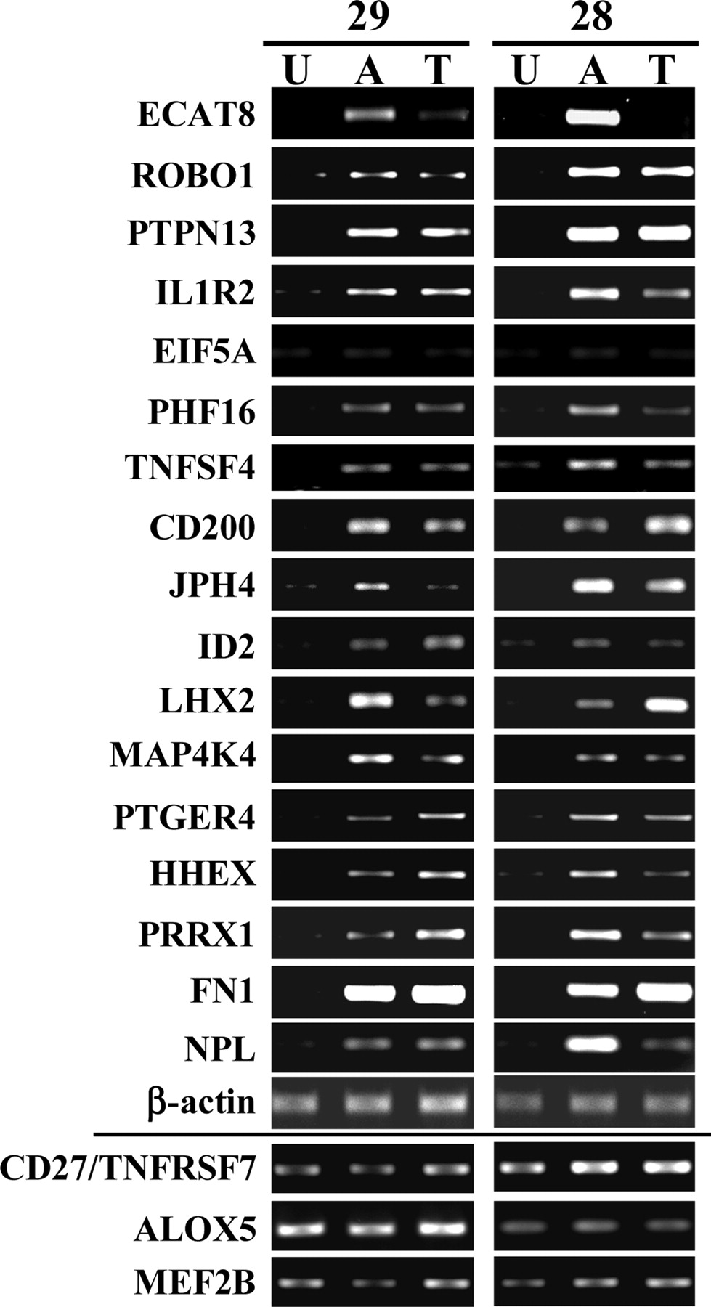
Figure 3. Distinct effects of histone deacetylation and DNA methylation inhibitors on genes showing altered expression ...
Notes:
Figure 3. Distinct effects of histone deacetylation and DNA methylation inhibitors on genes showing altered expression in ICF LCLs. Two normal LCLs were treated with 5 µm 5-azadC (‘A’) for 72 h or with 100 nm TSA (‘T’) for 24 h, or were mock treated (‘U’). Seventeen genes showing increased expression in ICF syndrome cells relative to normal cells were analyzed (see also Fig. 2A) by semiquantitative RT–PCR. Note that these genes were not expressed in normal LCLs or were expressed at low levels under standard growth conditions. Three genes that were downregulated in ICF relative to normal LCLs (see also Fig. 2B) were similarly analyzed (bottom three panels). Beta-actin served as a loading control.
Unless provided in the caption above, the following copyright applies to the content of this slide: © The Author 2007. Published by Oxford University Press. All rights reserved. For Permissions, please email: journals.permissions@oxfordjournals.org

Slide 5
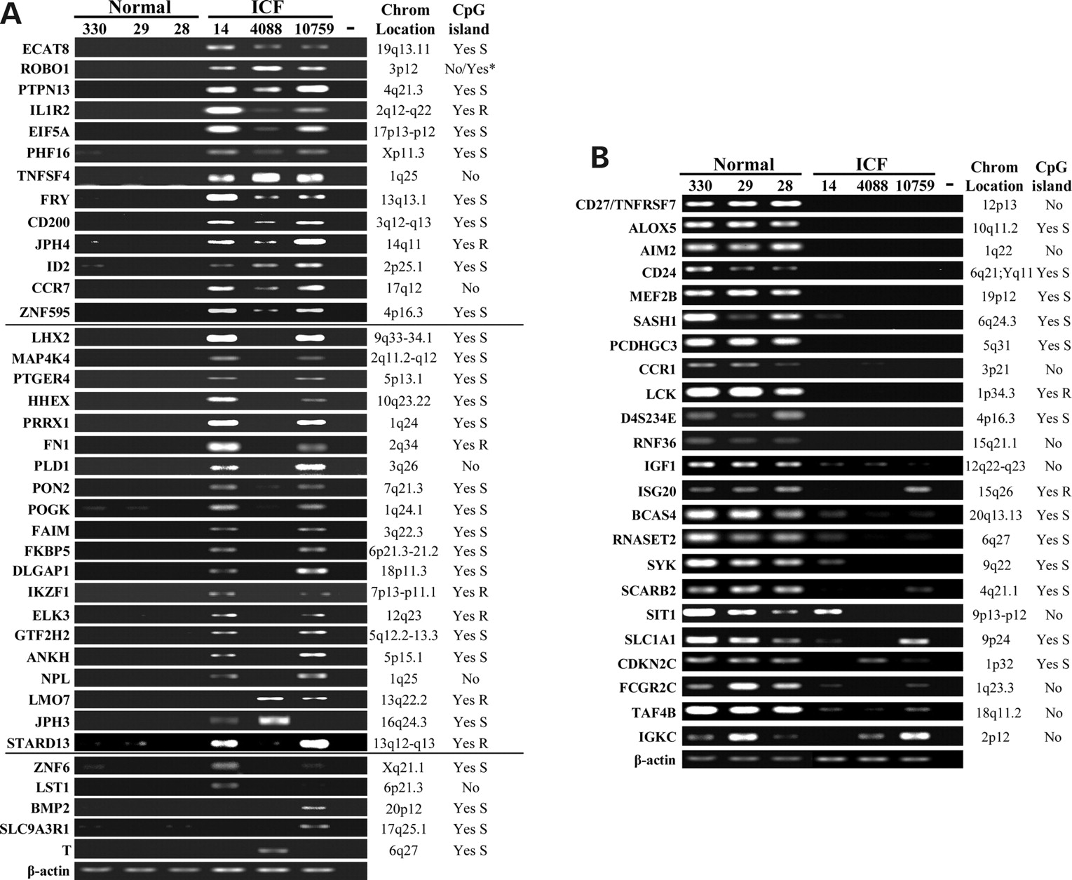
Figure 2. Confirmation of expression changes for a subset of genes identified as differentially expressed in ICF cells ...
Notes:
Figure 2. Confirmation of expression changes for a subset of genes identified as differentially expressed in ICF cells relative to normal cells by semi-quantitative RT–PCR. (A) Analysis of 38 genes predicted to be upregulated in ICF syndrome relative to normal LCLs. Results for three normal lines (LRL330-’330’, GM08729-’29’, and GM08728-’28’) and three ICF lines (GM08714-’14’, 4088 and 10759) are shown. Genes are divided into three classes based on degree of similarity in expression among the three ICF lines. (B) Analysis of 23 genes predicted by the microarray analysis to be downregulated in ICF relative to normal LCLs. The gene symbol is shown at the left and the chromosomal location and presence/absence of a CpG island at the 5’ end of the gene (‘Yes’ or ‘No’) is indicated at the right. ‘S’ and ‘R’ indicate the degree of stringency of the CpG island as discussed in Results section, stringent or relaxed, respectively. Beta-actin (bottom gel panel in both parts) serves as a loading control. All reactions were repeated at least three times and results shown are representative. ‘−’ water only negative control. The asterisk indicates that there are two alternative start sites for ROBO1, one is CpG-poor and one is a CpG island.
Unless provided in the caption above, the following copyright applies to the content of this slide: © The Author 2007. Published by Oxford University Press. All rights reserved. For Permissions, please email: journals.permissions@oxfordjournals.org

Slide 6
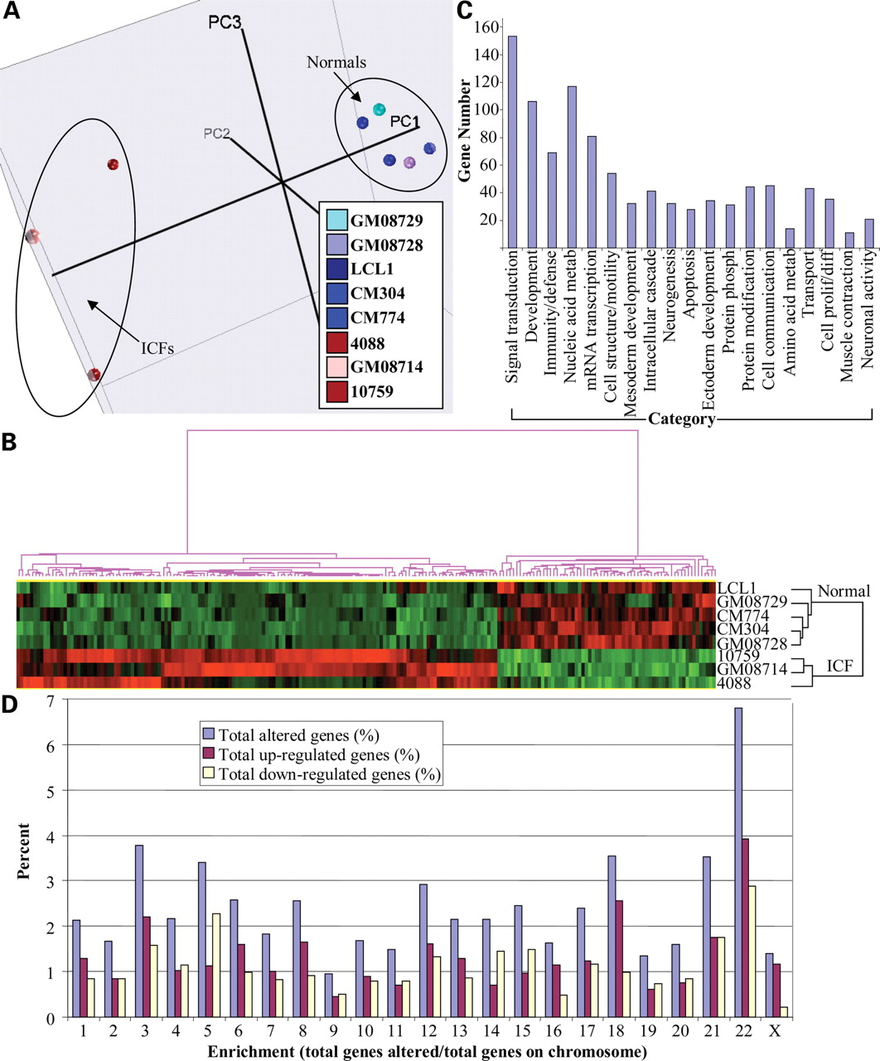
Figure 1. Global expression profiling of ICF syndrome and normal lymphoblastoid cell lines (LCLs). LCLs derived from ...
Notes:
Figure 1. Global expression profiling of ICF syndrome and normal lymphoblastoid cell lines (LCLs). LCLs derived from five normal and three ICF syndrome individuals were used for the analysis. Total RNA was isolated, labeled and hybridized to Affymetrix U133A/B Genechips. Data were analyzed as described in the text. (A) Principal component analysis (PCA) of the eight cell lines used for gene expression profiling (represented by the colored balls). (B) Hierarchical clustering of the 296 probe sets from both the A and B chips that most reflect differences between normal and ICF lines (from Supplementary Material, Table S2). (C) Grouping of genes showing altered expression levels (2-fold or greater, P < 0.05) between normal and ICF lines into functional pathways using PANTHER. The number of genes from Supplementary Material, Table S1 in each of 19 different significantly enriched classes is shown on the y-axis (P < 0.05). (D) Genes with altered expression in ICF syndrome cell lines broken down by chromosome. The total percent of all affected genes on each chromosome from Supplementary Material, Table S1 was plotted as the number of up- and/or downregulated genes divided by the total predicted number of genes on each chromosome (as the percent of total affected genes). The total number and the number of up- or downregulated genes are shown. χ2 test showed that the ICF gene distribution is highly associated (P < 0.0001).
Unless provided in the caption above, the following copyright applies to the content of this slide: © The Author 2007. Published by Oxford University Press. All rights reserved. For Permissions, please email: journals.permissions@oxfordjournals.org

Slide 7
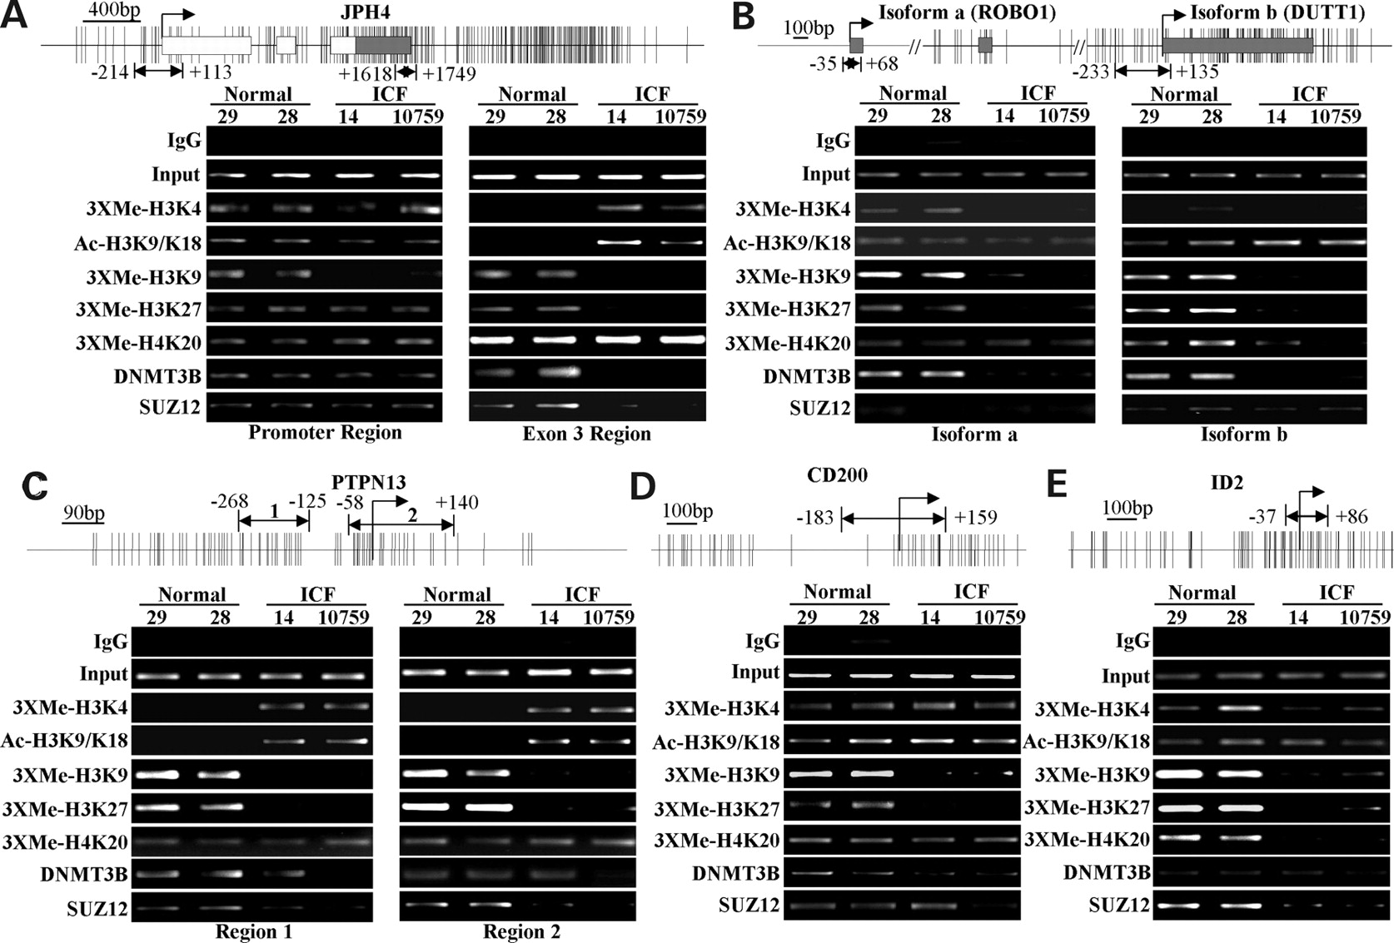
Figure 7. Chromatin immunoprecipitation (ChIP) analysis of five genes upregulated in ICF syndrome cells: (A) JPH4, (B) ...
Notes:
Figure 7. Chromatin immunoprecipitation (ChIP) analysis of five genes upregulated in ICF syndrome cells: (A) JPH4, (B) ROBO1/DUTT1 (isoform a/isoform b), (C) PTPN13, (D) CD200 and (E) ID2. The top of each panel is a CpG plot for each gene with locations of exons (boxes), transcription start site (bent arrow) and ChIP PCR primers (double headed arrows, numbering is relative to the transcription start site). Sonicated chromatin was prepared from two normal and two ICF LCLs and used in immunoprecipitations with the antibodies listed at the left of each panel. Normal rabbit IgG served as a negative control for non-specific binding. Input chromatin (1% of the ChIP reactions) is also shown as a loading control. Antibodies were directed against trimethylated (‘3XMe’) forms of H3K4, H3K9, H3K27 and H4K20, acetylated (‘Ac’) H3K9/K18, as well as DNMT3B and the PRC2 subunit SUZ12. Immunoprecipitated DNA was used with the primers indicated in semiquantitative PCR reactions and then analyzed on 2% agarose gels. Reactions were repeated at least three times from two independent ChIP reactions and the results were consistent (not shown). ICF line 4088 was not analyzed because we were unable to grow it in quantities sufficient for ChIP. Note that ROBO1 isoform b originates from within intron two of the isoform a transcript. Regions analyzed by ChIP correspond closely to those analyzed by BGS (Fig. 4, Supplementary Material, Figs. S1 and S2).
Unless provided in the caption above, the following copyright applies to the content of this slide: © The Author 2007. Published by Oxford University Press. All rights reserved. For Permissions, please email: journals.permissions@oxfordjournals.org

Slide 8
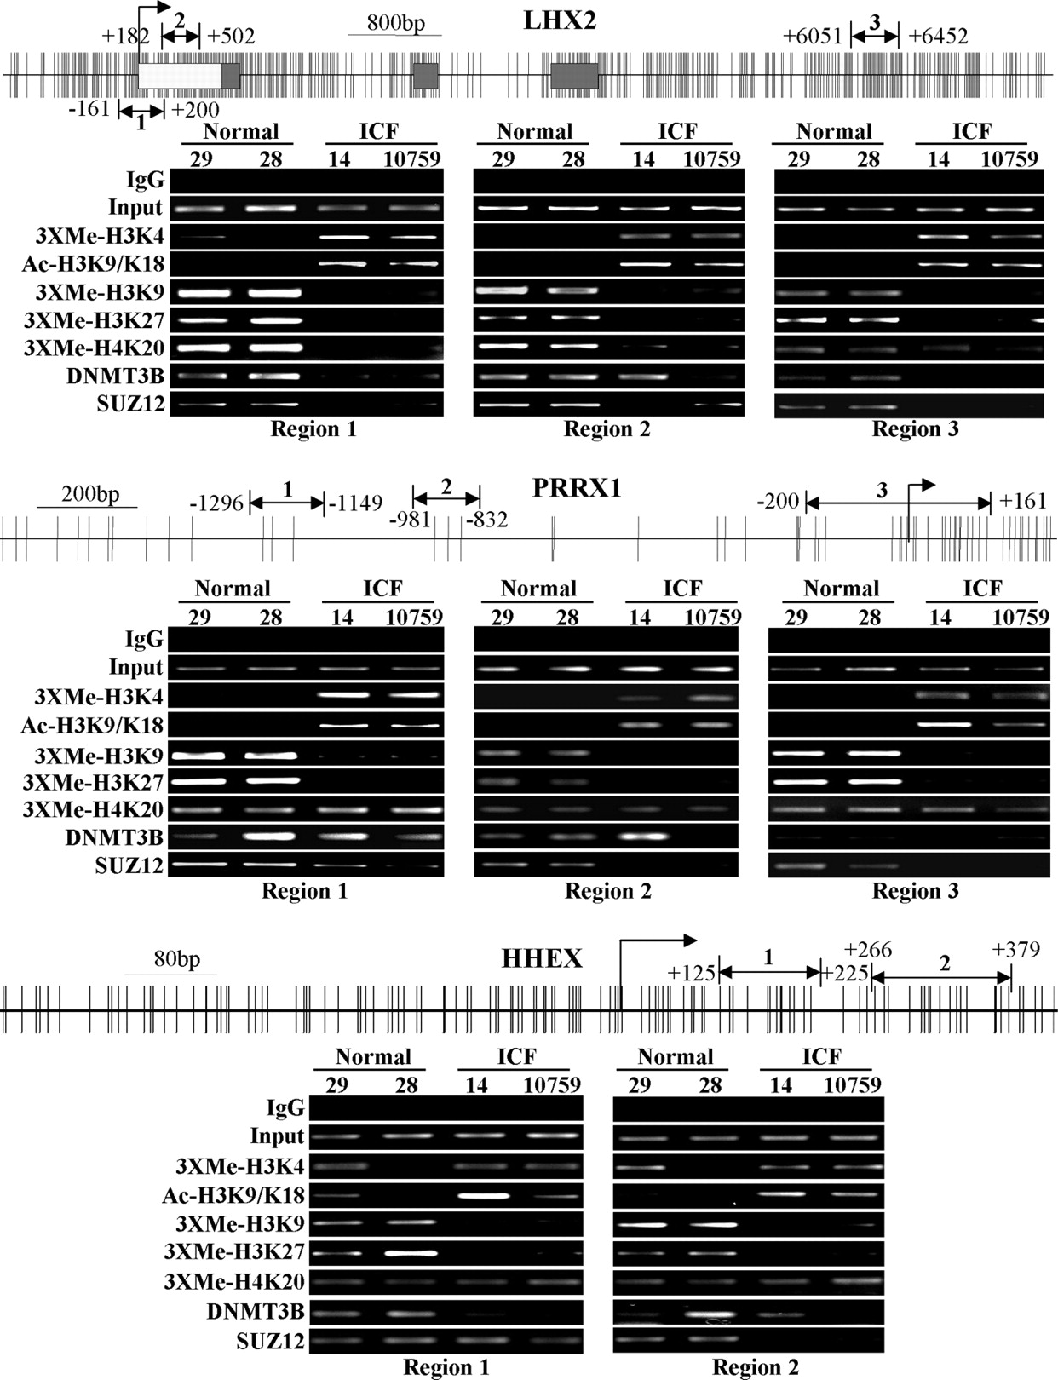
Figure 8. ChIP analysis of multiple regions of three homeobox genes demonstrating increased expression in ICF syndrome ...
Notes:
Figure 8. ChIP analysis of multiple regions of three homeobox genes demonstrating increased expression in ICF syndrome cells, LHX2, PRRX1 and HHEX. Labels, cell lines and antibodies are as described in Fig. 7. Regions analyzed by ChIP correspond closely to those analyzed by BGS for LHX2 and PRRX1 (Fig. 6, Supplementary Material, Fig. S2).
Unless provided in the caption above, the following copyright applies to the content of this slide: © The Author 2007. Published by Oxford University Press. All rights reserved. For Permissions, please email: journals.permissions@oxfordjournals.org

Slide 9
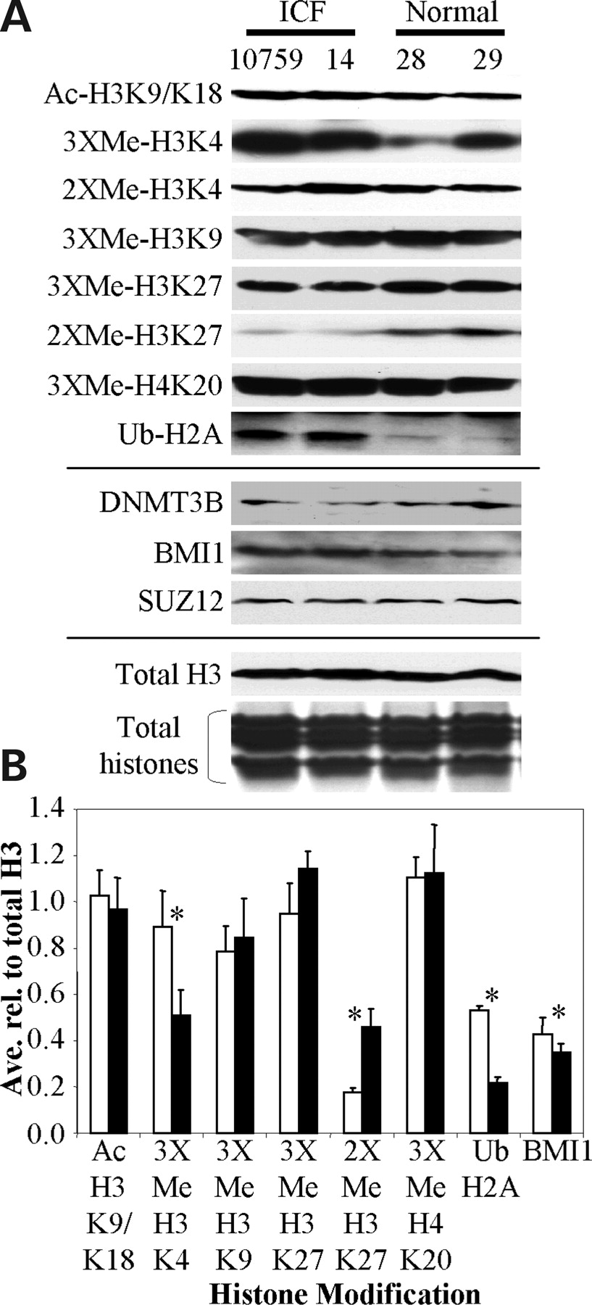
Figure 9. Global levels of histone modifications in ICF and normal LCLs assessed by western blotting. (A) Isolated ...
Notes:
Figure 9. Global levels of histone modifications in ICF and normal LCLs assessed by western blotting. (A) Isolated nuclear protein (soluble nuclear plus chromatin-enriched fractions) derived from two normal and two ICF LCLs was separated on SDS–PAGE gels, transferred to PVDF membrane and probed with the antibodies indicated at the left. Protein equivalent to 2 × 106 cells is loaded in each lane. Equal loading of all four samples is demonstrated by western blotting for total histone H3 and by coomassie blue staining (‘total histones’) of the core histones (bottom-most two panels). Antibody abbreviations are the same as in Fig. 7. ‘Ub’-H2A monoubiquitinated at K119, 2XMe, dimethylated form; 14, GM08714; 28, GM08728; 29, GM08729; BMI1 is a subunit of the PRC1 polycomb complex, SUZ12 is a subunit of the PRC2 polycomb complex. (B) Densitometry quantitation of select histone modifications from (A). Each protein sample was run in triplicate, scanned and quantitated. White bars, ICF cell lines; black bars, normal LCLs. Bars are the average signal intensity of six independent western blots (three from each cell line) normalized to the total histone H3 signal for each cell line. Error bars are the standard deviation from the mean. Asterisks indicate statistical significance (t-test, P ≤ 0.05, only the BMI1 result yielded a P = 0.05, all others were <0.05).
Unless provided in the caption above, the following copyright applies to the content of this slide: © The Author 2007. Published by Oxford University Press. All rights reserved. For Permissions, please email: journals.permissions@oxfordjournals.org

Slide 10
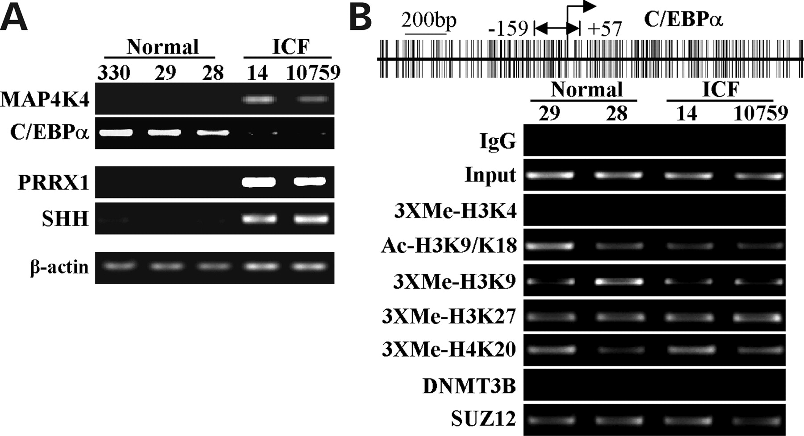
Figure 10. Use of microarray expression data to predict changes in potentially relevant downstream target genes in ICF ...
Notes:
Figure 10. Use of microarray expression data to predict changes in potentially relevant downstream target genes in ICF syndrome cells. C/EBPα and SHH (sonic hedgehog) are downstream targets of the transcriptional regulators MAP4K4 and PRRX1, respectively, that were upregulated in ICF syndrome cells. (A) Semi-quantitative RT-PCR analysis for the gene listed at the left in three normal and two ICF LCLs. Beta-actin (bottom panel) serves as a loading control. (B) ChIP analysis of the C/EBPα promoter region. Antibodies, conditions and abbreviations are the same as described in Fig. 7. A CpG plot is shown at the top with the location of the ChIP primers indicated with a double-headed arrow.
Unless provided in the caption above, the following copyright applies to the content of this slide: © The Author 2007. Published by Oxford University Press. All rights reserved. For Permissions, please email: journals.permissions@oxfordjournals.org

Slide 11
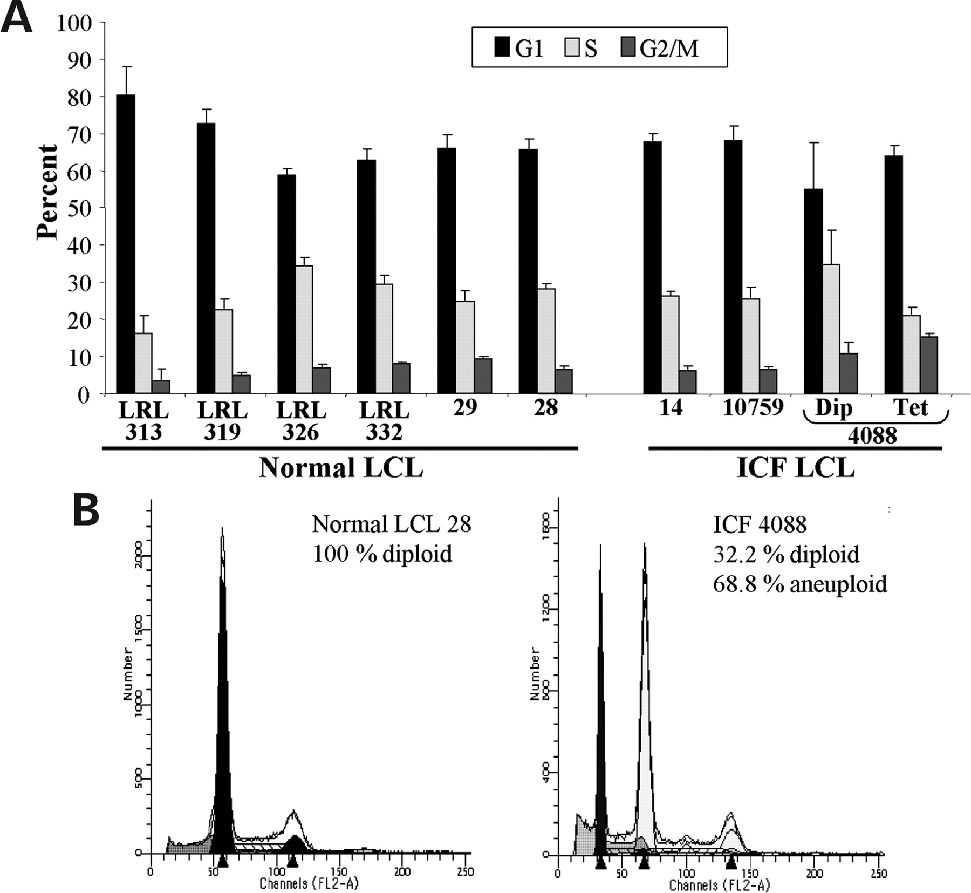
Figure 11. Cell cycle analysis of normal and ICF LCLs. (A) Summary of cell cycle profiles for five normal LCLs and three ...
Notes:
Figure 11. Cell cycle analysis of normal and ICF LCLs. (A) Summary of cell cycle profiles for five normal LCLs and three ICF LCLs showing the percent cells in G1 (black bars), S (light gray bars) and G2/M (dark gray bars) phases of the cell cycle. Cell lines were analyzed in triplicate with the bar showing the average and the error bar the standard deviation. (B) Representative raw cell cycle data for a normal LCL (GM08728) and the 4088 ICF LCL emphasizing the near tetraploid state of the 4088 cells. Dip, diploid; Tet, tetraploid.
Unless provided in the caption above, the following copyright applies to the content of this slide: © The Author 2007. Published by Oxford University Press. All rights reserved. For Permissions, please email: journals.permissions@oxfordjournals.org

