Slide 1
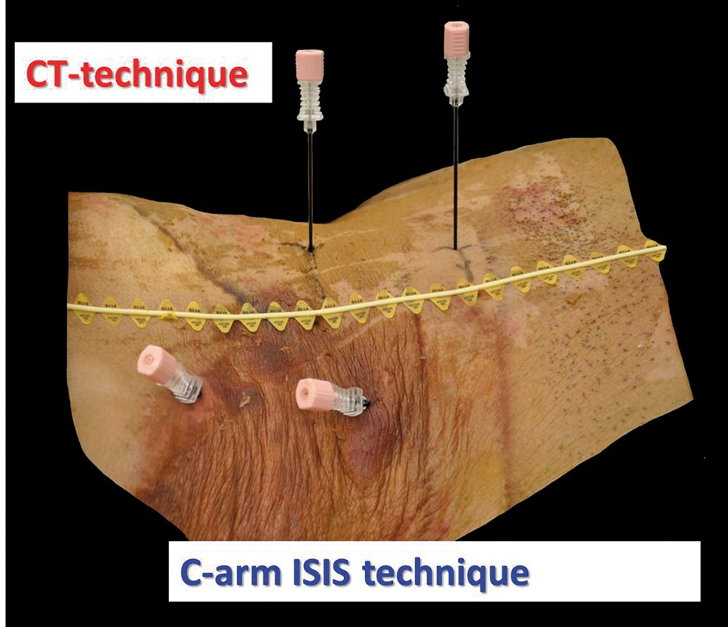
Figure 1 A photograph of an undissected cadaver in which electrodes have been placed on the left under CT guidance, ...
Notes:
Figure 1 A photograph of an undissected cadaver in which electrodes have been placed on the left under CT guidance, and in the right under flouroscopy guidance. The line marks the midline and location of the tips of the spinous processes.
Unless provided in the caption above, the following copyright applies to the content of this slide: © 2016 American Academy of Pain Medicine. All rights reserved. For permissions, please e-mail: journals.permissions@oup.com

Slide 2
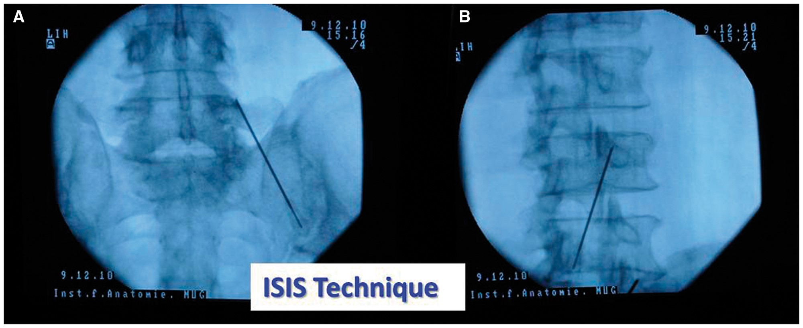
Figure 2 Radiographs of fluoroscopy views of electrodes. (A) Antero-posterior view of an electrode at L4. (B) Oblique ...
Notes:
Figure 2 Radiographs of fluoroscopy views of electrodes. (A) Antero-posterior view of an electrode at L4. (B) Oblique lateral view of an electrode at L3.
Unless provided in the caption above, the following copyright applies to the content of this slide: © 2016 American Academy of Pain Medicine. All rights reserved. For permissions, please e-mail: journals.permissions@oup.com

Slide 3
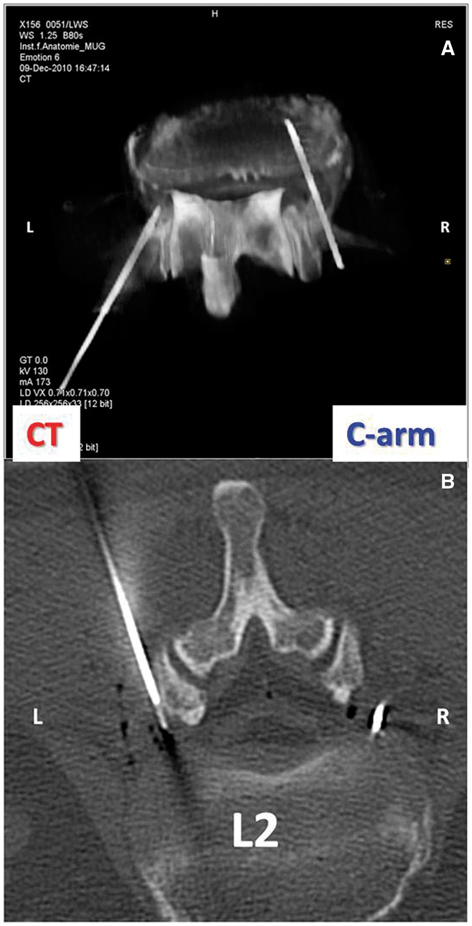
Figure 3 CT images of electrodes placed in a cadaver, inserted under CT on the left, and fluoroscopy in the right. (A) ...
Notes:
Figure 3 CT images of electrodes placed in a cadaver, inserted under CT on the left, and fluoroscopy in the right. (A) Reconstructed view. (B) Axial view. Note that the needle inserted under fluoroscopy has been advanced to a deeper location before transport, and has not been withdrawn to its original position.
Unless provided in the caption above, the following copyright applies to the content of this slide: © 2016 American Academy of Pain Medicine. All rights reserved. For permissions, please e-mail: journals.permissions@oup.com

Slide 4
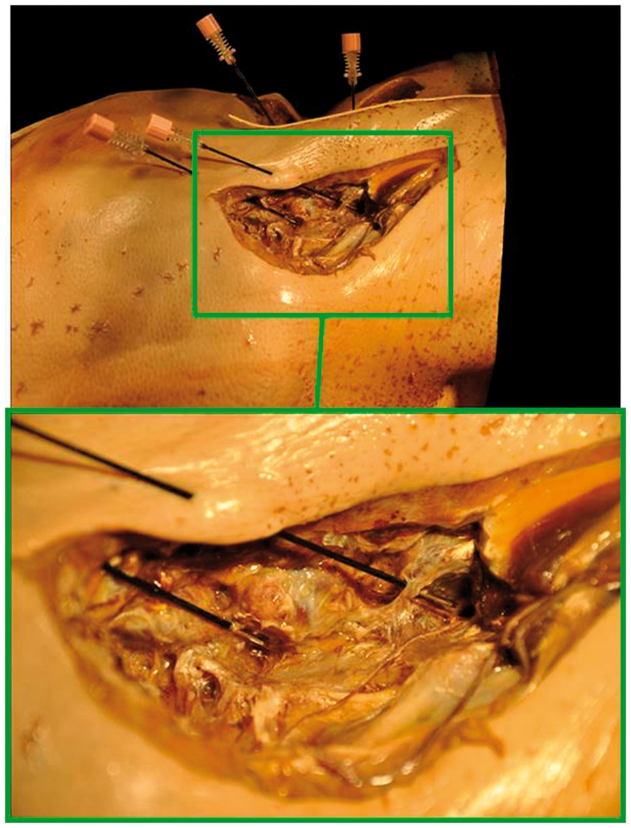
Figure 4 Photography of the final stages of a dissection of the lumbar medial branches with electrodes placed on them, ...
Notes:
Figure 4 Photography of the final stages of a dissection of the lumbar medial branches with electrodes placed on them, view from the right. The lower image is a close-up view of the region outlined in the upper image. Note how the dissection was performed along a lateral approach so as to preserve the position of the electrodes, which is held in placed by the puncture points in the skin.
Unless provided in the caption above, the following copyright applies to the content of this slide: © 2016 American Academy of Pain Medicine. All rights reserved. For permissions, please e-mail: journals.permissions@oup.com

