Slide 1
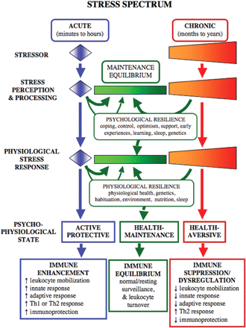
Fig. 1 The stress spectrum model. We have proposed a definition of stress as a constellation of events, consisting ...
Notes:
Fig. 1 The stress spectrum model. We have proposed a definition of stress as a constellation of events, consisting of a stimulus (STRESSOR), that precipitates a reaction in the brain (STRESS PERCEPTION & EVALUATION), that in turn activates physiologic fight-or-flight systems in the body (PHYSIOLOGICAL STRESS RESPONSE) (Dhabhar and McEwen 1997). The duration of a physiological response to stress is the critical determinant of its effects on immune function and health. The STRESSOR itself may be acute (e.g., a person narrowly misses being hit by a car) or chronic (e.g., a person caring for a chronically ill child, spouse or parent). STRESS PERCEPTION and PROCESSING by the brain are critical for determining the duration and magnitude of the PHYSIOLOGICAL STRESS RESPONSE stimulated by any given stressor. Acute or chronic stress is generally superimposed on a psycho-physiological HEALTH MAINTENANCE STEADY STATE. The extent and efficiency with which an organism returns to its health-maintenance steady state after stress depends on RESILIENCE, which we define as the capacity of psychological and interacting physiological systems to recover from challenging conditions. Factors such as coping mechanisms, sense of control, optimism, social support, early life experiences, learning, genetics, and sleep are important mediators of PSYCHOLOGICAL RESILIENCE. Factors such as neuro-endocrine reactivity, genetics, environment, nutrition, and sleep are important mediators of PHYSIOLOGICAL RESILIENCE. Mechanisms of psychological resilience are especially important for humans because these mechanisms can limit the duration and magnitude, and potentially, the deleterious effects, of chronic stress. By the same token, psychogenic stressors can be particularly detrimental in human subjects because they may generate stress responses long after exposure to the stressor, or even in the absence of physical stressors or salient threats. The PHYSIOLOGICAL STRESS RESPONSE is the ultimate effector arm of the stress spectrum. It may consist of acute or chronic physiological activation (neurotransmitters, hormones, and their molecular, cellular, organ-level and systemic effects) that results in PSYCHO-PHYSIOLOGICAL STATES that have different effects on health. Acute stress generally results in activation of mechanisms that include enhancement of immune function while chronic stress results in health-aversive conditions that result in dysregulation or suppression of immune function. The molecular mechanisms mediating conversion from positive to negative effects of stress on immune function and health are slowly beginning to emerge, and merit further investigation. Figure reprinted from Dhabhar and McEwen (2007). This figure was reprinted with permission from: Dhabhar FS, McEwen BS. 2007. Bidirectional effects of stress on immune function: possible explanations for salubrious as well as harmful effects. In: Ader R, editor. Psychoneuroimmunology IV. San Diego: Elsevier. p. 723–60. Copyright Elsevier.
Unless provided in the caption above, the following copyright applies to the content of this slide: © The Author 2009. Published by Oxford University Press on behalf of the Society for Integrative and Comparative Biology. All rights reserved. For permissions please email: journals.permissions@oxfordjournals.org.

