Slide 1
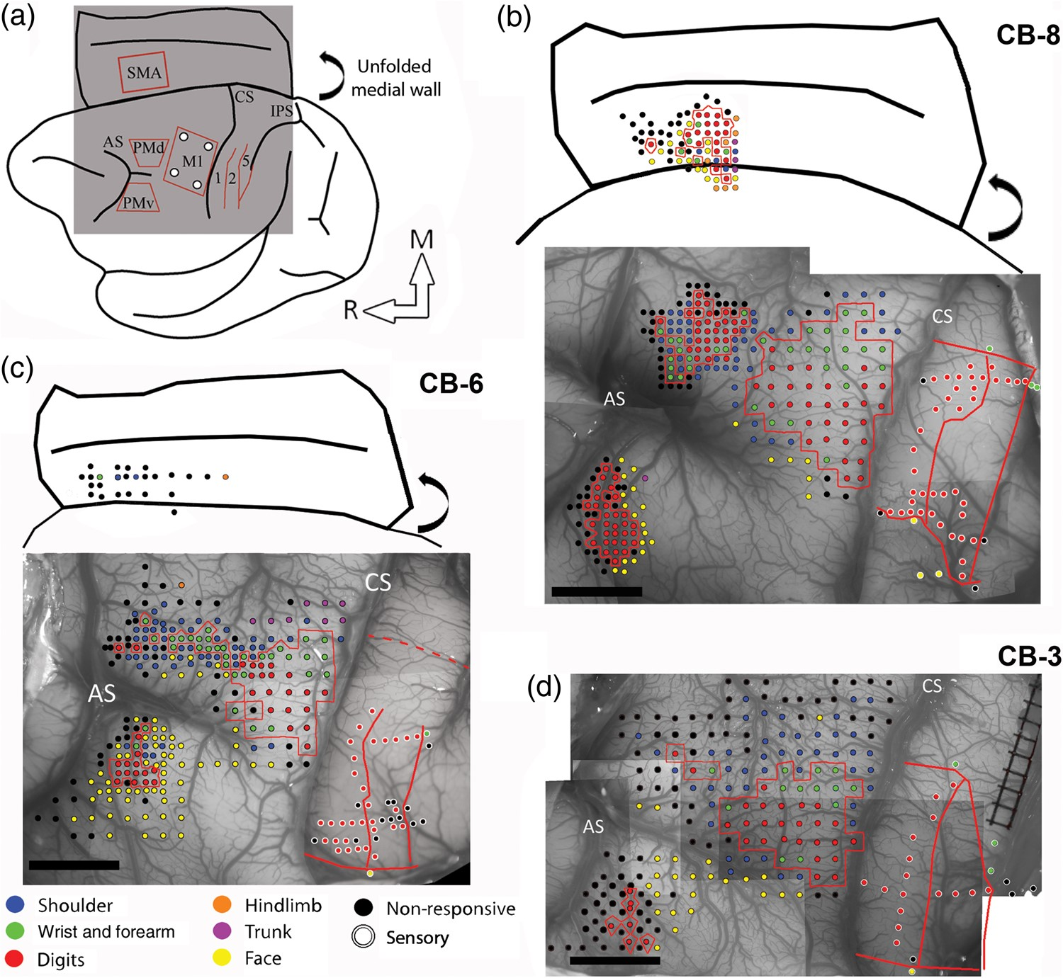
Figure 1. Electrophysiological mapping. (a) Cartoon showing a lateral view of the brain and the approximate location of ...
Notes:
Figure 1. Electrophysiological mapping. (a) Cartoon showing a lateral view of the brain and the approximate location of the craniotomy (gray square) and the areas of the frontal and parietal cortex studied with electrophysiological mapping methods. The medial wall is shown unfolded (curved arrow). (b) Motor and sensory mapping data in CB-8. Each colored dot on the digital photograph of the cortex represents a microelectrode penetration site. The evoked movement (frontal cortex) or somatosensory receptive field location (parietal cortex) is color-coded (legend). In the parietal cortex, the same color-code is used for the receptive field location on the body, but the dots have white contours. The hand representations of M1, PMv, PMd, and SMA are outlined with red contours. In the parietal cortex, the medio-lateral extent of the hand representation in S1 and the location of rostro-caudal borders between area 1, area 2, and area 5 are shown with red lines. Note that the location of stimulation sites for SMA are approximated based on the distance from PMd and the depth of the electrode. They are shown over a cartoon representation of the unfolded medial wall to provide an estimated location of the sites in relation to the medial wall's convexity and the cingulate sulcus. The location of these 2 landmarks is based on the anatomical reconstructions of each monkey. (c) Motor and sensory mapping data for CB-6. In this animal, we were able to locate SMA but got limited data from it. As for CB-8, the location of the stimulation sites in SMA is estimated. In S1, we did not physiologically define the medial border of the hand representation. Based on other animals, we estimated the location of this border and show it with a dotted red line. (d) Motor and sensory mapping data for CB-3. In this animal, we did not locate SMA. AS: arcuate sulcus; CS: central sulcus; IPS: intraparietal sulcus; M1: primary motor cortex; PMd: dorsal premotor cortex; PMv: ventral premotor cortex; SMA: supplementary motor area; 1: area 1; 2: area 2; 5: area 5; M: medial; R: rostral. Scale bar = 5 mm.
Unless provided in the caption above, the following copyright applies to the content of this slide: © The Author 2016. Published by Oxford University Press.This is an Open Access article distributed under the terms of the Creative Commons Attribution Non-Commercial License (http://creativecommons.org/licenses/by-nc/4.0/), which permits non-commercial re-use, distribution, and reproduction in any medium, provided the original work is properly cited. For commercial re-use, please contact journals.permissions@oup.com

Slide 2
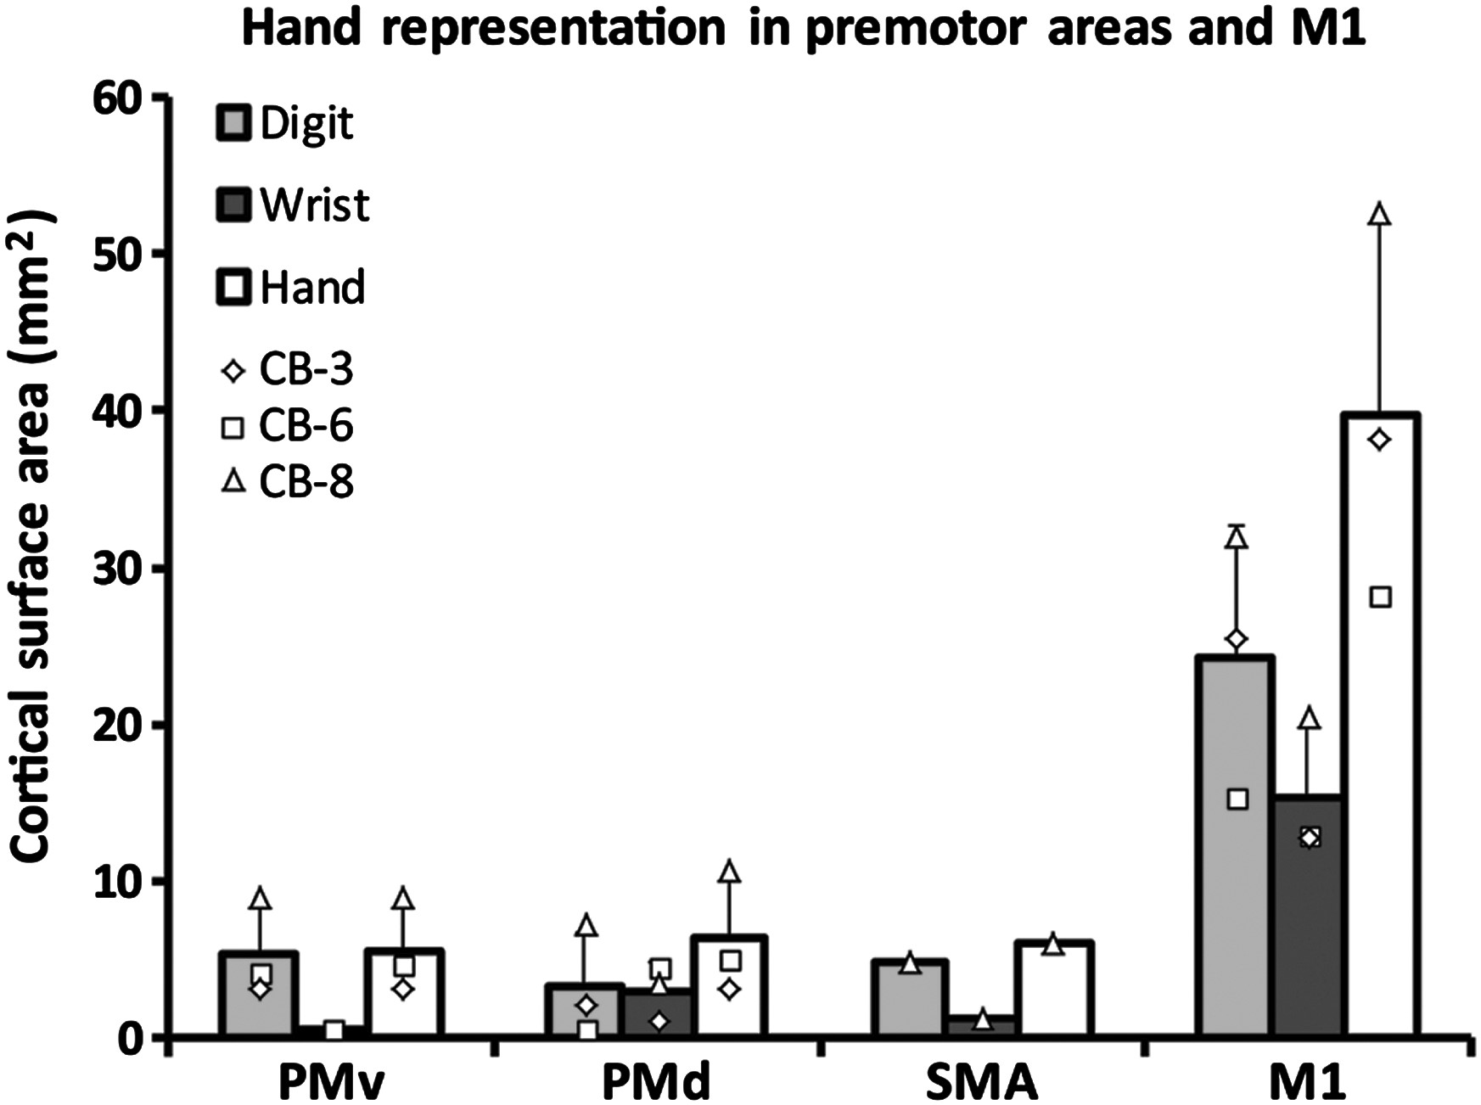
Figure 2. Cortical surface area of the hand representation in the primary (M1) and premotor areas of Cebus monkeys. The ...
Notes:
Figure 2. Cortical surface area of the hand representation in the primary (M1) and premotor areas of Cebus monkeys. The graph shows the cortical area from which movements of the digits and wrist could be evoked in the different motor areas (mean ± SD). The hand representation in PMv (n = 3), PMd (n = 3), and SMA (n = 1) was of comparable size and much smaller than in M1 (n = 3). Data from individual monkeys are shown with different symbols displayed on the top of the bars. In all 4 cortical areas, there was a larger territory devoted to movements of the digits in comparison with wrist. However, this difference was smaller in PMd and greater in PMv.
Unless provided in the caption above, the following copyright applies to the content of this slide: © The Author 2016. Published by Oxford University Press.This is an Open Access article distributed under the terms of the Creative Commons Attribution Non-Commercial License (http://creativecommons.org/licenses/by-nc/4.0/), which permits non-commercial re-use, distribution, and reproduction in any medium, provided the original work is properly cited. For commercial re-use, please contact journals.permissions@oup.com

Slide 3
Figure 3. Photomicrographs of retrogradely labeled cells in the hemisphere ipsilateral to the injection of neuronal ...
Notes:
Figure 3. Photomicrographs of retrogradely labeled cells in the hemisphere ipsilateral to the injection of neuronal tracer. Photomicrographs of retrogradely labeled cells with (a) FR, (b) FE, (c) FB, and (d) BDA in the ipsilateral hemisphere. Only cell bodies displaying a fully round soma and a minimum of 2 protuberances (considered being either dendrites and/or axon) were considered labeled neurons. A marker was overlaid onto the cell in Neurolucida (Microbright-Field, Inc.) in the reconstruction of the section. Brightness and contrast were adjusted. Scale bars = 100 µm.
Unless provided in the caption above, the following copyright applies to the content of this slide: © The Author 2016. Published by Oxford University Press.This is an Open Access article distributed under the terms of the Creative Commons Attribution Non-Commercial License (http://creativecommons.org/licenses/by-nc/4.0/), which permits non-commercial re-use, distribution, and reproduction in any medium, provided the original work is properly cited. For commercial re-use, please contact journals.permissions@oup.com

Slide 4
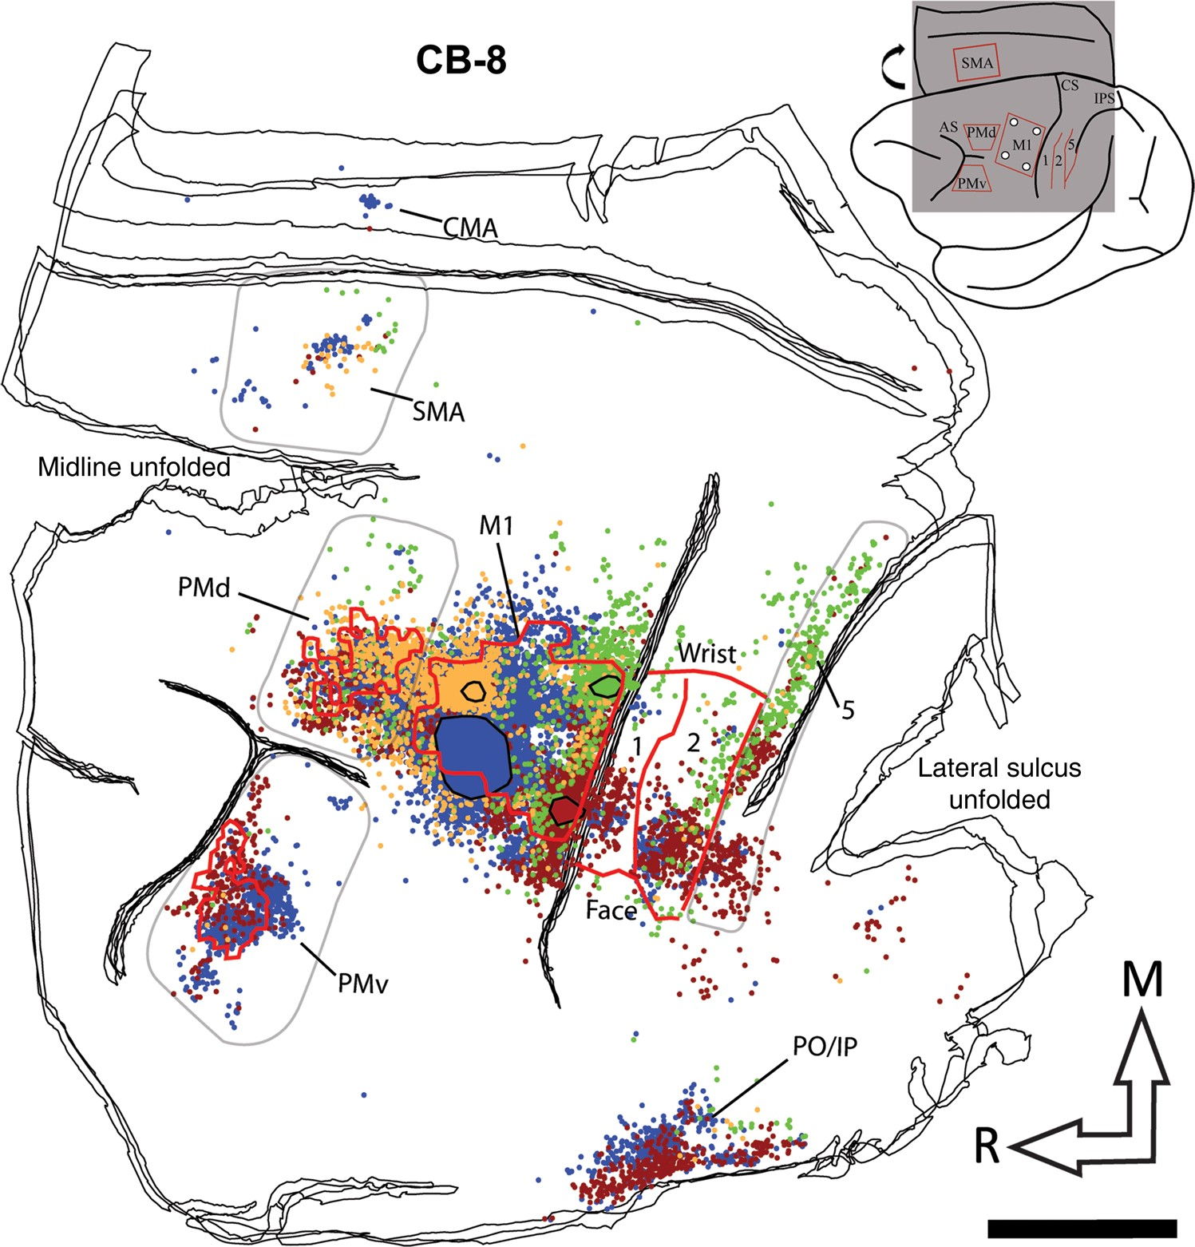
Figure 4. Reconstruction of the labeled cell bodies in CB-8. The cartoon (upper right corner) illustrates the ...
Notes:
Figure 4. Reconstruction of the labeled cell bodies in CB-8. The cartoon (upper right corner) illustrates the approximate extent and location of the sections in relation to the entire brain. The black lines show the outlines of tangential sections of the flattened hemisphere. In the frontal cortex, the location of PMv, PMd, and M1 hand representations are outlined with red contours. Because SMA was mainly located along the medial wall, we could not precisely align it with the anatomical data and thus do not show it on the reconstruction. In the parietal cortex, the medio-lateral extent of the hand representation and the location of the borders between area 1, area 2, and area 5 are shown with red lines. The location and extent of the injection cores in M1 are outlined with large color-coded blobs with black contours (BDA = orange; FE = green; FR = red, and FB = blue). Labeled cells from all 4 tracers are shown throughout the hemisphere with small dots that are colored according to the same colors used for the injection cores. The areas chosen to quantify cell bodies in PMv, PMd, SMA, and area 5 are shown with pale gray contours. Note that the contours are used to show cells that were counted in each area, and do not necessarily represent the extent of the areas. For areas 1 and 2, the contours physiologically defined for the hand representation (red lines) were used to quantify cells. In addition to the physiological data, these areas were defined using myelin and Nissl-stained sections and anatomical landmarks. In myelin sections, area 1 is more lightly myelinated than area 2 (Padberg et al. 2007). In Nissl-stained sections, the premotor cortex lacks giant pyramidal cells (Preuss and Goldman-Rakic 1991). We also used Nissl sections to help define borders between areas in the parietal cortex. Layer IV in area 2 is more densely packed than in area 1 and layers IV and VI in area 5 is more densely packed and darker than area 2 (Padberg et al. 2007). AS: arcuate sulcus; CMA: cingulate motor areas; CS: central sulcus; IPS: intraparietal sulcus; M1: primary motor cortex; PMd: dorsal premotor cortex; PMv: ventral premotor cortex; PO/IPC: posterior operculum/inferior parietal cortex; SMA: supplementary motor area; 1: area 1; 2: area 2; 5: area 5; M: medial; R: rostral. Scale bar = 5 mm.
Unless provided in the caption above, the following copyright applies to the content of this slide: © The Author 2016. Published by Oxford University Press.This is an Open Access article distributed under the terms of the Creative Commons Attribution Non-Commercial License (http://creativecommons.org/licenses/by-nc/4.0/), which permits non-commercial re-use, distribution, and reproduction in any medium, provided the original work is properly cited. For commercial re-use, please contact journals.permissions@oup.com

Slide 5
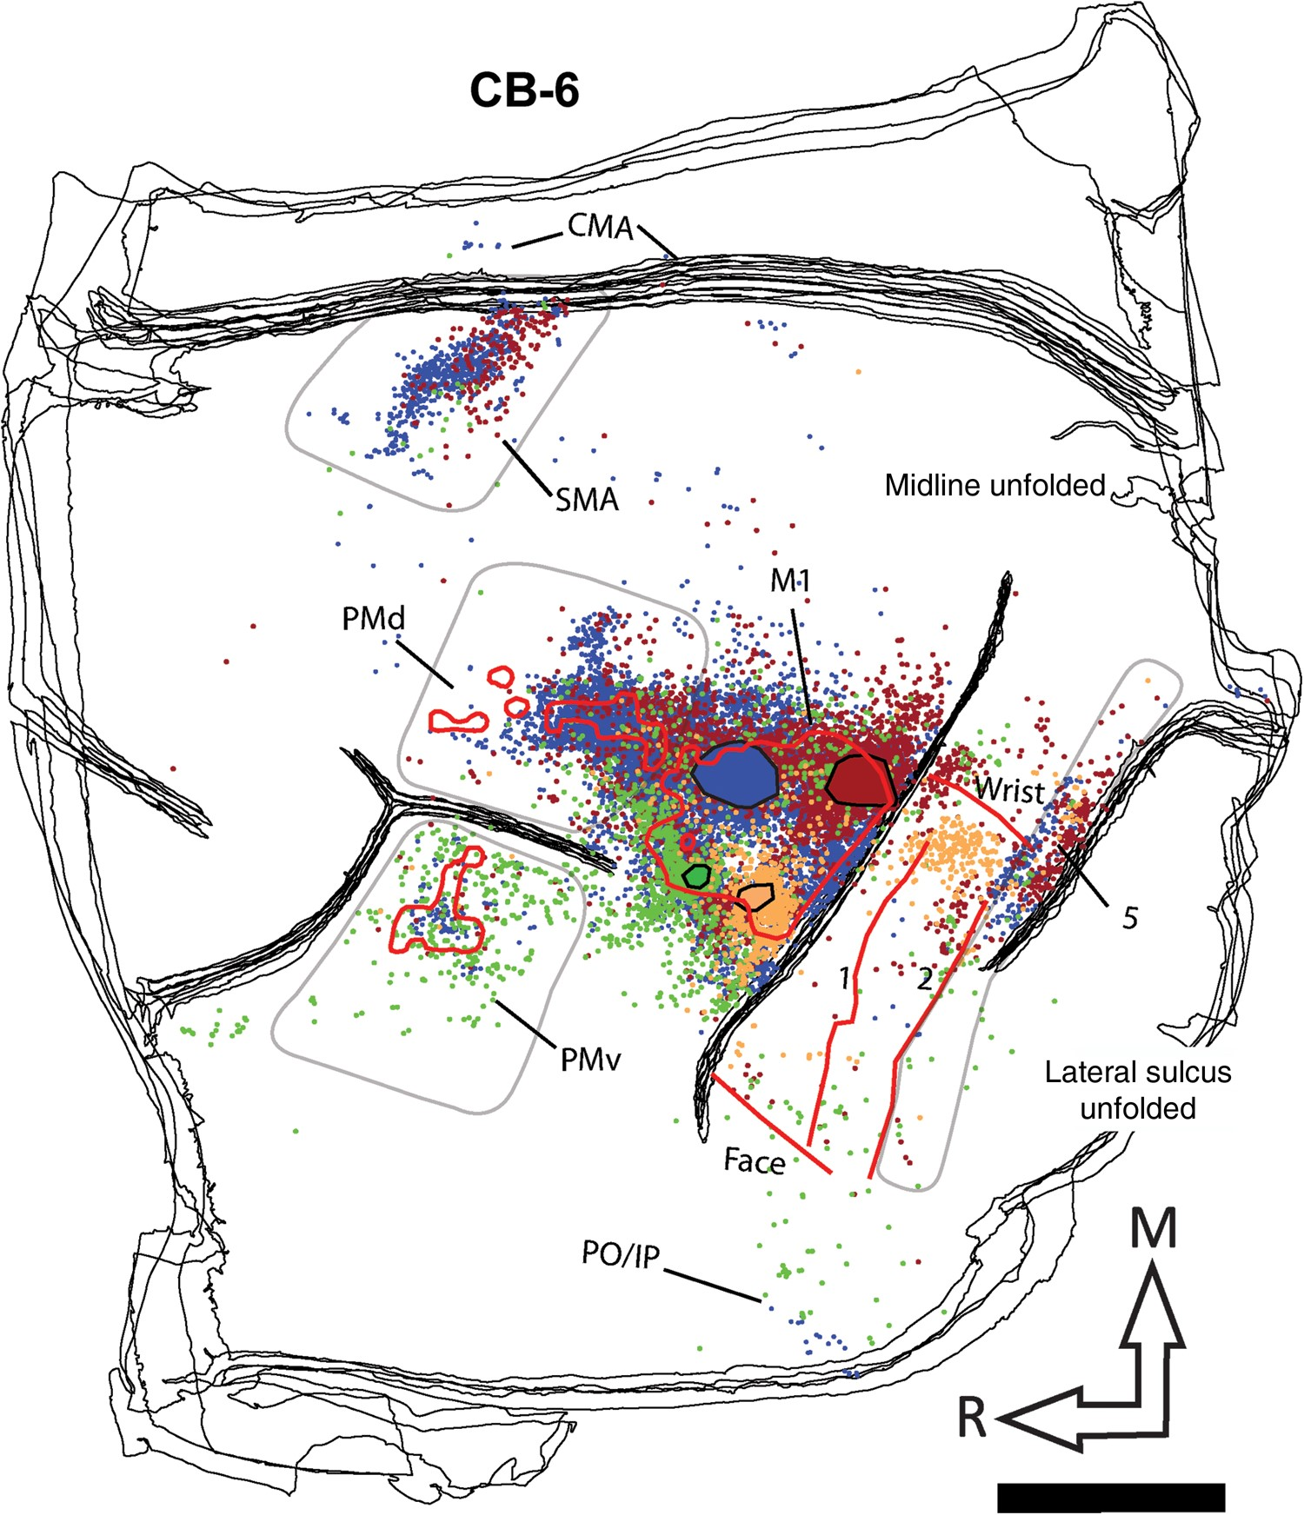
Figure 5. Reconstruction of the labeled cell bodies in CB-6. Color codes, contours, and abbreviations are as described ...
Notes:
Figure 5. Reconstruction of the labeled cell bodies in CB-6. Color codes, contours, and abbreviations are as described in Figure 4. However, note that the location of the different tracers within M1 varies from one animal to another. Furthermore, in this animal, the location of the medial border of the hand representation was estimated. Scale bar = 5 mm.
Unless provided in the caption above, the following copyright applies to the content of this slide: © The Author 2016. Published by Oxford University Press.This is an Open Access article distributed under the terms of the Creative Commons Attribution Non-Commercial License (http://creativecommons.org/licenses/by-nc/4.0/), which permits non-commercial re-use, distribution, and reproduction in any medium, provided the original work is properly cited. For commercial re-use, please contact journals.permissions@oup.com

Slide 6
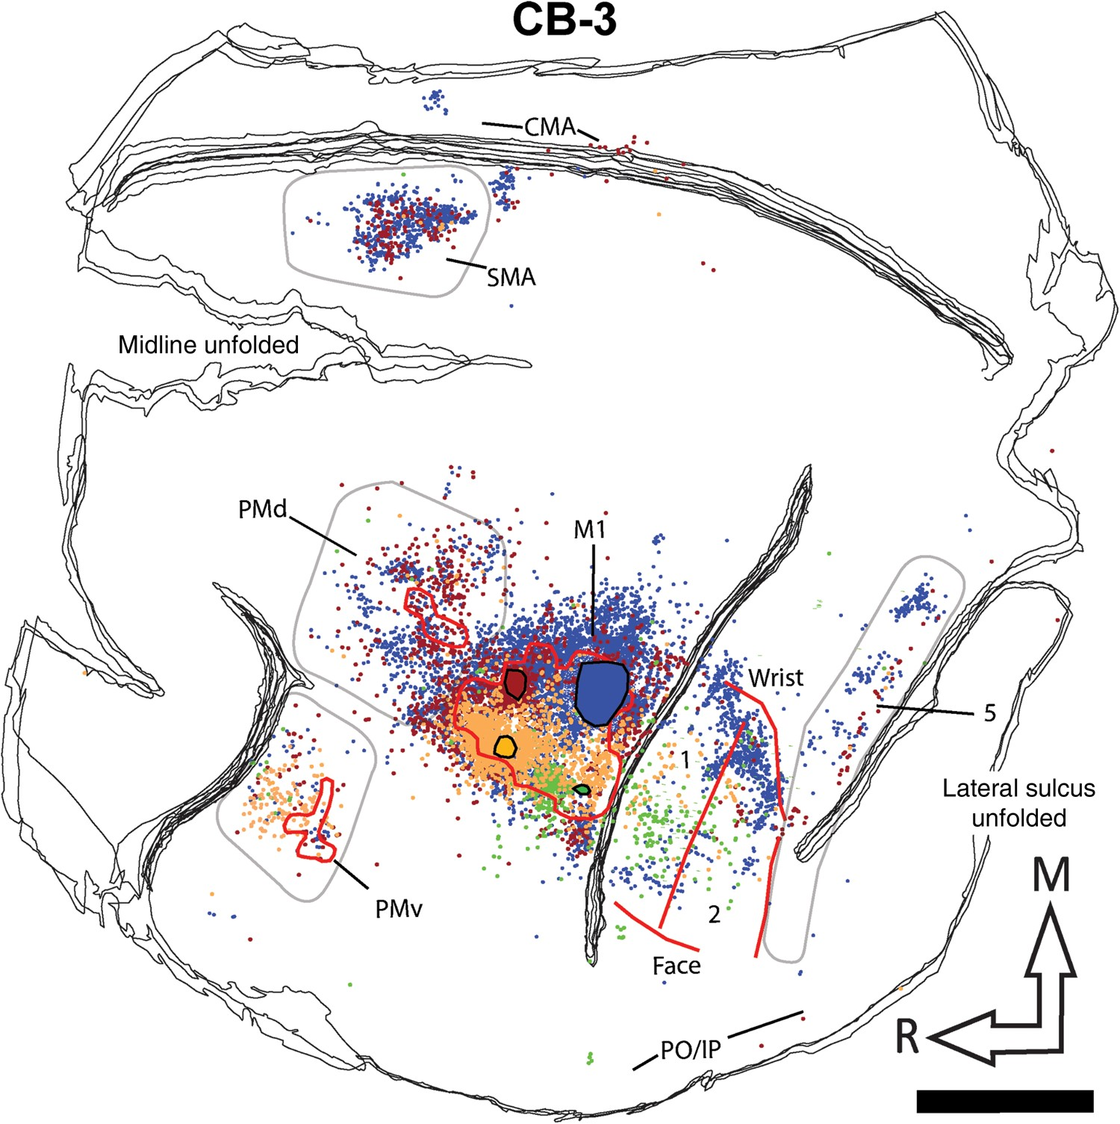
Figure 6. Reconstruction of the labeled cell bodies in CB-3. Color codes, contours, and abbreviations are as described ...
Notes:
Figure 6. Reconstruction of the labeled cell bodies in CB-3. Color codes, contours, and abbreviations are as described in Figure 4. Scale bar = 5 mm.
Unless provided in the caption above, the following copyright applies to the content of this slide: © The Author 2016. Published by Oxford University Press.This is an Open Access article distributed under the terms of the Creative Commons Attribution Non-Commercial License (http://creativecommons.org/licenses/by-nc/4.0/), which permits non-commercial re-use, distribution, and reproduction in any medium, provided the original work is properly cited. For commercial re-use, please contact journals.permissions@oup.com

Slide 7
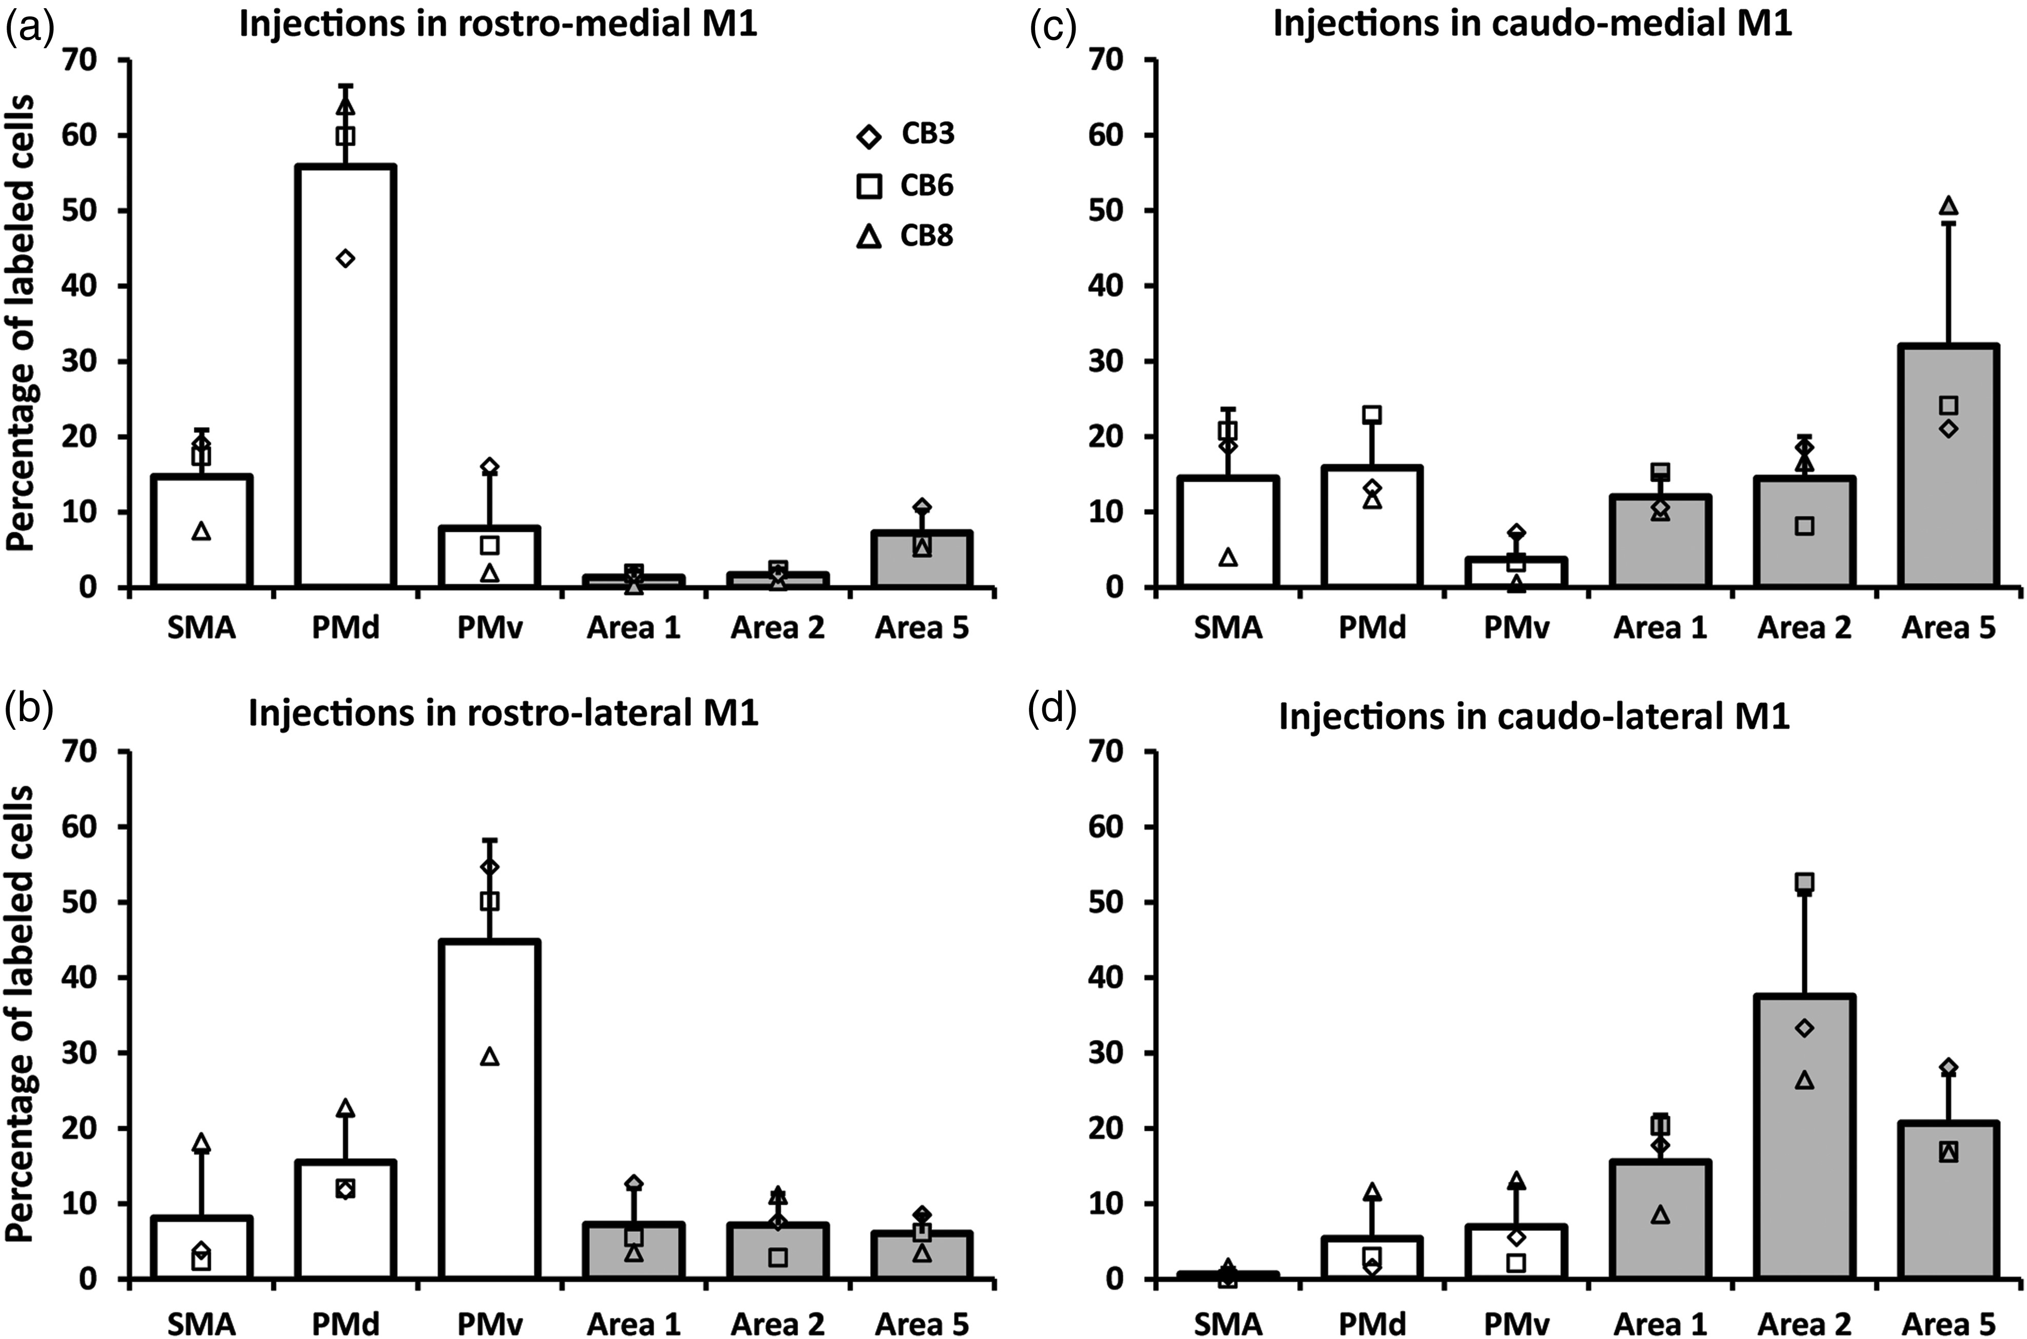
Figure 7. Proportion of labeled cell bodies in ipsilateral hemisphere. Each panel shows the average proportion of ...
Notes:
Figure 7. Proportion of labeled cell bodies in ipsilateral hemisphere. Each panel shows the average proportion of labeled cells in the different premotor and parietal areas (areas 1, 2, and 5) in the reconstructed sections (mean ± SD; n = 3). Data from individual monkeys are shown with different symbols displayed on the top of the bars. (a) Following injections in the RM, most labeled cells were in the premotor areas and we found the greatest number of cells in PMd. (b) Injections in the rostro-lateral (RL) M1 also labeled more cells in the premotor cortex but the area with most labeled cells was PMv. (c) Injections in the CM labeled more cells in area 5. However, the proportion of cells in other areas was more evenly distributed. (d) Finally, injections in the CL labeled more cells in area 2, followed by area 5.
Unless provided in the caption above, the following copyright applies to the content of this slide: © The Author 2016. Published by Oxford University Press.This is an Open Access article distributed under the terms of the Creative Commons Attribution Non-Commercial License (http://creativecommons.org/licenses/by-nc/4.0/), which permits non-commercial re-use, distribution, and reproduction in any medium, provided the original work is properly cited. For commercial re-use, please contact journals.permissions@oup.com

Slide 8
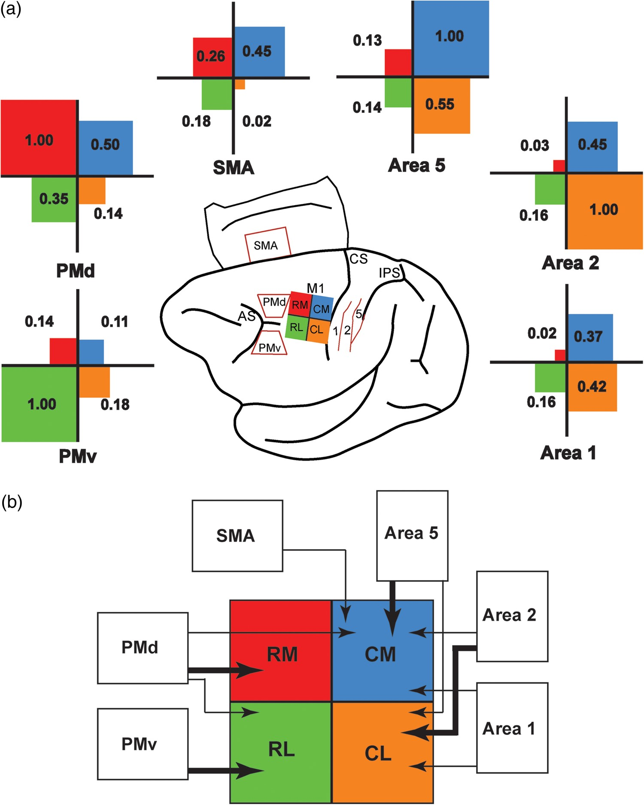
Figure 8. Normalized strength of cortical projections to the M1 hand area. (a) To compare the pattern of projections ...
Notes:
Figure 8. Normalized strength of cortical projections to the M1 hand area. (a) To compare the pattern of projections from each distant cortical area to M1, we normalized the proportion of labeled cells. For each injection site (RL: rostro-lateral; CL: caudo-lateral; RM: rostro-medial; CM: caudo-medial), the proportion of labeled cells found in a distant cortical area was divided by that of the area with the most labeled cells. For example, for RM injections, PMd had the highest proportion of labeled cells (normalized value = 1.0). The percentage of labeled cells found in SMA following RM injections was approximately 4 times lower than in PMd (normalized value = 0.26). The cartoon in the middle of the figure shows the color code for the different injection sites (RL = green; CL = orange; RM = red; CM = blue). For each distant cortical area (SMA, PMd, PMv, area 1, area 2, and area 5), a cross diagram shows the normalized strength of its projections to the 4 subregions of the M1 hand area. In each quadrant, the value of the normalized projections is provided and the size of the color square is proportional to the strength of the projections. (b) Cartoon summarizing the pattern of projections to the M1 hand representation from the different areas of the sensorimotor cortex investigated in the present study (SMA, PMd, PMv, area 1, area 2, and area 5). Connections of M1 reported in other studies but not studied here are not shown (e.g., area 3a, S2, etc.). Thick arrows represent “major” projections and thin arrows “moderate” projections, based on the relative strength of connections (a). PMd had the broadest pattern of projections, sending major projections to RM and moderate projections to both RL and CM. In contrast, PMv had a more focal pattern, sending only major projections to RL. SMA had moderate projections to CM. All 3 parietal areas studied were mainly connected with the caudal part of M1. Area 1 had moderate projections to both CM and CL. Area 2 had major projections to CL and moderate projections to CM, and area 5 had major projections to CM and moderate projections to CL.
Unless provided in the caption above, the following copyright applies to the content of this slide: © The Author 2016. Published by Oxford University Press.This is an Open Access article distributed under the terms of the Creative Commons Attribution Non-Commercial License (http://creativecommons.org/licenses/by-nc/4.0/), which permits non-commercial re-use, distribution, and reproduction in any medium, provided the original work is properly cited. For commercial re-use, please contact journals.permissions@oup.com

