Slide 1
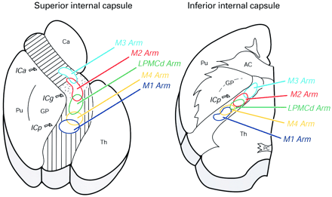
Fig. 9 Summary diagram illustrating the basic organization of the corticofugal projection at superior and ...
Notes:
Fig. 9 Summary diagram illustrating the basic organization of the corticofugal projection at superior and inferior levels of the internal capsule in case SDM 23. The individual corticofugal pathways in the IC were found to be widespread, partially overlapping and topographically organized. Descending fibres from the rostral cingulate (M3), supplementary (M2), dorsal lateral pre‐ (LPMCd), caudal cingulate (M4) and primary (M1) motor cortices occupied rostral to caudal positions of the internal capsule, respectively, at both superior (left) and inferior (right) levels. As each fibre system progressed inferiorly within the IC, all fibres shifted posteriorly to lie within the posterior limb (see also Fig. 6 sections I and J). M2 and LPMCd fibres were found to overlap extensively, as were fibres from M4 and M1. On a comparative basis, data from SDM 15 indicate that the projection from LPMCv would overlap with the projection from LPMCd with a slight anterior displacement. These data suggest that superior capsular lesions are likely to correlate with more favourable levels of functional recovery due to the widespread nature of arm representation (left). In contrast, the extensive overlap and comparatively condensed organization of arm representation at inferior levels (right) suggest that capsular lesions seated inferiorly are likely to correlate with poorer levels of recovery of upper limb movement. Since the origin of the corticospinal projection is densest in the lateral motor areas, our findings also suggest that motor deficit severity is likely to increase as a lesion occupies progressively posterior locations of the internal capsule. AC = anterior commissure; GP = globus pallidus; ICa = anterior limb of the internal capsule; ICg = genu of the internal capsule; ICp = posterior limb of the internal capsule; LPMCd = dorsal lateral premotor cortex; LPMCv = ventral lateral premotor cortex; M1 = primary motor cortex; M2 = supplementary motor cortex; M3 = rostral cingulate motor cortex; M4 = caudal cingulate motor cortex; PC = posterior commissure; Pu = putamen; Th = thalamus.
Unless provided in the caption above, the following copyright applies to the content of this slide:

Slide 2
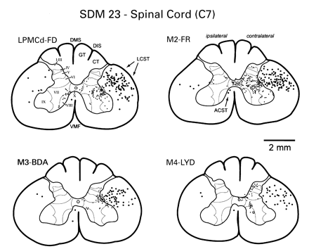
Fig. 8 A series of line drawings through the spinal cord of adjacent serial sections through spinal level C7 ...
Notes:
Fig. 8 A series of line drawings through the spinal cord of adjacent serial sections through spinal level C7 in case SDM 23 illustrating anterograde labelling following injections of neuronal tract tracers into the cortical arm areas of LPMCd (FD), M2 (FR), M3 (BDA) and M4 (LYD) (see Figs 6 and 7). Labelled axons in the lateral corticospinal tract (LCST) are illustrated by the large black dots, and terminal boutons in the spinal grey are illustrated by the small black dots. Heavy labelling also occurred in other key subcortical targets influencing arm movements such as the brainstem reticular formation and pontine grey matter. ACST = anterior corticospinal tract; CT = cuneate tract; DIS = dorsal intermediate septum; DMS = dorsal median septum; GT = gracile tract; VMF = ventral median fissure. Roman numerals denote Rexed’s laminae.
Unless provided in the caption above, the following copyright applies to the content of this slide:

Slide 3
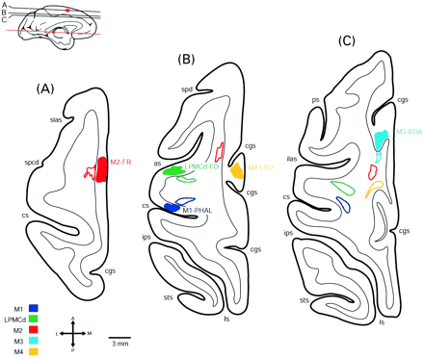
Fig. 7 Representative horizontal serial sections through the cerebral cortex of monkey SDM 23 illustrating ...
Notes:
Fig. 7 Representative horizontal serial sections through the cerebral cortex of monkey SDM 23 illustrating the individual cortical injection sites and corresponding trajectories of the five pathways studied through the corona radiata and internal capsule. Sections are shown from superior (A) to inferior (K). The location of each level is depicted in the top left of each plate as well as in relation to all other levels as shown in Fig. 6. Each injection site is colour coded and specifically identified to its right by tracer and motor area (A–C). Each descending fibre bundle is identified by a corresponding, colour‐coded outline. Only the respective pyramidal tract pathways are illustrated. ca = caudate nucleus; cgs = cingulate sulcus; cl = claustrum; cs = central sulcus; fx = fornix; hb = habenula; hp = hippocampus; in = insula; ios = inferior occipital sulcus; lgn = lateral geniculate nucleus; lf = lateral fissure; los; lateral orbital sulcus; ls = lunate sulcus; mos = medial orbital sulcus; na; nucleus accumbens; pu = putamen; rn = red nucleus; sc = superior colliculus; scpd = superior precentral dimple; sn = substantia nigra; spcc = splenium of the corpus callosum; th = thalamus; v = lateral ventricle; for other conventions, see Figs 1 and 6.
Unless provided in the caption above, the following copyright applies to the content of this slide:

Slide 4
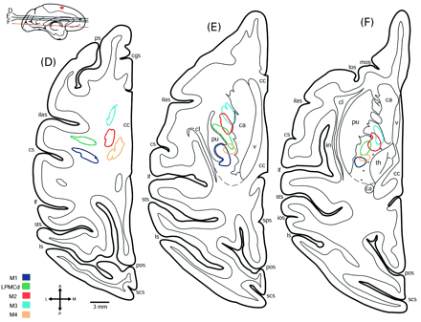
Fig. 7 Representative horizontal serial sections through the cerebral cortex of monkey SDM 23 illustrating ...
Notes:
Fig. 7 Representative horizontal serial sections through the cerebral cortex of monkey SDM 23 illustrating the individual cortical injection sites and corresponding trajectories of the five pathways studied through the corona radiata and internal capsule. Sections are shown from superior (A) to inferior (K). The location of each level is depicted in the top left of each plate as well as in relation to all other levels as shown in Fig. 6. Each injection site is colour coded and specifically identified to its right by tracer and motor area (A–C). Each descending fibre bundle is identified by a corresponding, colour‐coded outline. Only the respective pyramidal tract pathways are illustrated. ca = caudate nucleus; cgs = cingulate sulcus; cl = claustrum; cs = central sulcus; fx = fornix; hb = habenula; hp = hippocampus; in = insula; ios = inferior occipital sulcus; lgn = lateral geniculate nucleus; lf = lateral fissure; los; lateral orbital sulcus; ls = lunate sulcus; mos = medial orbital sulcus; na; nucleus accumbens; pu = putamen; rn = red nucleus; sc = superior colliculus; scpd = superior precentral dimple; sn = substantia nigra; spcc = splenium of the corpus callosum; th = thalamus; v = lateral ventricle; for other conventions, see Figs 1 and 6.
Unless provided in the caption above, the following copyright applies to the content of this slide:

Slide 5
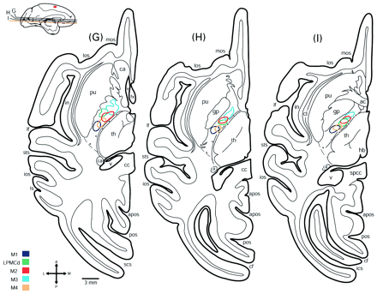
Fig. 7 Representative horizontal serial sections through the cerebral cortex of monkey SDM 23 illustrating ...
Notes:
Fig. 7 Representative horizontal serial sections through the cerebral cortex of monkey SDM 23 illustrating the individual cortical injection sites and corresponding trajectories of the five pathways studied through the corona radiata and internal capsule. Sections are shown from superior (A) to inferior (K). The location of each level is depicted in the top left of each plate as well as in relation to all other levels as shown in Fig. 6. Each injection site is colour coded and specifically identified to its right by tracer and motor area (A–C). Each descending fibre bundle is identified by a corresponding, colour‐coded outline. Only the respective pyramidal tract pathways are illustrated. ca = caudate nucleus; cgs = cingulate sulcus; cl = claustrum; cs = central sulcus; fx = fornix; hb = habenula; hp = hippocampus; in = insula; ios = inferior occipital sulcus; lgn = lateral geniculate nucleus; lf = lateral fissure; los; lateral orbital sulcus; ls = lunate sulcus; mos = medial orbital sulcus; na; nucleus accumbens; pu = putamen; rn = red nucleus; sc = superior colliculus; scpd = superior precentral dimple; sn = substantia nigra; spcc = splenium of the corpus callosum; th = thalamus; v = lateral ventricle; for other conventions, see Figs 1 and 6.
Unless provided in the caption above, the following copyright applies to the content of this slide:

Slide 6
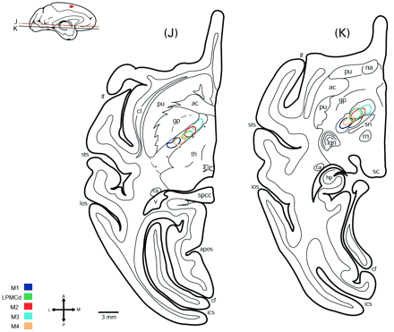
Fig. 7 Representative horizontal serial sections through the cerebral cortex of monkey SDM 23 illustrating ...
Notes:
Fig. 7 Representative horizontal serial sections through the cerebral cortex of monkey SDM 23 illustrating the individual cortical injection sites and corresponding trajectories of the five pathways studied through the corona radiata and internal capsule. Sections are shown from superior (A) to inferior (K). The location of each level is depicted in the top left of each plate as well as in relation to all other levels as shown in Fig. 6. Each injection site is colour coded and specifically identified to its right by tracer and motor area (A–C). Each descending fibre bundle is identified by a corresponding, colour‐coded outline. Only the respective pyramidal tract pathways are illustrated. ca = caudate nucleus; cgs = cingulate sulcus; cl = claustrum; cs = central sulcus; fx = fornix; hb = habenula; hp = hippocampus; in = insula; ios = inferior occipital sulcus; lgn = lateral geniculate nucleus; lf = lateral fissure; los; lateral orbital sulcus; ls = lunate sulcus; mos = medial orbital sulcus; na; nucleus accumbens; pu = putamen; rn = red nucleus; sc = superior colliculus; scpd = superior precentral dimple; sn = substantia nigra; spcc = splenium of the corpus callosum; th = thalamus; v = lateral ventricle; for other conventions, see Figs 1 and 6.
Unless provided in the caption above, the following copyright applies to the content of this slide:

Slide 7
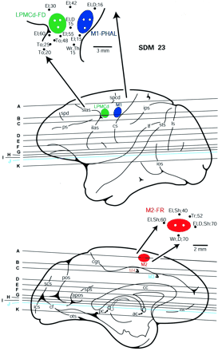
Fig. 6 Summary diagrams of the lateral (top) and medial (bottom) surfaces of the cerebral cortex illustrating ...
Notes:
Fig. 6 Summary diagrams of the lateral (top) and medial (bottom) surfaces of the cerebral cortex illustrating the experimental design in monkey SDM 23. Cortical injections (coloured irregular spheres) were made into five different arm representations in the left hemisphere and the course of the corticofugal projection was mapped in the corona radiata and internal capsule using immunohistochemically processed tissue sections. The top enlargement depicts the location of the PHA‐L injection site in M1 (blue) and the FD injection site in LPMCd (green) in relation to physiological mapping. The bottom enlargement demonstrates the location of the FR injection site in M2 (red) in relation to physiological mapping. Also depicted is the anatomical location of the BDA injection in M3 (light blue) and the LYD injection in M4 (yellow) in the cingulate sulcus. The M3 and M4 injection sites are not visible on surface view (see Fig. 7B and C). Each black dot represents a stimulation point labelled with the corresponding threshold level (µA) and body part where the movement was observed. The white dots within each coloured injection site represent the location of each Hamilton syringe penetration. The horizontal lines indicate the level of each representative tissue section shown graphically in Fig. 7 (see A–K) and are in reference to the anterior (CA) and posterior (CP) commissural plane (see horizontal section J). Generally, section F is representative of superior thalamic levels, G and H of middle thalamic levels and I and J of inferior thalamic levels. Section K represents the junctional region between the internal capsule and cerebral peduncle of the midbrain. ac = anterior commissure; apos = anterior parieto‐occipital sulcus; cc = corpus callosum; D = digit; El = elbow; ilas = inferior limb of the arcuate sulcus; ots = occipitotemporal sulcus; pc = posterior commissure; pos = parieto‐occipital sulcus; ps = principle sulcus; ros = rostral sulcus; scs = supracalcarine sulcus; Sh = shoulder; slas = superior limb of the arcuate sulcus; spd = superior pre‐central dimple; spd = supraprinciple dimple; Th = thumb; To = tongue; Tr = trunk; Wr = wrist; for other conventions, see Figs 1 and 5.
Unless provided in the caption above, the following copyright applies to the content of this slide:

Slide 8
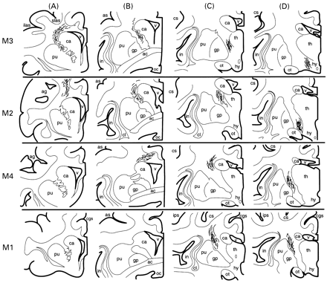
Fig. 5 Illustrated in rows, from the top to the bottom of the diagram, is the descending projection from the ...
Notes:
Fig. 5 Illustrated in rows, from the top to the bottom of the diagram, is the descending projection from the arm representation of M3 (SDM 6), M2 (SDM 7), M4 (SDM 10) and M1 (IM 121) in coronal section. Columns A–D are representative rostral to caudal coronal sections from each individual monkey case. Columns A and B illustrate coronal levels through the anterior limb of the internal capsule, with B coinciding with its approximate posterior boundary. Columns C and D illustrate rostral to caudal levels of the posterior limb, respectively. Medial motor area fibres arched over the caudate nucleus (M3, M2 and M4) whereas the lateral motor area fibres from M1 arched over putamen. Note the involvement of descending fibres from M3 and M2 at more anterior levels of the corona radiata and internal capsule (A and B) with progressive involvement of M4 and M1 fibres at more caudal levels (C and D). ac = anterior commissure; as = arcuate spur; ag = arcuate genu; ca = caudate nucleus; cgs = cingulate sulcus; cl = claustrum; cs = central sulcus; gp = globus pallidus; hy = hypothalamus; ilas = inferior limb of the arcuate sulcus; in = insula; ips = intraparietal sulcus; oc = optic chiasm; ot = optic tract; pu = putamen; slas = superior limb of the arcuate sulcus; th = thalamus; v = ventricle.
Unless provided in the caption above, the following copyright applies to the content of this slide:

Slide 9
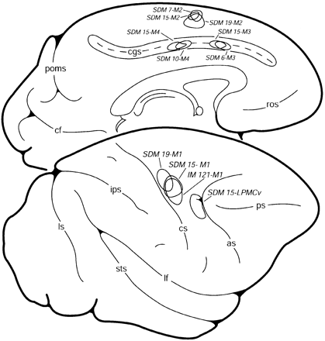
Fig. 4 Line drawing illustrating the general location of 12 different injection sites used to study the ...
Notes:
Fig. 4 Line drawing illustrating the general location of 12 different injection sites used to study the organization of the corticofugal fibres in the corona radiata and internal capsule. The location of the five injection sites evaluated in case SDM 23 are depicted separately in Fig. 6. as = arcuate sulcus; cf = calcarine sulcus; cgs = cingulate sulcus; cs = central sulcus; IM = Iowa monkey; ips = intraparietal sulcus; lf = lateral fissure; LPMCd = dorsal lateral premotor cortex; LPMCv = ventral lateral premotor cortex; ls = lunate sulcus; M1 = primary motor cortex; M2 = supplementary motor cortex; M3 = rostral cingulate motor cortex; M4 = caudal cingulate motor cortex; poms = medial parieto‐occipital sulcus; ros = rostral sulcus; SDM = South Dakota monkey; sts = superior temporal sulcus.
Unless provided in the caption above, the following copyright applies to the content of this slide:

Slide 10
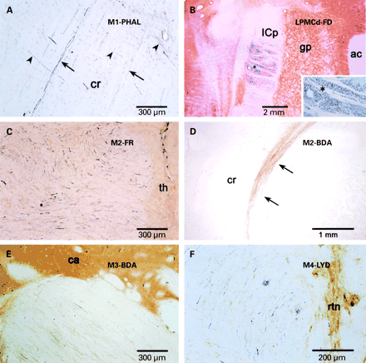
Fig. 3 Plate of photomicrographs illustrating examples of fibre bundles studied in the coronal radiata and ...
Notes:
Fig. 3 Plate of photomicrographs illustrating examples of fibre bundles studied in the coronal radiata and internal capsule following immunohistochemical visualization. (A) A coronal section illustrating PHA‐L‐labelled fibres (black) in the coronal radiata following an injection of PHA‐L in M1 in case IM 121. The arrows identify fibres coursing inferiorly, toward the superior portion of the internal capsule. The arrowheads identify fibres coursing medially, toward the corpus callosum. (B) FD‐labelled fibres (blue) in the posterior limb of the internal capsule following an injection of FD into LPMCd in case SDM 23. This horizontal section corresponds to inferior capsular levels marked by the presence of the anterior commissure (ac). Note the specificity in topography of the labelled field. The inset (bottom right) is an enlargement of fibres from the region marked by the asterisk. (C) Horizontal section depicting FR‐labelled fibres (blue) in the internal capsule following an injection in the arm representation of M2 in case SDM 23. Note the close proximity of the fibres to the medially located thalamus (th). (D) Coronal section illustrating BDA‐labelled fibres (brown) emanating from the injection site and forming a discrete bundle in the corona radiata following an injection of BDA in the arm area of M2 in case SDM 7. (E) Horizontal section showing densely packed BDA‐labelled fibres (brown) sweeping around the head of the caudate within the anterior limb of the internal capsule following an injection of BDA into the arm area of M3 in case SDM 23. (F) LYD‐labelled fibres (blue) at mid‐levels of the internal capsule following an injection of LYD into the arm area of M4 in case SDM 23. Note the close proximity of the fibres to the reticular nucleus of the thalamus in this horizontal section. ac = anterior commissure; cr = corona radiata; gp = globus pallidus; ICp = posterior limb of the internal capsule; rtn = reticular nucleus of the thalamus; th = thalamus.
Unless provided in the caption above, the following copyright applies to the content of this slide:

Slide 11
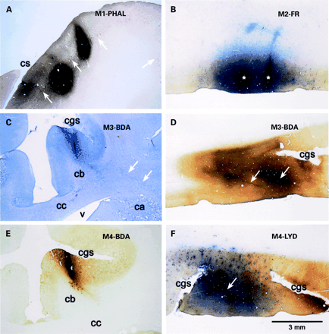
Fig. 2 Plate of low‐power photomicrographs illustrating representative examples of injection sites in ...
Notes:
Fig. 2 Plate of low‐power photomicrographs illustrating representative examples of injection sites in different motor fields following tissue processing for immunohistochemical visualization. (A) Injections of PHA‐L into M1 in case IM 121 visualized using ABC/DAB nickel‐enhanced immunostaining (black reaction product). White arrows identify the Betz cell layer of layer V. (B) Injections of FR in M2 in case SDM 23 visualized using ABC and Vector SG proxidase substrate immunostaining (blue reaction product). This injection site is also depicted graphically in Fig. 7A. Each asterisk identifies a needle tract. (C) An injection of BDA in M3 of case SDM 6 visualized using standard alkaline phosphatase histochemistry. The white arrows identify pyramidal tract fibres arching over the head of the caudate. (D) An injection of BDA into M3 in case SDM 23 visualized using ABC/DAB immunostaining (brown reaction product). The white arrows indicate BDA‐filled needle tracts. An adjacent level of this injection site is also depicted graphically in Fig. 7C. (E) An injection of BDA into M4 in case SDM 10 visualized using ABC/DAB immunostaining (brown reaction product). (F) An injection of LYD in M4 in case SDM 23 visualized using ABC and Vector SG peroxidase substrate immunostaining (blue reaction product). The white arrow identifies the LYD‐filled needle tract. An adjacent level of this injection site is also depicted graphically in Fig. 7B. ca = caudate nucleus; cb = cingulum bundle; cc = corpus callosum; cgs = cingulate sulcus; cs = central sulcus; v = ventricle. Scale bar in F corresponds to all photomicrographic plates.
Unless provided in the caption above, the following copyright applies to the content of this slide:

Slide 12
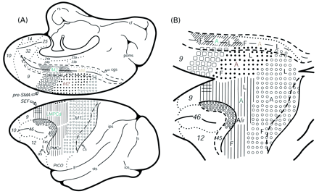
Fig. 1 (A) Schematic diagrams of the medial (top) and lateral (bottom) surfaces of the cerebral cortex of the ...
Notes:
Fig. 1 (A) Schematic diagrams of the medial (top) and lateral (bottom) surfaces of the cerebral cortex of the rhesus monkey depicting the basic organization of the frontal lobe and adjacent cingulate cortex. (B) Enlarged and slightly modified depiction of A illustrating the basic somatotopical organization of the motor cortices and the locations of the six different arm representations whose corticofugal trajectories were studied in the corona radiata and internal capsule. A = arm; as = arcuate sulcus; cf = calcarine fissure; cgs = cingulate sulcus; cs = central sulcus; F = face; FEF = frontal eye fields; ios = inferior occipital sulcus = ips = intraparietal sulcus; L = leg; lf = lateral fissure; LPMCd = dorsal lateral premotor cortex; LPMCv = ventral lateral premotor cortex; ls = lunate sulcus; M1 = primary motor cortex; M2 = supplementary motor cortex; M3 = rostral cingulate motor cortex; M4 = caudal cingulate motor cortex; pre‐SMA = pre‐supplementary motor cortex; rs = rhinal sulcus; SEF = supplementary eye field; sts = superior temporal sulcus; poms = medial parieto‐occipital sulcus; sts = superior temporal sulcus; UL = upper lip. Numerical designations (9, 10, 12, 14, 23a, 23b, 24a, 24b, 25, 45, 46) identify basic cytoarchitectonic areas.
Unless provided in the caption above, the following copyright applies to the content of this slide:

