Slide 1
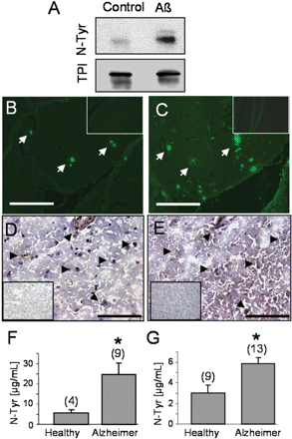
Figure 1 TPI nitrotyrosination is dependent on the presence of Aβ. (A) SH-SY5Y cells were treated with 1 µM ...
Notes:
Figure 1 TPI nitrotyrosination is dependent on the presence of Aβ. (A) SH-SY5Y cells were treated with 1 µM Aβ1–42 and TPI was immunoprecipitated. Blots were performed with either anti-nitrotyrosine or anti-TPI antibodies. (B and C) Hippocampus from double transgenic mice overexpressing APP and PS1, and (D and E) frontal cortex sections obtained from Alzheimer's disease brain patients were immunostained with antibodies against (B and D) TPI or (C and E) against nitrotyrosine. No staining is shown in wild-type mice for (inset B) TPI and (inset C) nitrotyrosine, and in healthy human controls for (inset D) TPI and (inset E) nitrotyrosine. Bars are 250 µm (B and C) and 98 µm (D and E). TPI was immunoprecipitated from healthy and Alzheimer's disease (F) hippocampus or (G) cortex and nitrotyrosine was measured. The number of independent samples is indicated between brackets; *P < 0.05 by student's t analysis.
Unless provided in the caption above, the following copyright applies to the content of this slide: © The Author (2009). Published by Oxford University Press on behalf of the Guarantors of Brain. All rights reserved. For Permissions, please email: journals.permissions@oxfordjournals.org

Slide 2
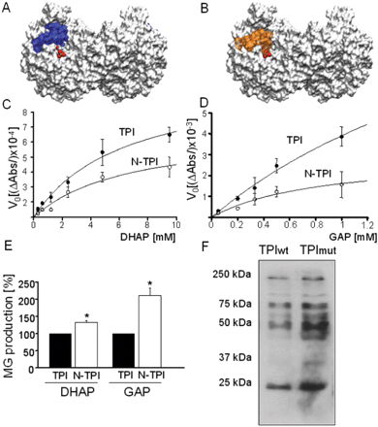
Figure 2 TPI nitrotyrosination induces a decrease in its isomerase activity but an increase in methylglyoxal ...
Notes:
Figure 2 TPI nitrotyrosination induces a decrease in its isomerase activity but an increase in methylglyoxal production. (A) The solvent surface accessible area (SASA) of the TPI enzyme (PDB:1NEY) in its dimer conformation is computed over the average conformation of a multi nanosecond trajectory of a molecular dynamics run (white surface) bound with the DHAP substrate in the catalytic site. (B) The same loop is plotted in orange in a similar simulation but introducing nitrated tyrosines at 164 and 208. In average the loop assumes a more closed conformation. Nitrotyrosination decreases the catalytic efficiency of TPI. The activity of control and nitrotyrosinated TPI was measured in both directions (C) from DHAP to GAP and (D) from GAP to DHAP. The respective Michaelis-Menten curves show that the nitrotyrosination of TPI produces a significant decrease in the TPI isomerase activity of the enzyme. n = 3–5 experiments for each point. (E) Methylglyoxal production by TPI or nitro-TPI using DHAP or GAP as initial substrates. n = 4 independent experiments; *P < 0.05 by student's t analysis. (F) Western blot analysis of methylglyoxal production using anti-argpyrimidin, which recognizes glication products. Protein extract (100 µg) from HEK cells overexpressing WT (first lane) or double mutant (Tyr164 and 208 by Phe164 and 208) TPI were applied.
Unless provided in the caption above, the following copyright applies to the content of this slide: © The Author (2009). Published by Oxford University Press on behalf of the Guarantors of Brain. All rights reserved. For Permissions, please email: journals.permissions@oxfordjournals.org

Slide 3
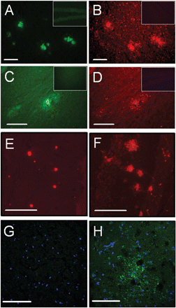
Figure 3 Methylglyoxal production is increased in APP-PS1 double transgenic mice and Alzheimer's disease patients. ...
Notes:
Figure 3 Methylglyoxal production is increased in APP-PS1 double transgenic mice and Alzheimer's disease patients. Consecutive serial hippocampal sections from double transgenic mice were immunostained to demonstrate the presence of (A) Aβ and (B) TPI; (C) Aβ identified by thioflavine T staining and (D) methylglyoxal; and, (E) TPI and (F) methylglyoxal. Controls with wild-type mice were performed for (insets A and C) Aβ, (inset B) TPI and (inset D) methylglyoxal. Cortex samples from (G) healthy and (H) Alzheimer's disease patients were immunostained with anti-MG antibody producing green fluorescence. Nuclei were stained in blue. Bars are 75 µm (A–D), 125 µm (E and F) and 250 µm (G and H).
Unless provided in the caption above, the following copyright applies to the content of this slide: © The Author (2009). Published by Oxford University Press on behalf of the Guarantors of Brain. All rights reserved. For Permissions, please email: journals.permissions@oxfordjournals.org

Slide 4
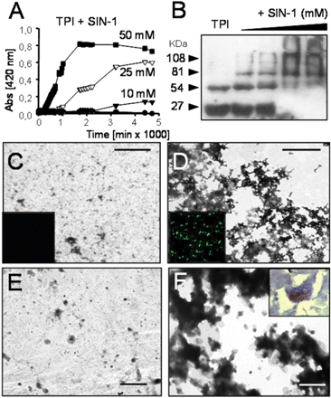
Figure 4 The nitrotyrosination of TPI is inducing its aggregation. (A) The in vitro aggregation was followed by a ...
Notes:
Figure 4 The nitrotyrosination of TPI is inducing its aggregation. (A) The in vitro aggregation was followed by a turbidometric assay of TPI (filled circle) and TPI+SIN-1 [10 mM (filled inverted triangle), 25 mM (open inverted triangle), 50 mM (filled square)] followed by measuring A402. (B) Western blot detection with an anti-TPI antibody of TPI nitrotyrosinated with SIN-1 (48 h) demonstrated the presence of TPI oligomers proportional to increasing concentrations of SIN-1 (0, 10, 25 and 50 mM). TEM images of immunoprecipitates were obtained using anti-TPI antibody in samples from (C) control TPI and (D) TPI nitrotyrosinated in vitro; and, human cortex from (E) healthy and (F) Alzheimer's disease patients. Immunoprecipitates of (inset C) normal TPI were negative for thioflavine T staining but they were positive for (inset D) nitro-TPI indicating the folding in β-sheet structure (inset F). The intracellular aggregation of TPI was demonstrated in cells from sections of Alzheimer's disease patient cortex. Bars are 1 µm (C and D) and 2 µm (E and F).
Unless provided in the caption above, the following copyright applies to the content of this slide: © The Author (2009). Published by Oxford University Press on behalf of the Guarantors of Brain. All rights reserved. For Permissions, please email: journals.permissions@oxfordjournals.org

Slide 5
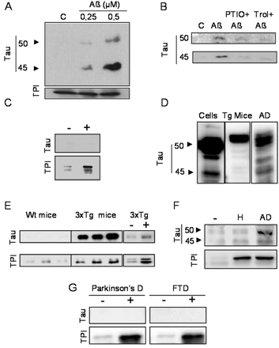
Figure 5 Tau protein coimmunoprecipitates with nitro-TPI. All the cell lysates and tissue samples were ...
Notes:
Figure 5 Tau protein coimmunoprecipitates with nitro-TPI. All the cell lysates and tissue samples were immunoprecipitated with an anti-TPI antibody. (A) SH-SY5Y cells were treated with two sub-lethal concentrations of Aβ fibrils. Western blots were performed with antibodies anti-tau and anti-TPI. (B) SH-SY5Y cells were pretreated with PTIO (a NO scavenger) or Trolox (a free radical scavenger) before adding the Aβ fibrils. A Western blot was performed with an anti-tau antibody. (C) Controls were performed to assay the unspecific TPI binding to protein G sepharose (lane −) compared with the normal anti-TPI immunoprecipitation (lane +). (D) Total lysates from SH-SY5Y cells, 3xTg mice and Alzheimer's disease cortex were applied to Western blot to identify the most abundant tau isoforms. (E) Co-immunoprecipitation of tau (50 kDa) with TPI was also assessed in three different mice overexpressing APP, PS1 and human tau. The respective controls for the immunoprecipitation without anti-TPI (lane −) and with anti-TPI (lane +) are also shown in the panel. (F) The presence of tau in the TPI immunoprecipitates obtained from healthy and Alzheimer's disease cortex was analysed by immunoblotting with antibodies anti-tau and anti-TPI. The control for the non-specific binding to protein G-sepharose is shown in the panel (lane −). (G) TPI immunoprecipitates obtained from frontal cortex of Parkinson's disease and frontotemporal dementia patients are shown with the respective controls for the non-specific binding to protein G-sepharose.
Unless provided in the caption above, the following copyright applies to the content of this slide: © The Author (2009). Published by Oxford University Press on behalf of the Guarantors of Brain. All rights reserved. For Permissions, please email: journals.permissions@oxfordjournals.org

Slide 6
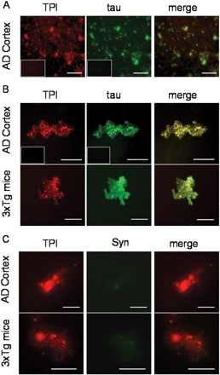
Figure 6 Co-localization of TPI and tau protein in brain samples. (A) TPI and tau were co-immunolabelled in tissue ...
Notes:
Figure 6 Co-localization of TPI and tau protein in brain samples. (A) TPI and tau were co-immunolabelled in tissue slides from Alzheimer's disease cortex. (Inset A) Controls with secondary antibody were performed for both TPI and tau. (B) TPI immunoprecipitates obtained from Alzheimer's disease cortex and triple transgenic mice overexpressing APP, PS1 and tau were immunolabelled with anti-TPI and tau. (Inset B) Controls with secondary antibody were performed for both TPI and tau. (C) TPI immunoprecipitates obtained from Alzheimer's disease cortex and triple transgenic mice were immunolabelled with anti-TPI and anti-syntaxin 1A as a control of the specificity of the tau binding to TPI. Bars are 100 µm (Alzheimer's disease cortex; A and B), 50 µm (3xTg mice; B) and 37.5 µm (C).
Unless provided in the caption above, the following copyright applies to the content of this slide: © The Author (2009). Published by Oxford University Press on behalf of the Guarantors of Brain. All rights reserved. For Permissions, please email: journals.permissions@oxfordjournals.org

Slide 7
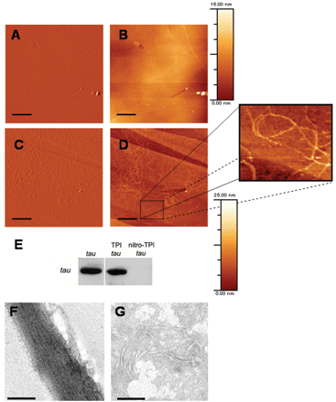
Figure 7 Fibrillation of tau into paired helical filaments demonstrated by atomic force microscopy and TEM. Tau was ...
Notes:
Figure 7 Fibrillation of tau into paired helical filaments demonstrated by atomic force microscopy and TEM. Tau was incubated for 4 days in the presence of (A and B) TPI or (C and D) nitro-TPI at a 1 : 1 (w/w) ratio and seeded on graphite surfaces for atomic force microscopy visualization. (A and B) Tau-control TPI samples show few fibrils without defined structure. (C and D) Tau-nitro-TPI samples exhibit abundant fibrils that are similar in morphology to paired helical filaments when their topography is visualized. (E) Western blot detection of tau in the samples used for atomic force microscopy studies: control of tau alone, TPI+tau and nitro-TPI+tau. (F and G) TEM images of the fibrils found in tau-nitro-TPI samples.
Unless provided in the caption above, the following copyright applies to the content of this slide: © The Author (2009). Published by Oxford University Press on behalf of the Guarantors of Brain. All rights reserved. For Permissions, please email: journals.permissions@oxfordjournals.org

