Slide 1
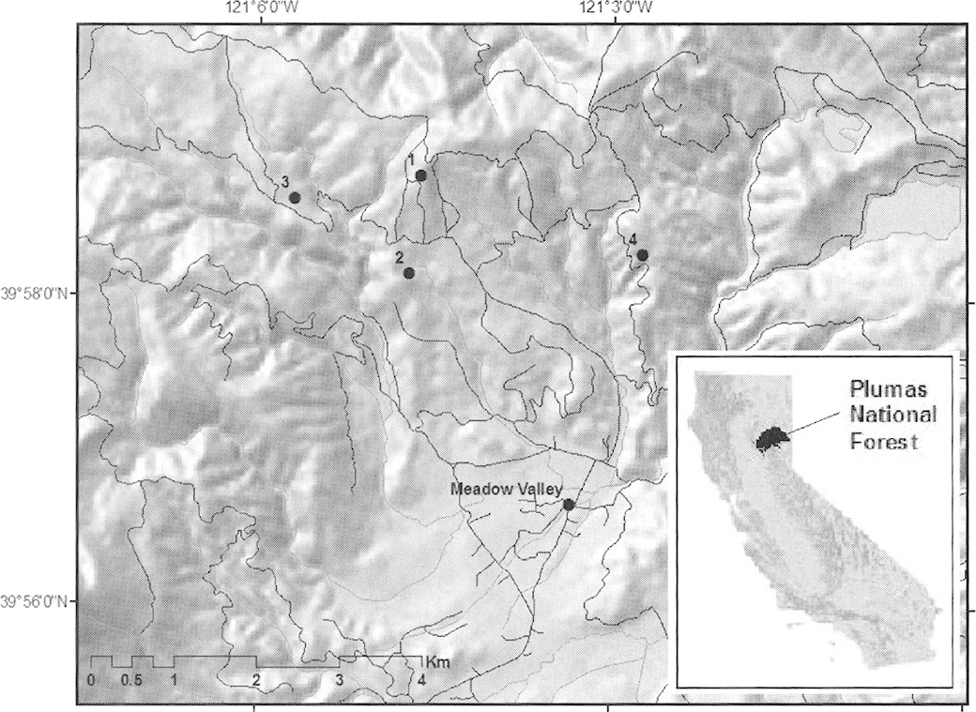
Fig. 1 Map of study area in Plumas Natiónal Forest, California. Numbers indicate study site locations. Inset shows ...
Notes:
Fig. 1 Map of study area in Plumas Natiónal Forest, California. Numbers indicate study site locations. Inset shows the location of Plumas Natiónal Forest in California.
Unless provided in the caption above, the following copyright applies to the content of this slide: © 2007 American Society of MammalogistsThis is an Open Access article distributed under the terms of the Creative Commons Attribution-NonCommercial-NoDerivs licence (http://creativecommons.org/licenses/by-nc-nd/3.0/) which permits non-commercial reproduction and distribution of the work, in any medium, provided the original work is not altered or transformed in any way, and that the work is properly cited. For commercial re-use, please contact journals.permissions@oup.com

