Slide 1
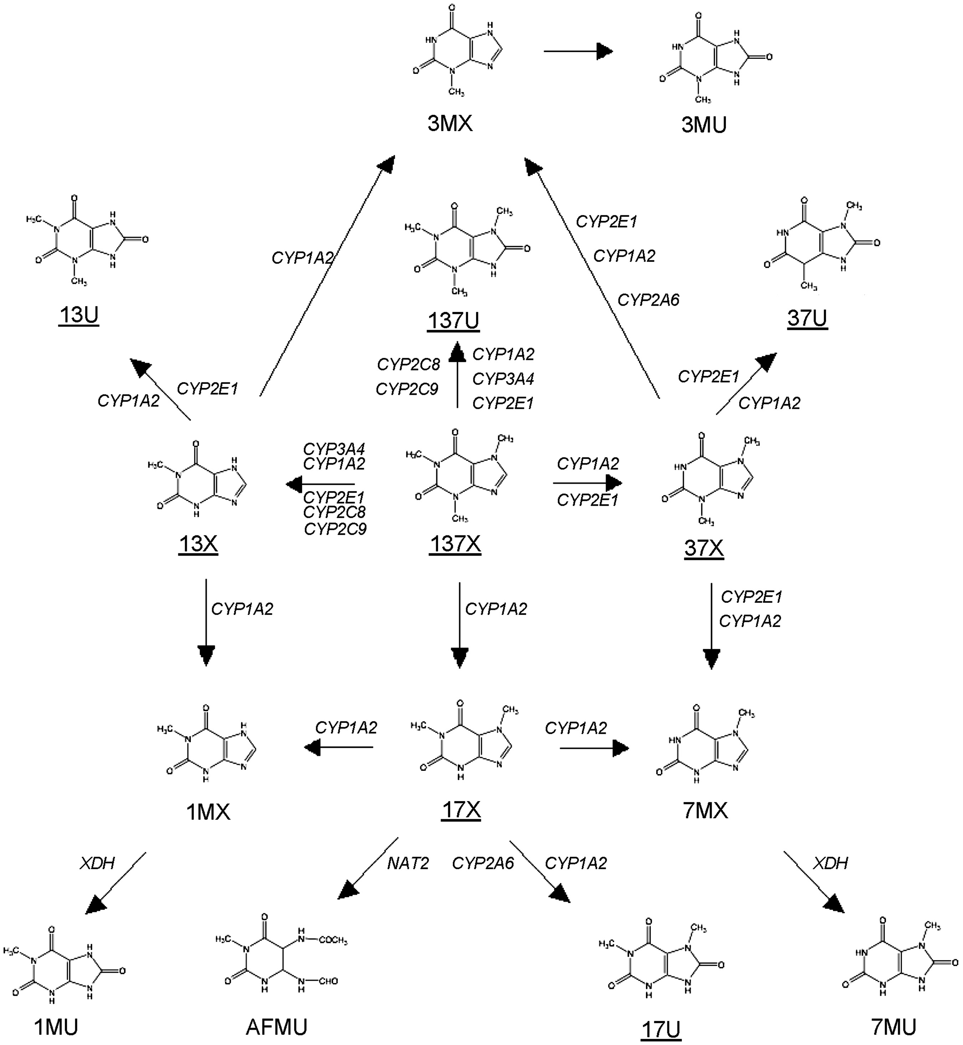
Figure 1. Our current understanding of caffeine metabolism in humans. Metabolites underlined are amongst those examined ...
Notes:
Figure 1. Our current understanding of caffeine metabolism in humans. Metabolites underlined are amongst those examined in the current study. 137X: 1,3,7-trimethylxanthine (caffeine); 17X: 1,7-dimethylxanthine (paraxanthine); 13X: 1,3-dimethylxanthine (theophylline); 37X: 3,7-dimethylxanthine (theobromine); 137U:1,3,7-trimethyluric acid; 17U: 1,7-dimethyluric acid; 13U:1,3-dimethyluric acid; 37U: 3,7-dimethyluric acid; 1MX: 1-methylxanthine; 3MX: 3-methylxanthine; 7MX: 7-methylxanthine; 1MU: 1-methyluric acid; 3MU: 3-methyluric acid; 7MU: 7-methyluric acid; AFMU: 5-acetylamino-6-formylamino-3-methyluracil. Data from (7, 8).
Unless provided in the caption above, the following copyright applies to the content of this slide: © The Author 2016. Published by Oxford University Press. All rights reserved. For Permissions, please email: journals.permissions@oup.com

