Slide 1
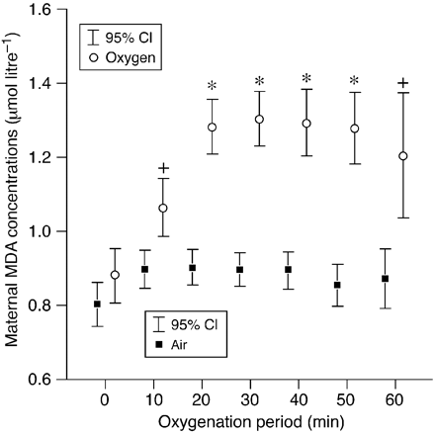
Fig 1 Maternal plasma concentrations of malondialdehyde at 10‐min intervals. Data are mean (95% confidence ...
Notes:
Fig 1 Maternal plasma concentrations of malondialdehyde at 10‐min intervals. Data are mean (95% confidence interval) concentration for each interval after commencement of oxygen supplementation +P<0.05; *P<0.001.
Unless provided in the caption above, the following copyright applies to the content of this slide:

Slide 2
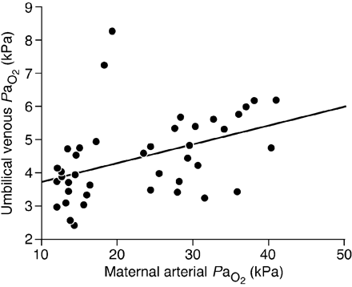
Fig 2 Scatter‐plot of maternal arterial PaO₂ at delivery and umbilical venous ...
Notes:
Fig 2 Scatter‐plot of maternal arterial PaO2 at delivery and umbilical venous PaO2. Data from air and oxygen groups are presented. r=0.516, P<0.001.
Unless provided in the caption above, the following copyright applies to the content of this slide:

Slide 3
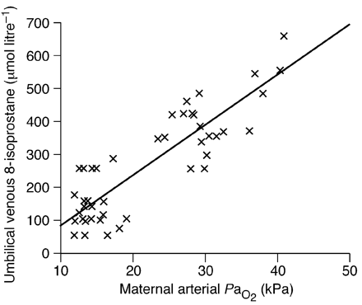
Fig 3 Scatter‐plot of maternal arterial PaO₂ at delivery and umbilical venous ...
Notes:
Fig 3 Scatter‐plot of maternal arterial PaO2 at delivery and umbilical venous concentration of 8‐isoprostane. Data from air and oxygen groups are presented. r=0.870, P<0.001.
Unless provided in the caption above, the following copyright applies to the content of this slide:

Slide 4
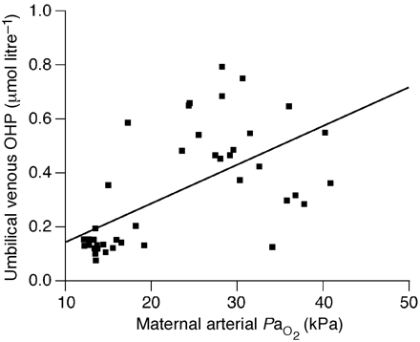
Fig 4 Scatter plot of maternal arterial PaO₂ at delivery and umbilical venous organic ...
Notes:
Fig 4 Scatter plot of maternal arterial PaO2 at delivery and umbilical venous organic hydroperoxides. Data from air and oxygen groups are presented. r=0.611, P<0.001.
Unless provided in the caption above, the following copyright applies to the content of this slide:

Slide 5
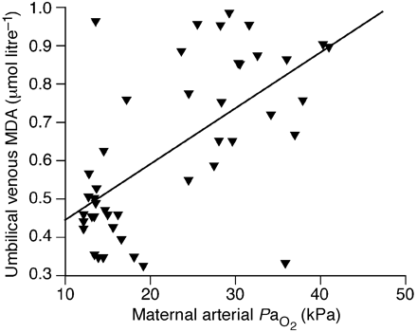
Fig 5 Scatter plot of maternal arterial PaO₂ at delivery and umbilical venous ...
Notes:
Fig 5 Scatter plot of maternal arterial PaO2 at delivery and umbilical venous malondialdehyde. Data from air and oxygen groups are presented. r=0.556, P<0.001.
Unless provided in the caption above, the following copyright applies to the content of this slide:

