Slide 1
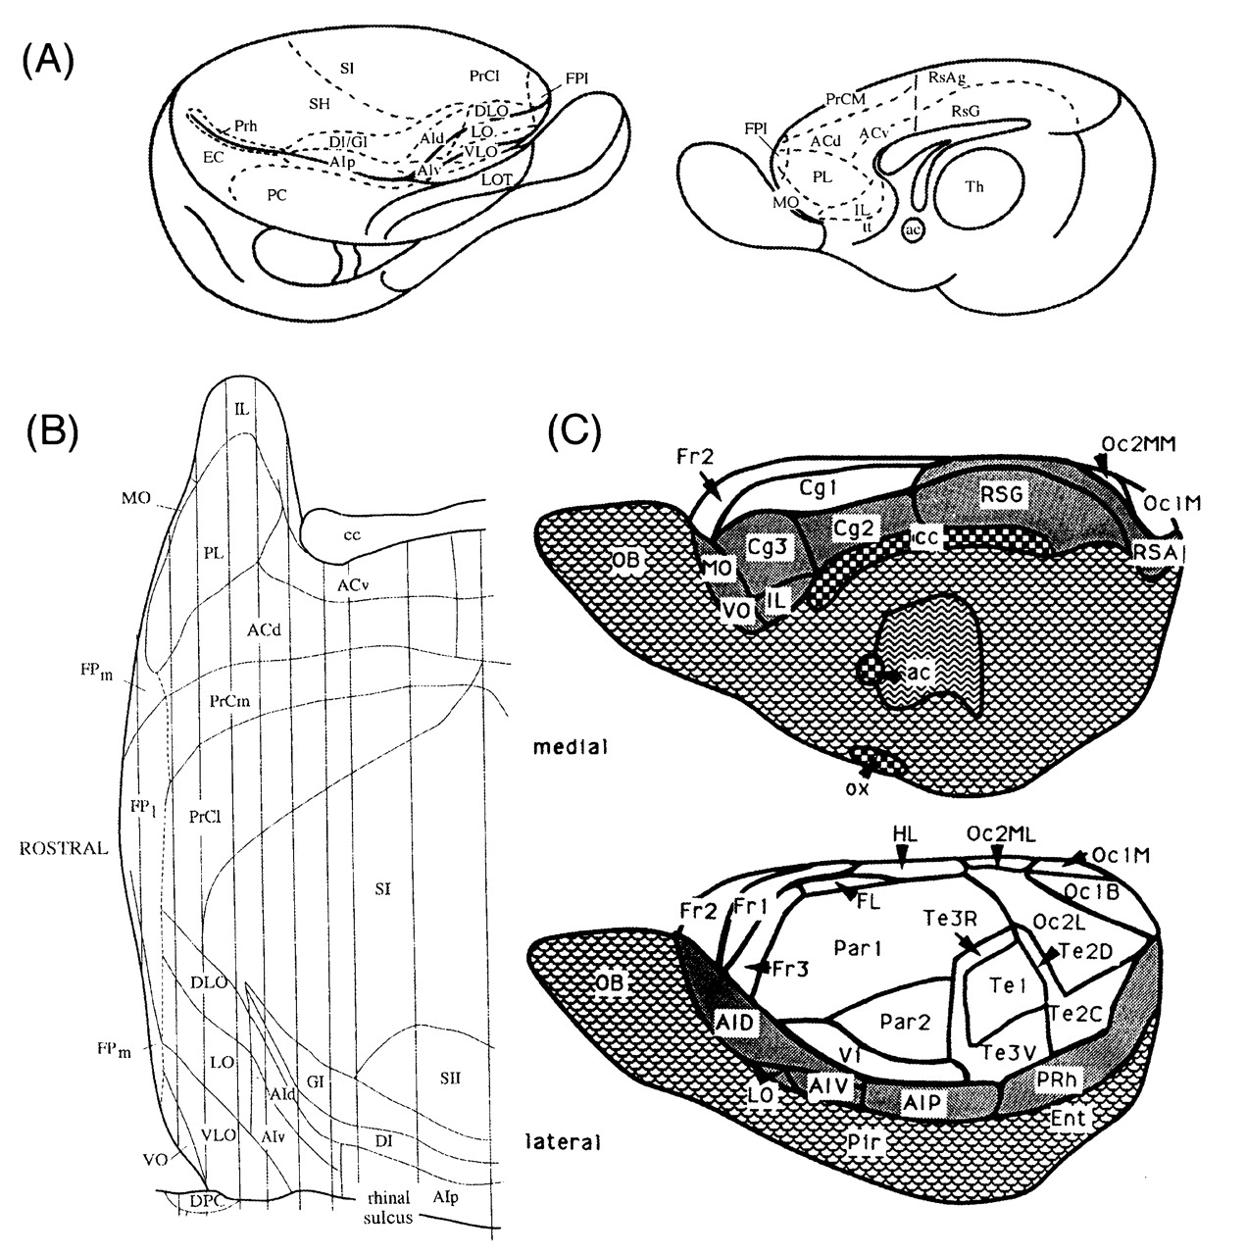
Figure 1. Architectonic maps of the prefrontal cortex of rats produced by three different investigators. (A) A map of ...
Notes:
Figure 1. Architectonic maps of the prefrontal cortex of rats produced by three different investigators. (A) A map of the medial and lateral surfaces of the rat brain (Krettek and Price, 1977); the rhinal sulcus has been spread open graphically, to allow visualization of the orbital cortex in the upper bank of the sulcus. (B) An unfolded map of the rostral half of the rat brain (Ray and Price, 1992); the medial surface and corpus callosum is at the top, the dorsolateral cortex is in the middle and the ventrolateral cortex is at the bottom, ending at the rhinal sulcus. The architectonic areas are slightly modified from those delineated by Krettek and Price. (C) A recent map of the medial and lateral surfaces of the rat cortex (Zilles and Wree, 1995). The areas are similar to those shown in the other two maps, but many of the names have been changed.
Unless provided in the caption above, the following copyright applies to the content of this slide: © Oxford University Press

Slide 2
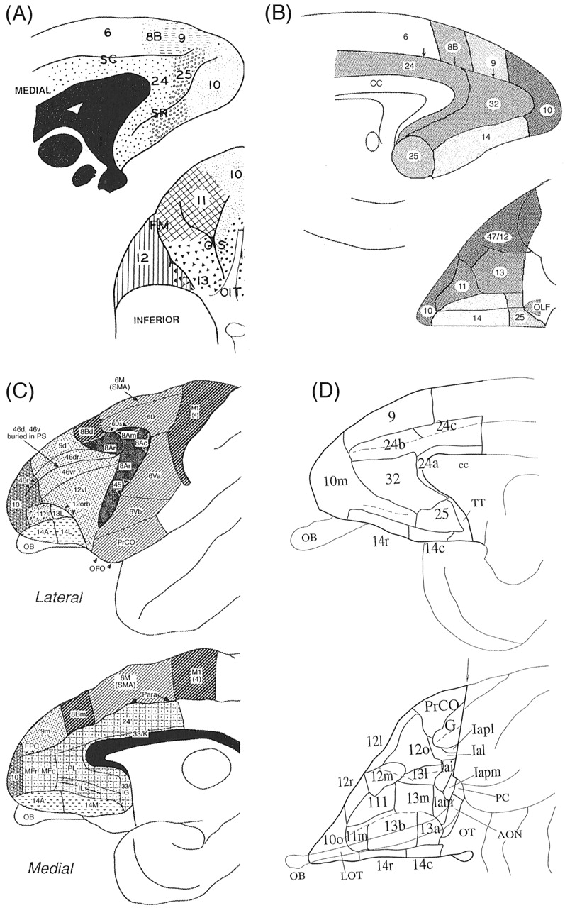
Figure 2. Architectonic maps of the prefrontal cortex of monkeys, taken from four different studies. (A) The classical ...
Notes:
Figure 2. Architectonic maps of the prefrontal cortex of monkeys, taken from four different studies. (A) The classical map of Walker, which divided the orbital cortex into areas 10, 11, 12, 13, and 14 (Walker, 1940). Note that area 25 on the medial surface is in the location usually occupied by area 32 in other maps. (B) A recent map (Petrides and Pandya, 1994). This map is very similar to that of Walker, except for areas 32 and 25 on the medial wall. The lateral convexity cortex is designated area 47/12 instead of simply area 12, for better correspondence with Brodmann's human map (see Fig. 3 and text). (C) A map of the lateral and medial surfaces (Preuss and Goldman-Rakic, 1991). (D) The map of the OMPFC published by Carmichael and Price, based on differential patterns of staining with nine separate methods, and on connections (Carmichael and Price, 1994). Note that the map of the orbital cortex is based on the map by Walker, but that each of his areas is subdivided into two to four different areas.
Unless provided in the caption above, the following copyright applies to the content of this slide: © Oxford University Press

Slide 3
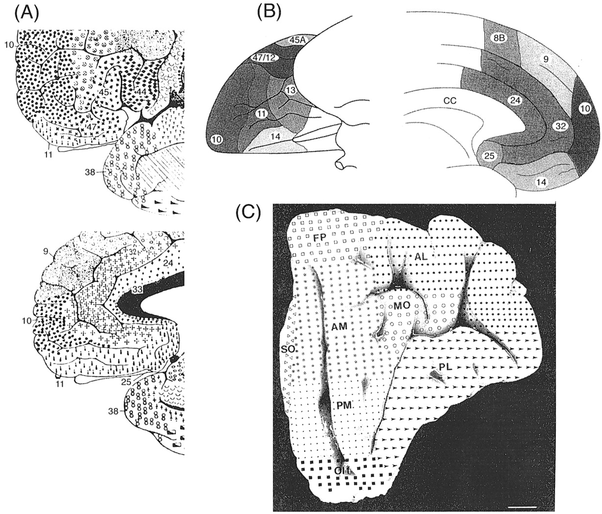
Figure 3. Architectonic maps of the prefrontal cortex of humans, by three investigators. (A) The rostral part of the ...
Notes:
Figure 3. Architectonic maps of the prefrontal cortex of humans, by three investigators. (A) The rostral part of the classical map by Brodmann (Brodmann, 1909). Note that area 32 is located rostral and dorsal to the genu of the corpus callosum, and the orbital cortex is apparently occupied by area 11. The ventrolateral convexity is designated area 47. (B) The map by Petrides and Pandya (Petrides and Pandya, 1994), which closely matches their monkey map (see Fig. 2). (C) A recent map of the orbital cortex by Hof et al. (Hof et al., 1995), who used letter designations instead of numbers.
Unless provided in the caption above, the following copyright applies to the content of this slide: © Oxford University Press

Slide 4
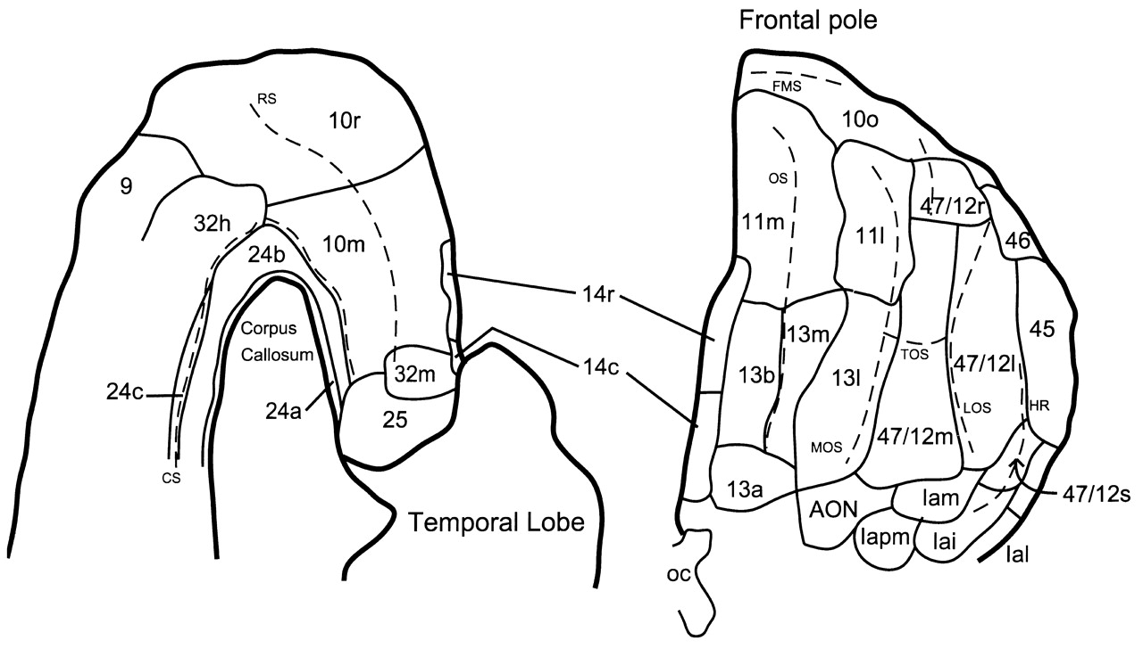
Figure 4. Architectonic map of the prefrontal cortex of humans (D. Öngür and J.L. Price, unpublished observations) ...
Notes:
Figure 4. Architectonic map of the prefrontal cortex of humans (D. Öngür and J.L. Price, unpublished observations) from a recent analysis that correlated patterns with several different staining methods, and applied the parcellation of the monkey cortex by Carmichael and Price (Carmichael and Price, 1994) (see Fig. 2). As in the map by Petrides and Pandya (Petrides and Pandya, 1994), the ventrolateral convexity is designated area 47/12. As in monkeys, this area is subdivided into four areas. Area 12o in monkeys is comparable with human area 47/12s, which is located within the depth of the rostral ramus of the lateral sulcus, as it extends into the frontal lobe.
Unless provided in the caption above, the following copyright applies to the content of this slide: © Oxford University Press

Slide 5
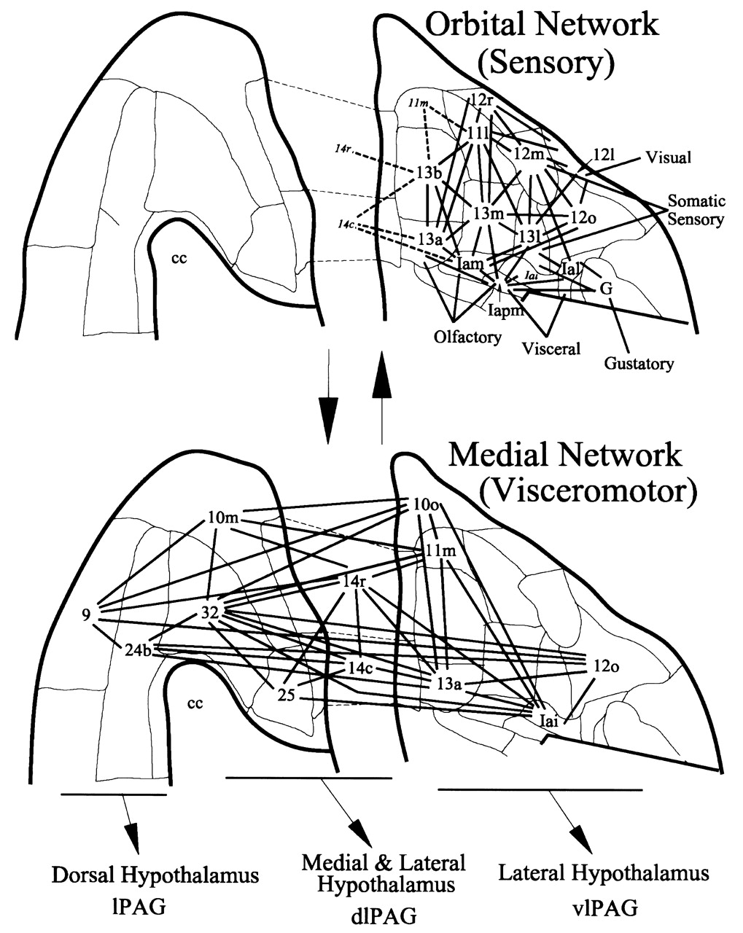
Figure 5. Summary of corticocortical connections within the OMPFC, which forms the basis for the division of the area ...
Notes:
Figure 5. Summary of corticocortical connections within the OMPFC, which forms the basis for the division of the area into an ‘orbital’ network and a ‘medial’ network (which also includes several orbital areas). [Modified from Carmichael and Price (Carmichael and Price, 1996).] Although the two networks are distinct, there are several points of interaction, especially through areas near the ventromedial corner of the frontal lobe. The orbital network receives several sensory inputs and appears to function as a system for sensory integration. The medial network projects to the hypothalamus and periaqueductal gray (PAG), and appears to function as a visceromotor system (An et al., 1999; Öngür et al., 1999). Note that different parts of the medial network are related to different parts of the hypothalamus, or to distinct longitudinal columns of the PAG. lPAG, lateral column; dlPAG, dorsolateral column; vlPAG, ventrolateral column.
Unless provided in the caption above, the following copyright applies to the content of this slide: © Oxford University Press

Slide 6
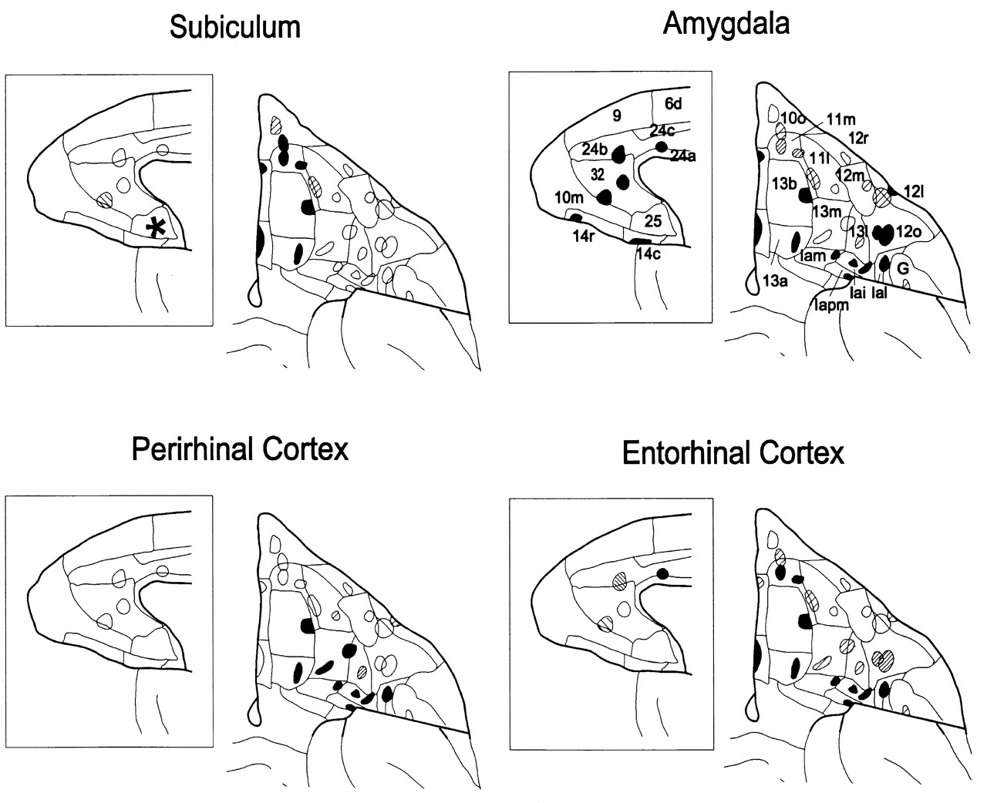
Figure 6. Summary of the distribution of projections from four limbic structures within the OMPFC. [Modified from ...
Notes:
Figure 6. Summary of the distribution of projections from four limbic structures within the OMPFC. [Modified from Carmichael and Price (Carmichael and Price 1995a).] The outlines on the projections of the medial or orbital cortical surface indicate the sites of injections of retrograde axonal tracers. The filled outlines indicate injections that produced many retrogradely labeled cells in the limbic structure. Hatched outlines indicate produced fewer labeled cells. The * in the subiculum map indicates an area that other studies have indicated projects to the subiculum, although a suitable injection was not available in the study by Carmichael and Price.
Unless provided in the caption above, the following copyright applies to the content of this slide: © Oxford University Press

Slide 7
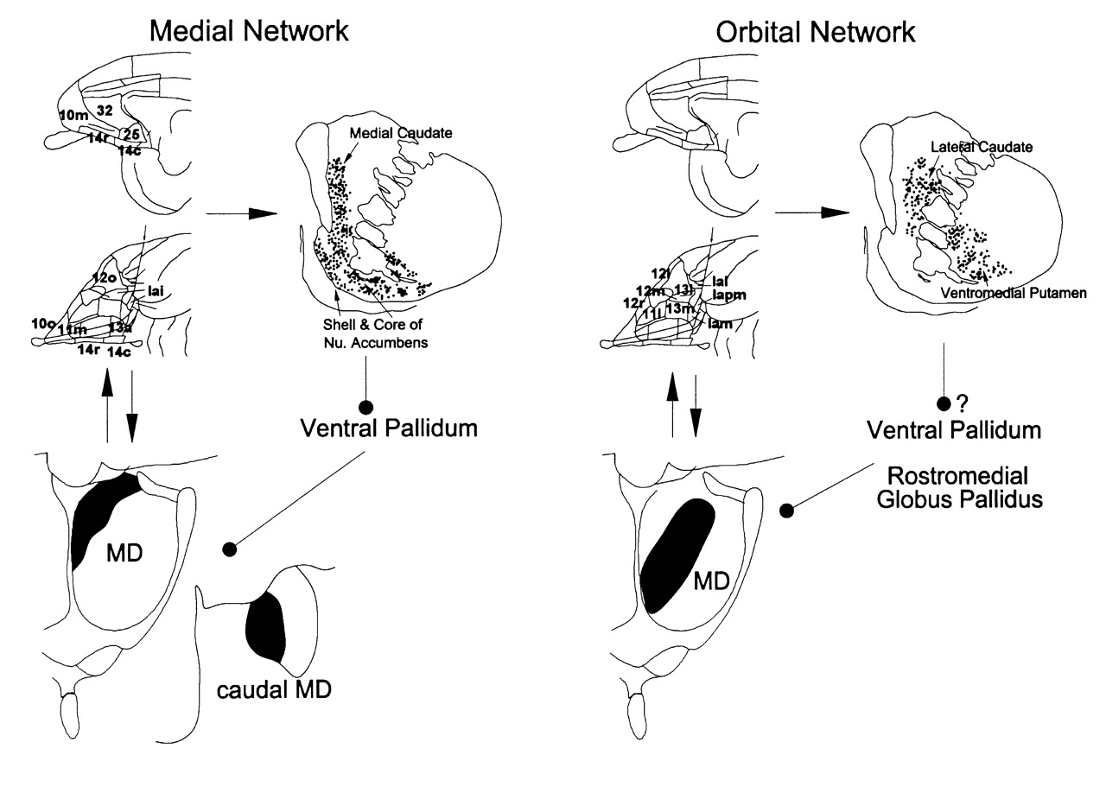
Figure 7. Summary of connections of the areas of the medial and orbital prefrontal networks with the striatum (An et ...
Notes:
Figure 7. Summary of connections of the areas of the medial and orbital prefrontal networks with the striatum (An et al., 1997) (also A. Ferry, D. Öngür, X. An and J.L. Price, unpublished observations) and the mediodorsal thalamic nucleus (MDm) (Ray and Price, 1993). The medial network projects primarily to the ventromedial striatum, including the medial caudate nucleus, the accumbens nucleus and the ventral putamen, and is also interconnected with the dorsomedial and caudal part of MDm . In contrast, the orbital network projects to a central region of the striatum, in the lateral caudate nucleus and the ventromedial putamen, and is interconnected with the more central part of MDm. The striatal and thalamic regions are connected through the ventral pallidum, although the pallidal projection of the central striatum has not been demonstrated in detail.
Unless provided in the caption above, the following copyright applies to the content of this slide: © Oxford University Press

Slide 8
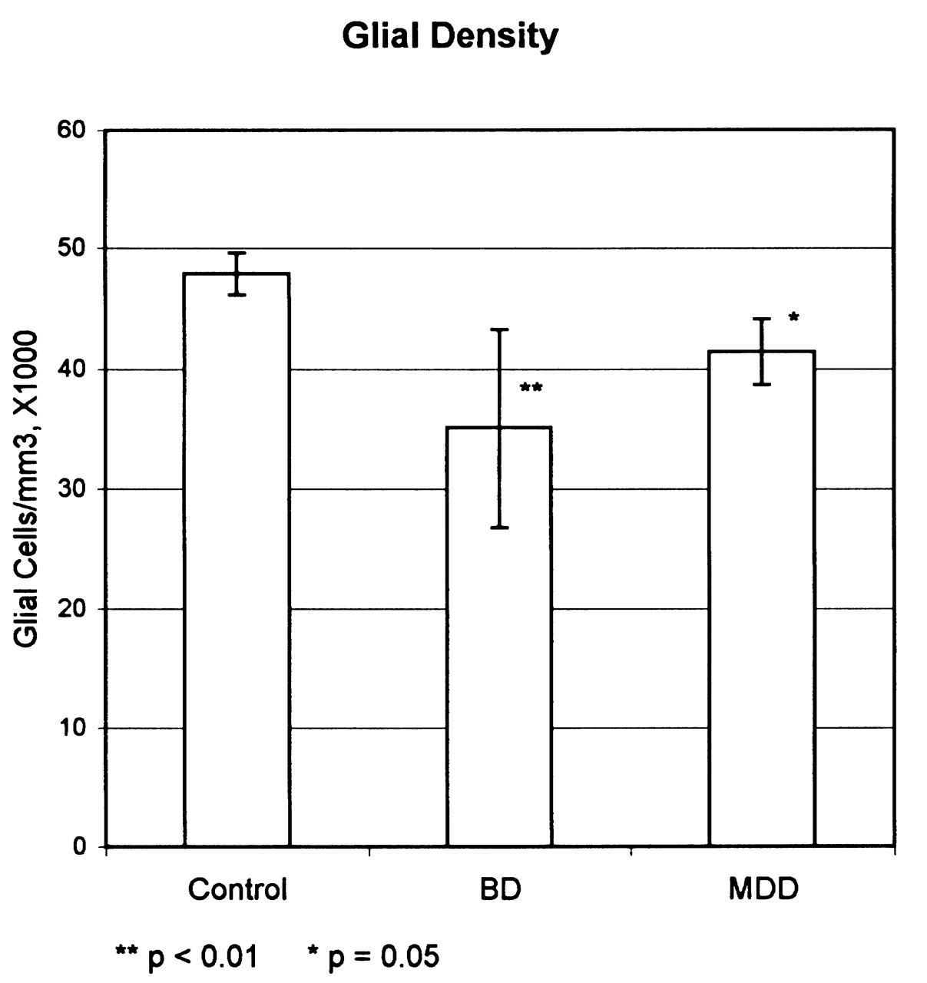
Figure 8. The average density of glia in the subgenual part of area 24 from controls and subjects with bipolar ...
Notes:
Figure 8. The average density of glia in the subgenual part of area 24 from controls and subjects with bipolar depression (BD) or major depressive disorder (MDD). The data was averaged from studies of brains from three different sources. [Modified from Öngür et al. (Öngür et al., 1998b).]
Unless provided in the caption above, the following copyright applies to the content of this slide: © Oxford University Press

