Slide 1
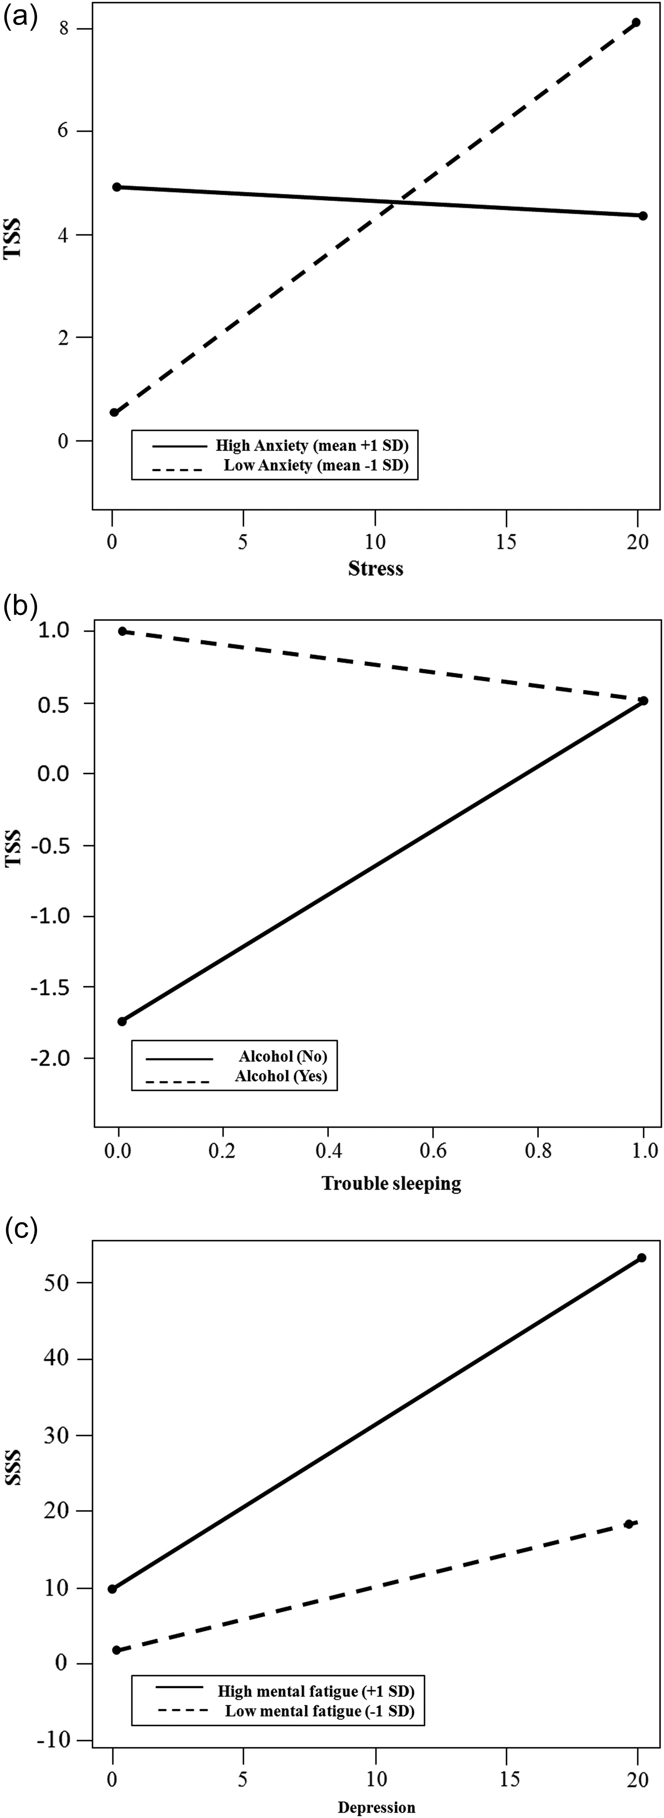
Fig. 1. Plots for the interacting predictors. (a) Two-way interaction plot between stress and anxiety for the TSS. ...
Notes:
Fig. 1. Plots for the interacting predictors. (a) Two-way interaction plot between stress and anxiety for the TSS. (b) Two-way interaction plot between trouble sleeping and alcohol consumption for the TSS. (c) Two-way interaction plot between depression and mental fatigue for the SSS.
Unless provided in the caption above, the following copyright applies to the content of this slide: © The Author 2016. Published by Oxford University Press. All rights reserved. For permissions, please e-mail: journals.permissions@oup.com.

