Slide 1
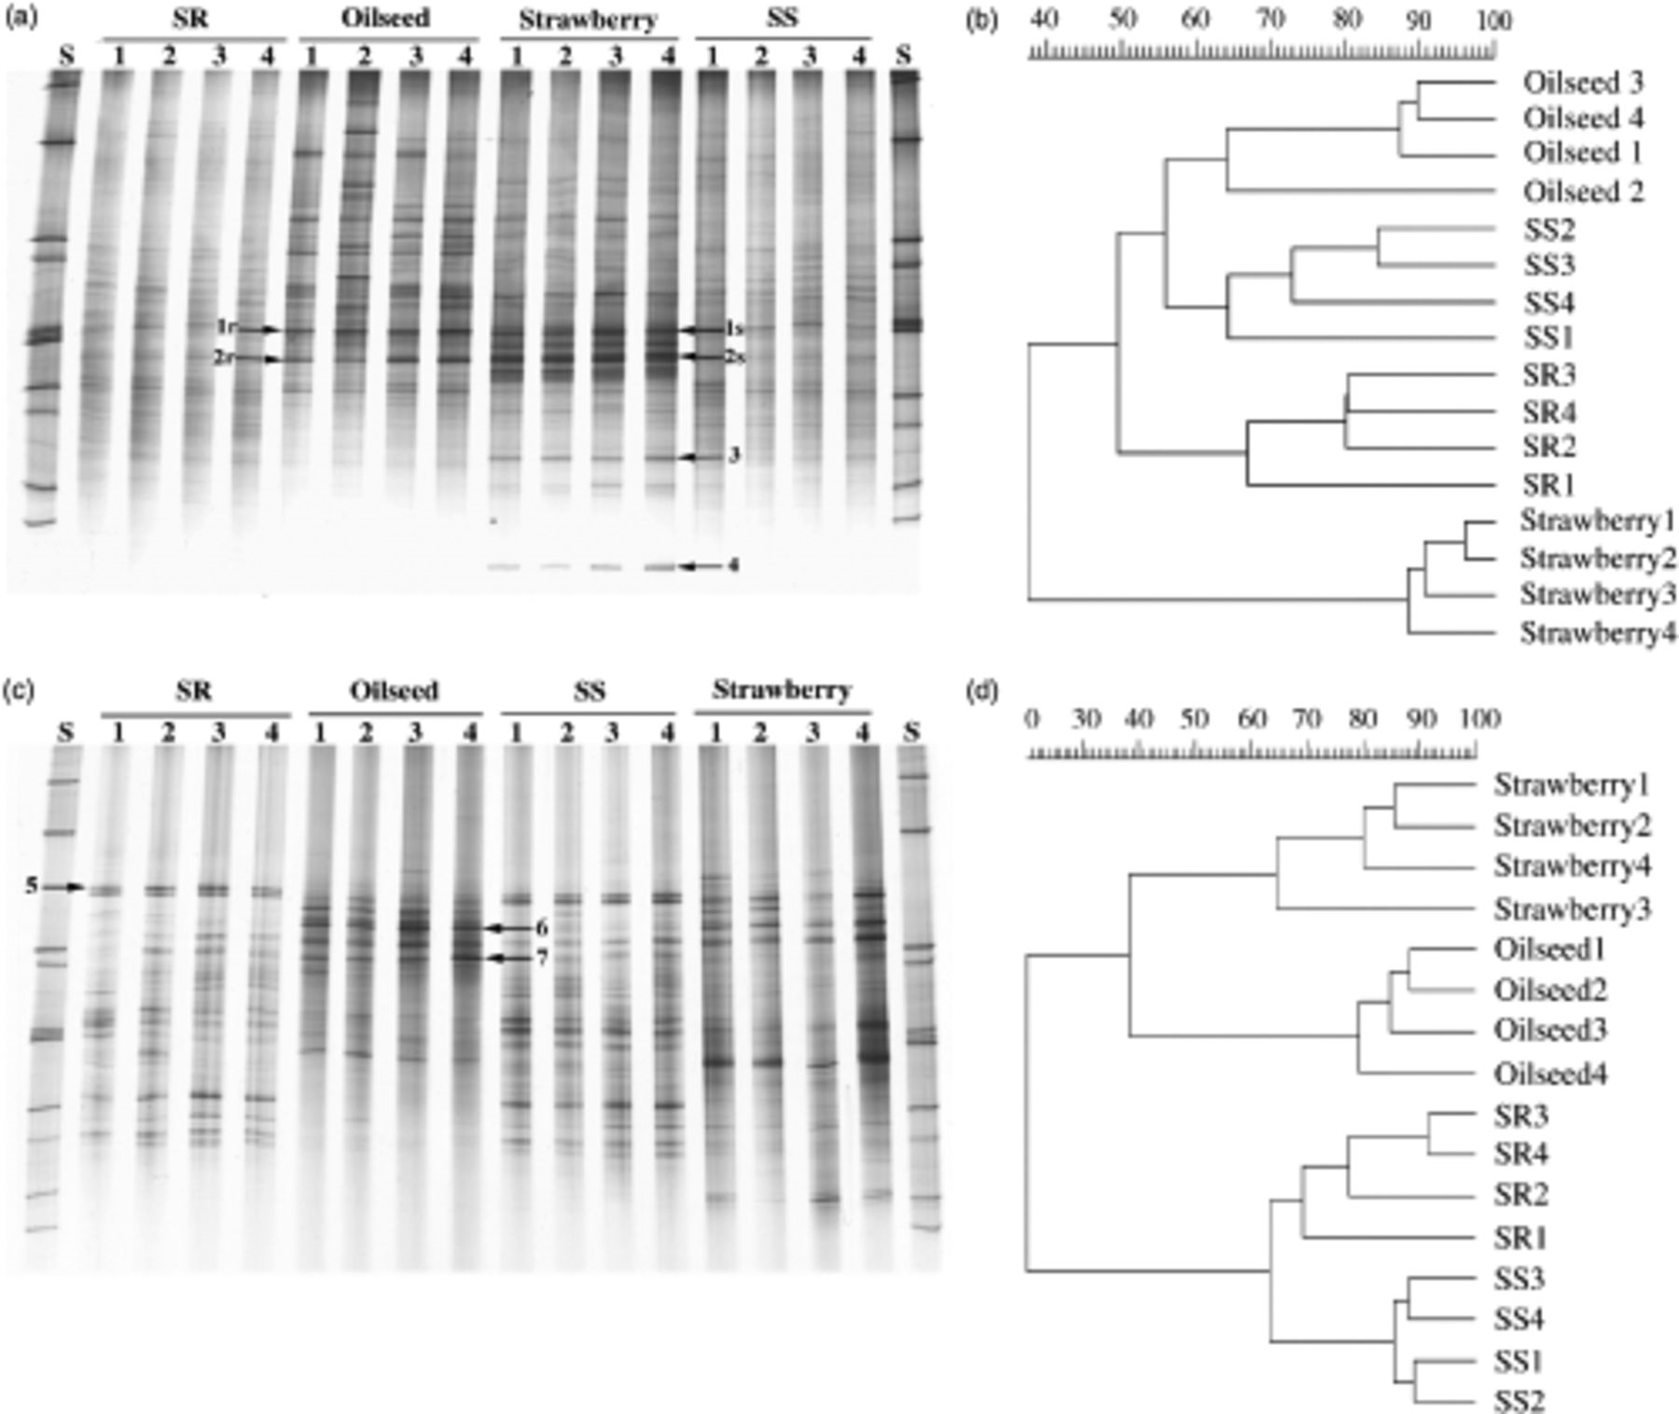
1 Within-site comparisons among denaturing gradient gel electrophoresis fingerprints of 16S rRNA gene fragments ...
Notes:
1 Within-site comparisons among denaturing gradient gel electrophoresis fingerprints of 16S rRNA gene fragments amplified from bulk and rhizosphere (strawberry and oilseed rape) soil DNA templates. Gels obtained for the sampling site Rostock with their respective dendrograms generated by cluster analysis (UPGMA) are shown. (a) bacterial profiles, 2003; (b) respective dendrogram; (c) betaproteobacterial profiles, 2002; (d) respective dendrogram. Arrows indicate dominant bands, which were extracted from the gels for sequence analysis. SS, bulk soil samples from strawberry field; SR, bulk soil samples from oilseed rape field; Strawberry, strawberry rhizosphere samples; Oilseed, oilseed rape rhizosphere samples.
Unless provided in the caption above, the following copyright applies to the content of this slide: © 2006 Federation of European Microbiological Societies Published by Blackwell Publishing Ltd. All rights reserved

Slide 2
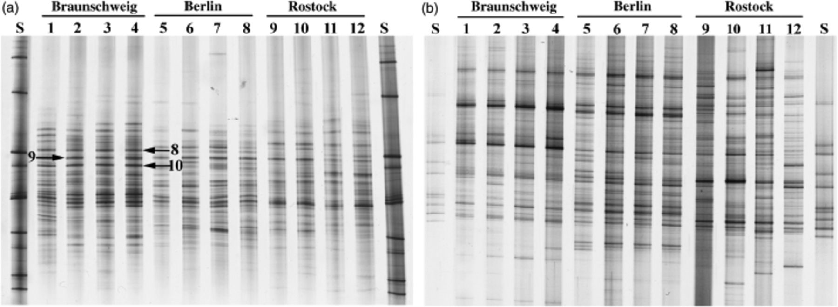
2 Denaturing gradient gel electrophoresis fingerprinting of bulk soil samples collected at three sampling ...
Notes:
2 Denaturing gradient gel electrophoresis fingerprinting of bulk soil samples collected at three sampling sites. (a) Alphaproteobacterial 16S rRNA gene fragments, 2003; (b) fungal 18S rRNA gene fragments, 2003. Arrows indicate alphaproteobacterial bands that were dominant and characteristic of the sampling site Braunschweig. Bands were extracted from the gel prior to cloning and sequencing analysis.
Unless provided in the caption above, the following copyright applies to the content of this slide: © 2006 Federation of European Microbiological Societies Published by Blackwell Publishing Ltd. All rights reserved

Slide 3
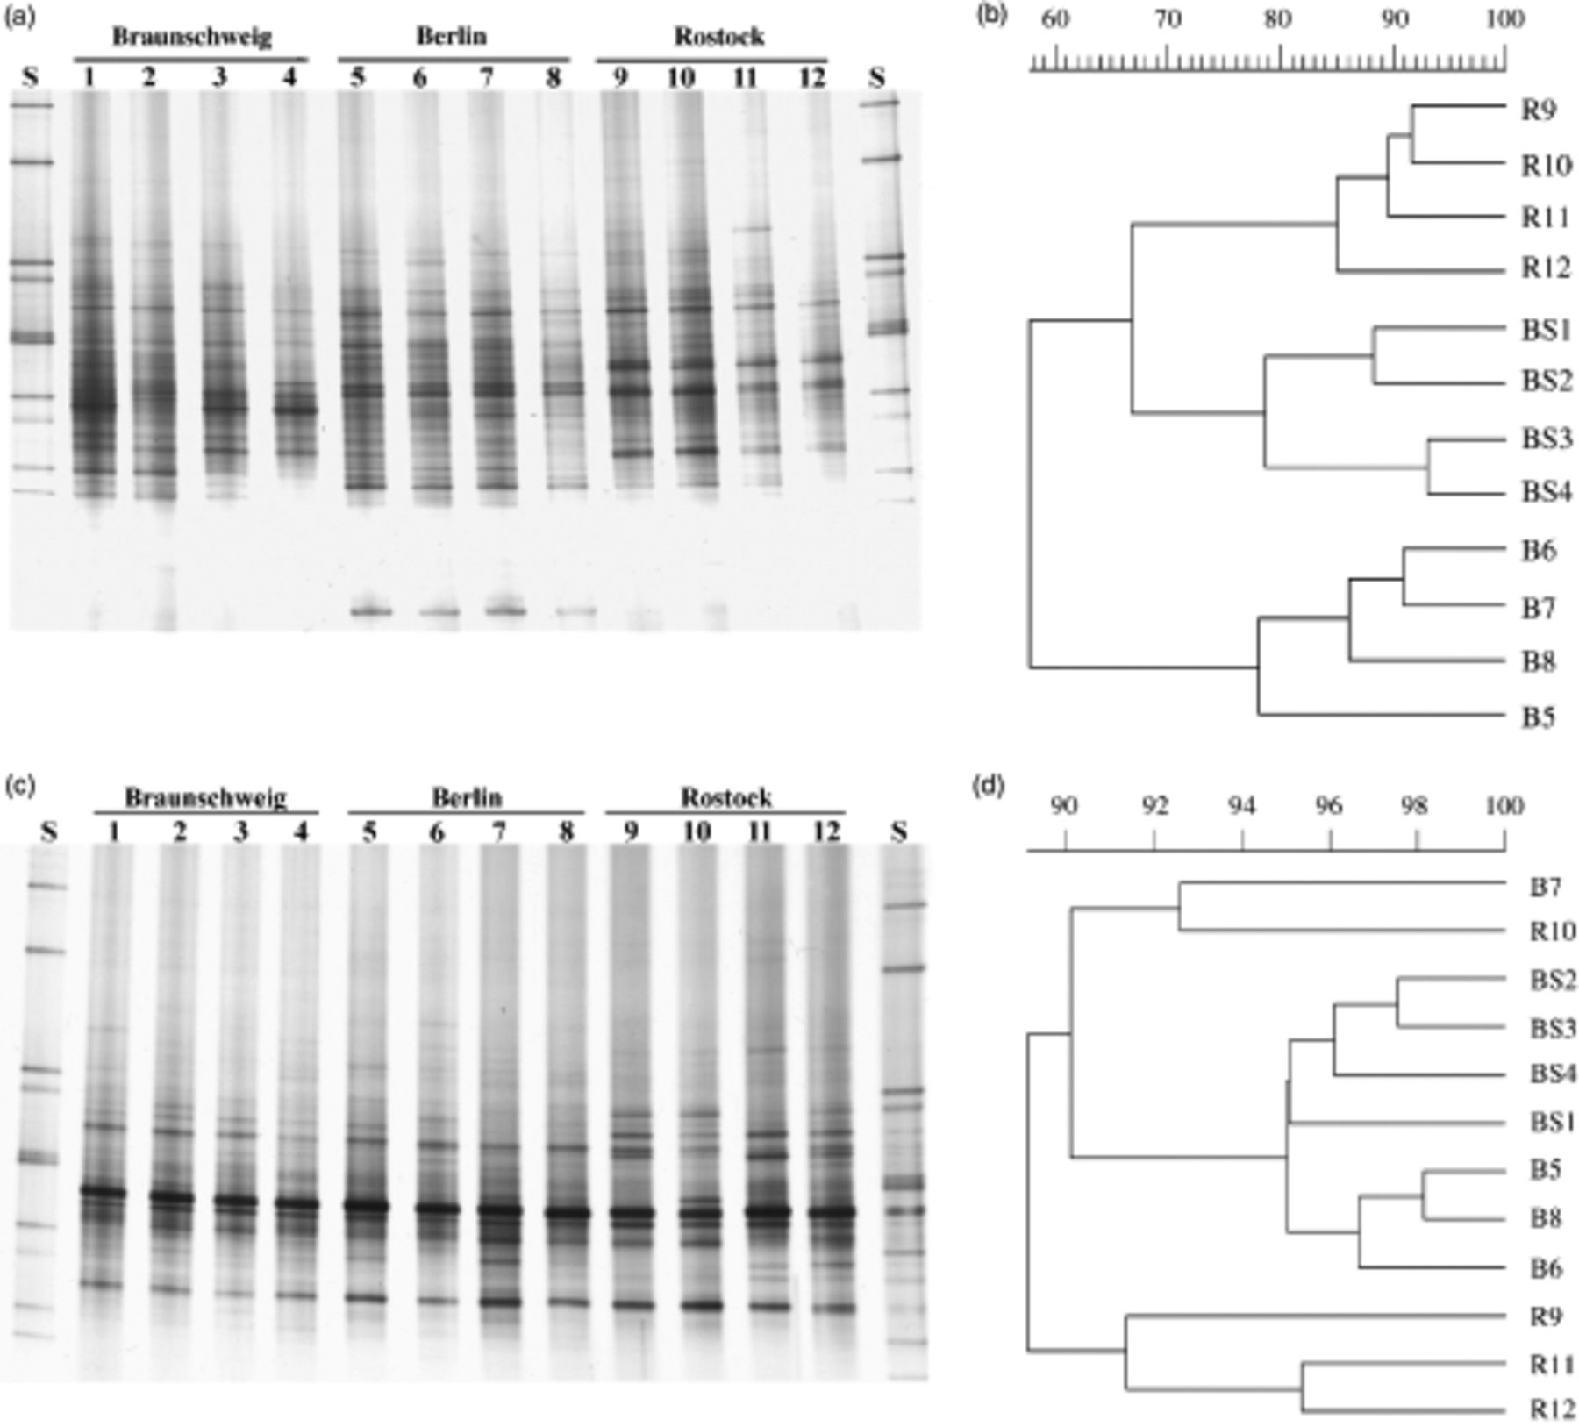
3 Actinobacterial denaturing gradient gel electrophoresis community fingerprints of 16S rRNA gene fragments ...
Notes:
3 Actinobacterial denaturing gradient gel electrophoresis community fingerprints of 16S rRNA gene fragments obtained for bulk soil (a) and strawberry rhizosphere (c) samples collected at three sampling sites (2002). The respective dendrograms generated by cluster analysis (UPGMA) of Pearson's similarity indices are shown (b, c). BS, Braunschweig; B, Berlin; R, Rostock.
Unless provided in the caption above, the following copyright applies to the content of this slide: © 2006 Federation of European Microbiological Societies Published by Blackwell Publishing Ltd. All rights reserved

