Slide 1
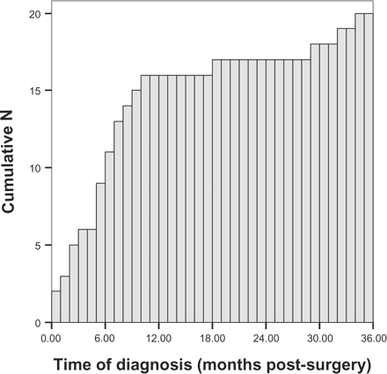
Figure 1. Cumulative frequency chart showing range of development times for lymphoedema up to 3 years post-surgery.
Notes:
Figure 1. Cumulative frequency chart showing range of development times for lymphoedema up to 3 years post-surgery.
Unless provided in the caption above, the following copyright applies to the content of this slide: © The Author 2005. Published by Oxford University Press on behalf of the Association of Physicians. All rights reserved. For Permissions, please email: journals.permissions@oupjournals.org

