Slide 1
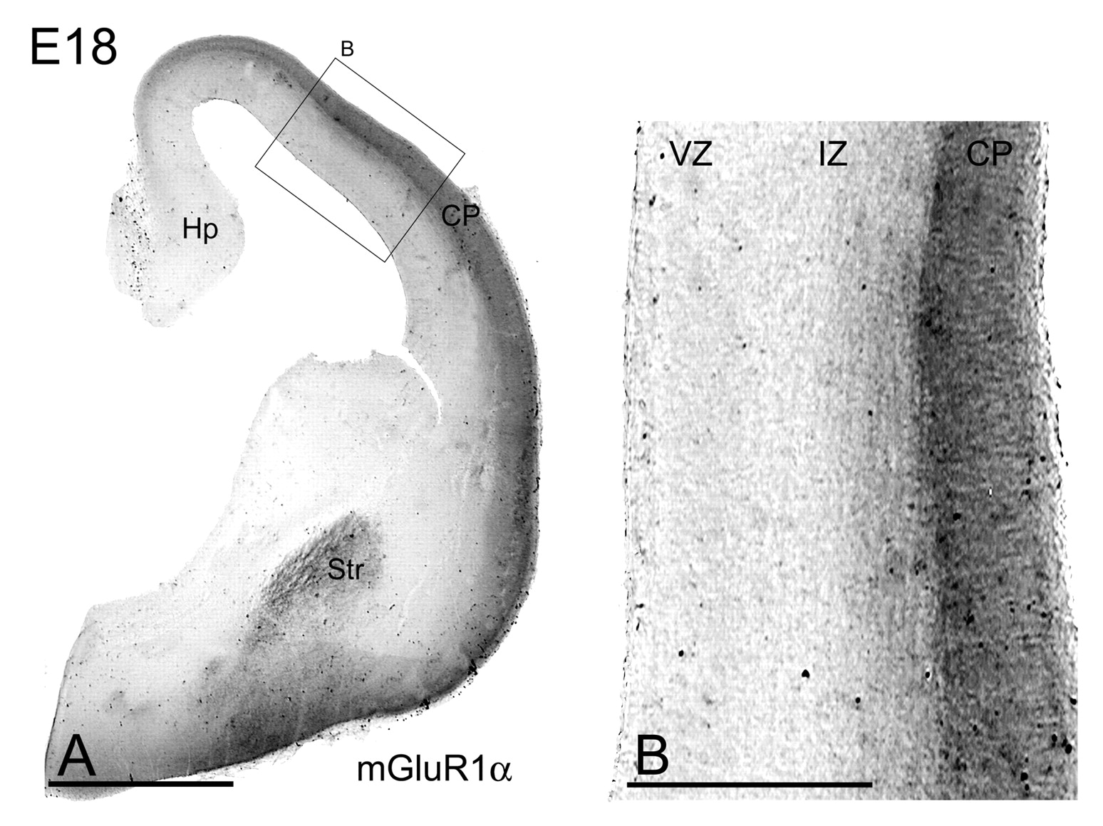
Figure 1. Immunoreactivity for mGluR1α at E18 using a pre-embedding immunoperoxidase method. (A) Mid-caudal coronal ...
Notes:
Figure 1. Immunoreactivity for mGluR1α at E18 using a pre-embedding immunoperoxidase method. (A) Mid-caudal coronal section of the telencephalon showing the expression and distribution of mGluR1α. The receptor was mainly localized in the cortical plate (CP) and in the striatum (Str). (B) Higher magnification of a cortical area labeled for the receptor. Note that only a diffuse immunolabeling was found along the CP. Scale bars: 1 mm (A); 200 μm (B).
Unless provided in the caption above, the following copyright applies to the content of this slide: © Oxford University Press

Slide 2
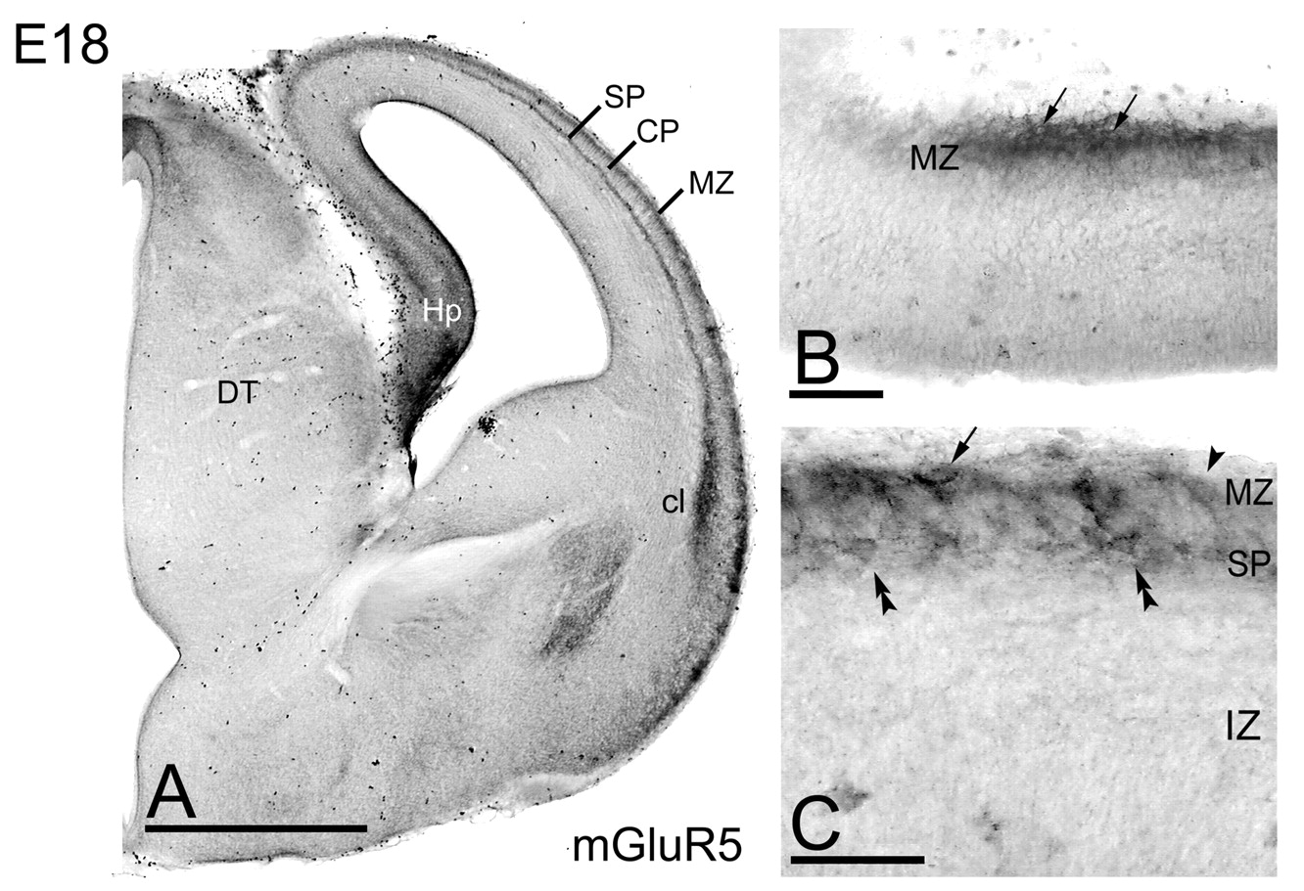
Figure 2. Immunoreactivity for mGluR5 at E18 using a pre-embedding immunoperoxidase method (A–C). (A) Mid-caudal ...
Notes:
Figure 2. Immunoreactivity for mGluR5 at E18 using a pre-embedding immunoperoxidase method (A–C). (A) Mid-caudal coronal section labeled for mGluR5. Immunoreactivity was found in the marginal zone (MZ) and subplate (SP) of the cerebral cortex, in the claustrum (Cl) and in the hippocampus (Hp). (B,C) High magnification views of the hippocampus and cortex immunopositive for mGluR5. In the MZ of both structures we found a strong somatic labeling in cells located more superficially in this layer (arrows). In the cortex we observed another cell type immunoreactive for mGluR5, but located deeper in this layer (arrowhead). Note also the presence of immunoreactive cells in the SP (double arrowheads). Scale bars: 1 mm (A); 100 μm (D); 50 μm (E).
Unless provided in the caption above, the following copyright applies to the content of this slide: © Oxford University Press

Slide 3
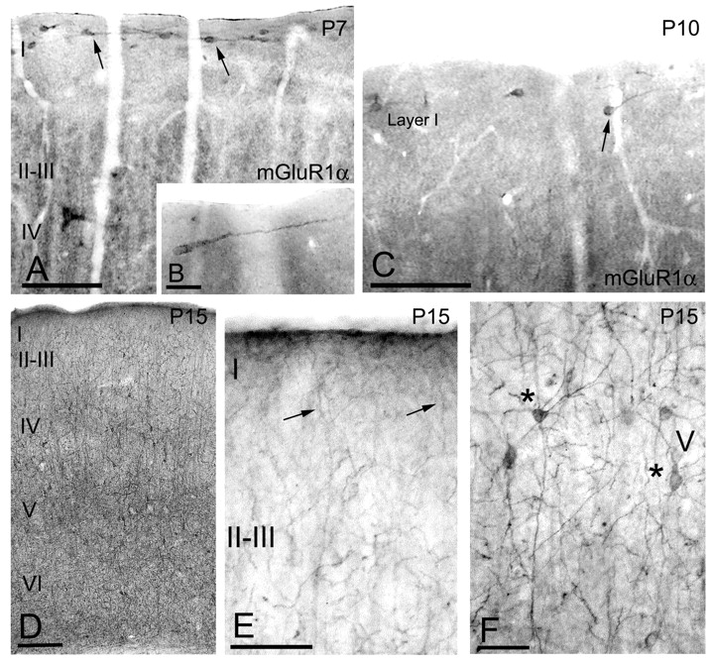
Figure 3. Immunoreactivity for mGluR1α in the neocortex during postnatal development using a pre-embedding ...
Notes:
Figure 3. Immunoreactivity for mGluR1α in the neocortex during postnatal development using a pre-embedding immunoperoxidase method (A–F). (A) Coronal section of a P7 rat brain showing the expression for mGluR1α in the supragranular layers of the cerebral cortex. The receptor was highly expressed in cells located horizontally in layer I with processes running parallel to the pial surface (arrows). (B) High magnification of a mGluR1α positive layer I cell with Cajal–Retzius-like morphology. (C) At P10, the number of immunolabeled cells in layer I (arrow) decreased. (D–F) Later on in development (P15), mGluR1α expression was localized in interneurons along all the cortical layers. We did not observe any cells showing the morphology of Cajal–Retzius cells in layer I at this age. Immunoreactive interneurons were found throughout all layers (asterisks), some of them with their dendrites running up to layer I (arrows), crossing the still undifferentiated upper part of the cortical plate. Scale bars: 100 μm (A,C–E); 25 μm (B); 50 μm (F).
Unless provided in the caption above, the following copyright applies to the content of this slide: © Oxford University Press

Slide 4
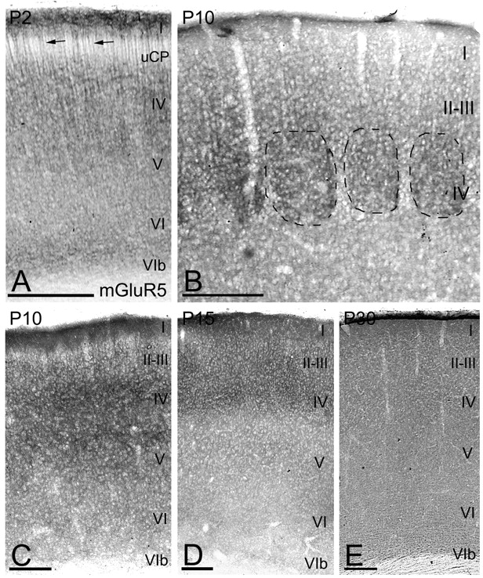
Figure 4. Immunoreactivity for mGluR5 in the neocortex during postnatal development using a pre-embedding ...
Notes:
Figure 4. Immunoreactivity for mGluR5 in the neocortex during postnatal development using a pre-embedding immunoperoxidase method (A–E). (A) Immunolabeling for mGluR5 along the cerebral cortex at P2. The receptor was localized in the neuropil of all cortical layers, but was stronger in layers I and IV. At this age, we observed numerous apical dendrites of pyramidal cells immunoreactive for mGluR5 (arrows). (B,C) During the second week of postnatal development, mGluR5 was mainly localized in the neuropil of all cortical layers. Intense immunolabeling for the receptor was observed in the layer IV barrel cortex. (D) During the third week of postnatal development, mGluR5 was mainly localized in all cortical layers, with a strong labeling in layers I-IV. (E) From the fourth postnatal week to adulthood we observed a strong neuropilar staining in all cortical layers. Scale bars: 100 μm (A,B); 200 μm (C–E).
Unless provided in the caption above, the following copyright applies to the content of this slide: © Oxford University Press

Slide 5
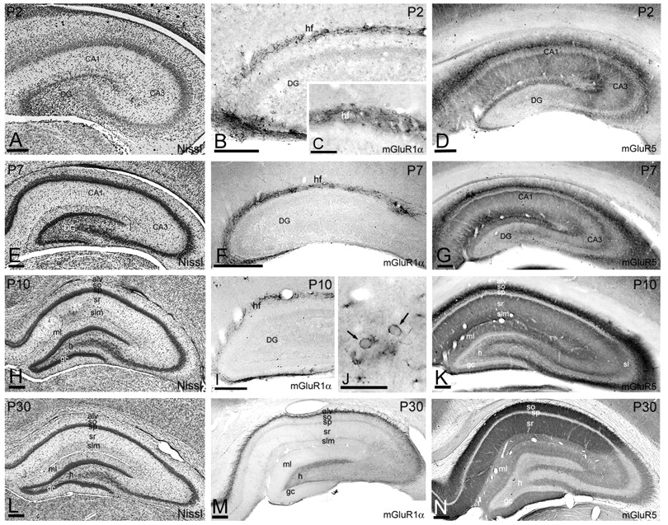
Figure 5. Expression of group I mGluRs during hippocampal development using a pre-embedding immunoperoxidase method. ...
Notes:
Figure 5. Expression of group I mGluRs during hippocampal development using a pre-embedding immunoperoxidase method. (A,E,H,L) Nissl staining of P2, P7, P10 and P30 hippocampi, respectively. (B,C,F) At P2 and P7, mGluR1α immunoreactive cells were observed at both sides of the hippocampal fissure (hf), in the outer molecular layer of the fascia dentata and the stratum lacunosum-moleculare of the hippocampus. Those cells had an elongate morphology resembling to Cajal–Retzius cells. (I,J) At P10, the number of immunolabeled cells for mGluR1α in the hf decreased. Note the location of the receptor in the plasma membrane (arrows). (M) From P15 to adulthood, mGluR1α immunoreactivity was only detected in the alveus, some scattered interneurons in the strata oriens and radiatum of the CA1 and CA3 regions, and in the hilus (h) of the dentate gyrus (de). (D,G,K,N) Coronal section of the hippocampus of P2 (G), P7 (H), P10 (I) and P30 (J) rat brains. Immunoreactivity for mGluR5 increased during postnatal development. During the first and second postnatal weeks (D,G,K), mGluR5 immunoreactivity was strongest in the stratum oriens of the CA1 and CA3 region. At P30–P60 (N), immunoreactivity was very strong in the strata oriens and radiatum of the CA1 region. The alveus, stratum lacunosum-moleculare of CA1, strata oriens and radiatum of the CA3 regions and the molecular layer (ml) of the dentate gyrus were labeled less intensely, with the stratum lucidum (sl) and the dentate hilus (h) being weakly labeled. gc, granule cell layer. Scale bars: 200 μm (A,B,D–I,K–N); 50 μm (C); 30 μm (J).
Unless provided in the caption above, the following copyright applies to the content of this slide: © Oxford University Press

Slide 6
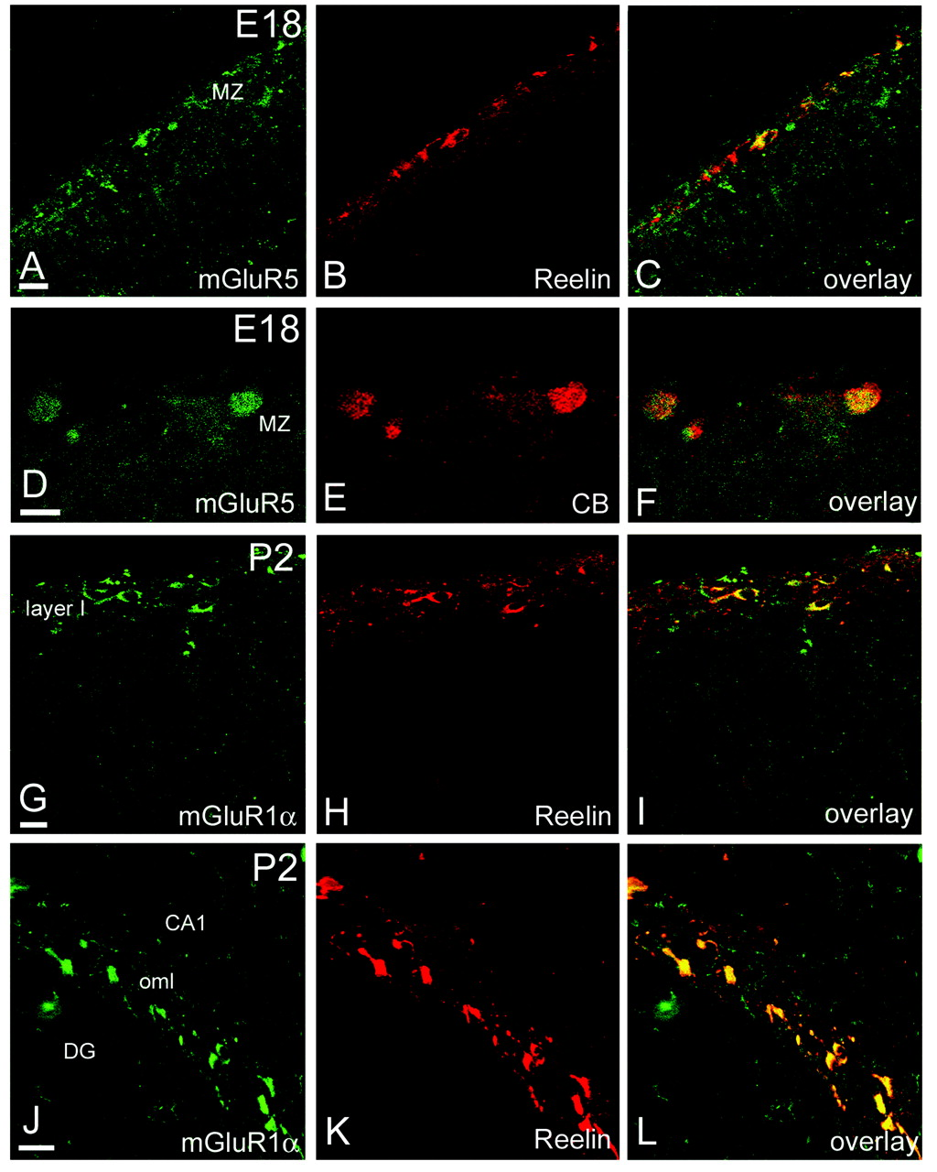
Figure 6. Characterization of the cell population expressing group I mGluRs during pre- and postnatal development. ...
Notes:
Figure 6. Characterization of the cell population expressing group I mGluRs during pre- and postnatal development. Double-labeling for mGluR1α or mGluR5 and different neuronal markers (calbindin and reelin). (A–C) Immunofluorescence for mGluR5 (green) and reelin (red) in the cerebral cortex at E18. Approximately 25 % of the reelin-positive cells in MZ co-localized the receptor, demonstrating that mGluR1α was expressed in Cajal–Retzius cells. The co-localization is shown in (C). (D–F) High magnification of MZ region labeled with mGluR5 (green) and Calbindin (red). Around 45.% of the calbindin-positive cells in the MZ co-localized mGluR5, as shown in (F). (G–L) Double immunofluorescence for mGluR1α (green) and reelin (red) in layer I of the cortex (G–I) and in the hippocampus (J–L) at P2. Virtually all neurons immunopositive for reelin co-expressed mGluR1α in both regions, as shown in (I) and (L), respectively. hf, hippocampal fissure; DG, dentate gyrus. Scale bars: 20 μm.
Unless provided in the caption above, the following copyright applies to the content of this slide: © Oxford University Press

Slide 7
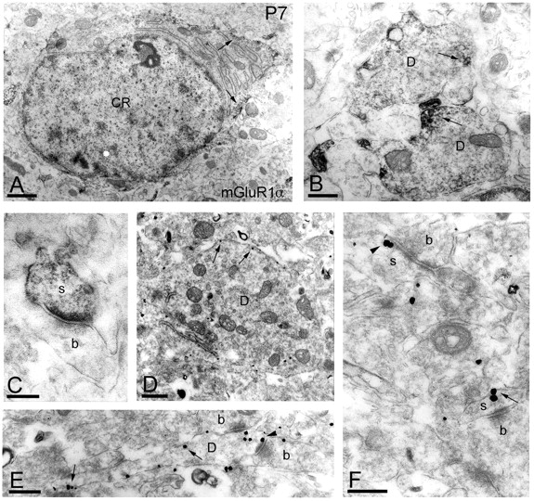
Figure 7. Immunoreactivity for mGluR1α in layer I of the cortex and hippocampus at P7 as demonstrated by pre-embedding ...
Notes:
Figure 7. Immunoreactivity for mGluR1α in layer I of the cortex and hippocampus at P7 as demonstrated by pre-embedding immunoperoxidase and immunogold reactions — (A,B) cortex, (C–F) hippocampus — showing the subcellular localization of the receptor in Cajal–Retzius cells. The neuron contained a rounded large nucleus and abundant stacks of endoplasmic reticulum, identifying it as a Cajal–Retzius (CR) cell. (A–C) the peroxidase reaction end-product was detected in somata, in dendrites (D) and in dendritic spines (s), mainly in association with the plasma membrane — arrows in (A,B). Many of the immunoreactive spines were postsynaptic to axon terminals (b), forming asymmetrical synapses. (D–F) Immunoreactive dendrites and spines revealed by an immunogold method. Immunoparticles were associated with the internal surface of the plasma membrane (arrows) of dendrites (D) and spines (s) at extrasynaptic sites. Gold particles were often present at the edge (arrowheads) of the postsynaptic membrane specialization of asymmetrical synapses between dendrites (D) or spines (s) of Cajal–Retzius cells and axon terminals (b). Scale bars: 10 μm (A); 0.2 μm (C,F); 0.3 μm (B,E); 0.5 μm (D).
Unless provided in the caption above, the following copyright applies to the content of this slide: © Oxford University Press

Slide 8
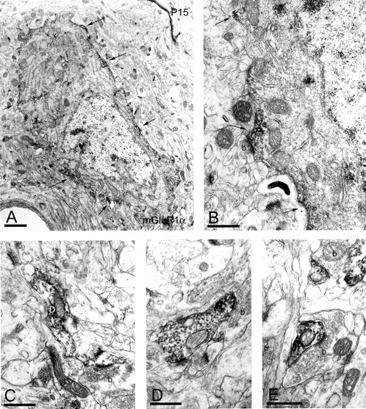
Figure 8. Electron micrographs of layer V of the cortex showing immunoreactivity for mGluR1α in interneurons at P15 as ...
Notes:
Figure 8. Electron micrographs of layer V of the cortex showing immunoreactivity for mGluR1α in interneurons at P15 as demonstrated by a pre-embedding immunoperoxidase method. (A,B) Aggregates of immunoperoxidase reaction product were mainly associated with the somatic plasma membrane (arrows) and also with the cytoplasmic face of membranes of the endoplasmic reticulum. The soma received abundant synaptic contacts with axon terminals (b) and immunolabeling for the receptor could be seen very close to these synapses (arrow in figure B). The proximal (D in C and D) and distal dendrites (D in E) of these interneurons were immunolabeled for mGluR1α and often surrounded by axon terminals (b), forming symmetrical or asymmetrical synapses. Scale bars: 1 μm (A); 0.5 μm (C–E).
Unless provided in the caption above, the following copyright applies to the content of this slide: © Oxford University Press

Slide 9
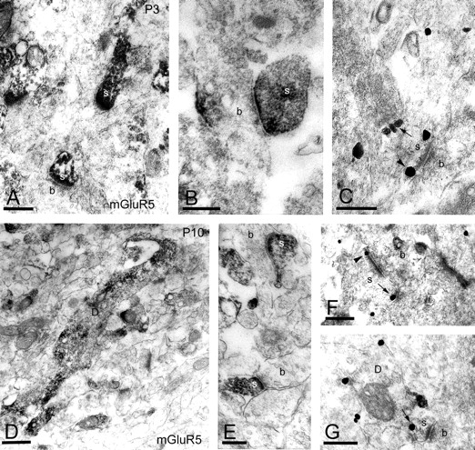
Figure 9. Immunoreactivity for mGluR5 in the cortex during postnatal development as demonstrated by pre-embedding ...
Notes:
Figure 9. Immunoreactivity for mGluR5 in the cortex during postnatal development as demonstrated by pre-embedding immunoperoxidase and immunogold reactions. (A–C) Subcellular localization of mGluR5 in layer I at P3 showing intense immunoreactivity for the receptor in dendritic spines (s) of pyramidal cells. Many of these dendritic spines formed asymmetrical synapses with axon terminals (b). Immunoparticles were associated with the extrasynaptic plasma membrane (arrows) of the spines and often were localized at the edge of the synaptic specialization (arrowhead). (D, E) At P10, dendritic shafts (D) of interneurons (illustrated from layer II–III) and pyramidal cells were also immunoreactive for mGluR5 throughout the cortex and hippocampus. Immunoreactive dendritic spines (s) belonging to pyramidal cells of layer V formed asymmetrical synapses with axon terminals (b). (F, G) Immunoparticles were also associated with the extrasynaptic plasma membrane (arrows) of dendrites (D) and the dendritic spines (s) and also are localized at the edge of the synaptic specialization (arrowhead). Scale bars: 0.3 μm (A–C, E–G); 0.5 μm (D).
Unless provided in the caption above, the following copyright applies to the content of this slide: © Oxford University Press

