Slide 1
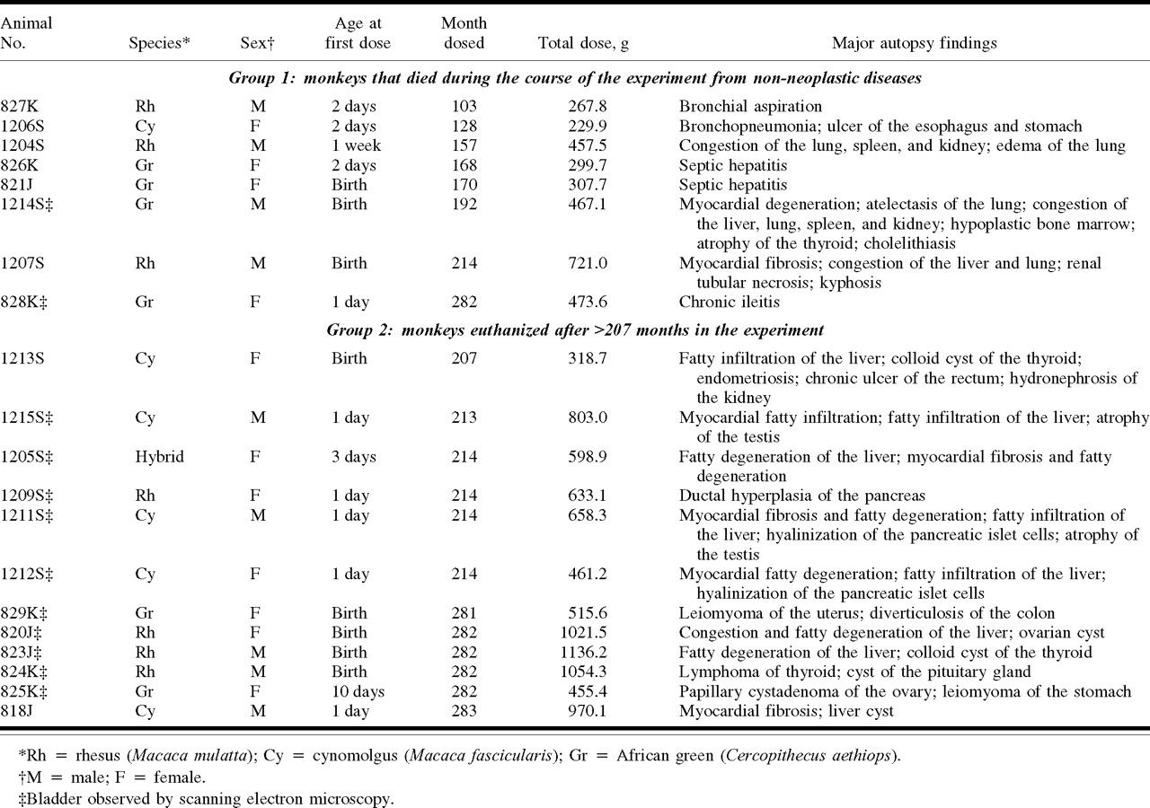
Table 1. Table 1. Tumors and other lesions in monkeys treated with sodium saccharin
Notes:
Table 1. Table 1. Tumors and other lesions in monkeys treated with sodium saccharin
Unless provided in the caption above, the following copyright applies to the content of this slide:

Slide 2
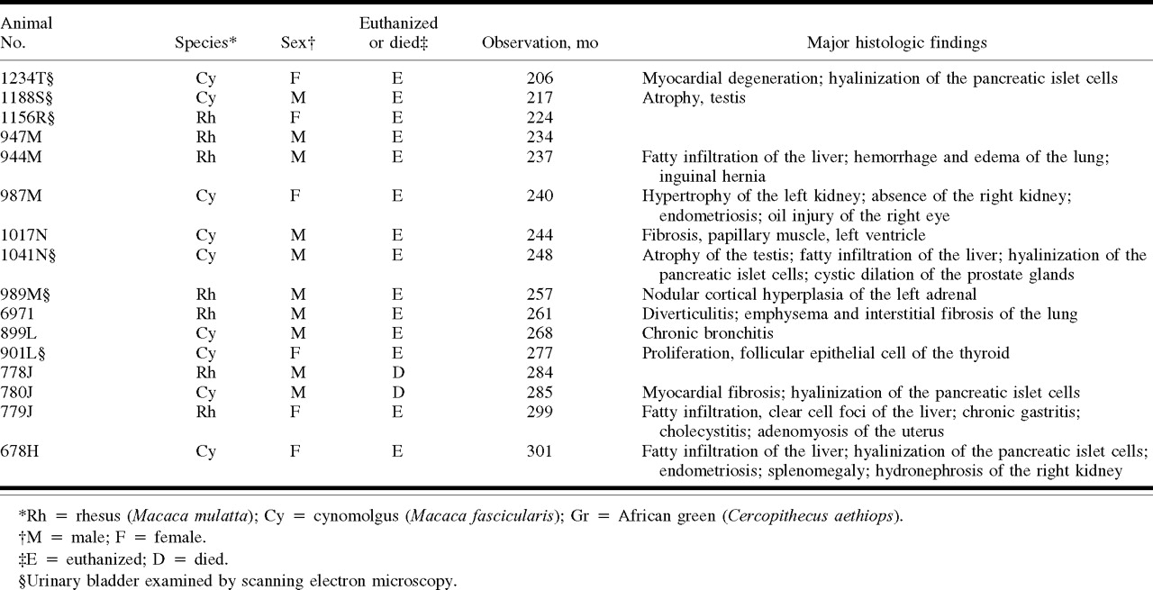
Table 2. Table 2. Major autopsy findings in control monkeys
Notes:
Table 2. Table 2. Major autopsy findings in control monkeys
Unless provided in the caption above, the following copyright applies to the content of this slide:

Slide 3
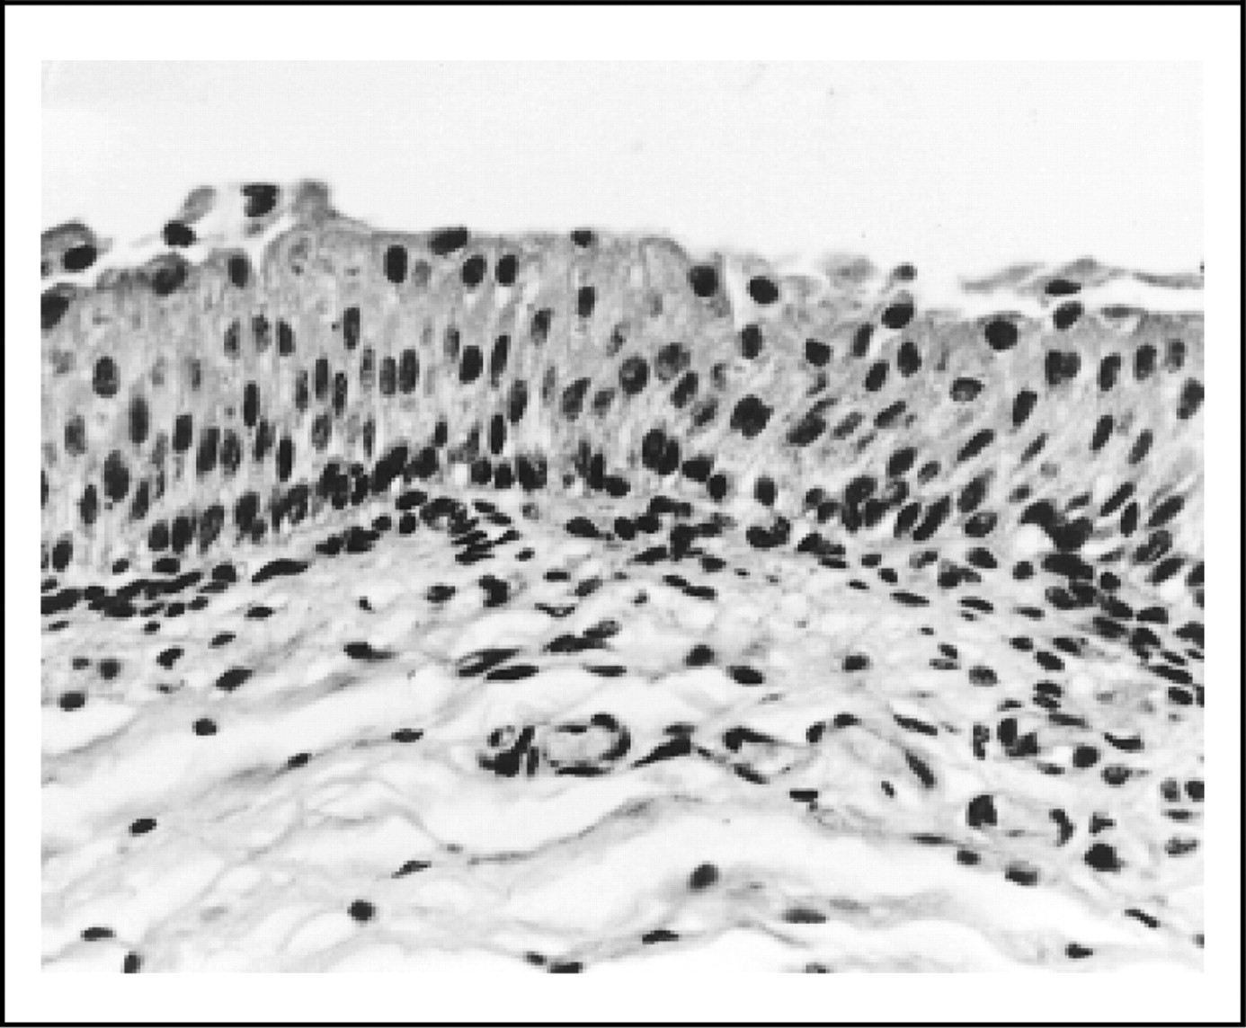
Fig. 1. Fig. 1. Light microscopy of the urinary bladder of a monkey (monkey 1212S) fed sodium saccharin. A similar ...
Notes:
Fig. 1. Fig. 1. Light microscopy of the urinary bladder of a monkey (monkey 1212S) fed sodium saccharin. A similar appearance was noted for all monkeys (treated and controls) in the study.
Unless provided in the caption above, the following copyright applies to the content of this slide:

Slide 4
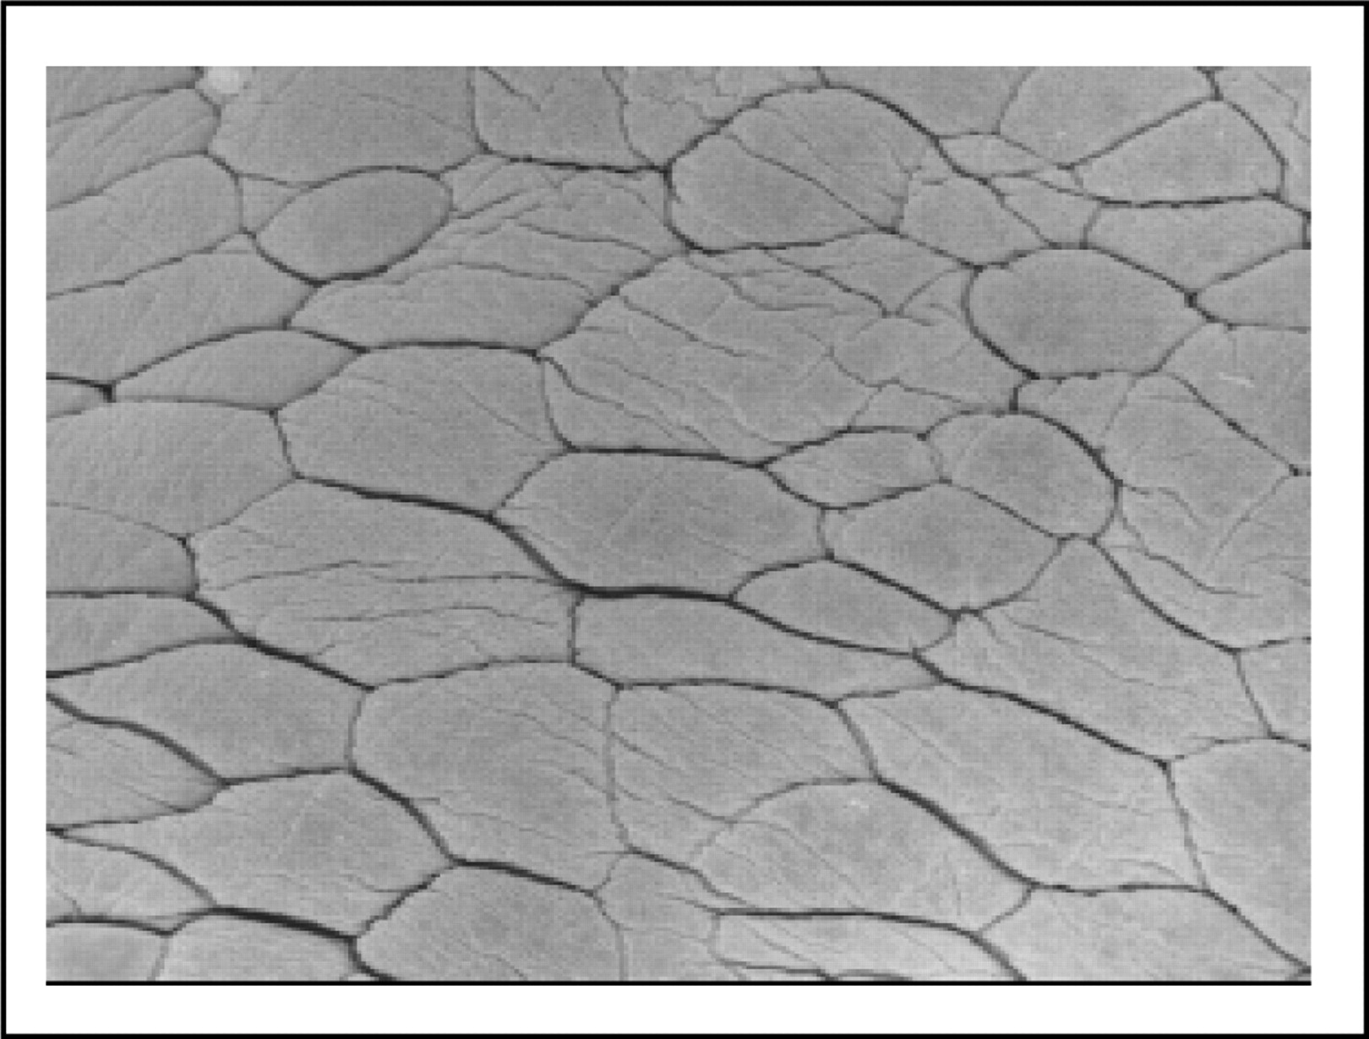
Fig. 2. Fig. 2. Scanning electron micrograph of the surface of the urinary bladder of a monkey (monkey 1211S) ...
Notes:
Fig. 2. Fig. 2. Scanning electron micrograph of the surface of the urinary bladder of a monkey (monkey 1211S) administered sodium saccharin. The bladder was in-flated in situ with phosphate-buffered glutaraldehyde while the animal was under deep anesthesia but not yet dead. A similar appearance was observed in the urinary bladders of control monkeys processed the same way (original magni-fication ×810).
Unless provided in the caption above, the following copyright applies to the content of this slide:

Slide 5
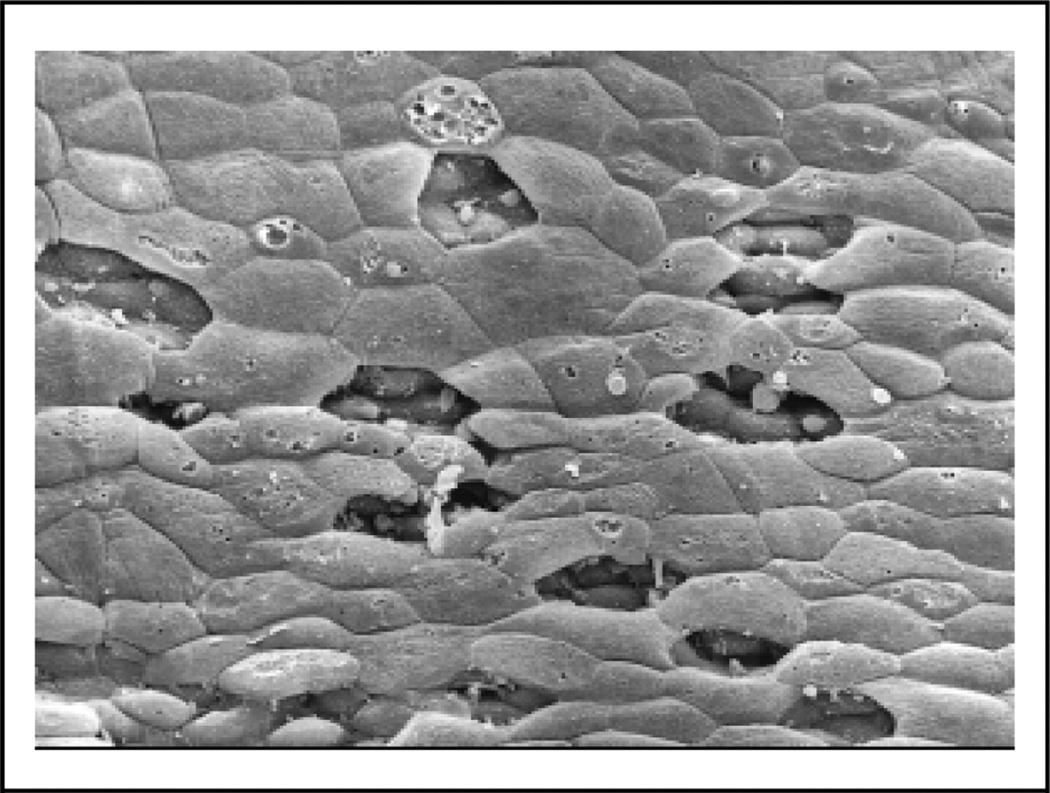
Fig. 3. Fig. 3. Scanning electron micrograph of the surface of the urinary bladder of a monkey (monkey 823J) ...
Notes:
Fig. 3. Fig. 3. Scanning electron micrograph of the surface of the urinary bladder of a monkey (monkey 823J) administered sodium saccharin. Changes observed are due to autolytic changes occurring within minutes after euthanasia. The bladder was removed and remained on the autopsy table for 15–20 minutes before being placed in buffered formalin. Similar changes occurred in the urinary bladders of other saccharin-treated and control monkeys processed in the same way. Also, similar changes were seen in rat urinary bladders if they were not placed in fixative until 5–15 minutes after death (original magnification ×400).
Unless provided in the caption above, the following copyright applies to the content of this slide:

Slide 6
Table 3. Table 3. Urinary chemistries from monkeys 2 years before being euthanized*
Notes:
Table 3. Table 3. Urinary chemistries from monkeys 2 years before being euthanized*
Unless provided in the caption above, the following copyright applies to the content of this slide:

