Slide 1
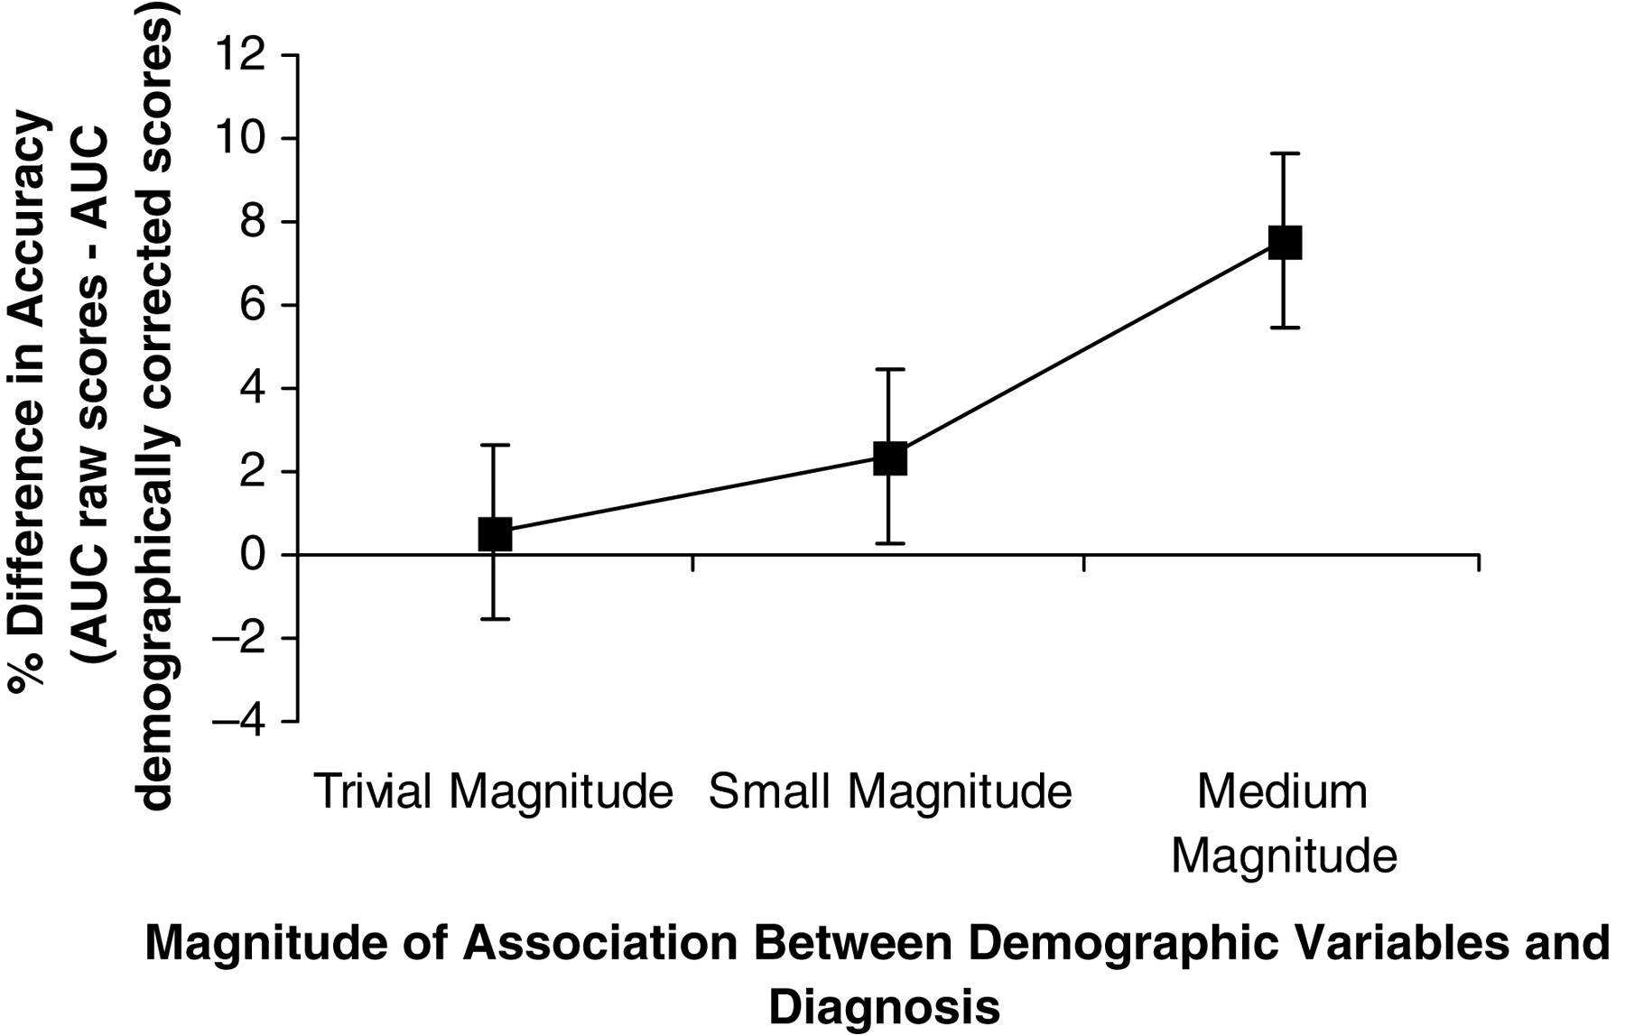
Fig. 1. For simulated data: Percent (%) difference in accuracy raw score AUC minus AUC for demographically corrected ...
Notes:
Fig. 1. For simulated data: Percent (%) difference in accuracy raw score AUC minus AUC for demographically corrected scores plotted by the magnitude of association between the demographic variables and diagnosis.
Unless provided in the caption above, the following copyright applies to the content of this slide: © The Author 2010. Published by Oxford University Press. All rights reserved. For permissions, please e-mail: journals.permissions@oxfordjournals.org

Slide 2
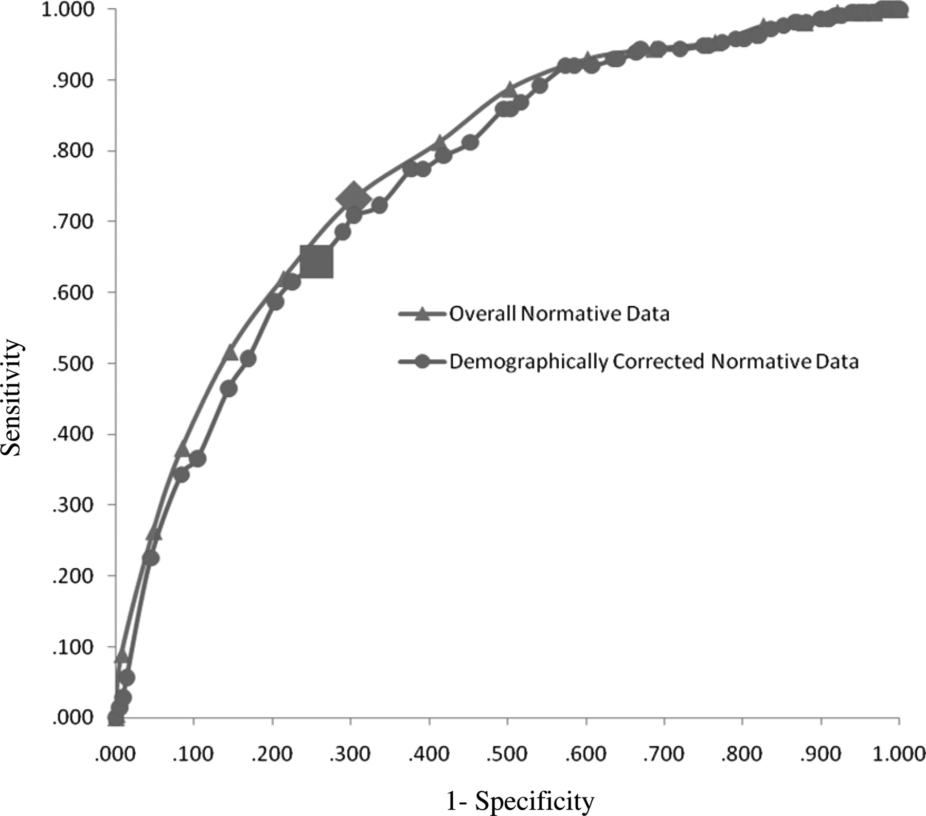
Fig. 2. For archival clinical data: ROC curve of Animal Naming scores based on “overall normative data” (equivalent ...
Notes:
Fig. 2. For archival clinical data: ROC curve of Animal Naming scores based on “overall normative data” (equivalent to raw score accuracy) versus “demographically corrected normative data” (with age stratified metanorms provided by Mitrushina et al., 2005). Cutoffs for impairment at the 8/9th percentile are indicated with a diamond for “overall normative data” and a square for “demographically corrected normative data.”
Unless provided in the caption above, the following copyright applies to the content of this slide: © The Author 2010. Published by Oxford University Press. All rights reserved. For permissions, please e-mail: journals.permissions@oxfordjournals.org

Slide 3
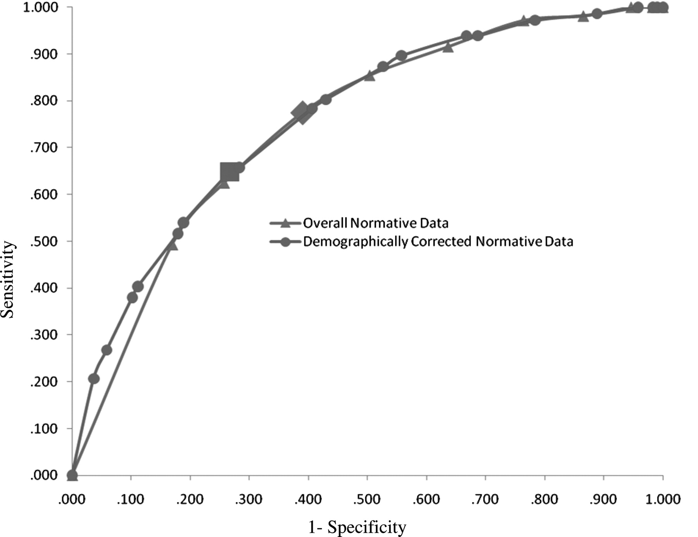
Fig. 3. For archival clinical data: ROC curve for BVRT-total correct scores based on “overall normative data” ...
Notes:
Fig. 3. For archival clinical data: ROC curve for BVRT-total correct scores based on “overall normative data” (equivalent to raw score accuracy) versus “demographically corrected normative data” (with education stratified normative data from Miatton et al., 2004, as cited in Strauss et al., 2006). Cutoffs for impairment at the 8/9th percentile are indicated with a diamond for “overall normative data” and a square for “demographically corrected normative data.”
Unless provided in the caption above, the following copyright applies to the content of this slide: © The Author 2010. Published by Oxford University Press. All rights reserved. For permissions, please e-mail: journals.permissions@oxfordjournals.org

Slide 4
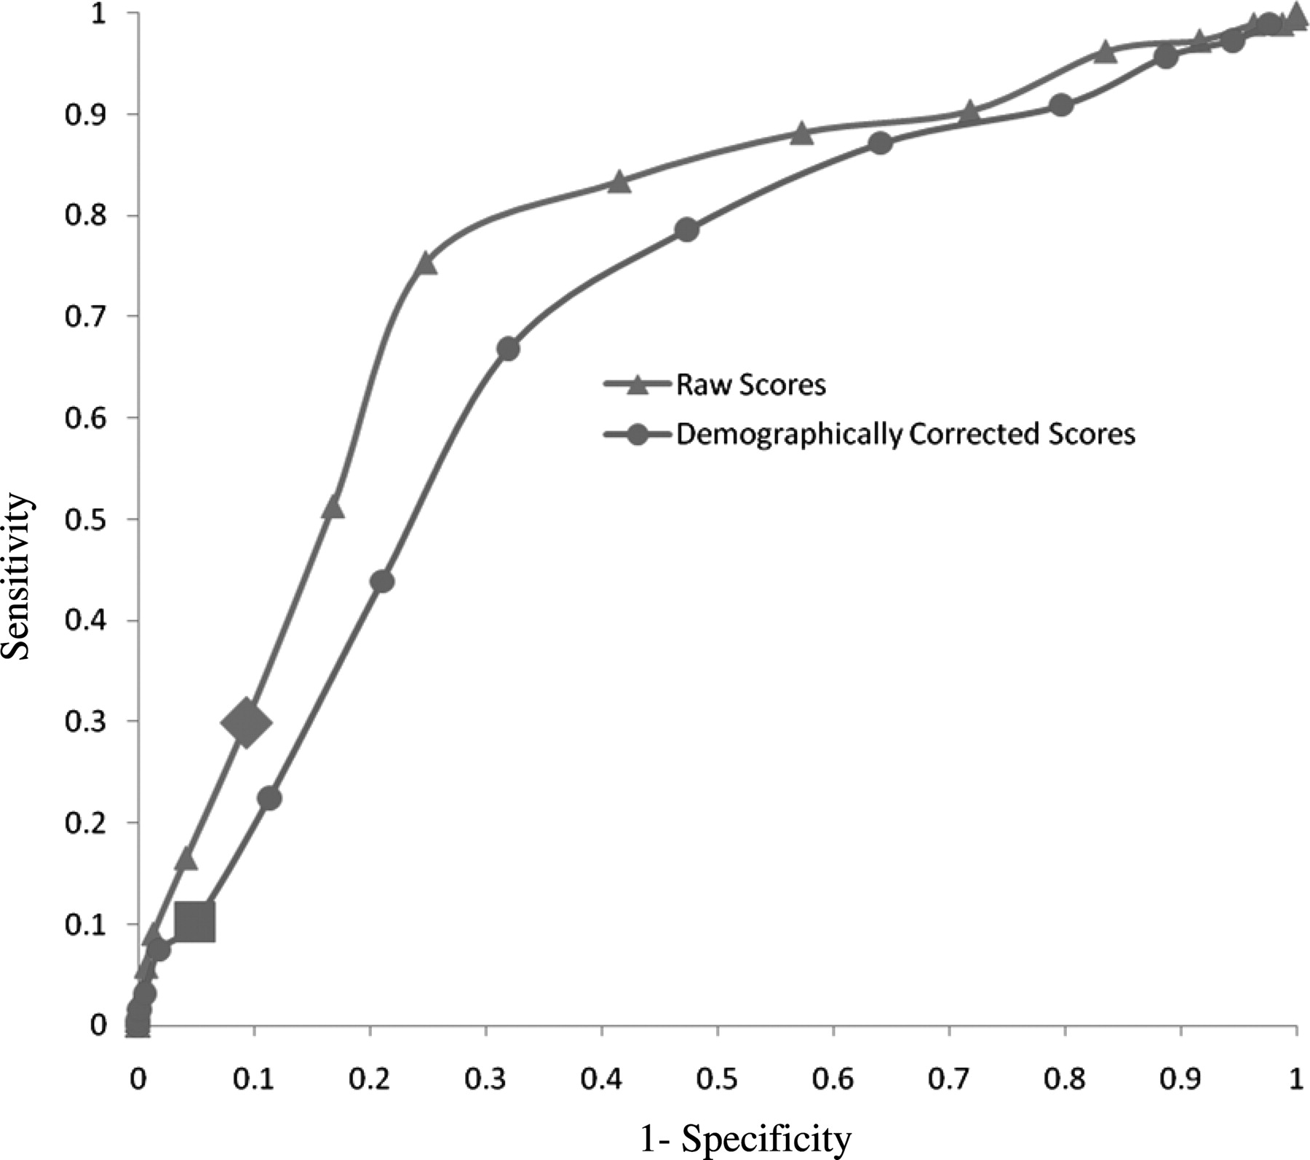
Fig. 4. For simulated data: ROC curve of raw and demographically corrected scores for the “Medium Magnitude” ...
Notes:
Fig. 4. For simulated data: ROC curve of raw and demographically corrected scores for the “Medium Magnitude” condition (average accuracy simulation trials), where age was moderately associated with a dementia diagnosis. Cutoffs for impairment at the 8/9th percentile are indicated with a diamond for the “raw scores” and a square for the “demographically corrected scores.”
Unless provided in the caption above, the following copyright applies to the content of this slide: © The Author 2010. Published by Oxford University Press. All rights reserved. For permissions, please e-mail: journals.permissions@oxfordjournals.org

