Slide 1
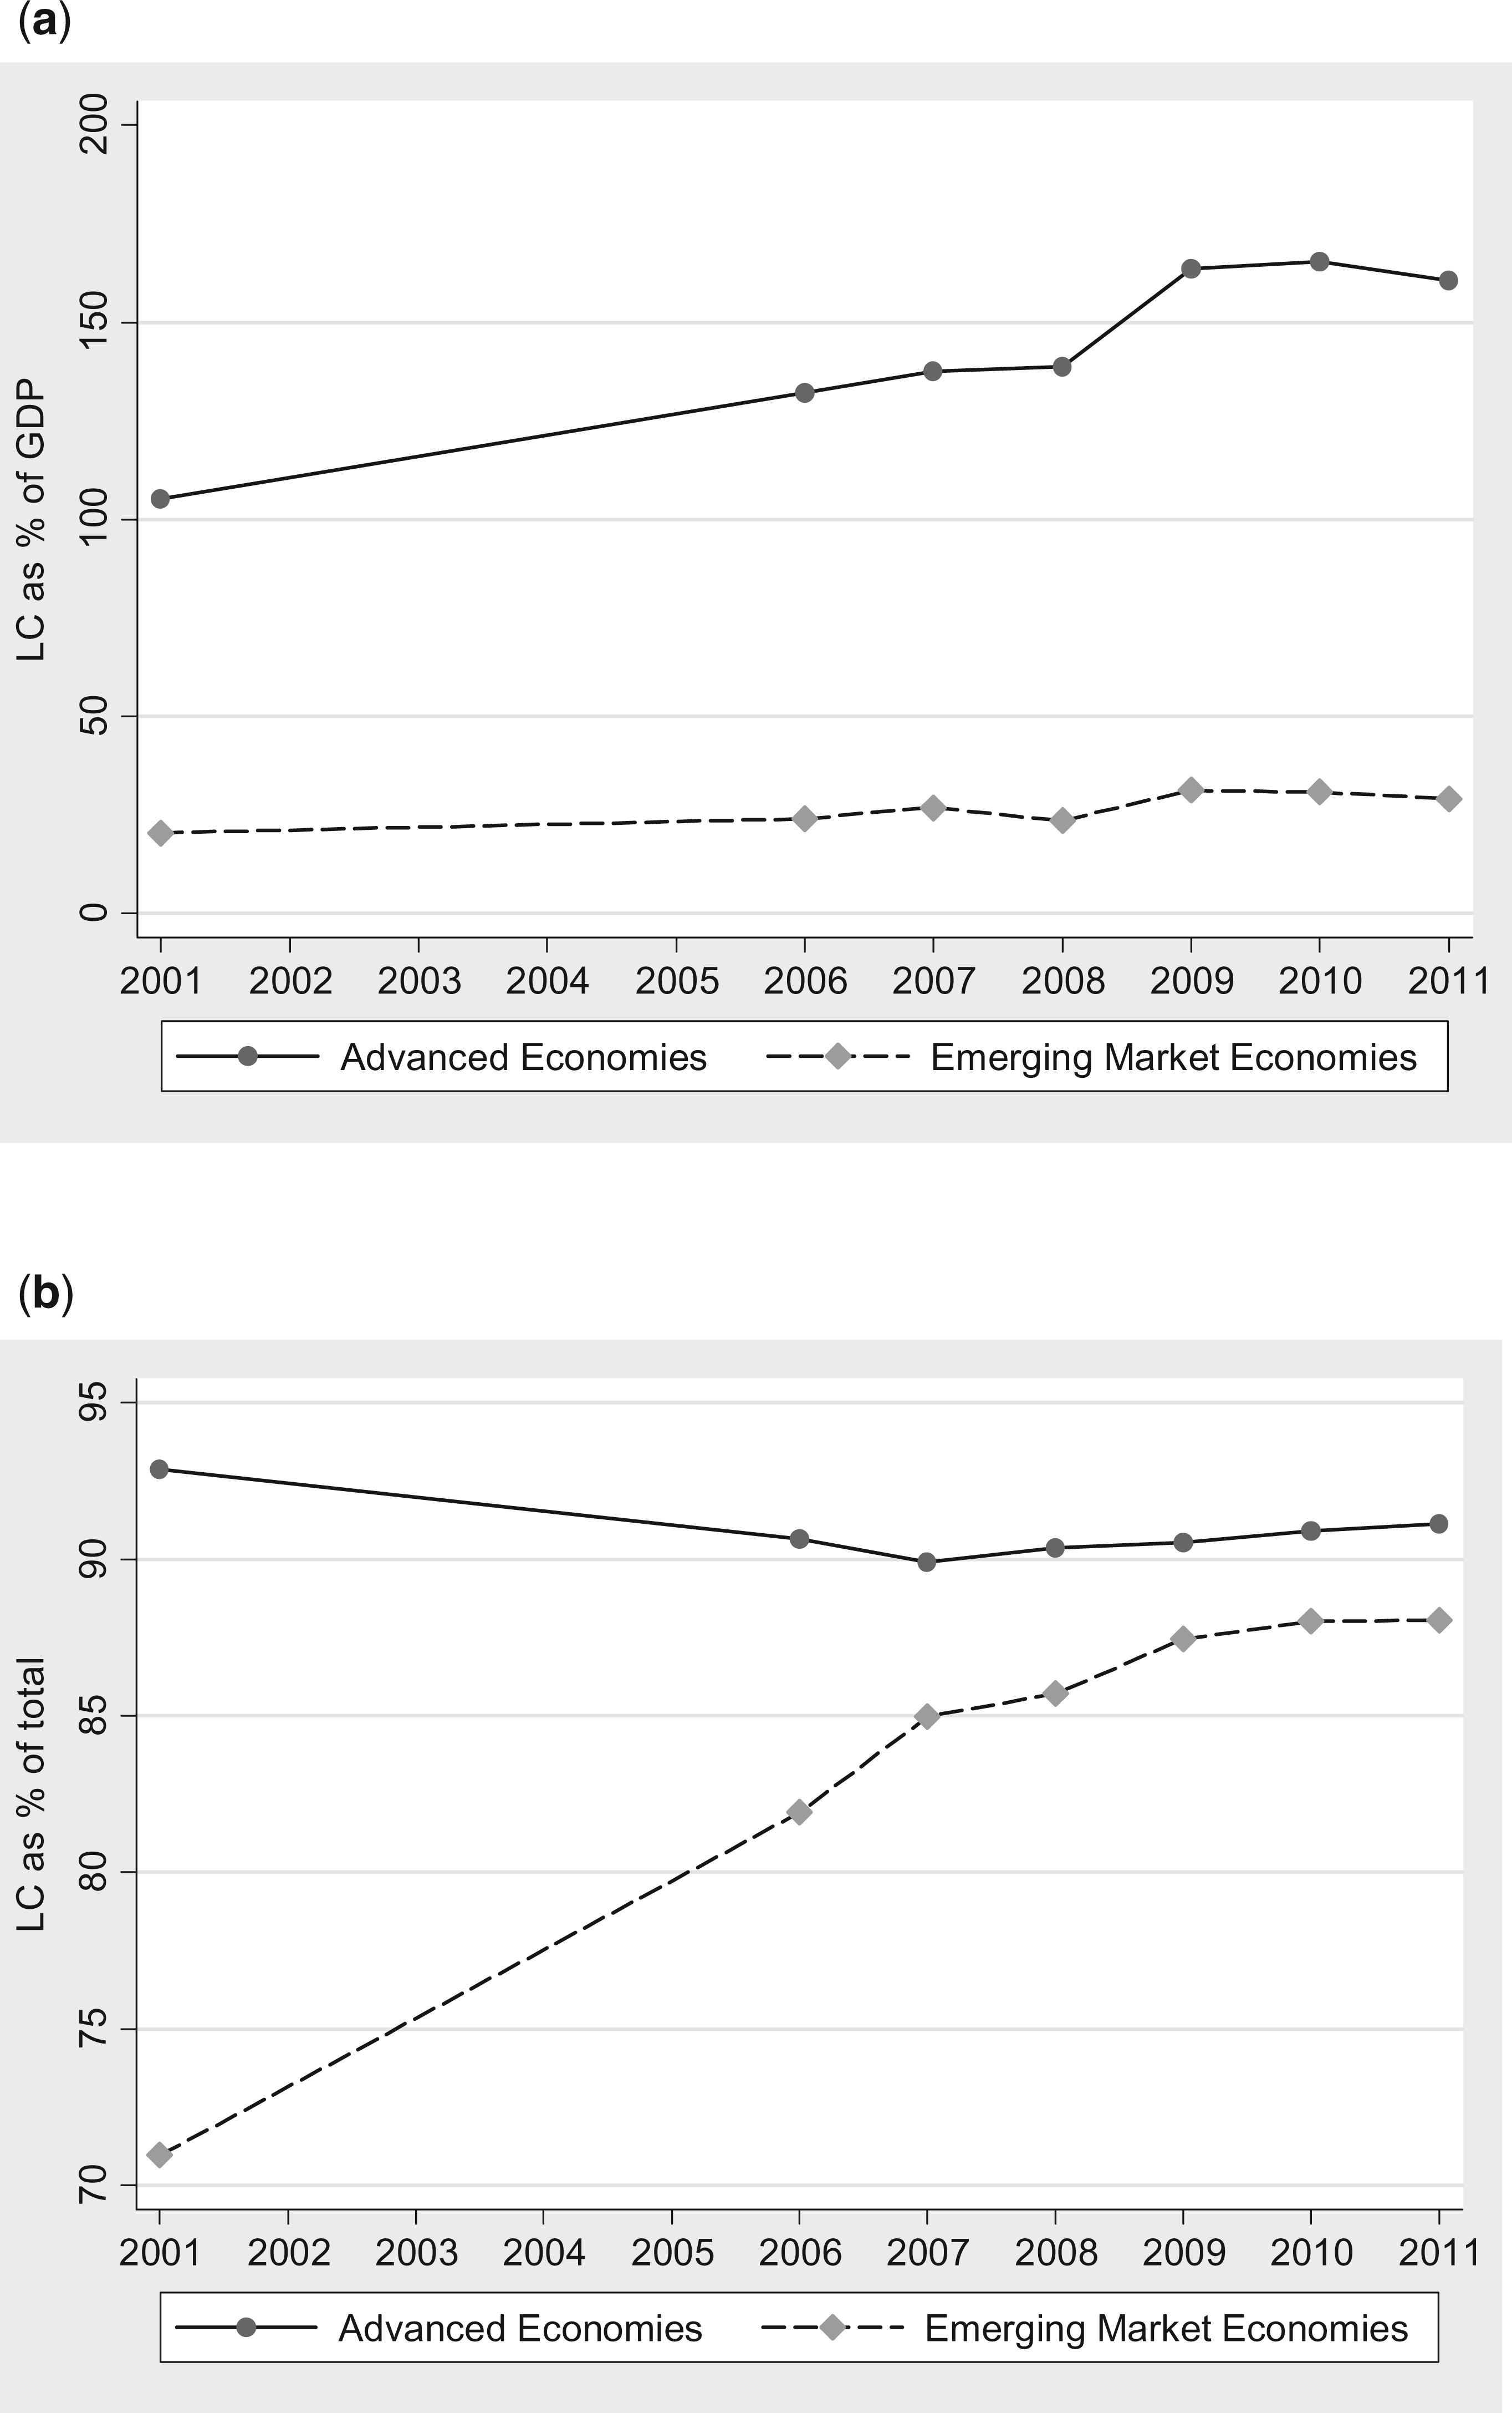
Figure 1. The structure of global bond markets. Included are all 46 countries in Appendix Table A1 : the United ...
Notes:
Figure 1. The structure of global bond markets. Included are all 46 countries in Appendix Table A1 : the United States, 24 other AEs, and 21 EMEs. (a) Local currency bonds as a percent of GDP; (b) local currency bonds as a percent of total bonds outstanding.
Unless provided in the caption above, the following copyright applies to the content of this slide: © CEPR, CESifo, Sciences Po, 2015.

Slide 2
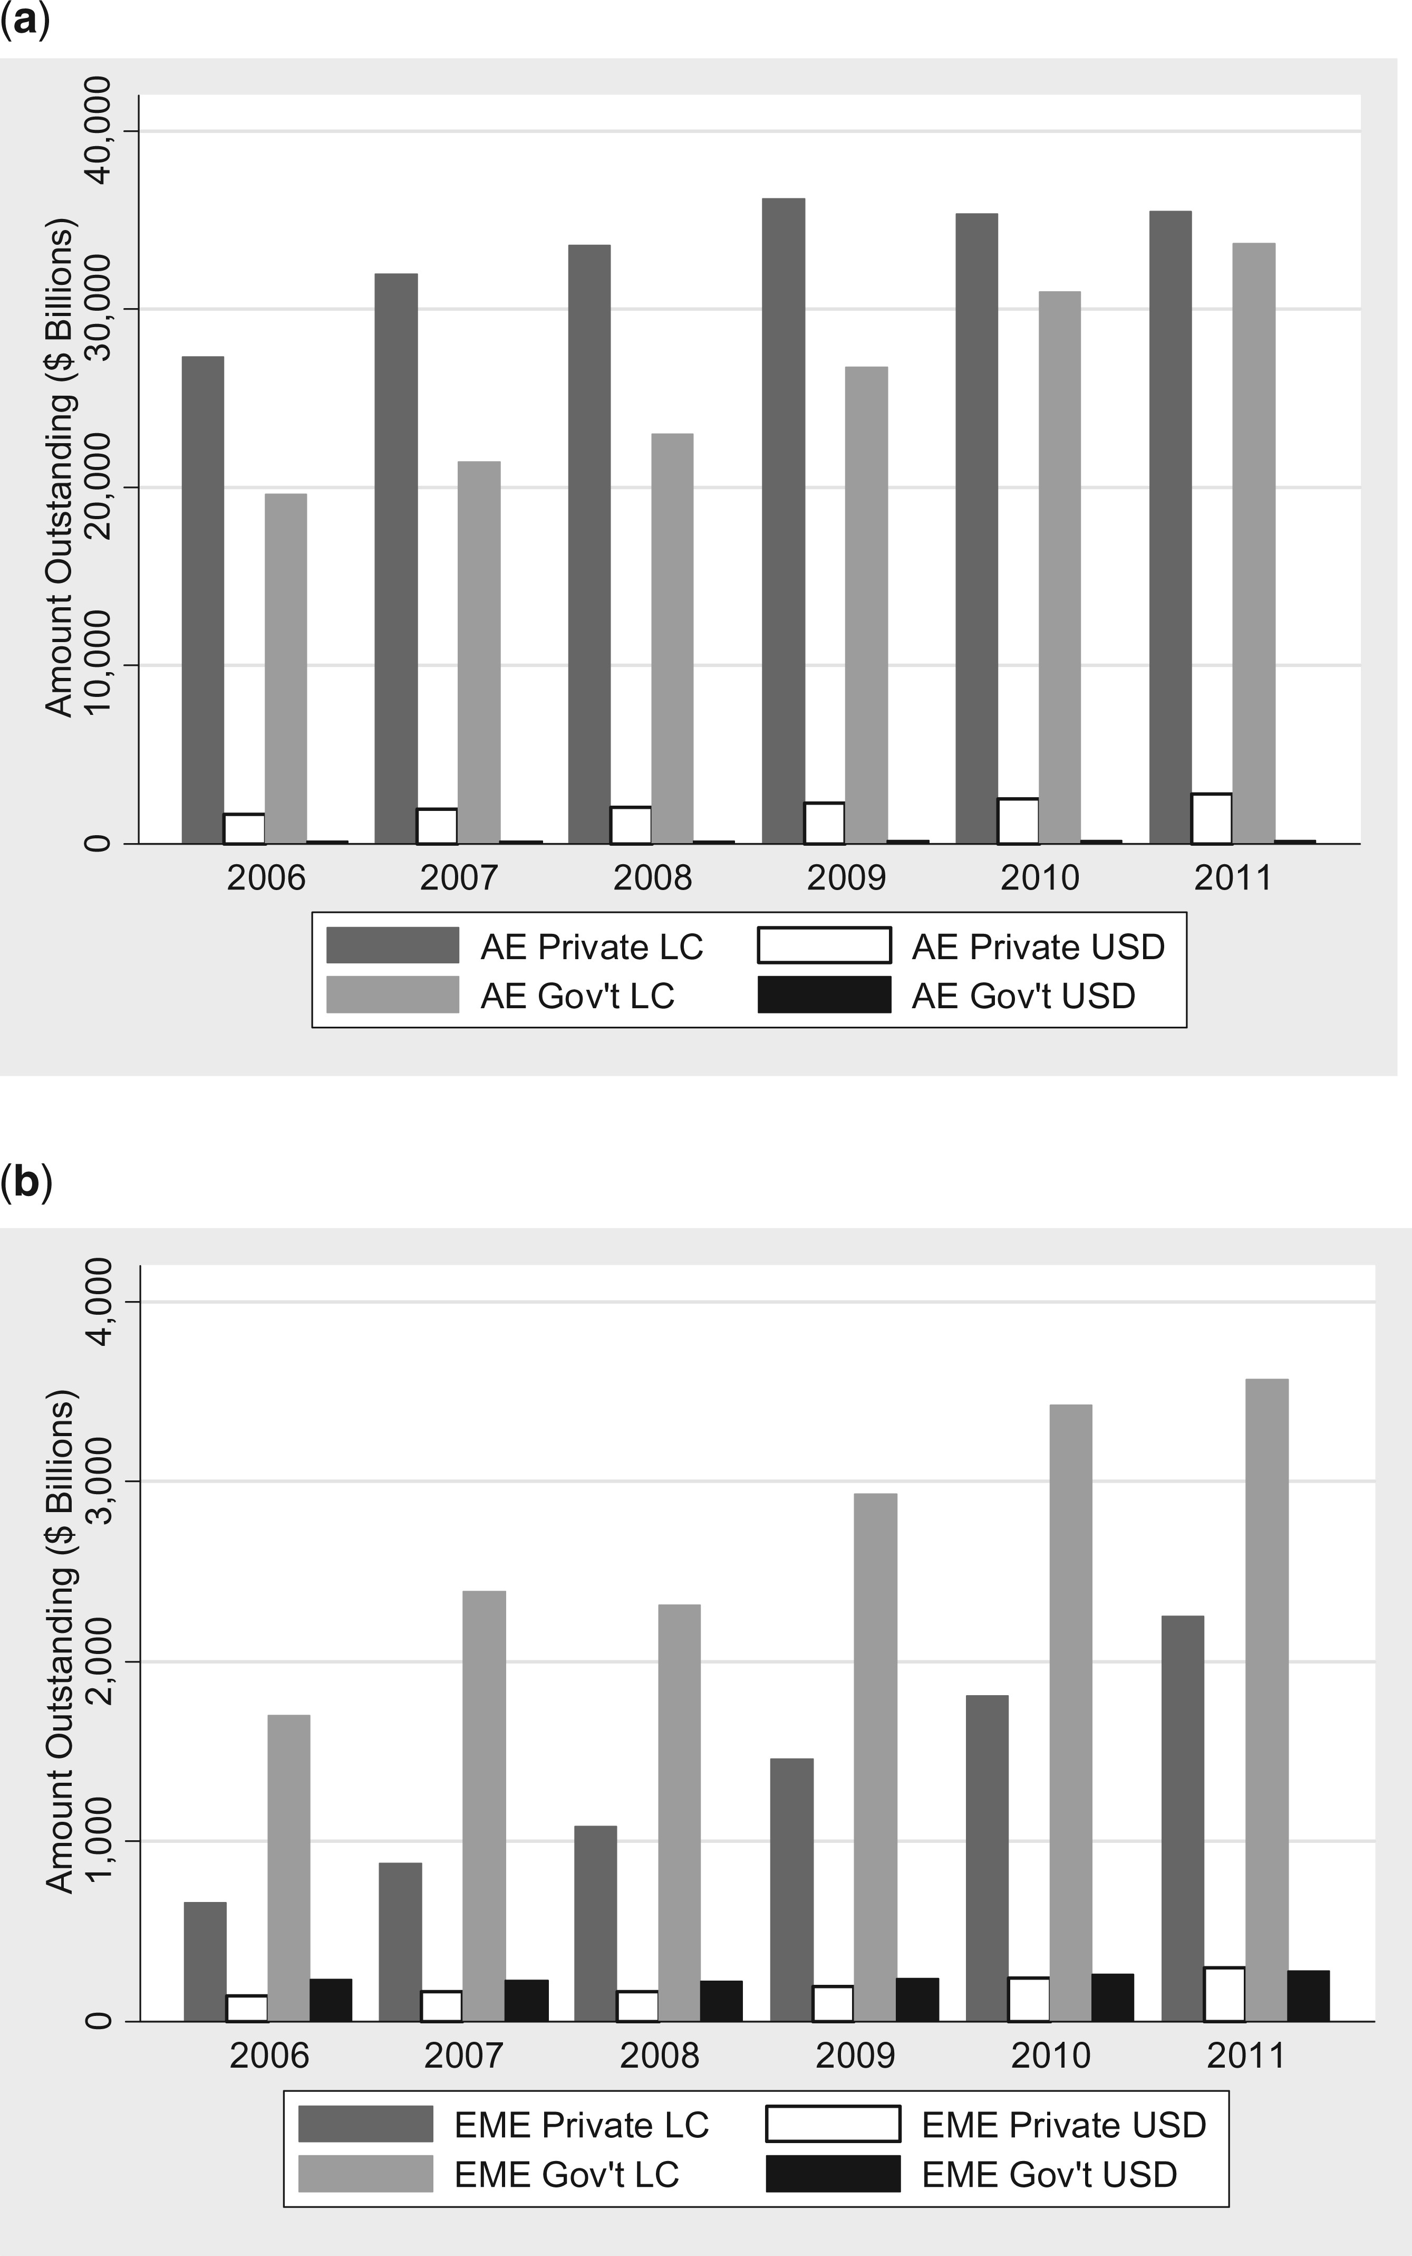
Figure 2. The structure of global bond markets by sector and currency. Amounts of outstanding bonds denominated in the ...
Notes:
Figure 2. The structure of global bond markets by sector and currency. Amounts of outstanding bonds denominated in the local currency (LC) or in US dollar (USD) and issued by private entities or the government. Note that in this figure United States is in the LC-denominated but excluded from USD-denominated. (a) AEs; (b) EMEs.
Unless provided in the caption above, the following copyright applies to the content of this slide: © CEPR, CESifo, Sciences Po, 2015.

Slide 3
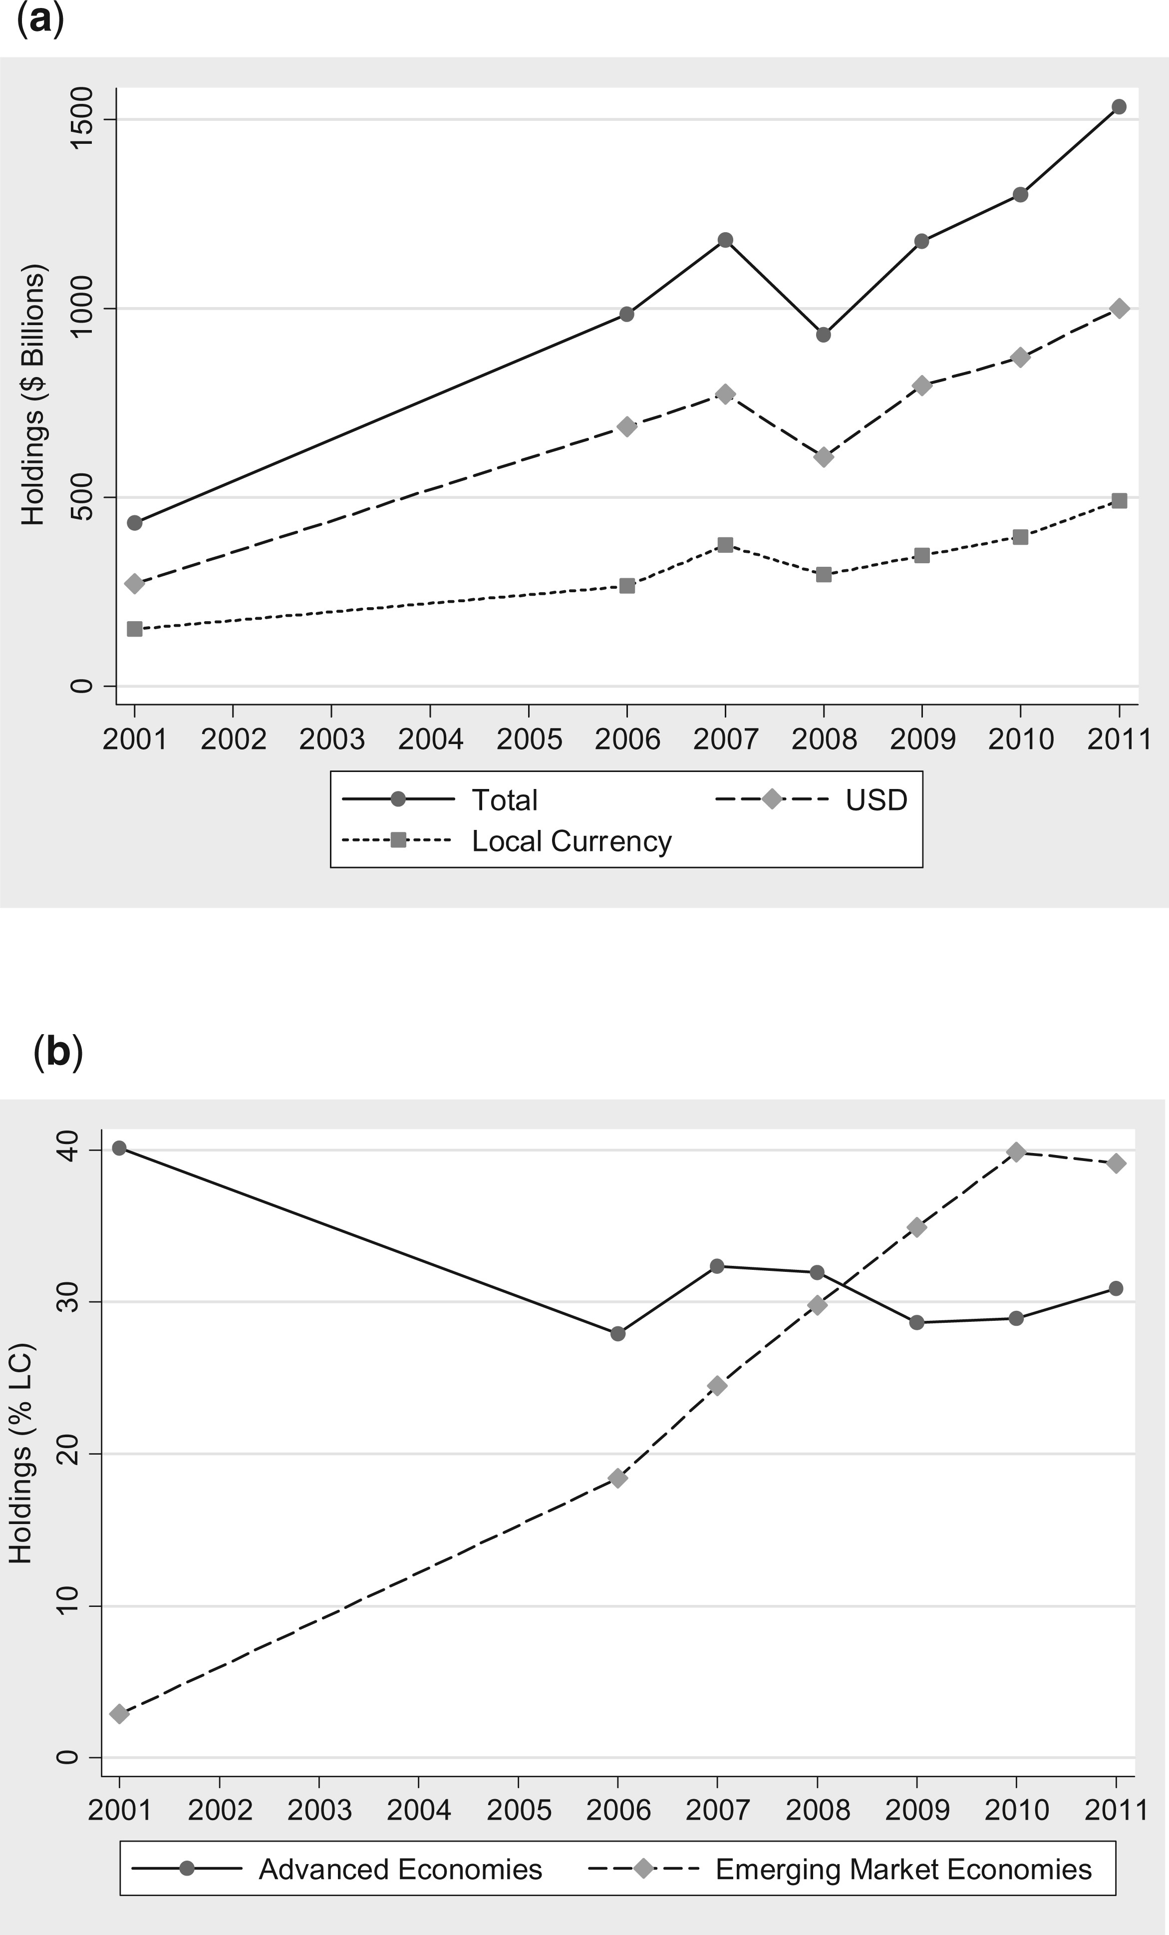
Figure 3. US investors’ foreign bond holdings, 2001–11. Data as of year-end 2001, 2006, 2007, 2008, 2009, 2010 and ...
Notes:
Figure 3. US investors’ foreign bond holdings, 2001–11. Data as of year-end 2001, 2006, 2007, 2008, 2009, 2010 and 2011. (a) US investors’ foreign bond holdings (in billions of US dollars) by currency of bond: total, USD-denominated and local currency denominated; (b) shares of local currency denominated bonds in US holdings of bonds in AEs and EMEs.
Unless provided in the caption above, the following copyright applies to the content of this slide: © CEPR, CESifo, Sciences Po, 2015.

Slide 4
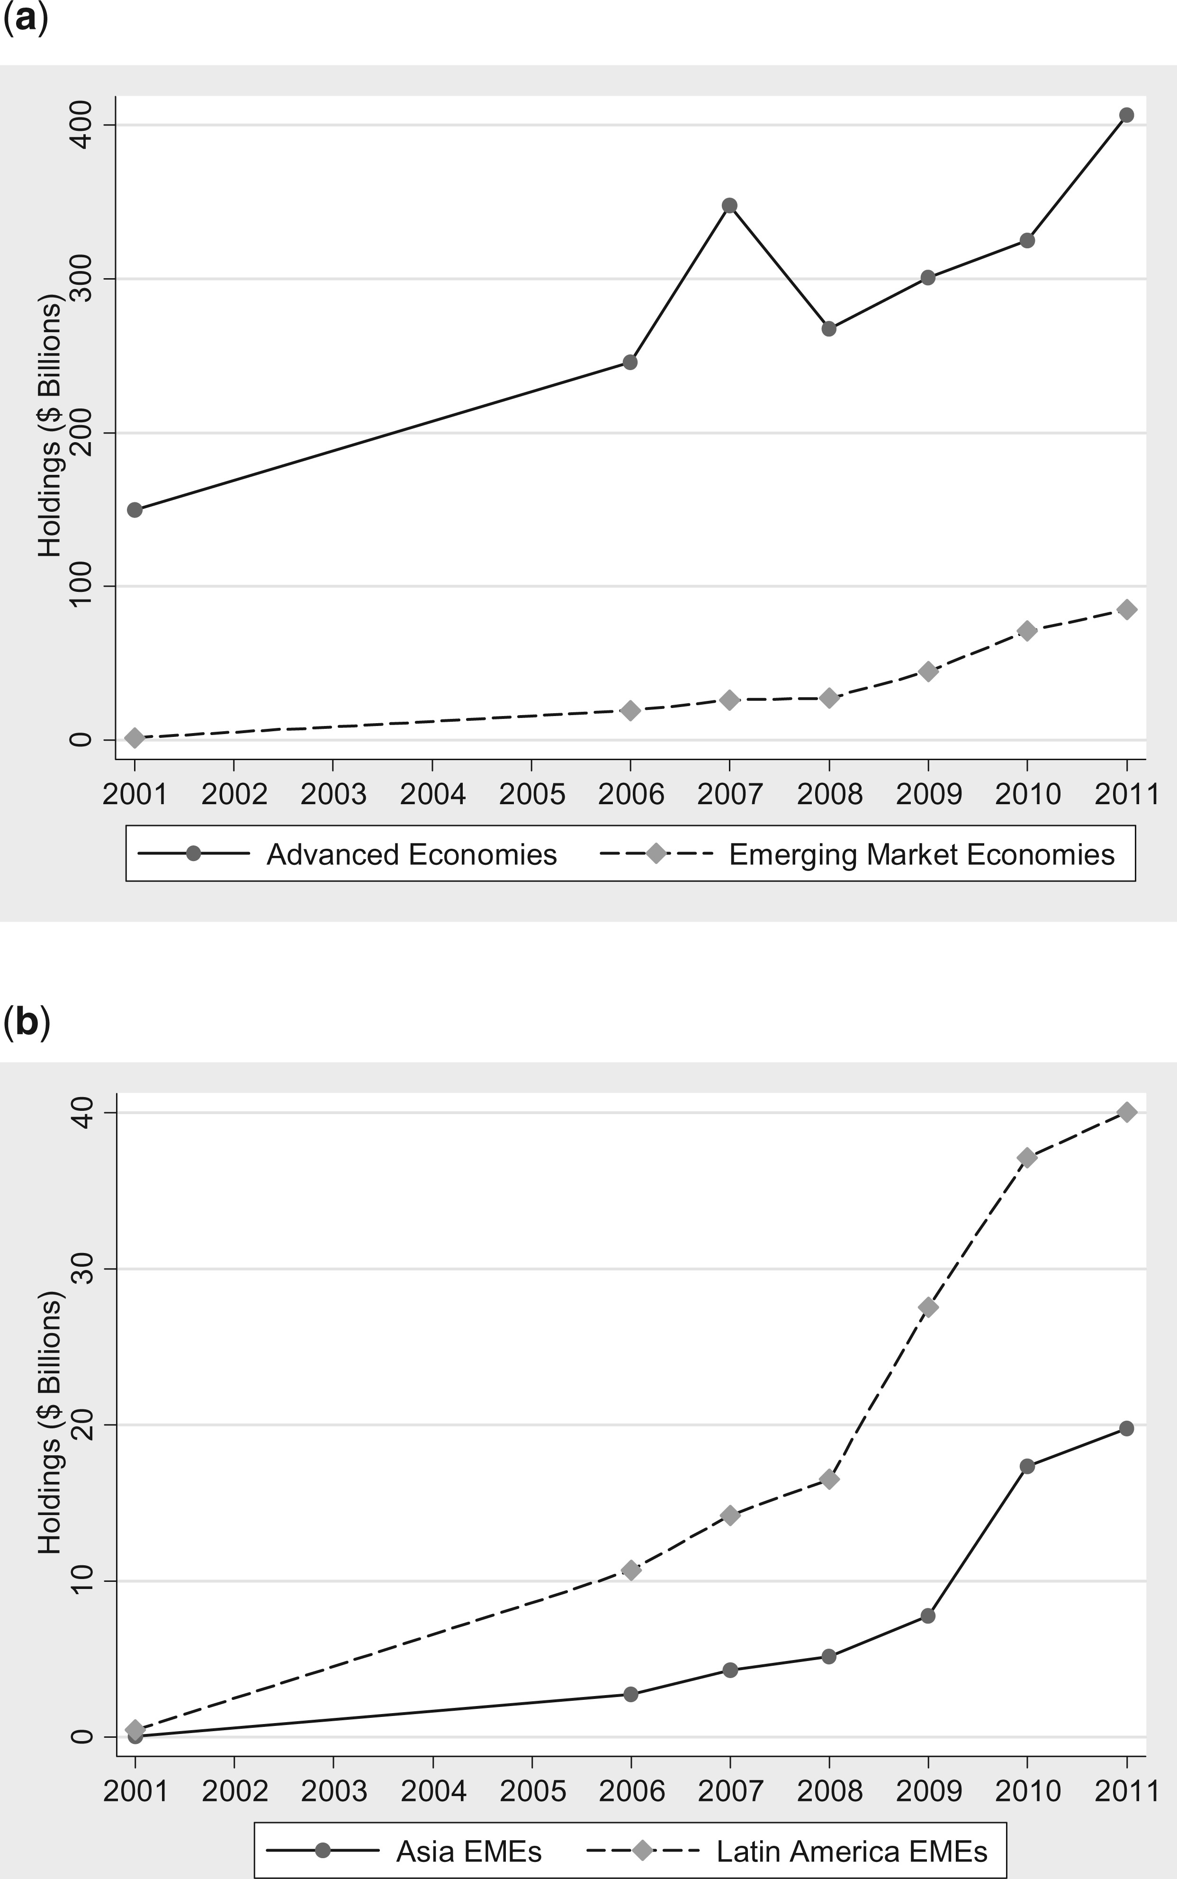
Figure 4. US investors’ bond portfolios (in billions of USD). Data as of year-end 2001, 2006, 2007, 2008, 2009, 2010 ...
Notes:
Figure 4. US investors’ bond portfolios (in billions of USD). Data as of year-end 2001, 2006, 2007, 2008, 2009, 2010 and 2011. (a) US investors’ holdings of AE and EME local currency bonds; (b) US investors’ holdings of Emerging Asian and Latin American bonds.
Unless provided in the caption above, the following copyright applies to the content of this slide: © CEPR, CESifo, Sciences Po, 2015.

Slide 5
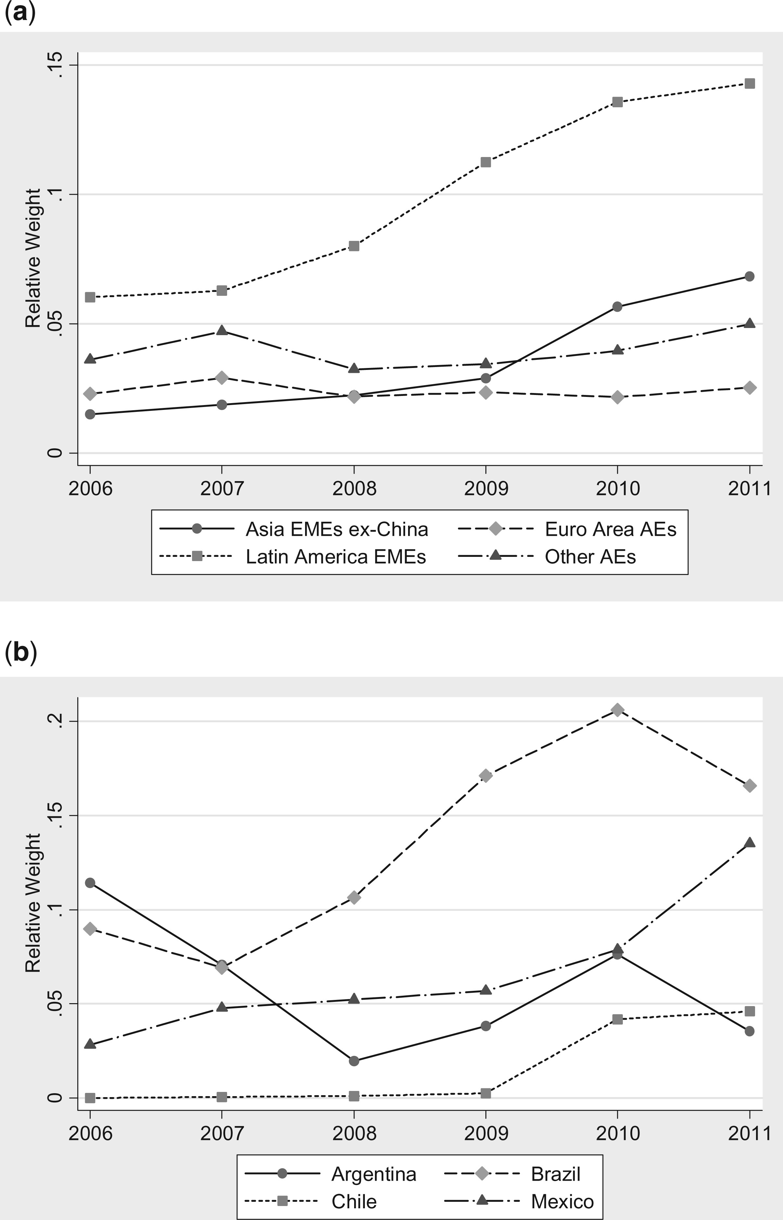
Figure 5. US investors’ relative weights on local currency bonds. Data on local currency bond portfolios as of year ...
Notes:
Figure 5. US investors’ relative weights on local currency bonds. Data on local currency bond portfolios as of year ends 2006, 2007, 2008, 2009, 2010 and 2011. (a) US investors’ relative weights on AE and EME local currency bonds; (b) US investors’ relative weights on bonds of selected Latin American countries.
Unless provided in the caption above, the following copyright applies to the content of this slide: © CEPR, CESifo, Sciences Po, 2015.

Slide 6
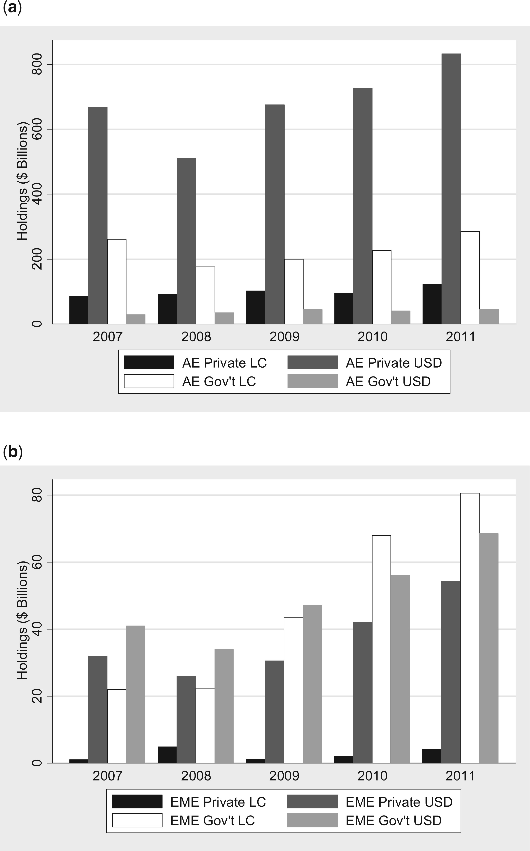
Figure 6. US investors’ holdings of foreign bonds by issuer type and currency. Data on US investors’ foreign bond ...
Notes:
Figure 6. US investors’ holdings of foreign bonds by issuer type and currency. Data on US investors’ foreign bond portfolios as of year ends 2007, 2008, 2009, 2010 and 2011. (a) US investors’ holdings of AEs bonds. (b) US investors’ holdings of bonds in EMEs.
Unless provided in the caption above, the following copyright applies to the content of this slide: © CEPR, CESifo, Sciences Po, 2015.

Slide 7
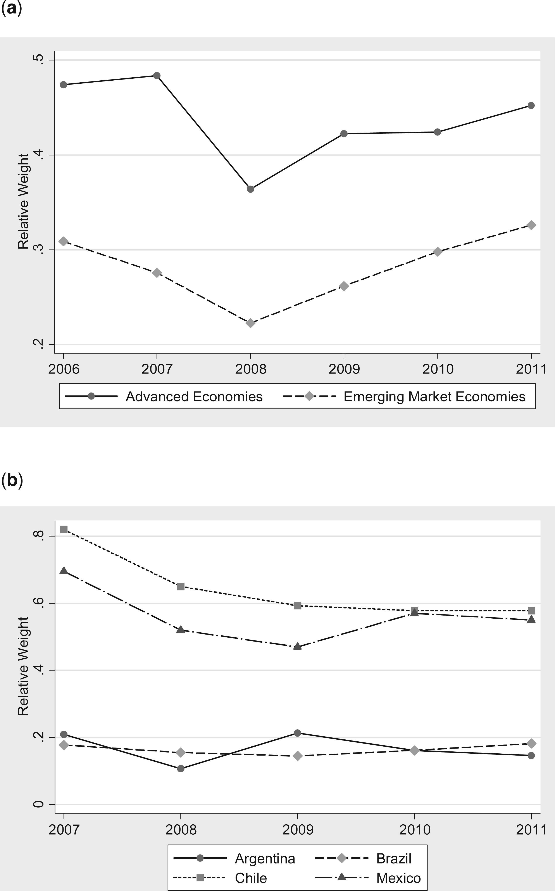
Figure 7. US investors’ relative weights on USD-denominated bonds. (a) US investors’ relative weights on AE and EME ...
Notes:
Figure 7. US investors’ relative weights on USD-denominated bonds. (a) US investors’ relative weights on AE and EME USD-denominated bonds. (b) US investors’ relative weights on selected Latin American Private Sector USD-denominated bonds.
Unless provided in the caption above, the following copyright applies to the content of this slide: © CEPR, CESifo, Sciences Po, 2015.

