Slide 1
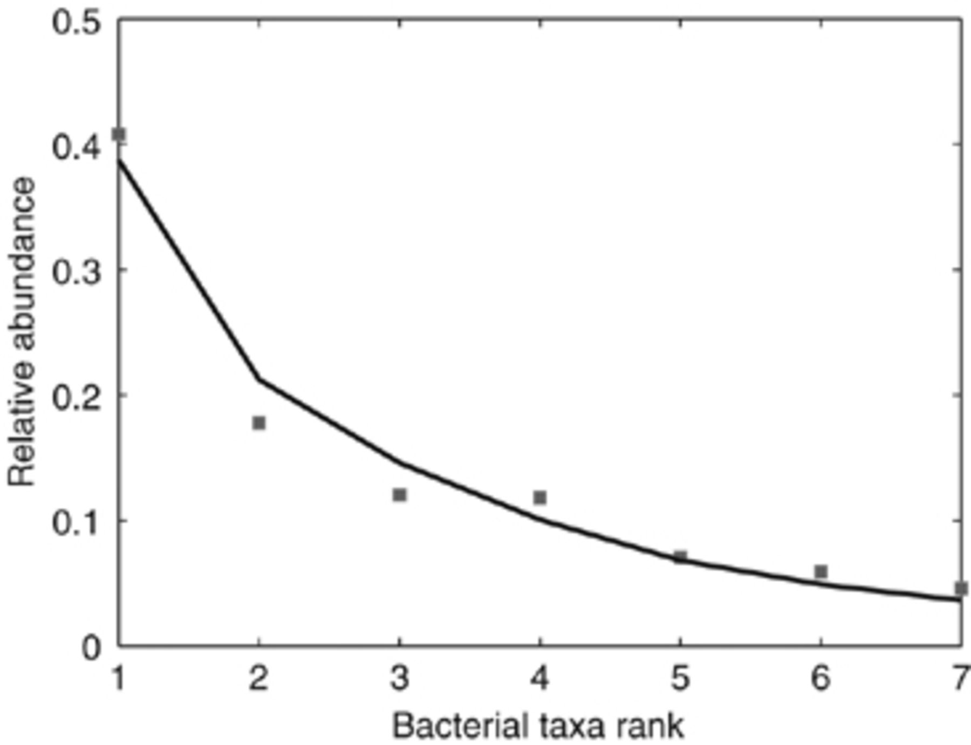
1 The ranked taxa-abundance distribution (squares) observed in a 5 mL sample from the smallest tree hole which ...
Notes:
1 The ranked taxa-abundance distribution (squares) observed in a 5 mL sample from the smallest tree hole which had a volume of 50 mL. The line shows the expected rank abundance distribution obtained by averaging 1000 realizations of ranked abundances simulated by Hubbell's neutral model with NT=5 × 105, θ=15 and m=1.0 × 10−6.
Unless provided in the caption above, the following copyright applies to the content of this slide: © 2007 Federation of European Microbiological Societies

Slide 2
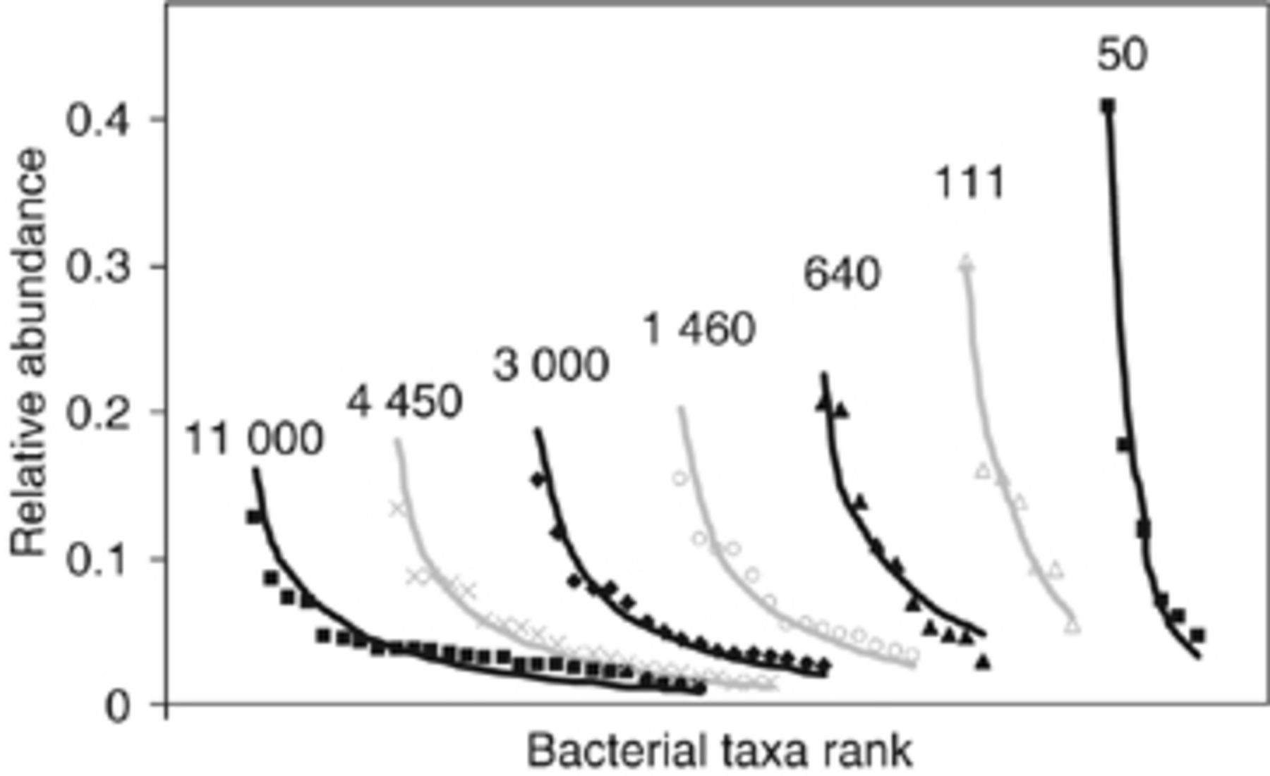
2 Ranked taxa-abundance distributions for a selection of seven of the 29 tree holes ranging in volume from 11 ...
Notes:
2 Ranked taxa-abundance distributions for a selection of seven of the 29 tree holes ranging in volume from 11 000–50 mL. The lines represent taxa-abundance distributions predicted by the neutral model with m=10−6 and θ=15 calibrated using data from the 50 mL tree hole.
Unless provided in the caption above, the following copyright applies to the content of this slide: © 2007 Federation of European Microbiological Societies

Slide 3
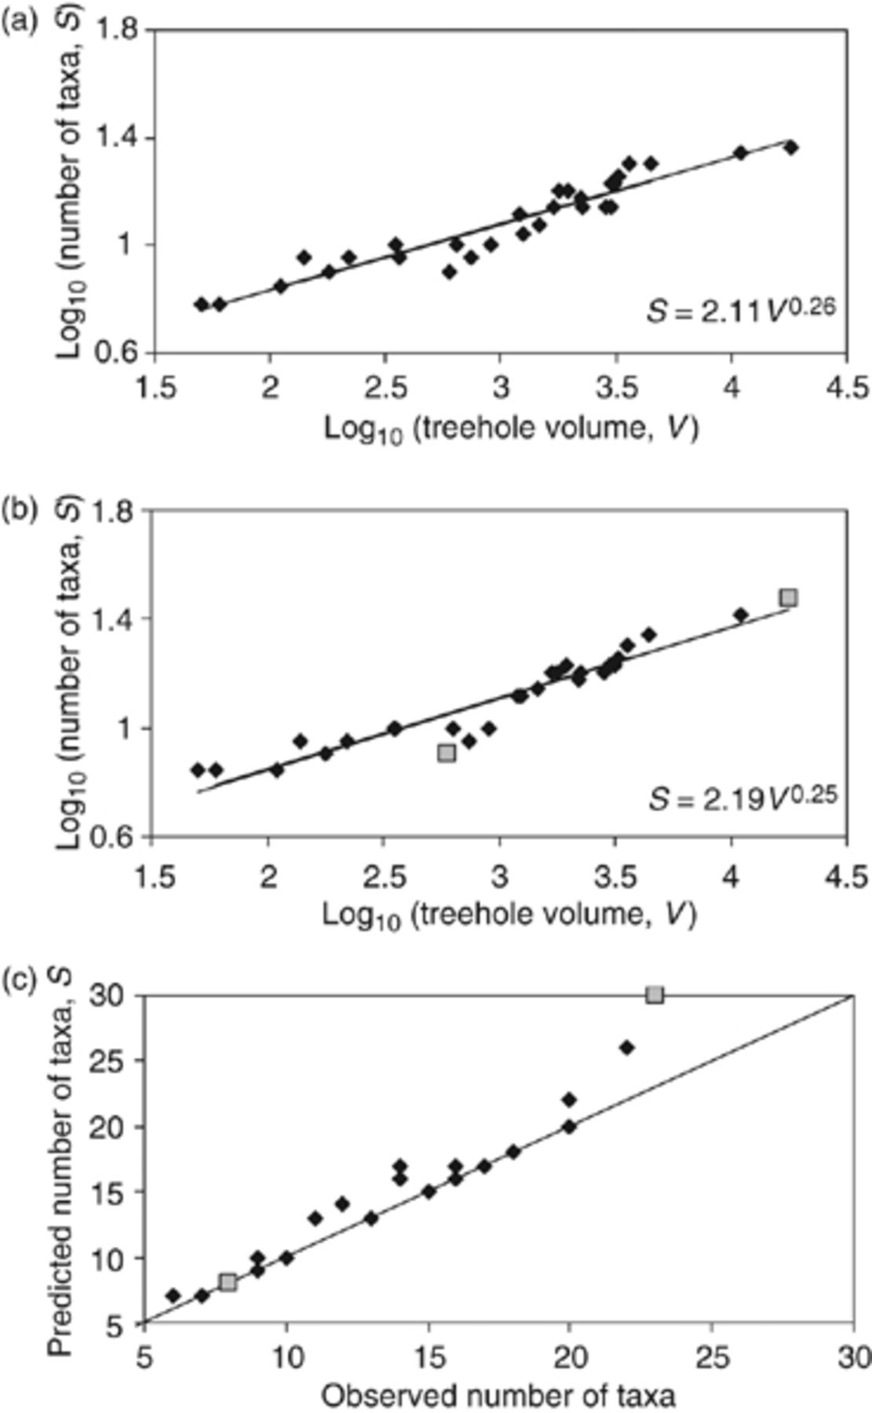
3 (a)The observed bacterial richness in all 29 tree holes. The solid line represents the power-law ...
Notes:
3 (a)The observed bacterial richness in all 29 tree holes. The solid line represents the power-law relationship, S=2.11 V0.26, fitted using linear regression. (b) The bacterial richness predicted by the neutral model with θ=15 and m=10−6 calibrated using the taxa-abundance distribution of the smallest tree hole. The solid line represents the power-law relationship, S=2.19 V0.25, again fitted using linear regression. (c) Observed vs. predicted richness in each tree hole. The line represents perfect agreement and the two squares indicate where the neutral model was rejected.
Unless provided in the caption above, the following copyright applies to the content of this slide: © 2007 Federation of European Microbiological Societies

Slide 4
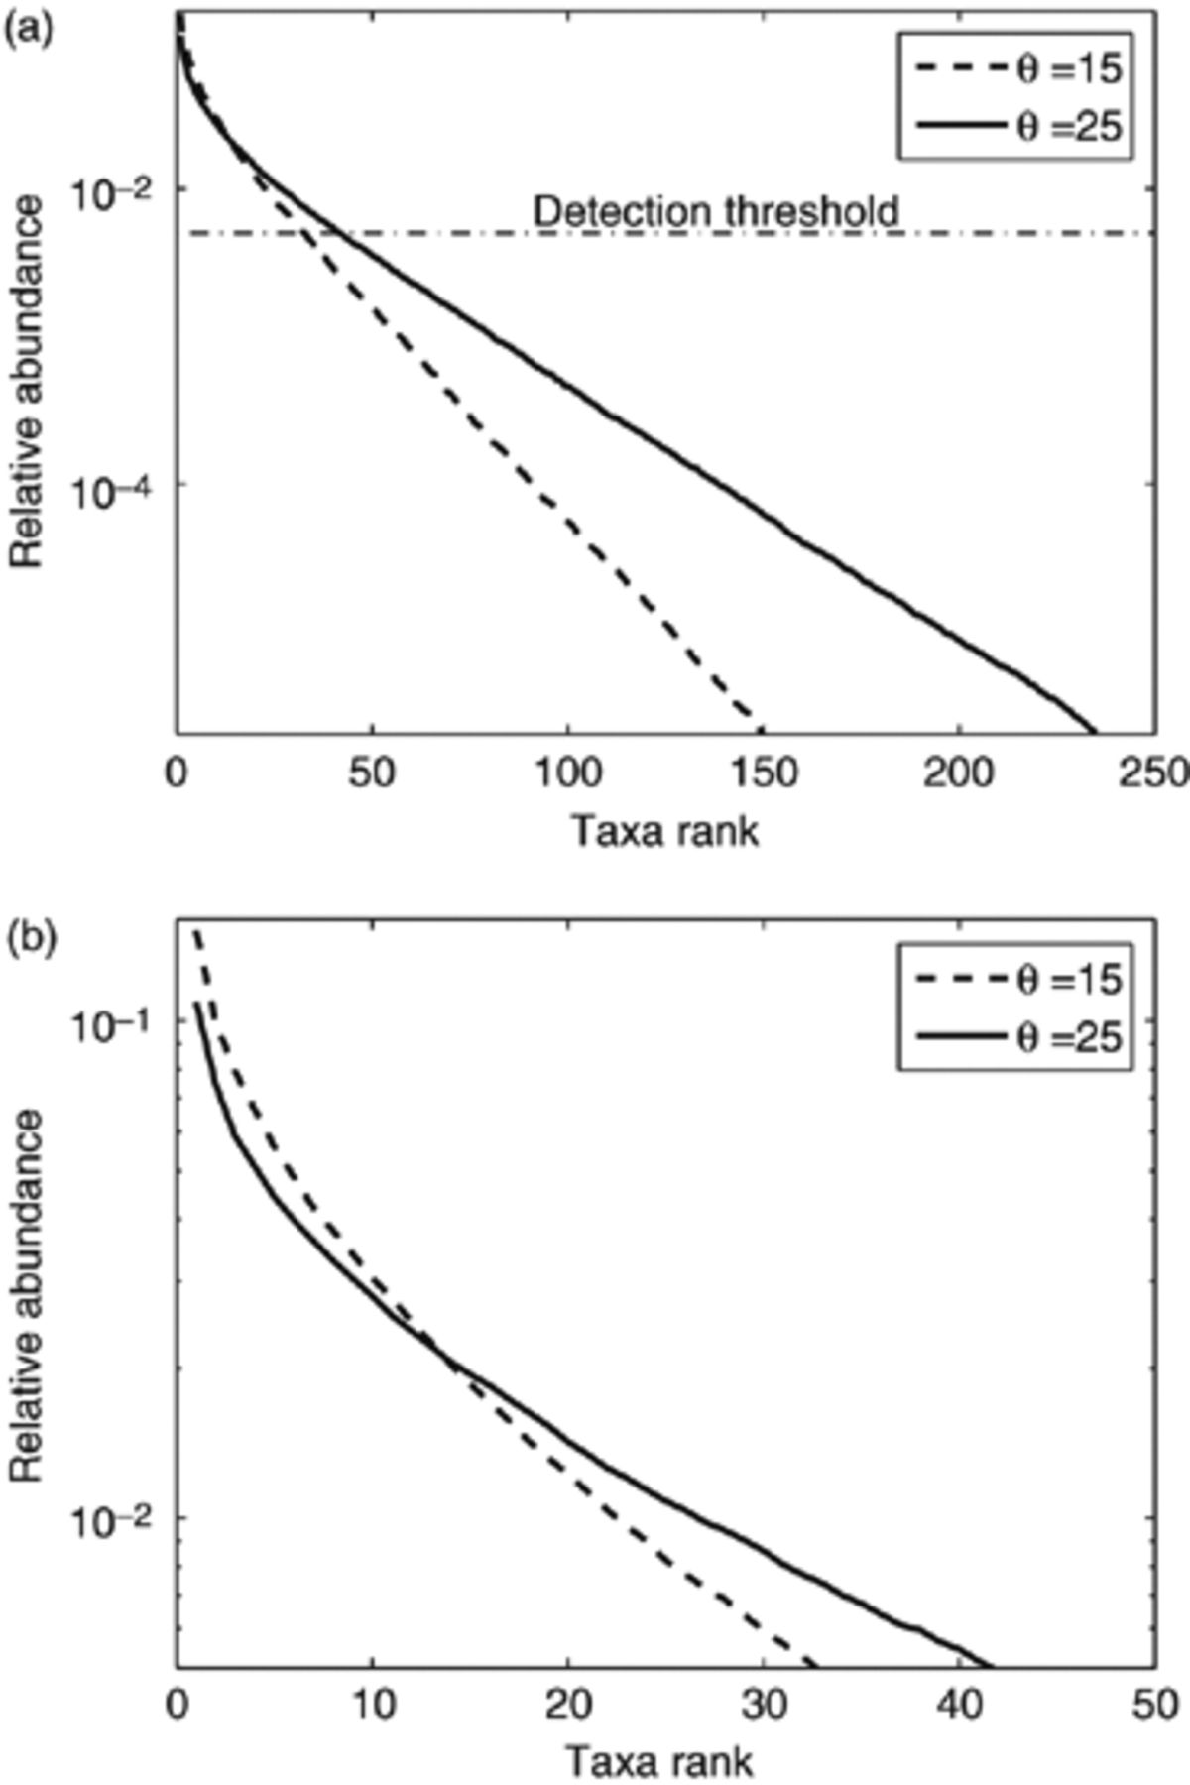
4 (a)The ranked relative abundance of taxa in a random sample of 5 × 10⁵ individuals from two ...
Notes:
4 (a)The ranked relative abundance of taxa in a random sample of 5 × 105 individuals from two different log-series distributed source communities; one with parameter θ=15 the other, more diverse, with θ=25. The dashed line is a threshold in relative abundance below which taxa will not be detected using DGGE. (b) The distribution of abundance taxa in the random samples that can be detected by DGGE. The distribution of common taxa is less sensitive to the value θ than that of rare taxa.
Unless provided in the caption above, the following copyright applies to the content of this slide: © 2007 Federation of European Microbiological Societies

