Slide 1
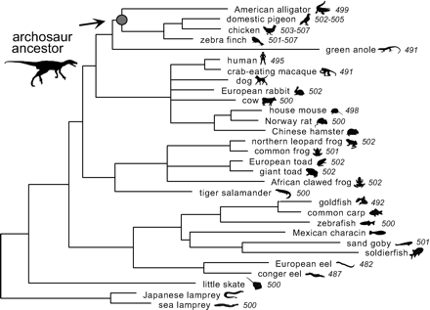
Fig. 1.—Vertebrate phylogeny used for ancestral sequence reconstruction of the archosaur node, with ...
Notes:
Fig. 1.—Vertebrate phylogeny used for ancestral sequence reconstruction of the archosaur node, with approximate λmax for extant rhodopsins indicated in italics. References for rhodopsin genes and spectral measurements are as follows: American alligator, Alligator mississippiensis (Lythgoe 1972 ; Smith et al. 1995a ); pigeon, Columbia livia (Bowmaker et al. 1997 ; Kawamura, Blow, and Yokoyama 1999 ); chicken, Gallus gallus (Takao, Yasui, and Tokunaga 1988 ; Bowmaker et al. 1997 ; Heath et al. 1997 ); zebra finch, Taeniopygia guttata (Bowmaker et al. 1997 ; Yokoyama, Blow, and Radlwimmer 2000 ); green anole, Anolis carolinensis (Kawamura and Yokoyama 1998 ); human, Homo sapiens (Nathans, Thomas, and Hogness 1984 ; difference spectrum); crab eating macaque, Macaca fascicularis (Baylor, Nunn, and Schnapf 1984 ; Schnapf et al. 1988 ; Nickells et al. 1995 ); dog, Canis familiaris (Kylma et al. 1997 ); European rabbit, Oryctolagus cuniculus (Lythgoe 1972 ; Smith et al. 1995b ); cow, Bos taurus (Nathans and Hogness 1983 ); mouse, Mus musculus (Lythgoe 1972 ; Baehr et al. 1988 ); Norway rat, Rattus norvegicus (Z46957; Crouch 1976 ); Chinese hamster, Cricetulus griseus (Gale, Tobey, and D'Anna 1992 ); Northern leopard frog, Rana pipiens (Pittler, Fliesler, and Baehr 1992 ; Fyhrquist et al. 1998b ); common frog, Rana temporaria (Fyhrquist et al. 1998a ); European toad, Bufo bufo (Fyhrquist et al. 1998b ); giant toad, Bufo marinus (Fyhrquist et al. 1998b ); African clawed frog, Xenopus laevis (Saha and Grainger 1993 ; Koskelainen et al. 2000 ); tiger salamander, Ambystoma tigrinum (Makino et al. 1999 ); goldfish, Carassius auratus (Johnson et al. 1993 ); common carp, Cyprinus carpio (Tsai et al. 1994 ); zebrafish, Danio rerio (Lythgoe 1972 ; Vihtelic, Doro, and Hyde 1999 ); Mexican characin, Astyanax fasciatus (Yokoyama, Knox, and Yokoyama 1995 ); sandgoby, Pomatoschistus minutus (Archer, Lythgoe, and Hall 1992 ); soldierfish, Myripristis berndti (U57538); European eel, Anguilla anguilla (Archer, Hope, and Partridge 1995 ); conger eel, Conger conger (Archer and Hirano 1996 ); skate, Raja erinacea (Cornwall et al. 1989 ; O'Brien, Ripps, and Al-Ubaidi 1997 ); Japanese lamprey, Lampetra japonica (Hisatomi et al. 1991 ); sea lamprey, Petromyzon marinus (Harosi and Kleinschmidt 1993 ; Zhang and Yokoyama 1997 ). All measurements are for A1 pigments
Unless provided in the caption above, the following copyright applies to the content of this slide:

Slide 2
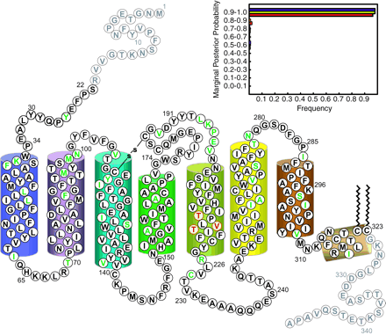
Fig. 2.—Protein sequence of the reconstructed ancestral archosaur rhodopsin drawn as a schematic on the basis ...
Notes:
Fig. 2.—Protein sequence of the reconstructed ancestral archosaur rhodopsin drawn as a schematic on the basis of the crystal structure for bovine rhodopsin (Palczewski et al. 2000 ). Sites that differ among the best three reconstructions, for which variants were also synthesized, are marked in red. The 38 residues that differ from bovine or alligator rhodopsin are marked in green. Inset, frequencies of marginal posterior probabilities calculated for the most likely amino acid reconstruction at each site of the ancestral archosaur rhodopsin sequence. These posterior probabilities, which represent the likelihood of having reconstructed the correct amino acid, under the assumptions of the model used, were calculated for the best-fitting nucleotide (HKY+Γ, purple bars), codon (F61+Γ, yellow bars), and amino acid (Jones+F+Γ, red bars) models
Unless provided in the caption above, the following copyright applies to the content of this slide:

Slide 3
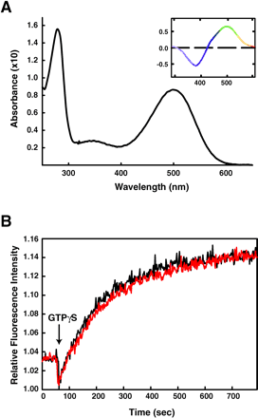
Fig. 3.—In vitro expression of the artificial ancestral archosaur rhodopsin gene. (A) Dark absorption ...
Notes:
Fig. 3.—In vitro expression of the artificial ancestral archosaur rhodopsin gene. (A) Dark absorption spectrum for the archosaur pigment recorded using a Perkin-Elmer spectrophotometer (model 800) at 25°C. Inset, a difference spectrum generated by taking an absorbance spectrum after bleaching with a fiber optic lamp equipped with a long-pass filter (>495 nm) for 30 s and subtracting it from the dark spectrum. Ancestral archosaur rhodopsin was expressed by transient transfection into COS cells using Lipofectamine Plus (Life Technologies), harvested after 48 h, regenerated in 5 μM 11-cis retinal, solubilized in 1% n-dodecyl-β-d-maltoside detergent (50 mM Tris pH 6.8, 100 mM NaCl, 1 mM CaCl2), and immunoaffinity purified using the 1D4 monoclonal antibody. (B) Rate of transducin activation by purified ancestral archosaur rhodopsin as measured by increases in fluorescence intensity (plotted in red), plotted against similarly treated bovine rhodopsin as a control (plotted in black). Fluorescence intensities are normalized to values at the time of GTPγS addition. Fluorescence of Gαt (250 nM), catalyzed by 1 nM rhodopsin in the presence of excess GTPγS, was monitored at 10°C using a SPEX spectrofluorometer equipped with a Xenon arc lamp by methods described previously (Marin et al. 2000 )
Unless provided in the caption above, the following copyright applies to the content of this slide:

