Slide 1
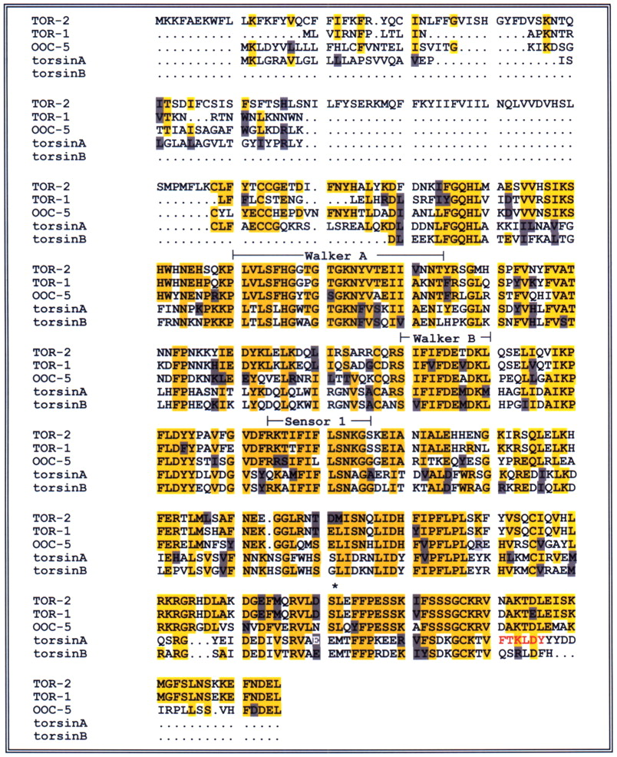
Figure 1. Multiple amino acid sequence alignment between C. elegans torsin-related proteins and human torsinA ...
Notes:
Figure 1. Multiple amino acid sequence alignment between C. elegans torsin-related proteins and human torsinA and torsinB. Residues shaded in yellow correspond to identical matches in sequence homology and residues shaded grey represent those with similar amino acid properties. The asterisk represents the serine deletion at position 368 in TOR-2. Residues in human torsinA shown in either white or red letters correspond to precise sites of amino acid deletions clinically associated with torsion dystonia (4,6). Areas labeled between the bracketed regions are structural motifs among AAA+ family members: Walker A, phosphate binding of ATP; Walker B, metal binding and ATP catalysis; Sensor I, role in nucleotide binding. For a complete description of these motifs refer to Neuwald et al. (20). The GenBank Accession Numbers for these sequences are: TOR-l, CAA19495; TOR-2, CAA19484; OOC-5, Z70034 (long isoform, C18E9. 11b is listed above); torsinA, NM_000113; torsinB, AF317129.
Unless provided in the caption above, the following copyright applies to the content of this slide:

Slide 2
Figure 2. Western blot analysis of TOR-2 and polyglutamine proteins in C. elegans extracts from wild-type ...
Notes:
Figure 2. Western blot analysis of TOR-2 and polyglutamine proteins in C. elegans extracts from wild-type (N2) and various transgenic lines. (A) The specific band at the predicted molecular weight of the TOR-2 protein is present in all extracts from isogenic integrated lines of nematodes. Native TOR-2 is detectable as a weak band in extracts from either N2 or polyglutamine-repeat containing lines (three left lanes) and strongly in lines where the tor-2 gene is overexpressed under the control of the unc-54 promoter (four lanes on the right). (B) Immunoreactive bands detected by an anti-polyglutamine monoclonal antibody depicting either Q19::GFP or Q82::GFP polyglutamine protein fusions from transgenic C. elegans extracts in the absence of TOR-2 or in the presence of either functional or mutant TOR-2. As a loading control, the same blots were stripped and probed with an anti-actin antibody.
Unless provided in the caption above, the following copyright applies to the content of this slide:

Slide 3
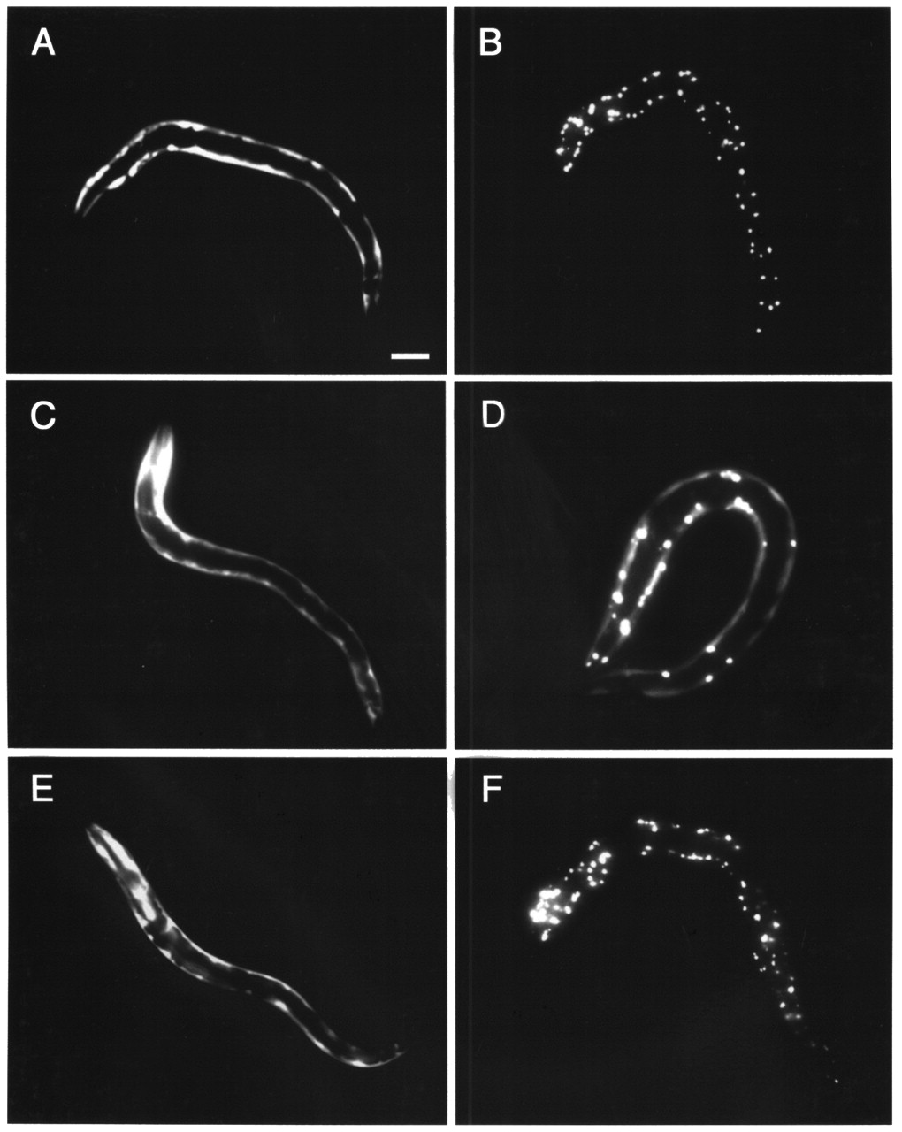
Figure 3. Analysis of C. elegans lines containing integrated transgenes expressing polyglutamine GFP fusions ...
Notes:
Figure 3. Analysis of C. elegans lines containing integrated transgenes expressing polyglutamine GFP fusions with and without TOR-2 or mutant TOR-2(Δ368) protein. The animals on the left side of this composite photo (A, C, E) express a Q19::GFP protein fusion, while animals depicted on the right half of the figure express a Q82::GFP fusion either in the absence of TOR-2 (B) in the presence of TOR-2 (D) or in the presence of TOR-2(Δ368) mutant protein (F). Overexpression of either TOR-2 or TOR-2(Δ368) has no apparent effect on Q19::GFP animals (C, E, respectively) compared to Q19::GFP without TOR-2 (A). Suppression of polyglutamine-induced protein aggregation is evident in the presence of wild-type TOR-2 protein (D) whereas the TOR-2(Δ368) mutant has lost this activity (F). Bar=100 µm.
Unless provided in the caption above, the following copyright applies to the content of this slide:

Slide 4
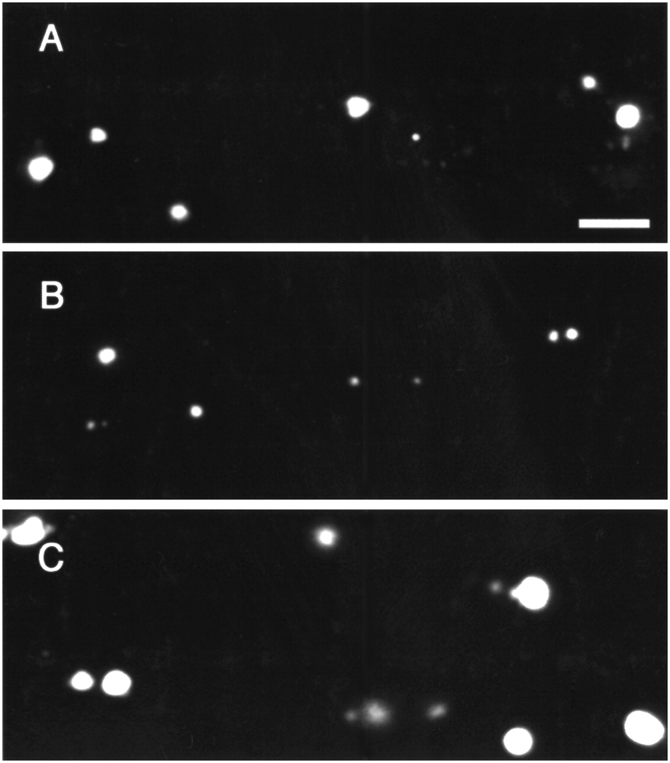
Figure 4. Size comparison of polyglutamine-induced protein aggregates in the tail region of transgenic lines ...
Notes:
Figure 4. Size comparison of polyglutamine-induced protein aggregates in the tail region of transgenic lines of C. elegans. Aggregates in Q82::GFP animals either in the absence of TOR-2 (A) in the presence of wild-type TOR-2 protein (B) or TOR-2(Δ368) (C). Bar=10 µm.
Unless provided in the caption above, the following copyright applies to the content of this slide:

Slide 5
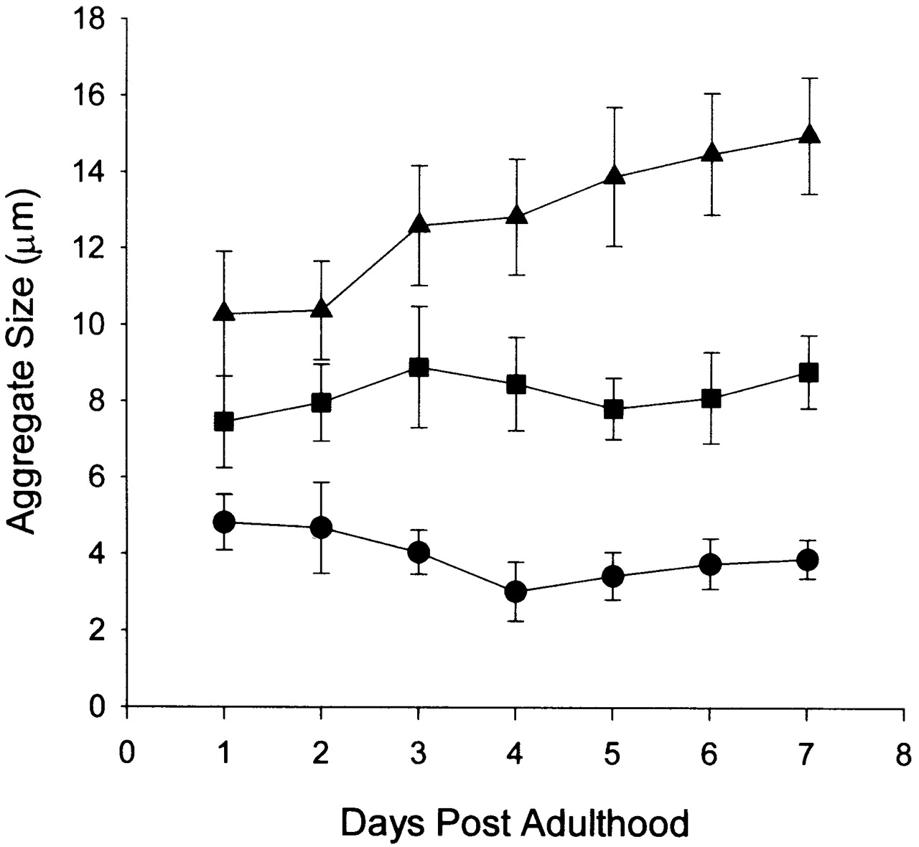
Figure 5. Effects of TOR-2 activity during aging of C. elegans. Protein aggregates are consistently smaller ...
Notes:
Figure 5. Effects of TOR-2 activity during aging of C. elegans. Protein aggregates are consistently smaller as Q19::GFP animals age in the presence of TOR-2 (circle) in comparison to Q19:GFP animals lacking TOR-2 (square) or containing TOR-2(Δ368) (triangle). Size differences among these three strains are significant (P<0.001).
Unless provided in the caption above, the following copyright applies to the content of this slide:

Slide 6
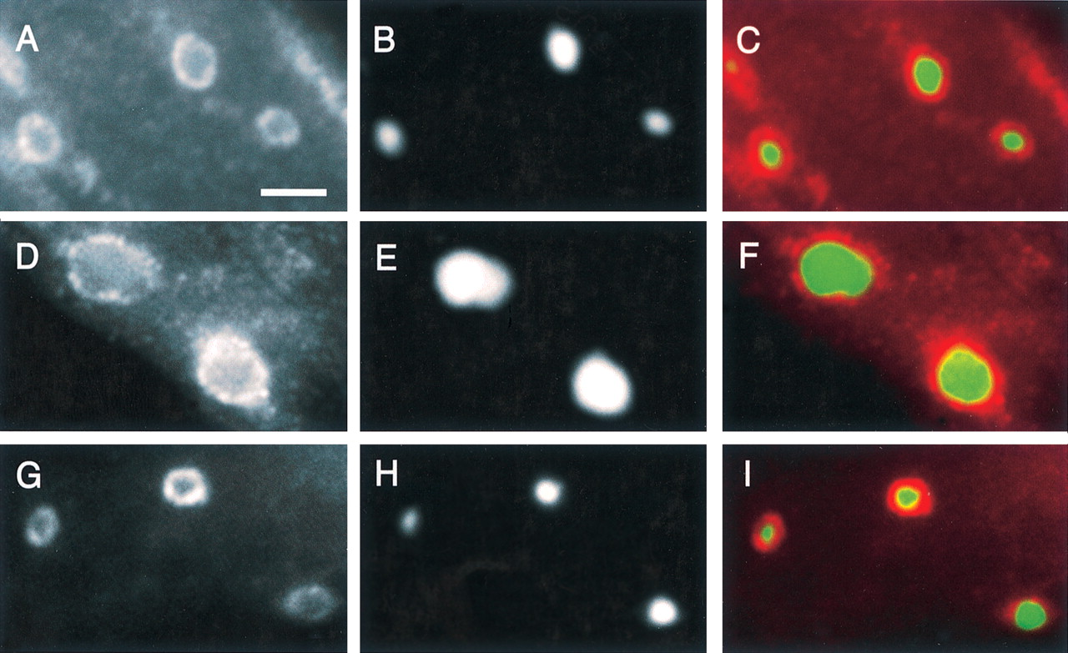
Figure 6. Immunolocalization of TOR-2 or ubiquitin in transgenic C. elegans lines. Q82::GFP animals ...
Notes:
Figure 6. Immunolocalization of TOR-2 or ubiquitin in transgenic C. elegans lines. Q82::GFP animals co-expressing either wild-type TOR-2 (A–C; G–I) or TOR-2(Δ368) (D–F) are depicted. These animals exhibited strong TOR-2 expression (A and D) to sites of polyglutamine-induced protein aggregation (B and E) when stained with affinity-purified antiserum specifically recognizing TOR-2. Merged images of GFP fluorescence and TOR-2 staining of Q82::GFP with wild-type TOR-2 [C] or Q82::GFP with TOR-2(Δ368) (F) are shown. Q82::GFP+TOR-2 worms, when stained with affinity purified an anti-ubiquitin antibody (G), show a similar pattern of colocalization (I) around aggregates of Q82::GFP [H]. Bar=5 µm.
Unless provided in the caption above, the following copyright applies to the content of this slide:

Slide 7
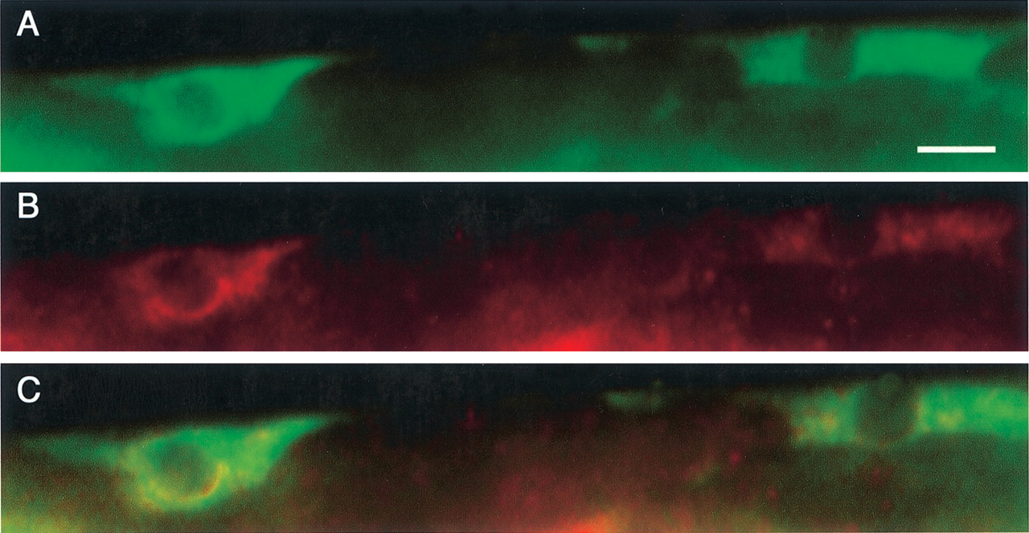
Figure 7. Localization of C. elegans TOR-2 to the endoplasmic reticulum in the absence of polyglutamine ...
Notes:
Figure 7. Localization of C. elegans TOR-2 to the endoplasmic reticulum in the absence of polyglutamine proteins. (A) A marker for the endoplasmic reticulum in C. elegans body-wall muscles, myo-3::CFP-TRAM (27), is shown following antibody staining with monoclonal anti-GFP antibody, as outlined in the Methods. (B) TOR-2 localization is evident in these same cells using affinity-purified anti-TOR-2. (C) A merged fluorescent image depicts the predominant perinuclear overlap (yellow) demonstrating co-localization of these two proteins. Bar=5 µm.
Unless provided in the caption above, the following copyright applies to the content of this slide:

Slide 8
Figure 8. Suppression of polyglutamine-induced protein aggregation in C. elegans by torsin homologs. ...
Notes:
Figure 8. Suppression of polyglutamine-induced protein aggregation in C. elegans by torsin homologs. Representative photos of Q82::GFP transgenic animals co-expressing either human torsinA (A) C. elegans OOC-5 (B) or OOC-5 and TOR-2 simultaneously (C) Bar=100 µm.
Unless provided in the caption above, the following copyright applies to the content of this slide:

