Slide 1
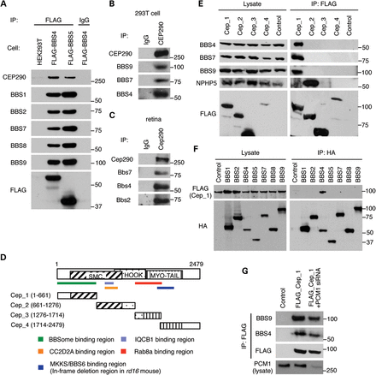
Figure 1. Physical interaction between CEP290 and the BBSome. (A) Co-immunoprecipitation of CEP290 in HEK293T cells ...
Notes:
Figure 1. Physical interaction between CEP290 and the BBSome. (A) Co-immunoprecipitation of CEP290 in HEK293T cells stably expressing FLAG-BBS4 and FLAG-BBS5. Lysates from stable cell lines and control (parental) cells were subjected to immunoprecipitation (IP) with the anti-FLAG antibody and precipitated proteins were analyzed by immunoblotting with indicated antibodies. Normal mouse IgG pull-down was used as a negative control. (B and C) Interaction of endogenous CEP290 and the BBSome in HEK293T cells (B) and mouse retina (C). Lysates from HEK293T cells and mouse retina were subjected to IP using antibodies against CEP290, and precipitated proteins were analyzed by immunoblotting with indicated antibodies. (D) Schematic representation of the CEP290 deletion mutants. Numbers indicate expressed portions of CEP290 in amino acid positions. Known IQCB1-, CC2D2A- and RAB8A-binding domains and the BBSome-interacting region are also summarized. SMC, structural maintenance of chromosomes; MYO-Tail, myosin-tail homology domain. (E) The BBSome binds to the N-terminal part of CEP290. CEP290 deletion mutants (FLAG-tagged) were transfected into HEK293T cells and lysates were analyzed by IP using anti-FLAG antibodies. Untransfected cells were used as a negative control. (F) BBS4 interacts with CEP290. HA-tagged, individual BBSome components were transiently transfected with FLAG-Cep_1 constructs. Lysates were subjected to IP with anti-HA antibodies. (G) PCM1-independent interaction between the BBSome and CEP290. HEK293T cells were co-transfected with Cep_1 fragment and siRNA against PCM1.
Unless provided in the caption above, the following copyright applies to the content of this slide: © The Author 2013. Published by Oxford University Press. All rights reserved. For Permissions, please email: journals.permissions@oup.com

Slide 2
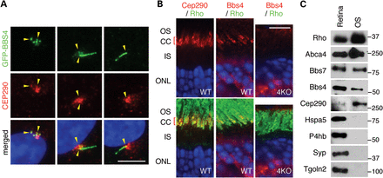
Figure 2. Co-localization of CEP290 and the BBSome. (A) Co-localization of GFP-tagged BBS4 and CEP290 in RPE1 cells ...
Notes:
Figure 2. Co-localization of CEP290 and the BBSome. (A) Co-localization of GFP-tagged BBS4 and CEP290 in RPE1 cells (yellow arrowheads). Localization of CEP290 (red) was probed with the anti-CEP290 antibody in hTERT-RPE1 after 24 h of serum withdrawal, whereas BBS4-GFP was probed with the anti-GFP antibody. Nuclei were stained with 4′,6-diamidino-2-phenylindole (DAPI, blue). Note the variable localization of BBS4, although these cells were cultured in the same condition (from a single well). Scale bar, 5 μm. (B) Co-localization of Bbs4 and Cep290 in the mouse retina. Antibodies against Cep290 (red) and rhodopsin (green; a marker of the OS) were used in WT photoreceptors in the left panel, whereas in the middle and right panels Bbs4 (red) and rhodopsin (green) localizations were probed in WT and Bbs4−/− (4KO) photoreceptors. Both Cep290 and Bbs4 localize to the connecting cilium. CC, connecting cilium; ONL, outer nuclear layer. Scale bar, 10 μm. (C) Co-fractionation of the BBSome and Cep290 in the photoreceptor OS fraction. The photoreceptor OS was isolated from the mouse retina and probed with antibodies against multiple subcellular marker proteins, Bbs4, Bbs7 and Cep290.
Unless provided in the caption above, the following copyright applies to the content of this slide: © The Author 2013. Published by Oxford University Press. All rights reserved. For Permissions, please email: journals.permissions@oup.com

Slide 3
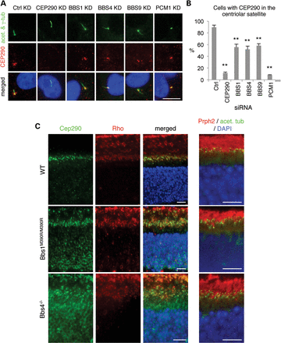
Figure 3. The CEP290 localization in the centriolar satellite and the connecting cilium is BBSome-dependent. (A) The ...
Notes:
Figure 3. The CEP290 localization in the centriolar satellite and the connecting cilium is BBSome-dependent. (A) The BBSome is required for centriolar satellite localization of CEP290 (red). RPE1 cells were transfected with siRNAs against CEP290, BBS1, BBS4, BBS9 and PCM1. Antibodies against γ-tubulin and acetylated tubulin (green) were used to mark the basal body and cilia, respectively. (B) Quantification of CEP290 mis-localization in BBSome-depleted RPE1 cells. Cells with concentrated CEP290 staining around the centrosome (within 2 μm from the centrosome) were counted as positive, whereas cells with CEP290 only in the TZ and centrosome were considered negative. At least 120 cells per experiment were counted and graphs represent averages of three independent experiments. Error bars represent SEM. One-way ANOVA followed by Tukey's post-test was used for statistical analysis. **P < 0.01 compared with Ctrl KD cells. (C) Localization of Cep290 (green; left) in WT (top), Bbs1M390R/M390R (middle) and Bbs4−/− (bottom) mouse retinas. OS localization of Prph2 (red) with respect to acetylated tubulin (green) is not affected in BBS mutant retinas (right panels). Scale bars, 10 μm.
Unless provided in the caption above, the following copyright applies to the content of this slide: © The Author 2013. Published by Oxford University Press. All rights reserved. For Permissions, please email: journals.permissions@oup.com

Slide 4
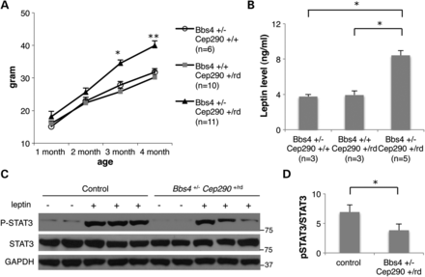
Figure 4. Increased body weight and higher leptin levels in Bbs4^{+/−}; Cep290^{+/rd16} mice. (A) ...
Notes:
Figure 4. Increased body weight and higher leptin levels in Bbs4+/−; Cep290+/rd16 mice. (A) Weight gains in male animals versus age (minimum of six animals per group). Values are expressed as mean + SEM. By month 3, double-heterozygous mice are significantly heavier than single-heterozygous littermates. *P < 0.05 versus single-heterozygous animals; **P < 0.01 versus single-heterozygous animals. (B) Serum leptin levels of single- and double-heterozygous mice. One-way ANOVA and t-test were used for statistical analysis. *P < 0.05 versus single-heterozygous animals. (C) STAT3 phosphorylation upon leptin administration was reduced in double-heterozygous mice. Hypothalamic protein extracts were analyzed by western blotting. (D) Quantification of STAT3 phosphorylation. Band intensities of phospho-STAT3 (P-STAT3) were normalized with those of total STAT3 and induction ratios were calculated by comparison with vehicle-injected samples. Data represent mean + SEM. n = 5 for vehicle and n = 10 for leptin. *P < 0.05.
Unless provided in the caption above, the following copyright applies to the content of this slide: © The Author 2013. Published by Oxford University Press. All rights reserved. For Permissions, please email: journals.permissions@oup.com

Slide 5
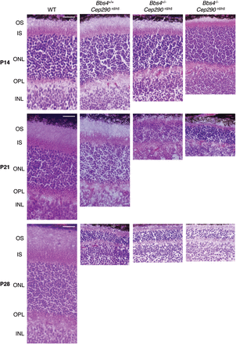
Figure 5. Accelerated photoreceptor degeneration with additional loss of Bbs4 alleles in Cep290^{rd16/rd16} ...
Notes:
Figure 5. Accelerated photoreceptor degeneration with additional loss of Bbs4 alleles in Cep290rd16/rd16 mice. H&E-stained sections of the superior central retina at the level of the optic nerve head from P14, P21 and P28 mice are shown. Scale bars, 10 μm.
Unless provided in the caption above, the following copyright applies to the content of this slide: © The Author 2013. Published by Oxford University Press. All rights reserved. For Permissions, please email: journals.permissions@oup.com

Slide 6
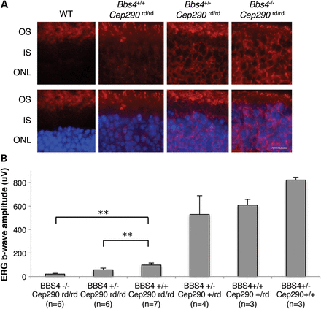
Figure 6. Impaired rhodopsin trafficking and diminished ERG responses in mice with combined loss of Cep290 and Bbs4 ...
Notes:
Figure 6. Impaired rhodopsin trafficking and diminished ERG responses in mice with combined loss of Cep290 and Bbs4 alleles. (A) Immunohistochemical analysis of WT, Bbs4+/+;Cep290rd/rd, Bbs4+/−;Cep290rd/rd and Bbs4−/−; Cep290rd/rd retinas at P21 with antibodies against rhodopsin. Scale bar, 5 μm. (B) DA-SCR ERG b-wave amplitudes in the indicated mouse genotypes (at the age of 1 month). Removing one or two Bbs4 alleles on a Cep290rd/rd background results in a lower ERG response. **P < 0.01 versus Bbs4+/+;Cep290rd/rd mice. Error bars are SD.
Unless provided in the caption above, the following copyright applies to the content of this slide: © The Author 2013. Published by Oxford University Press. All rights reserved. For Permissions, please email: journals.permissions@oup.com

