Slide 1
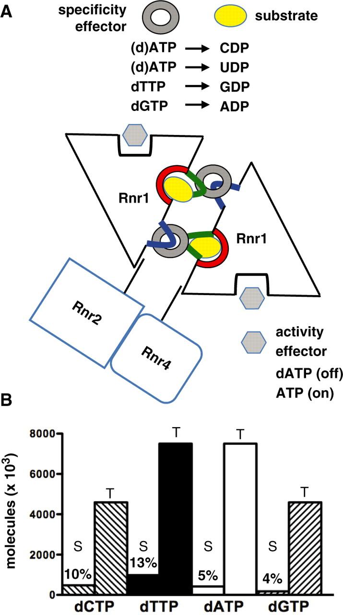
Figure 1. RNR regulation and dNTP pools in S. cerevisiae . ( A ) Schematic representation of yeast RNR. The large ...
Notes:
Figure 1. RNR regulation and dNTP pools in S. cerevisiae . ( A ) Schematic representation of yeast RNR. The large subunit is an Rnr1 dimer, the small subunit is an Rnr2/Rnr4 heterodimer, although higher order complexes may also exist. Rnr3 (not shown) is a non-essential DNA-damage-inducible Rnr1 paralogue, which can form Rnr3 homodimers or heterodimers with Rnr1. The specificity effectors contact both loop 1 (blue) and loop 2 (green), while the substrates contact only loop 2. The specificity information is transmitted to the catalytic sites (red) via loop 2. ( B ) The approximate number of dNTP molecules present at any given moment in S-phase (S) and the total number of dNTP molecules required for the duplication of the yeast nuclear DNA (T). Numbers above the bars indicate the S/T ratios in percent.
Unless provided in the caption above, the following copyright applies to the content of this slide: © The Author(s) 2010. Published by Oxford University Press.This is an Open Access article distributed under the terms of the Creative Commons Attribution Non-Commercial License (http://creativecommons.org/licenses/by-nc/2.5), which permits unrestricted non-commercial use, distribution, and reproduction in any medium, provided the original work is properly cited.

Slide 2
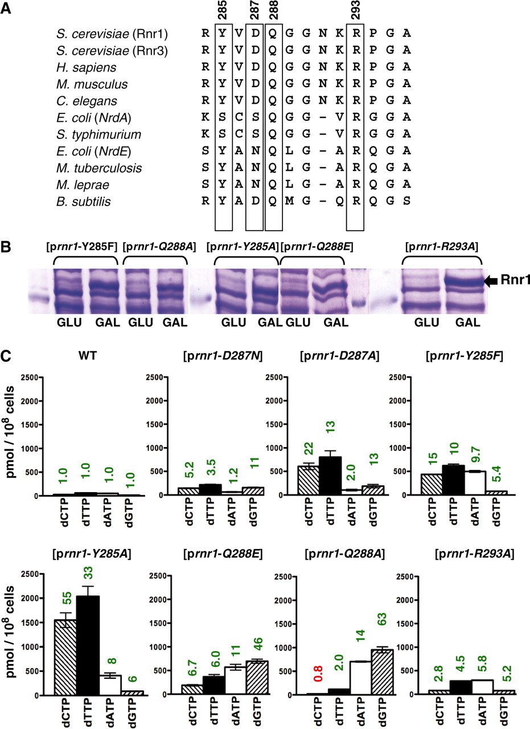
Figure 2. Overexpression of loop 2 rnr1 mutants leads to imbalanced dNTP pools. ( A ) Sequence alignment of loop 2 in ...
Notes:
Figure 2. Overexpression of loop 2 rnr1 mutants leads to imbalanced dNTP pools. ( A ) Sequence alignment of loop 2 in RNRs from different organisms. Numbering is according to yeast Rnr1. The residues mutated in this study are boxed. ( B ) Incubation of yeast strains harbouring the indicated plasmids in SC – URA + GAL media for 3 h results in overexpression of Rnr1 proteins. ( C ) dNTP pools in the wild-type strain grown in SC + GLU media (28 pmol dCTP, 62 pmol dTTP, 51 pmol dATP and 15 pmol dGTP per 10 8 cells) and mutant strains grown in SC – URA + GAL media for at least six generations. Two independent isogenic strains for each genotype were analysed. Data are represented as mean ± SD. Numbers above the bars indicate fold-increase (green) or fold-decrease (red) of the dNTP concentration relative to wild-type.
Unless provided in the caption above, the following copyright applies to the content of this slide: © The Author(s) 2010. Published by Oxford University Press.This is an Open Access article distributed under the terms of the Creative Commons Attribution Non-Commercial License (http://creativecommons.org/licenses/by-nc/2.5), which permits unrestricted non-commercial use, distribution, and reproduction in any medium, provided the original work is properly cited.

Slide 3
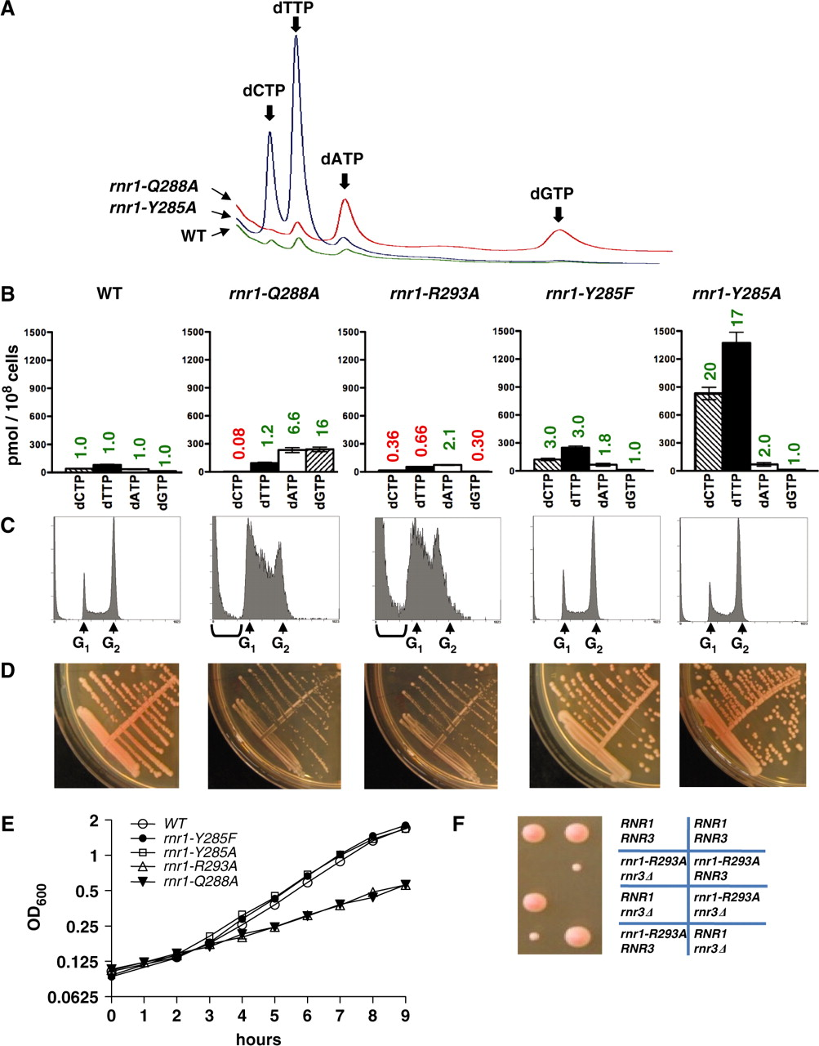
Figure 3. Effects of dNTP pool imbalances on cell cycle and proliferation. ( A ) Representative HPLC chromatograms ...
Notes:
Figure 3. Effects of dNTP pool imbalances on cell cycle and proliferation. ( A ) Representative HPLC chromatograms demonstrating the OD 260 absorbance of dNTPs in the wild-type (green), rnr1-Q288A (red) and rnr1-Y285A (blue) strains. Some of the dNTP peaks are invisible at this level of magnification. ( B ) dNTP pools in the wild-type (41 pmol dCTP, 81 pmol dTTP, 35 pmol dATP and 15 pmol dGTP per 10 8 cells) and mutant strains with the integrated rnr1 alleles grown in YPAD media. Two independent isogenic strains for each genotype were analysed. Data are represented as mean ± SD. Numbers above the bars indicate fold-increase (green) or fold-decrease (red) of the dNTP concentration relative to wild-type. ( C ) Flow cytometry histograms for the strains indicated in ( B ). Peaks with less than G 1 DNA content (prominent in rnr1-Q288A and rnr1-R293A and indicated by brackets) represent dead cells and cell debris. ( D ) YPAD plates with strains indicated in ( B ). ( E ) Proliferation curves. Two independent isogenic strains for each genotype were grown overnight in YPAD, re-inoculated into fresh YPAD at the OD 600 = 0.1, the OD 600 was measured every hour and the values were plotted on log 2 scale. Data are represented as mean ± SD. The slow growing rnr1-Q288A and rnr1-R293A did not show any lag phase as their overnight cultures did not reach the stationary phase. ( F ) Tetrad analysis demonstrating that rnr1-293A relies on RNR3 for survival.
Unless provided in the caption above, the following copyright applies to the content of this slide: © The Author(s) 2010. Published by Oxford University Press.This is an Open Access article distributed under the terms of the Creative Commons Attribution Non-Commercial License (http://creativecommons.org/licenses/by-nc/2.5), which permits unrestricted non-commercial use, distribution, and reproduction in any medium, provided the original work is properly cited.

Slide 4
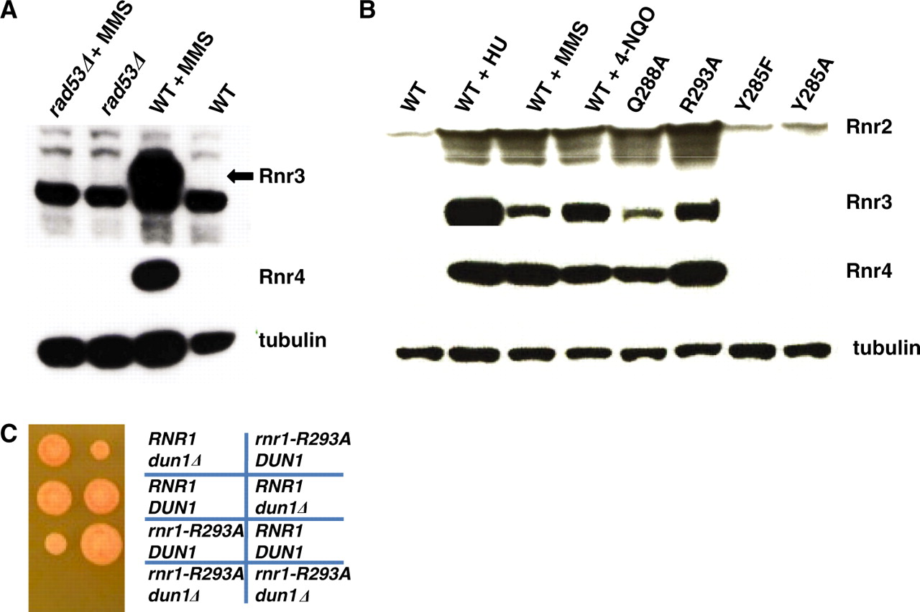
Figure 4. The S-phase checkpoint is not activated in rnr1-Y285F and rnr1-Y285A strains. ( A ) Rnr3 and Rnr4 proteins ...
Notes:
Figure 4. The S-phase checkpoint is not activated in rnr1-Y285F and rnr1-Y285A strains. ( A ) Rnr3 and Rnr4 proteins are indicators of the S-phase checkpoint activation. Western blot analysis demonstrating that the increase of Rnr3 and Rnr4 levels in response to DNA damage by methyl methane sulphonate (MMS) depends on a functional S-phase checkpoint (presence of RAD53 ). ( B ) Western blot analysis demonstrating that the Rnr2, Rnr3 and Rnr4 levels are not elevated in rnr1-Y285F and rnr1-Y285A , whereas the Rnr2, Rnr3 and Rnr4 levels are elevated in rnr1 - Q288A and rnr1-R293A to the similar level as after treatment by DNA damaging [4-nitroquinoline oxide (4-NQO) and MMS] and replication blocking [hydroxyurea (HU)] agents. ( C ) Tetrad analysis demonstrating that the rnr1-R293A strain requires DUN1 for survival.
Unless provided in the caption above, the following copyright applies to the content of this slide: © The Author(s) 2010. Published by Oxford University Press.This is an Open Access article distributed under the terms of the Creative Commons Attribution Non-Commercial License (http://creativecommons.org/licenses/by-nc/2.5), which permits unrestricted non-commercial use, distribution, and reproduction in any medium, provided the original work is properly cited.

